Slide 1

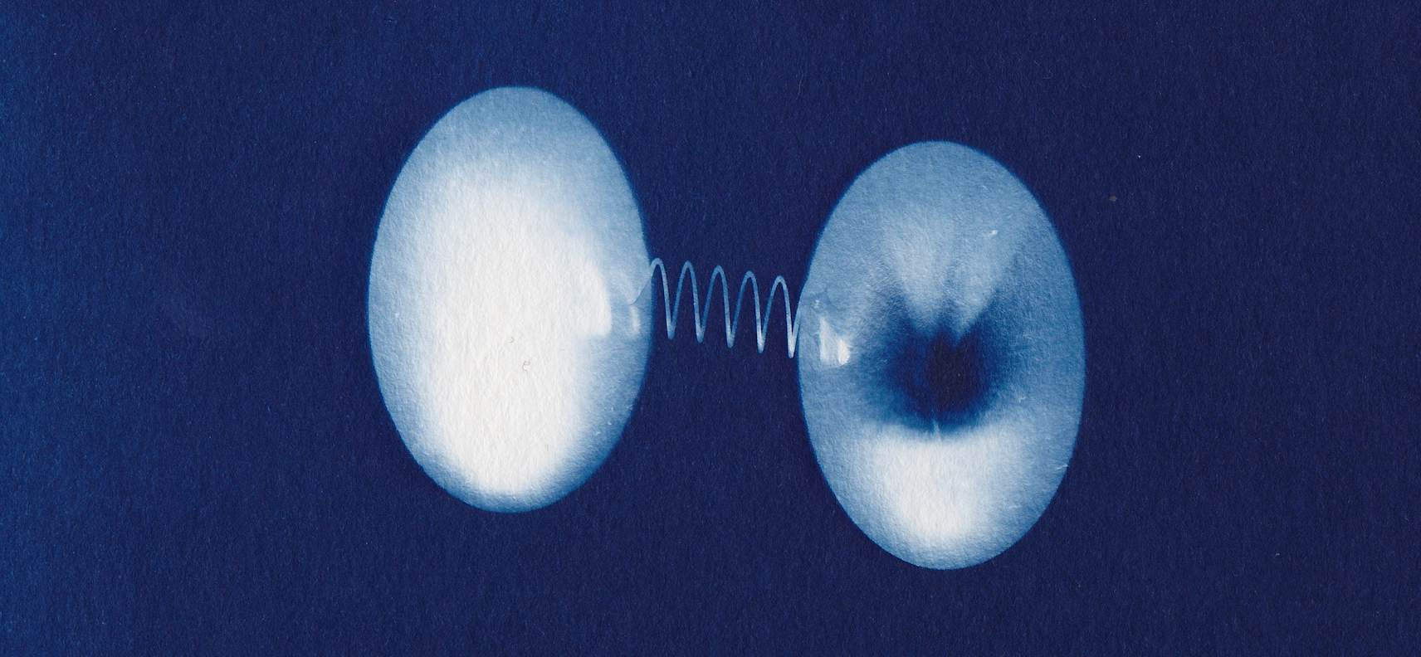
New heavy bound state(s)?
LHC
A-Higgs or Toponium discovered?
G. Kozlov
/

Slide 2
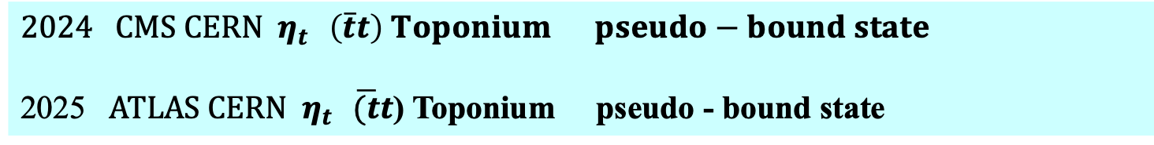
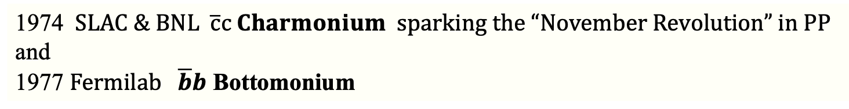
Part I
Experiment
1974 $SLAC \& BNL \overline{с}с Charmonium sparking the “November Revolution” in PP$
and
1977 $Fermilab \overline{b}b$ Bottomonium
$CMS CERN η_{t } \left(\overline{t}t\right) Toponium pseudo−bound state$
2025 $ATLAS CERN{ η}_{t } \overline{(t}t$) Toponium pseudo - bound state

Slide 3
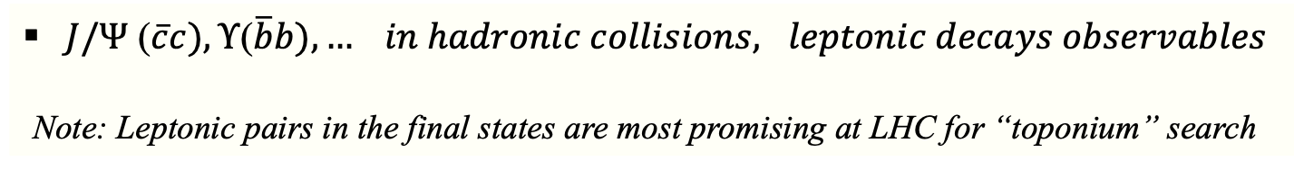
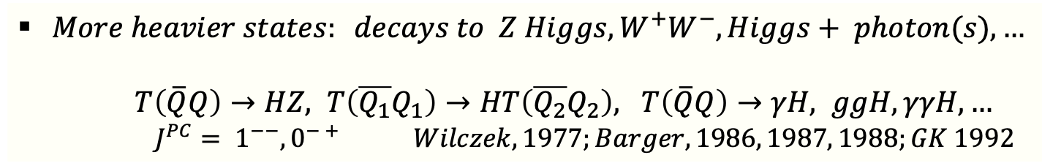
Heavy quarkonia (historically)
$J/Ψ$ ($\overline{c}c), Υ\text{(}\overline{b}b), … in hadronic collisions, leptonic decays observables$
Note: Leptonic pairs in the final states are most promising at LHC for “toponium” search
$More heavier states: decays to Z Higgs, W^{+}W^{−}, Higgs+ photon(s), …$
$T\left(\overline{Q}Q\right)→HZ, T\left(\overline{Q_{1}}Q_{1}\right)→HT\left(\overline{Q_{2}}Q_{2}\right), T\left(\overline{Q}Q\right)→γH, ggH, γγH,…$
$J^{PC}= 1^{−−}, 0^{− +} Wilczek, 1977;Barger, 1986, 1987, 1988;GK 1992$
Models: NRQCD, QCD-inspired potentials, B-S models… Caswell, Lepage, 1986; GK 1992,94
Indirect manifestation of the 4th GENERATION quark families, $U→DW^{+},…$
Attempts at Tevatron (CDF, D0) Gunion et al., 1996; Frampton, Hung, 1998, GK 2003
An alternative/additional possibility to heavy hadron could be existence of NEW
particles with mass close to twice that of t -quark & decays to $\overline{t}t pair$

Slide 4
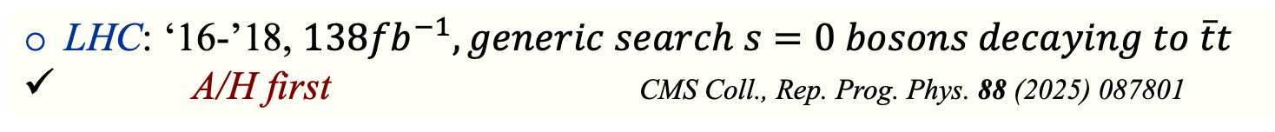
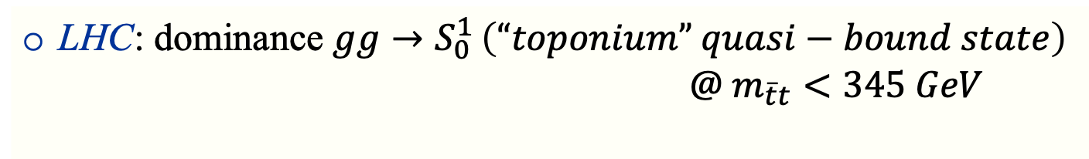
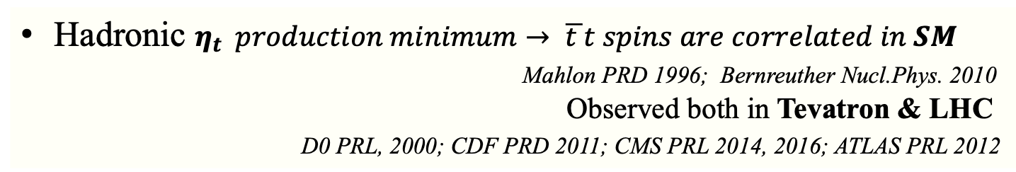
Today: TOP / New Structure at the $\overline{t}t threshold$
1995 Fermilab Top-q is the major milestone in particle physics
Short life-time of t-quark precludes its hadronization ??
Bigi et al.,1986
Hadronic $η_{t} production minimum→ \overline{t }t spins are correlated in SM$
Mahlon PRD 1996; Bernreuther Nucl.Phys. 2010
Observed both in Tevatron & LHC
D0 PRL, 2000; CDF PRD 2011; CMS PRL 2014, 2016; ATLAS PRL 2012
$$η_{t} still predicted at the threshold:Fadin et al., 1990;GK 2003; Kiyo 2009;Fuks 2021$$
LHC: dominance $gg→S_{0}^{1 }\left(“toponium” quasi−bound state\right)$
$@ m_{\overline{t}t}<345 GeV$
LHC: enhancement # events, Ps state observation in $\overline{t}t$ spin correlation obs’s
LHC: ‘16-’18, $138{fb}^{−1}, generic search s=0 bosons decaying to \overline{t}t$
A/H first CMS Coll., Rep. Prog. Phys. 88 (2025) 087801
Result: excess is comparable with production of $S_{0}^{1 }$”toponium” modeled with NRQCD
Notes:
Preclude -исключать

Slide 5
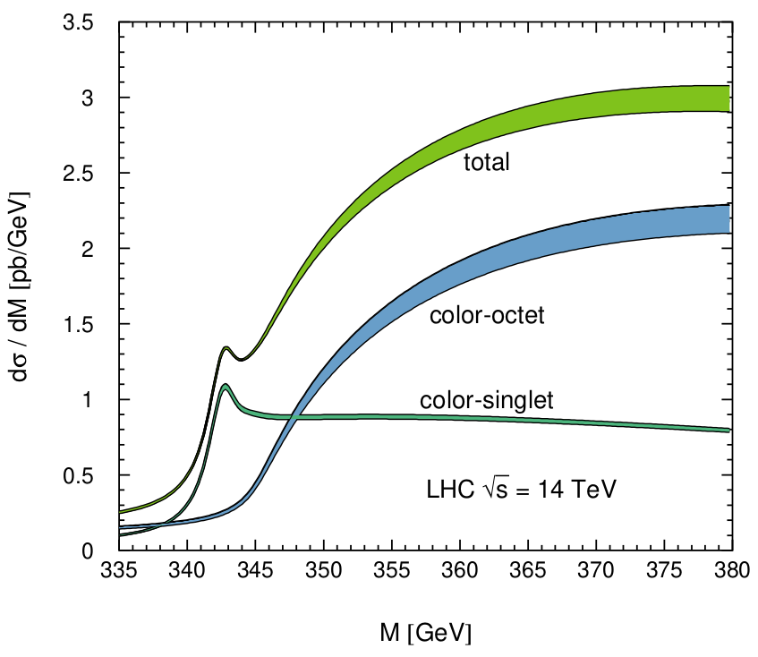
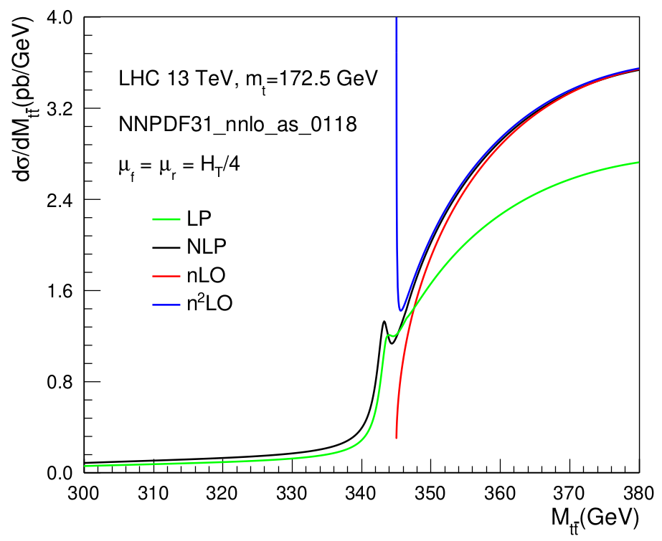

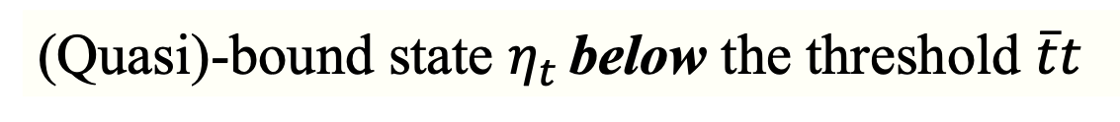
(Quasi)-bound state $η_{t }$below the threshold $\overline{t}t$
Pseudoscalar dominance? Can people search for it?
attractive
repulsive
Kiyo et al., EPJ C60 (2009) 375
Ju et al., JHEP 06 (2020) 158
The only in 2024-2025 observed definitely by both CMS & ATLAS

Slide 6
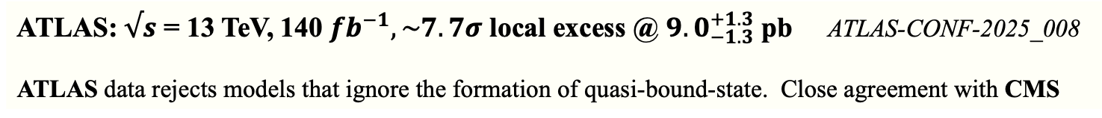

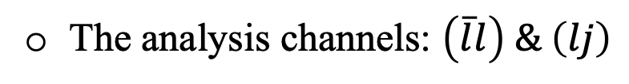
OverView of the${ η}_{t } Search$
The t-quark is typically a loner.
QM makes it possible for top-anti-top pair to occasionally survive long
enough if produced in rest with respect to each other
Search for NEW s = 0 Ps with $η_{t }$final state @ 138 ${fb}^{−1}(full Run 2 dataset)$
Make use of invariant $m_{\overline{t}t}, angular \& spin correlation observables$
The analysis channels: $\left(\overline{l}l\right) \& \left(lj\right)$
CMS: $√s$ = 13 TeV, 138 ${fb}^{−1}, \sim 5σ$ local excess @ ${8.8}_{−1.4}^{+1.2}$ pb Rep. Prog. Phys. 88 (2025) 087801
ATLAS: $√s$ = 13 TeV, 140 ${fb}^{−1}, \sim 7.7σ$ local excess @ ${9.0}_{−1.3}^{+1.3}$ pb ATLAS-CONF-2025_008
ATLAS data rejects models that ignore the formation of quasi-bound-state. Close agreement with CMS

Slide 7
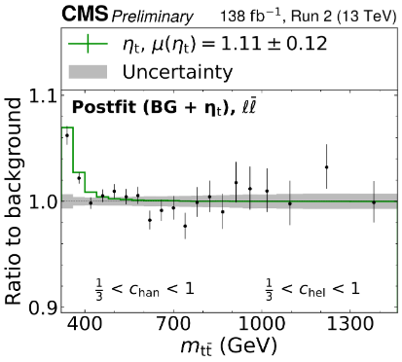
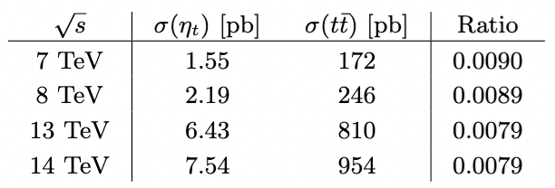

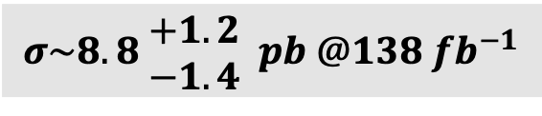

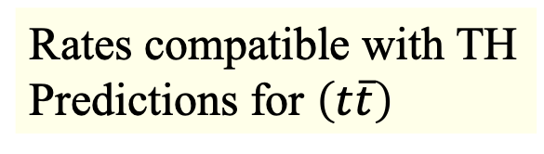
CMS Collaboration
SIGNAL
Consistent with PS: $η_{t} or A−Higgs ??$
Peak-dip structure !
Rates compatible with TH
Predictions for $\left(t\overline{t}\right)$
CMS-PAS-HIG-22-013
Fuks et al., PRD 104 (2021) 034023
2016-2018
$$σ\sim 8.8\begin{matrix} +1.2 \\ −1.4\end{matrix} pb @138{ fb}^{−1}$$

Slide 8

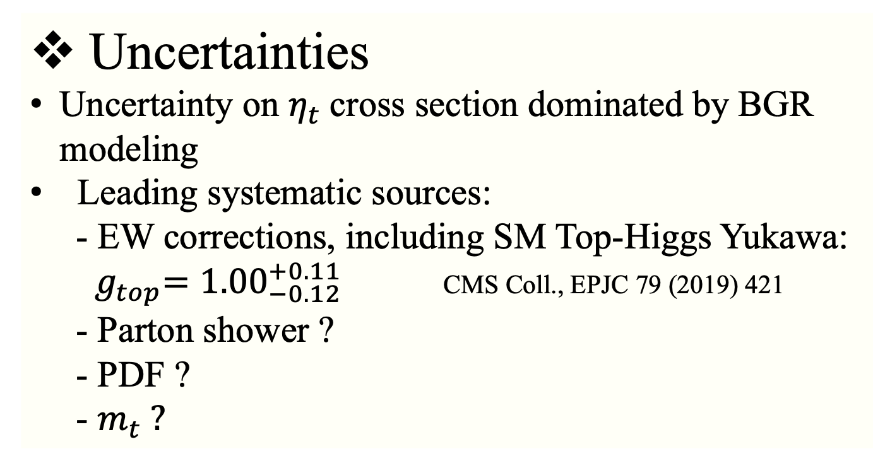
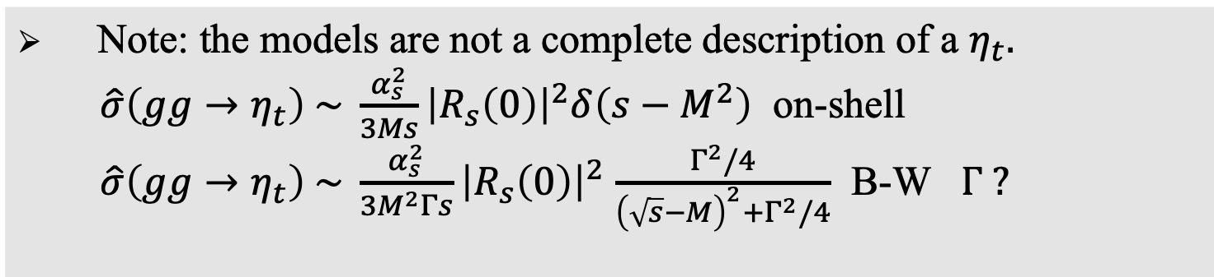
Uncertainties
Uncertainty on $η_{t}$cross section dominated by BGR modeling
Leading systematic sources:
- EW corrections, including SM Top-Higgs Yukawa:
${ g}_{top}=1.00_{−0.12}^{+0.11}$ CMS Coll., EPJC 79 (2019) 421
- Parton shower ?
- PDF ?
- $m_{t} ?$
Note: the models are not a complete description of a $η_{t}.$
$\hat{σ}\left(gg→η_{t}\right) \sim \frac{α_{s}^{2}}{3Ms}{\left|R_{s}\left(0\right)\right|}^{2}δ\left(s−M^{2}\right)$ on-shell
$\hat{σ}\left(gg→η_{t}\right) \sim \frac{α_{s}^{2}}{3M^{2}Γs}{\left|R_{s}\left(0\right)\right|}^{2}$ $\frac{Γ^{2}/4}{{\left(\sqrt{s}−M\right)}^{2}+Γ^{2}/4}$ B-W $Γ ?$

Slide 9
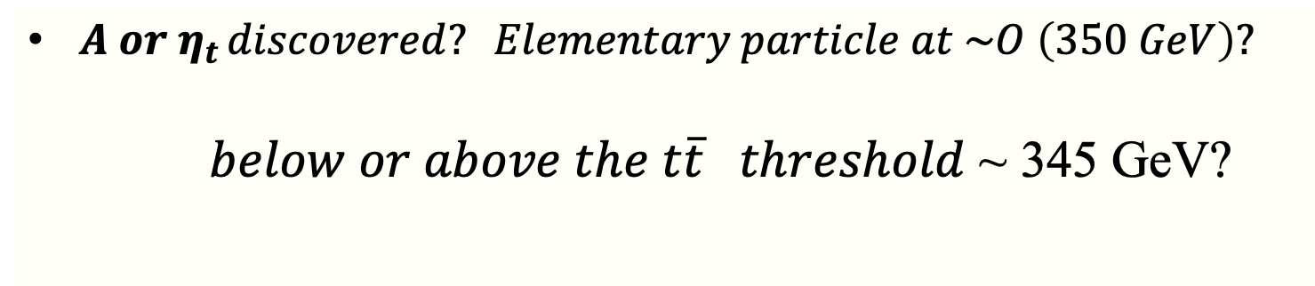
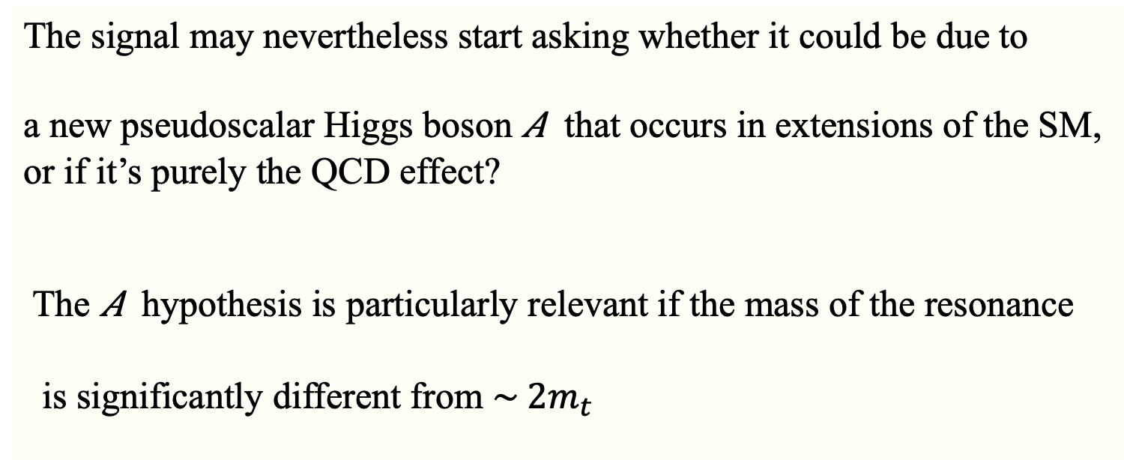
LHC
${ A or η}_{t }discovered? Elementary particle at \sim O \left(350 GeV\right)?$
$below or above the t\overline{t} threshold$ ~ 345 GeV?
The signal may nevertheless start asking whether it could be due to
a new pseudoscalar Higgs boson 𝐴 that occurs in extensions of the SM,
or if it’s purely the QCD effect?
The 𝐴 hypothesis is particularly relevant if the mass of the resonance
is significantly different from ${\sim 2m}_{t}$

Slide 10
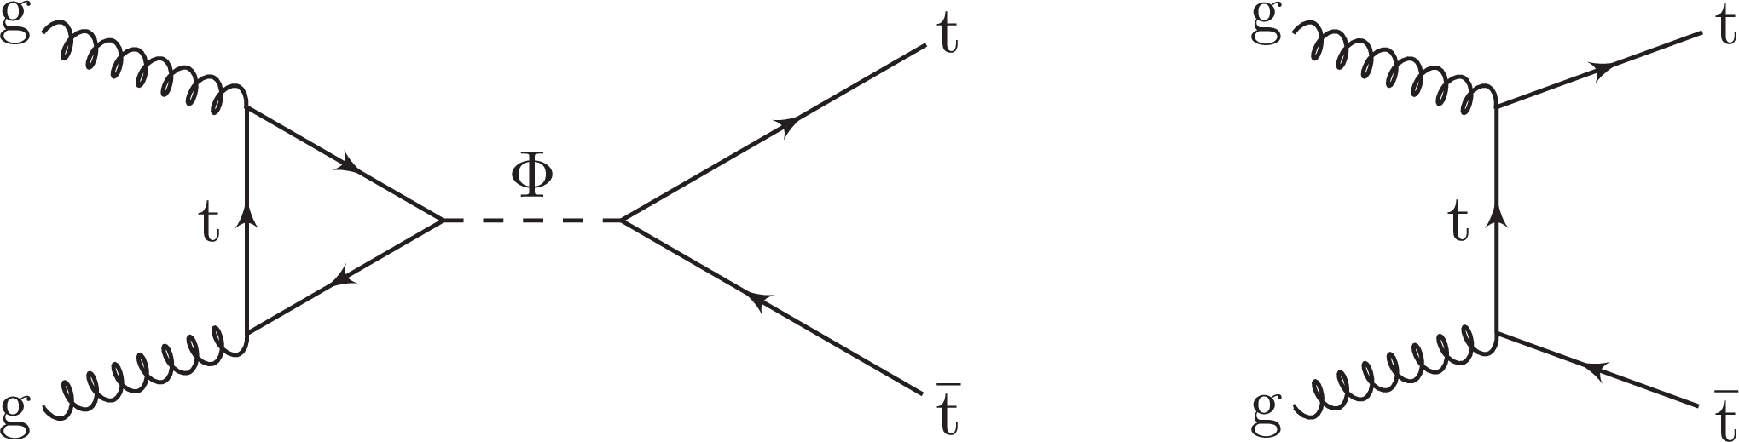

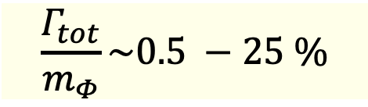


Effective interaction, couplings ….
A search for heavy Ps or S bosons @ LHC
Generic heavy pseudoscalar (A) or scalar (H) coupling solely to top quarks
$L_{Yuk,A}\sim$i$g_{At\overline{t}}\frac{m_{t}}{v}\overline{t}γ_{5}t A; { L}_{Yuk,H}\sim g_{Ht\overline{t}}\frac{m_{t}}{v}\overline{t}t H$; $g_{Φt\overline{t}}≥0$
$$\frac{Γ_{tot}}{m_{Φ}}\sim 0.5 −25 \%$$
$$m_{Φ} \sim 350 −1000 GeV$$
$$SM \overline{t}t$$
$$:A/H$$
Signal process
SM production of t-quark pairs
Notes:
The invariant mass of the reconstructed t¯t system and variables sensitive to its spin state are used to discriminate against the standard model t¯t background. An excess of the data above the background prediction, as modeled using perturbative quantum chromodynamics (QCD) only, is observed. The excess is located close to the t¯t production threshold and it significantly favors the pseudoscalar signal hypothesis over the scalar hypothesis. It is compatible with the production of a 1S[1]0 t¯t bound state (ηt), as predicted by a simplified model of nonrelativistic QCD, with a cross section of 7.1 pb and an uncertainty of 11%. The excess has a significance of above five standard deviations. Including the ηt contribution in the background modeling, exclusion limits at 95% confidence level are set on the coupling of further pseudoscalar or scalar bosons to top quarks in a mass range of 365-1000 GeV and relative widths of 0.5-25%.

Slide 11
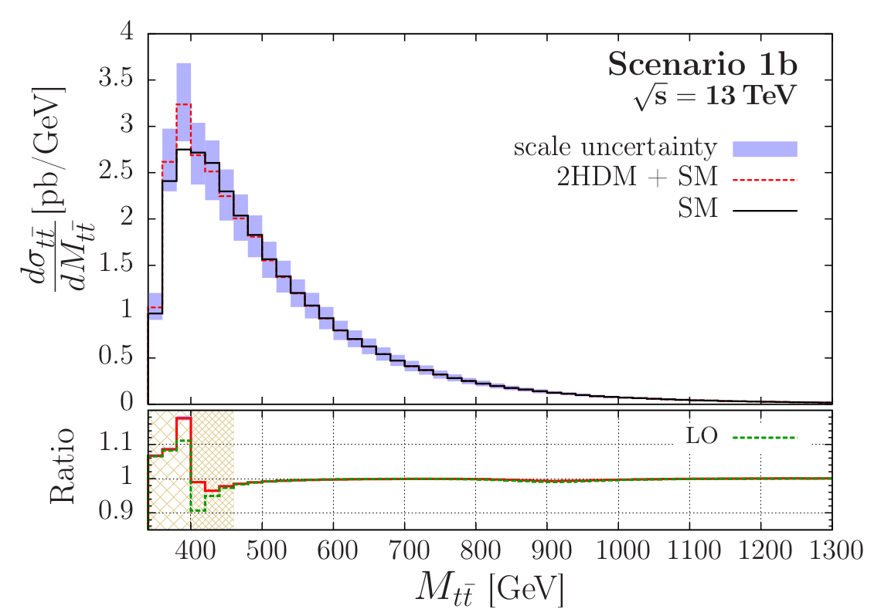
Final states
Same final state as the SM $\overline{t}t →interference →peak−dip structure m_{\overline{t}t}$

Slide 12
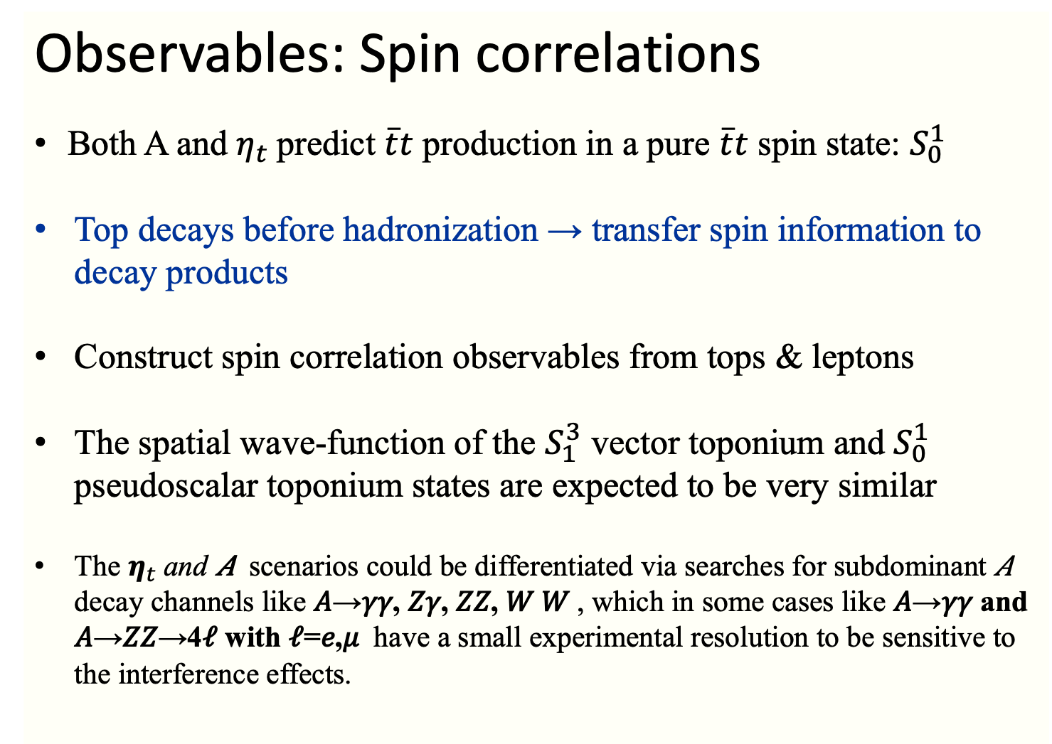
Observables: Spin correlations
Both A and $η_{t}$predict $\overline{t}t$ production in a pure $\overline{t}t$ spin state: $S_{0}^{1}$
Top decays before hadronization → transfer spin information to decay products
Construct spin correlation observables from tops & leptons
The spatial wave-function of the $S_{1}^{3}$ vector toponium and $S_{0}^{1}$ pseudoscalar toponium states are expected to be very similar
The $η_{t}$and 𝐴 scenarios could be differentiated via searches for subdominant 𝐴 decay channels like 𝐴→𝛾𝛾, 𝑍𝛾, 𝑍𝑍, 𝑊 𝑊 , which in some cases like 𝐴→𝛾𝛾 and 𝐴→𝑍𝑍→4𝓁 with 𝓁=𝑒,𝜇 have a small experimental resolution to be sensitive to the interference effects.

Slide 13
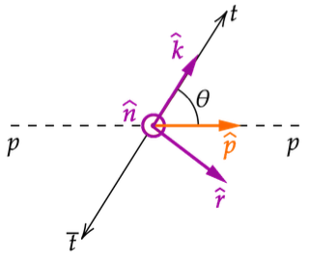
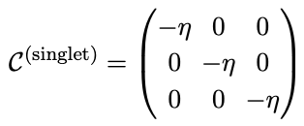




Top spin observations
Spin of top transferred directly to its decay products
Spin correlation signal (t –spins strongly correlated with $\overline{t}−spins)$
Correlation matrix + Net subsystem polarization
Spin singlet Correlation matrix
$$\frac{1}{σ}\frac{dσ}{d\cos{θ}}= \frac{1}{2}\left(1−D cosθ\right)$$
Entanglement marker for spin 0:
Afic et al., Eur. Phys. Plus 2021
Maltoni et al, 2401.08751
Notes:
Th spin of top quark to be transferred directly to its decay products, enabling precise measurements of spin properties via angular distribution.
Entanglement marker - маркер запутанности

Slide 14
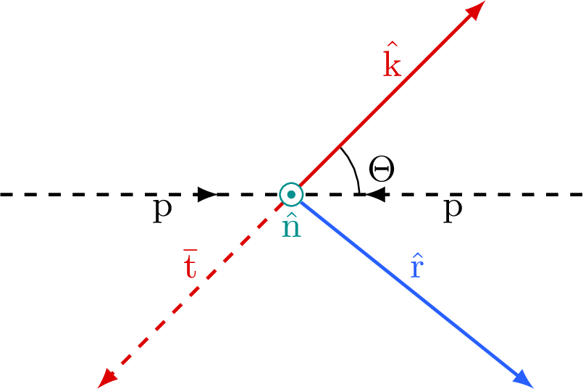
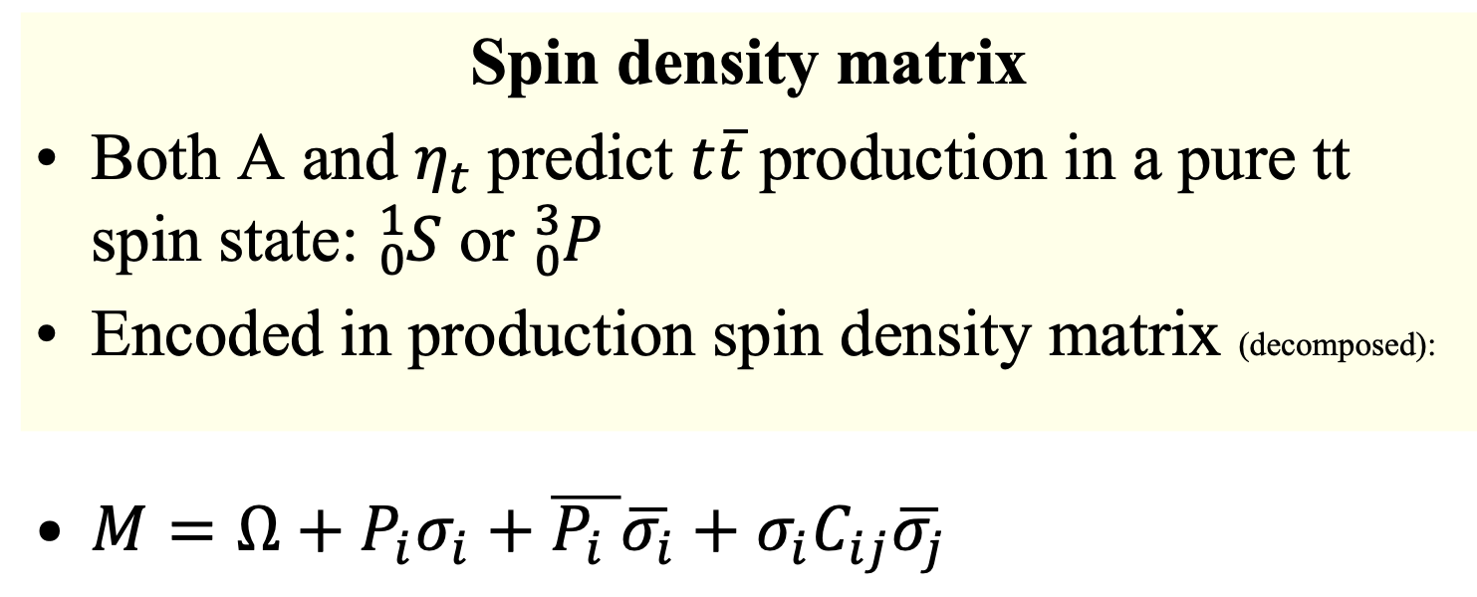

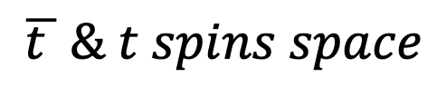
Spin density matrix
Both A and $η_{t}$predict $t\overline{t}$production in a pure tt spin state: ${}_{0}^{1}S$ or ${}_{0}^{3}P$
Encoded in production spin density matrix (decomposed):
$M=Ω+P_{i}σ_{i}+\overline{P_{i} }\overline{σ_{i}}+σ_{i}C_{ij}\overline{σ_{j}}$
Cross section
Polarization
vectors
Correlation matrix for $\overline{t } \& t spins$
$$\overline{t } \& t spins space$$
CMS Coll. PRD100 (2019) 072002

Slide 15
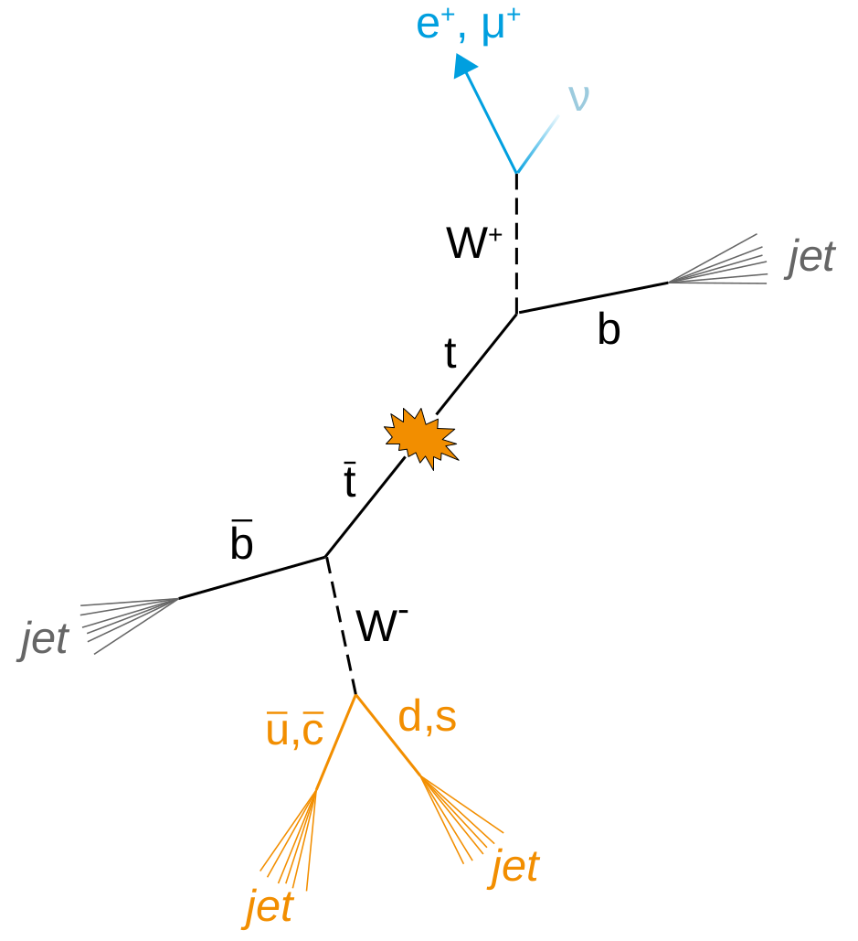
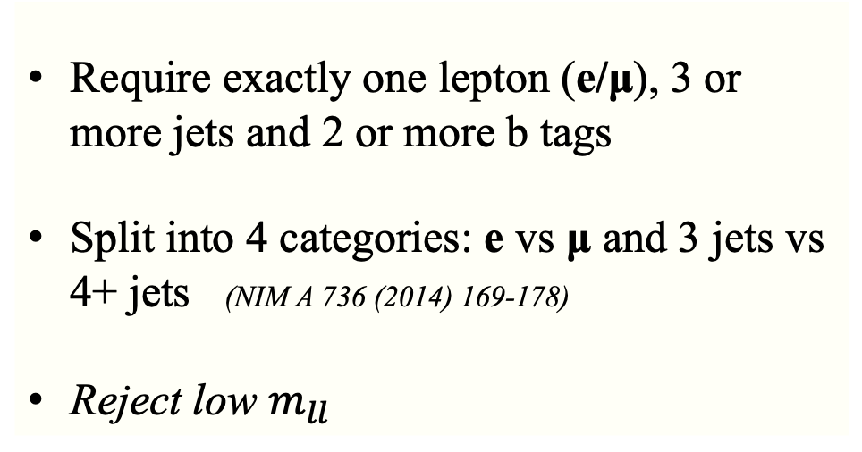
Final states. Observables.
Event selections: leptons + jets channel
Require exactly one lepton (e/μ), 3 or more jets and 2 or more b tags
Split into 4 categories: e vs μ and 3 jets vs 4+ jets (NIM A 736 (2014) 169-178)
Reject low $m_{ll}$

Slide 16
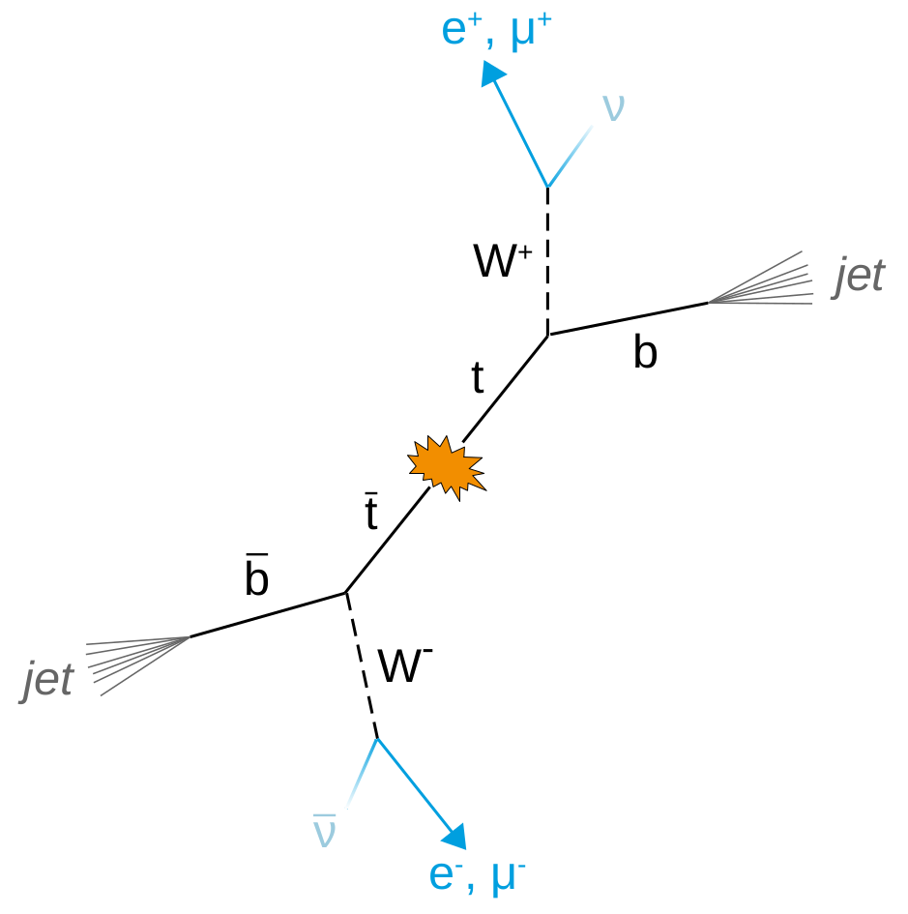
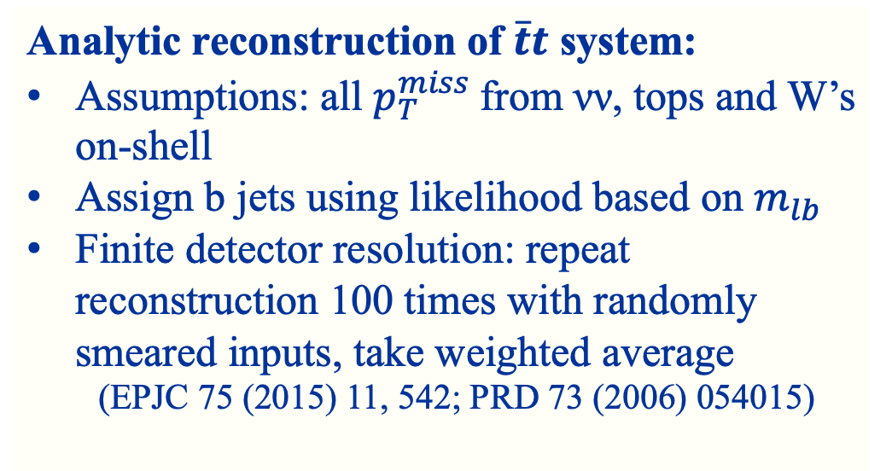
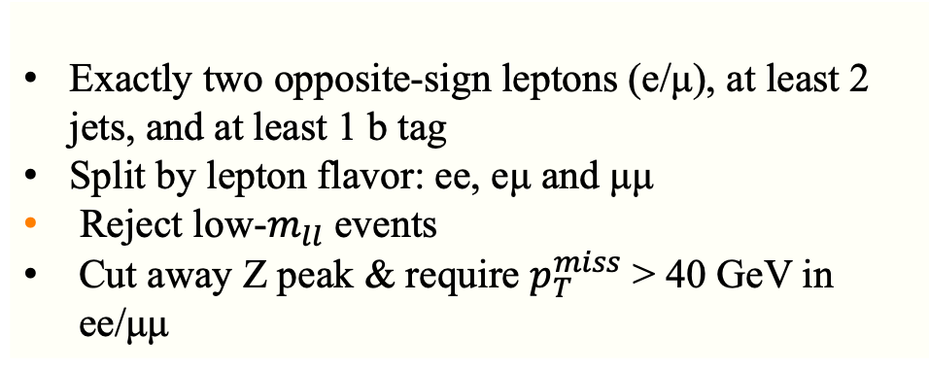
Dilepton channel
Analytic reconstruction of $\overline{t}t$ system:
Assumptions: all $p_{T}^{miss}$from νν, tops and W’s on-shell
Assign b jets using likelihood based on $m_{lb}$
Finite detector resolution: repeat reconstruction 100 times with randomly smeared inputs, take weighted average
(EPJC 75 (2015) 11, 542; PRD 73 (2006) 054015)
Exactly two opposite-sign leptons (e/μ), at least 2 jets, and at least 1 b tag
Split by lepton flavor: ee, eμ and μμ
Reject low-$m_{ll}$ events
Cut away Z peak & require $p_{T}^{miss}$ > 40 GeV in ee/μμ

Slide 17
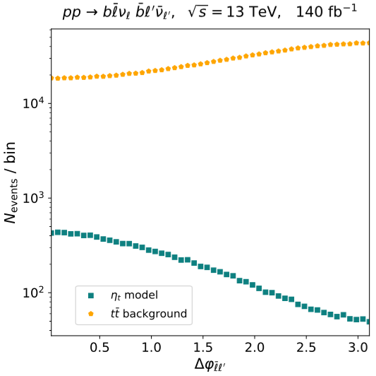
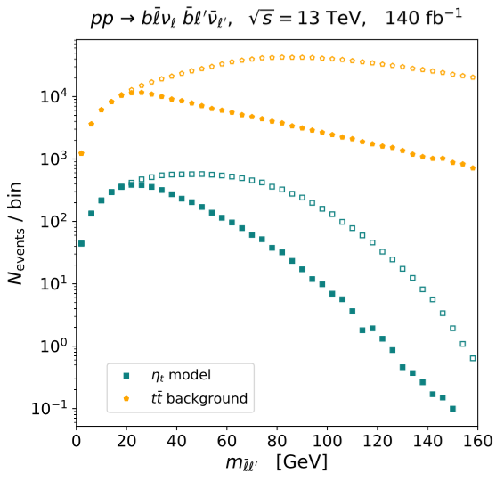
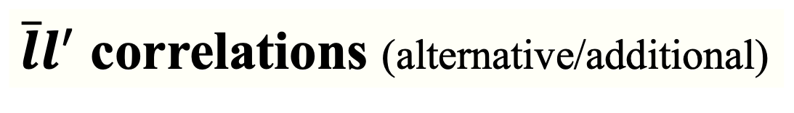

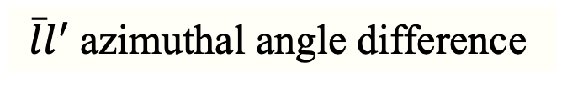
$\overline{l}l^{′}$ correlations (alternative/additional)
$\overline{l}l^{′}$azimuthal angle difference
$m_{\overline{l}l^{′}}$ with(out) azimuthal angle cut
Fuks, Hagiwara, Ma & Zheng, PRD 104 (2021) 034023

Slide 18

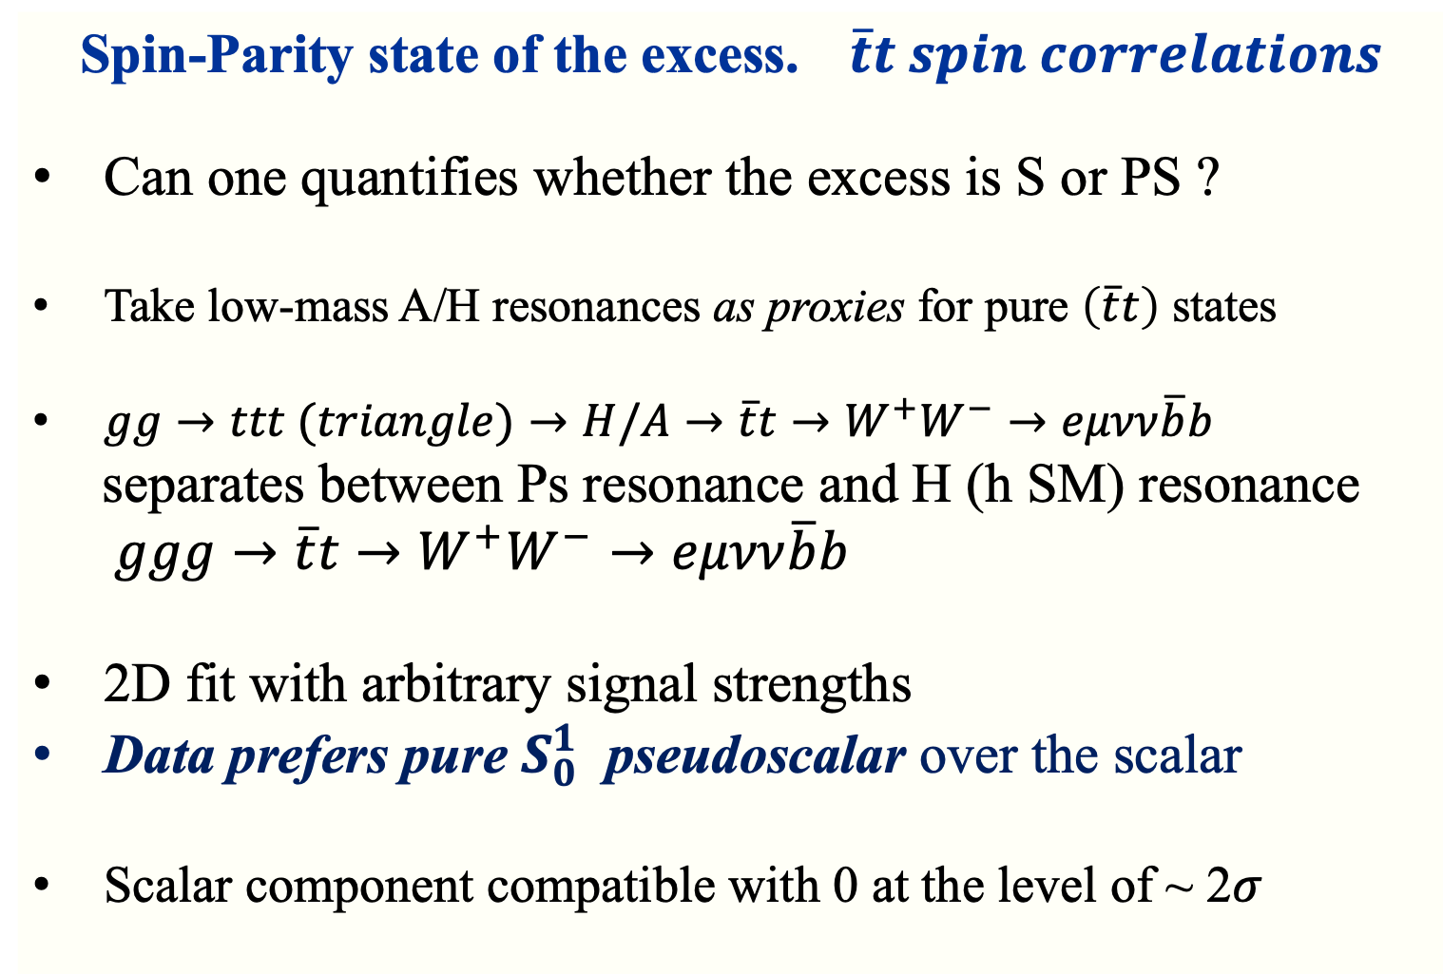
Spin-Parity state of the excess. $\overline{t}t spin correlations$
Can one quantifies whether the excess is S or PS ?
Take low-mass A/H resonances as proxies for pure $\left(\overline{t}t\right)$ states
$gg→ttt (triangle)→H/A→\overline{t}t→W^{+}W^{−}→eμνν\overline{b}b$
separates between Ps resonance and H (h SM) resonance
$ggg→\overline{t}t→W^{+}W^{−}→eμνν\overline{b}b$
2D fit with arbitrary signal strengths
Data prefers pure $S_{0}^{1}$ pseudoscalar over the scalar
Scalar component compatible with 0 at the level of ~ 2$σ$
CMS ${@ 138 fb}^{−1}, 2025$

Slide 19
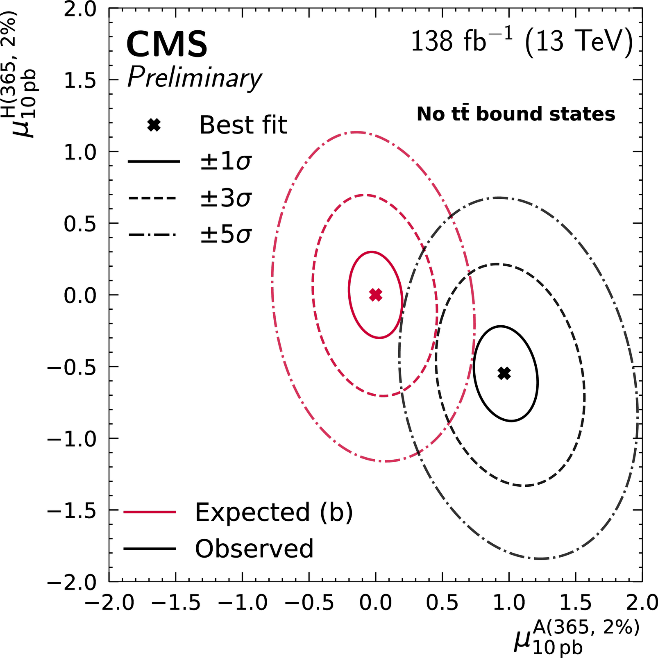
scalar
Pseudoscalar

Slide 20
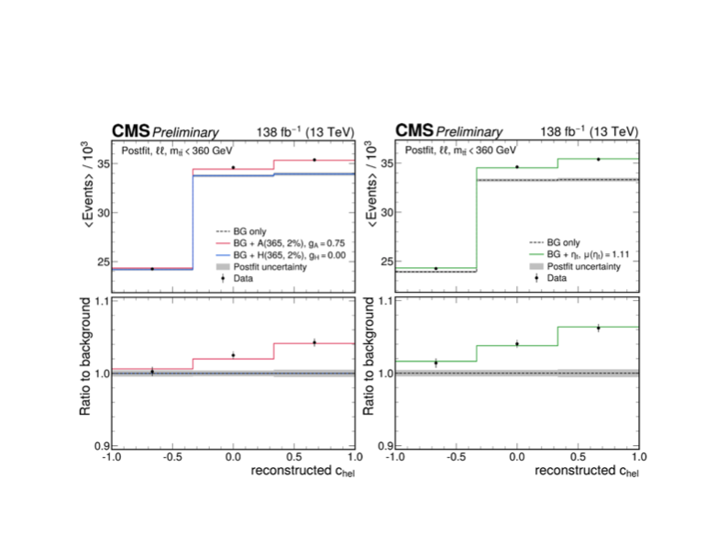


Toponium ${\left(t\overline{t}\right)}_{s=0}$or A-Higgs?
Both consistent with data
CMS Coll., Rep. Prog. Phys. 88 (2025) 087801
tanβ ≡ $v_{2}/v_{1}$ in 2HDM chosen to fit reported cross section, also fixes $g_{A\overline{t}t},$ $Γ_{A}$
Result: $tanβ≈2.5 (A→Zh), tanβ≈1.4 \left(CMS\right) @ m_{A}≈m_{\overline{t}t} ≈343 GeV$
$tanβ\left(A→Zh, h→b\overline{b}\right) \sim tanβ\left(CMS\right) \sim 1.5 @ m_{A}≈m_{\overline{t}t} ≈380 GeV$
Notes:
Angular observables C_hel are defined to probe the spin correlation of \bar t t system

Slide 21

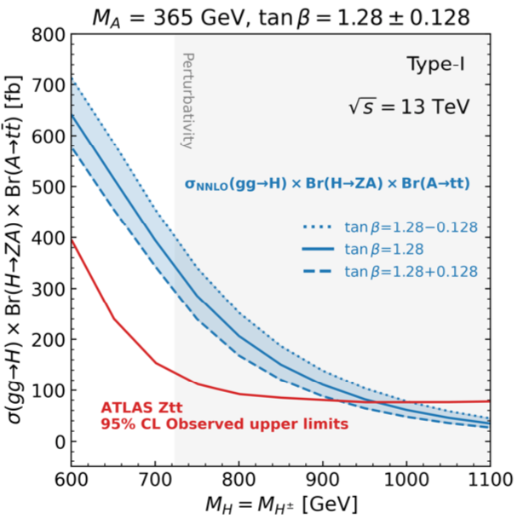

Constraints on 2HDM
LHC constraints on H → Z$\overline{t}t$
h(125) coupling measurements → small mixing with heavy scalar H : $\cos^{2}$(β − α) ≲ 0.05 “alignment limit”
Su et al., Eur. Phys. J. C81 (2021), 810
$\cos\left(β−α\right)\sim 0, tanβ⊂\left[1−50\right]$ TH
Lu, Cheung, Kim, Lee & Song, arXiv:2410.08609, Djouadi, JE & Quevillon, preliminary
Notes:
“Alignment” limit – предел выравнивания

Slide 22


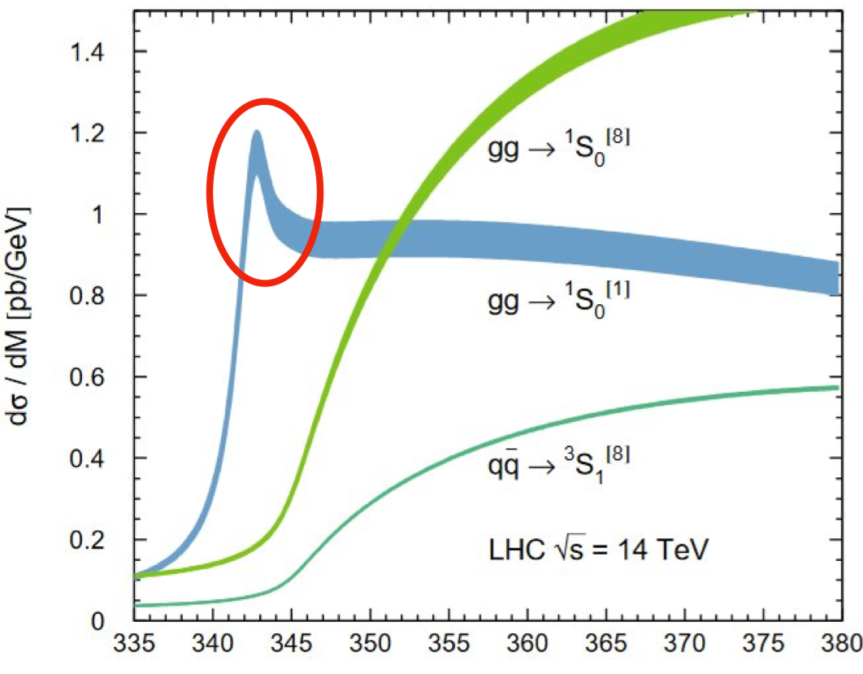
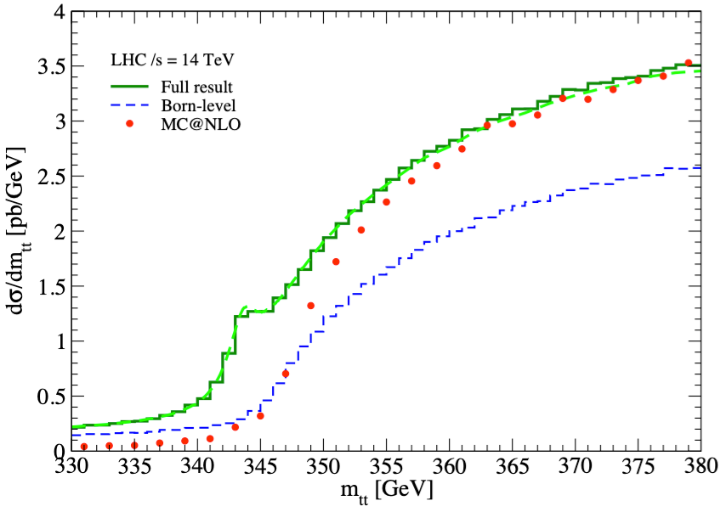
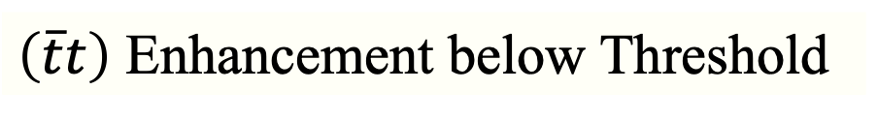
$\left(\overline{t}t\right)$ Enhancement below Threshold
Simulation
Sumino & Yokoya, JHEP 09 (2010) 034
Kiyo, Kühn, Moch, Steinhauser & Uwer, Eur. Phys. J. C60 (2009) 375
Cross-section perturbative OCD calculation of dσ/d$m_{\overline{t}t}$
Colour-singlet, $\left(\overline{t}t\right)$ pole dominant below nominal $\overline{t}t$ threshold
The width & line-shape are not exactly known: below exp. resolution

Slide 23

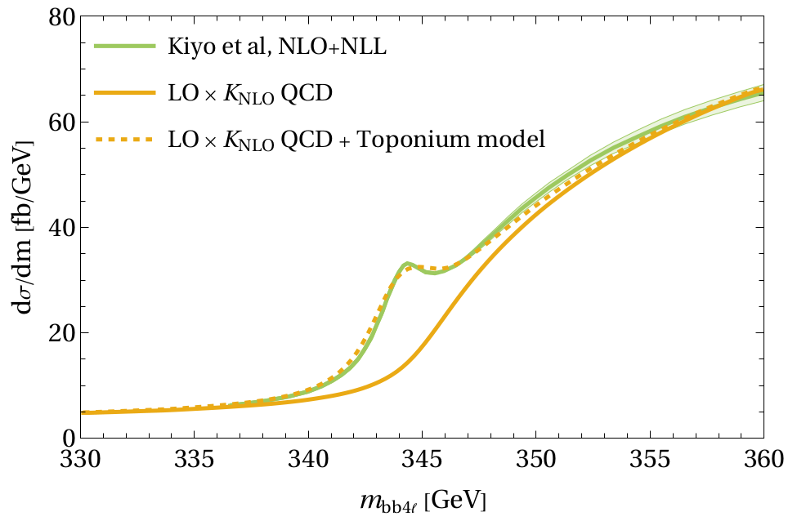
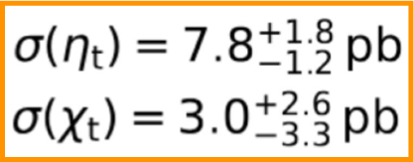




Modeling: $(\overline{t }t)$ bound states
Use simplified model for MC simulation: $\left(\overline{t}t\right)$
(PRD 104 (2021) 034023, JHEP 03 (2024) 099
Generic spin-0, color-singlet state $\left(\overline{t}t\right)$
Couplings to gluons and tops (Ps)
Fit mass from NRQCD:
$m_{\left(\overline{t}t\right)}−2m_{t}=E_{b}=−2 GeV→$ $m_{\left(\overline{t}t\right)}$= 343 GeV
JHEP 09 (2024) 001
Result CMS:
Result:
very similar signature as low-mass A/H resonances

Slide 24

Problems. Perspectives. Observables.
Observables? Allowing to characterize an excess as $η_{t}$
2. Required strong TH and precise TH modeling
3. Di-lepton mode is most clean with quite small BGR
4. Source of systematics uncertainties – TH modeling + EXP uncertainties
5. $η_{t}$signal is in localized domain close to $\overline{t}t threshold$
6. The deviations decrease fast as from $m_{\overline{t}t}>400 GeV$
7. $η_{t}$effect on spin & observables < 1$σ if m_{\overline{t}t }>400 GeV \left(Run2+3\right)$
8. Difficult to distinguish $η_{t }\& A in \overline{t}t final state$
Need: search for other A & heavy Higgs production mechanism

Slide 25



Part II
$$Nobody understands quantum theory$$
$$Richard Feynman, 1967$$
Theory & Phenomenology

Slide 26
(Super)Heavy Quarkonia. Toponia: Theory & Phenomenology
1984
V. Barger, H. Baer, K. Hagiwara, and R.J.N. Phillips
“Fourth-generation quarks and leptons”
Phys. Rev. D30 (1984) 947
…………………………
2025
Djouadi, J. Ellis, J. Quevillou
“Contrasting pseudoscalar Higgs and Toponium states at the LHC”
Phys. Lett. B866 (2025) 139583
Y. Bai, T-K Chen, Y. Yang
“Toponium at the HL- LHC, CEPC, and FCC-ee”
arXiv 2506.14552
…………………………

Slide 27

“Toponium” BGR for TH
Smallest bound state to date in SM
$R^{Bohr}\sim 0.01 fm$
predominantly captured by pQCD in the short-distance regime, AF.
$$τ_{t }\sim {10}^{−25 }s< Λ_{QCD}^{−1} \sim {10}^{−24}s≪ m_{t}Λ_{QCD}^{−2} \sim {10}^{−21}s$$
hadronisation
spin decorrelations time scale
LHC: Avenue to novel class of QCD-like Bound State
$$τ_{BS}^{form}\sim O\left[{\left(α_{s}^{2}m_{t}\right)}^{−1}\right] \sim τ_{decay}\sim {\left(2Γ_{t}\right)}^{−1}\sim 0.2×{10}^{−24 }s$$

Slide 28





TH “Toponium” through the pp LHC
$\overline{t}t continuum$
SM $pp→$ $\overline{t}t$ $→b\overline{b}WW$
$m_{t}=172.52\begin{matrix}+ \\ −\end{matrix}\begin{matrix}0.33 \\ 0.33\end{matrix}$ GeV ~ weight of ${Au}^{79 }gold nucleus$
$$η_{t} production is TH modelled with m_{η_{t}}≈2m_{t}−2GeV=343 GeV$$
$Γ_{η_{t}}≈2.8 GeV$
$$L=−g_{ggη_{t}}G_{μν}^{a}\tilde{G^{μν a}}{ η}_{t}−ig_{ttη_{t}}\overline{t}γ_{5}t{ η}_{t}$$

Slide 29
TH “Toponium” before discovering @ LHC
Is the t-quark connected to NP ?
Large coupling to Higgs boson, ~ O(1)
important role of EW symmetry breaking
Do Toponia connect to new (pseudo) scalars?
If couplings are Yukawa-like:
strongest couplings to t-quarks
2HDM: $m_{A}, m_{H}>2m_{t}:decay to t−pair quarks$

Slide 30


$\overline{t}t$ Threshold Structure
Pioneering study in e+e− annihilation
Fadin & Khoze, Pis’ma Zh.E.T.P., 11, p417 (1987)
Solve Schrödinger equation with Coulomb potential
TH “Toponium” (one-gluon inter.)
Sommerfeld enhancement:
- Green’s functions
- summation of ${\left(α_{s}/v\right)}^{n}$
Lowest-lying $\overline{t}t states in S−wave: S_{0}^{1} \left(PS\right),{ S}_{1}^{3} \left(V\right)$

Slide 31



(Super)Heavy quark bound states
Lowest $T\left(\overline{t}t\right) @ relative distances r\sim {\left[m_{t}λ\left(m_{t}\right)\right]}^{−1}≪r_{strong}$
Non-relativistic behavior --> potential model used
$V\left(r\right)\sim \int_{0}^{∞}{dq α_{s}\left(q^{2}\right)\frac{\sin\left(qr\right)}{qr} ⇒} \int_{Λ}^{∞}{dq}{ α}_{s}\left(q^{2}\right)Υ\left(q^{2},m^{2}\right)\frac{sin⁡(qr)}{qr}$
<well-defined function>
$Υ\left(q^{2},m^{2}\right)→1, { m}^{2}→∞$ H-C Pauli 2003
Screening$Υ\left(q^{2},m^{2}\right)={\left(1+ q^{2}/m^{2}\right)}^{−1 }to avoid lnln q divergence$ @ upper limit
${ α}_{s}\left(q^{2}\right)=\frac{4π}{\left[β_{0}ln\left(\frac{q^{2}}{Λ^{2}}\right)\right]} @ large q^{2}$with rapid oscillation
$${ α}_{s}\left(q^{2}\right)\frac{\sin\left(qr\right)}{qr}$$
Formal integration in the limit $\frac{Λ^{2}}{q^{2}}→0, V\left(r\right)\sim α_{s}\left(q_{0}^{2}\right)\left[−\frac{1}{r}+\frac{e^{−mr}}{r}\right]$
add. contr. due to scalar (Higgs?) exchange

Slide 32


$t\overline{t} condensation$
The strong “top-color” dynamics can bind $\overline{t} and t into a set of “heavy pions”$
Existence of $\left(\overline{t}t\right) criterion c=\frac{Γ_{tot}}{ε_{B}}<1$
- one-gluon exchange $\sim −\left(\frac{4}{3}α_{s}\right)\frac{m_{t}}{r}$
- Scalar (Higgs)-boson interactions Sher, Silverman, 1985
Inazawa, Morii, 1988, 1990
Hagiwara et al., 1990; GK, Morii 2003
Creation of $\left(\overline{t}t\right)$ out of vacuum from the screening of quark color charges at r
QCD vacuum, gluon fields fluctuations at large r
distortion in $\overline{Q}Q interactions Voloshin, 1979, 1986$
The breaking of color flux tubes or splitting of quarks may occur GK 2008,09

Slide 33




Effective potential
Effective potential
Lowest $\left(\overline{t}t\right) interaction @ r\sim {\left[m_{t}λ\left(m_{t}\right)\right]}^{−1}<r_{strong}; W.F. \sim e^{−μr}$
$$r_{\left(\overline{t}t\right) }small enough →potential formalism$$
$$V_{eff}\left(r\right)\sim −\frac{C_{F}}{r}α_{s}\left(m_{t}\right)−\frac{λ\left(m_{t},ξ_{χt}\right)}{r}e^{−m_{χ}r}$$
Fig. 1 follows
$λ\left(m_{t},ξ_{χt}\right)=\frac{m_{t}^{2}}{4πv^{2}}ξ_{χt}^{2} scalar Higgs χ; ξ_{χt}$= 1 SM/ $ξ_{χt}>$1 otherwise
$λ\left(m_{t},ξ_{χt}\right)$ > $C_{F}α_{s}\left(m_{t}\right)→ m_{t}>\frac{v}{ξ_{χt}}{\left(4πC_{F}α_{s}\right)}^{1/2}$ fig. 2 follows
$$Variational par. μ>0 in Ψ\left(r\right)=2μ^{−3/2}e^{−μr}→ ε_{B}=2λ\frac{μ^{3}\left(2μ−m_{χ}\right)}{{\left(2μ+m_{χ}\right)}^{3}}$$
$$μ≈\frac{λm_{t}}{2}\frac{{\left(λm_{t}\right)}^{2}−m_{χ}^{2}}{{\left(λm_{t}\right)}^{2}+2m_{χ}^{2} }⇒upper limit on m_{χ},$$
$$v= \sqrt{v_{1}^{2}+v_{2}^{2} }$$
Fig. 3 follows

Slide 34

Efficiency of combined couplings
2004
Fig. 1 Ratio of the combined coupling αcomb to the QCD coupling $\overline{α_{s}}$ as a function of $m_{Q}$ for ξχ Q = 1 (left fig. a ) and ξχ Q = 2, 3 (right fig. b).
The χ-boson masses mχ = 90, 100 and 120 GeV. 2003! No Higgs discovery yet
G.K., 2003
G.K., T. Morii, 2004

Slide 35


Lower bound on $m_{Q}$. Upper limit on $m_{χ}$
2004
Fig.2 Lower bound on the heavy quark masses as a function of ξχ Q.
G.K., 2003
G.K., T. Morii, 2004
Fig.3 Upper limit on the scalar χ-boson
mass as a function of $m_{Q}$ for different
values of $ξ_{χQ}$.
The regions above the corresponding
curves are excluded.

Slide 36

The heavy quark bound state criterium
The ratio $c=\frac{Γ_{tot}}{ε_{B}}<1 could be guaranteed for T−quarkonium$
$$to be formed by srong Higgs−boson exchange with Yukawa$$
$λ\left(m_{Q},ξ_{χQ}\right)$ = $\frac{m_{Q}^{2}}{4πv^{2}}ξ_{χQ}^{2} ξ_{χQ}=1 \left(SM\right), { ξ}_{χQ}>1 \left(beyond SM\right)$
$$Γ_{tot}= Γ_{T}+Γ_{Q}$$
$Γ_{T}(\left(\overline{Q}Q\right)→hZ, γZ, γh,{ W}^{+}W^{−},\overline{b}b$,$\overline{t}t$,${ τ}^{+}τ^{−},{ μ}^{+}μ^{−}, ggg)$
Suppression: radiative channel ~$α small$
$ggg small contribution, {\sim α}_{s}^{3}$
$\overline{q}q,\overline{l}l$ small, 2-loop diagrams,~$α interm.γ^{′}s, Fermi const. G_{F }(W^{±} virt.)$
$Γ\left(U→DW^{+},bW^{+},bH^{+}\right)$
$$U→bH^{+} small contribions \left(CDF+D0 restrictions\right)$$
CDF Phys. Rev. 2000
D0 Phys. Rev. Lett. 2002

Slide 37

The heavy quark bound state criterium. Con’d.
Survived
$$Γ_{tot}≈ Γ_{T}(\left(\overline{U}U)→hZ\right)+Γ_{U}(U→DW^{+}, bW^{+})$$
$Γ_{T}(\left(\overline{U}U)→hZ\right)≈2.2{ η}_{hU}^{2 } GeV m_{χ}\sim m_{h}\sim O(100 GeV)$
$η_{hU}≈1+{\left(\frac{m_{Z}}{m_{A}}\right)}^{2}s_{2β} c_{2β} \tan^{−1}β$
$Γ_{U}\left(U→DW^{+}\right)≈1.21GeV m_{U}=0.4 TeV$
$Γ_{U}\left(U→bW^{+}\right)≈2.1MeV m_{D}=0.3 TeV$
$c=\frac{Γ_{tot}}{ε_{B}}$ = 0.27, ${ ε}_{B}=12.65 GeV$
Topology $U→DW^{+}$, $U→bW^{+}$ the same as to t$→bW^{+},D→tW^{−}$
$Γ_{T}(\left(\overline{D}D)→hZ\right)≈2.25 η_{hD}^{2 } GeV$
Enhanced due to Yukawa-flavor factor $η_{hD}=−\frac{sinα}{cosβ} @ large tanβ$
$Γ_{D}\left(D→tW^{−}\right)≈1.47 MeV$, $α$is the angle to CP-even Higgs matrix diagonal’n

Slide 38


Heavy $\left(\overline{Q}Q\right) emergence$
2004
G.K., 2003
G.K., T. Morii, 2004
Fig.4 Ratio c = Γtot/$ε_{B}$ being responsible for occurrence of $\left(\overline{Q}Q\right)$ as a function of $m_{Q}$at different values of ξχU for mχ = 100 GeV. The region below the value c = 1 is allowed.

Slide 39




Ps- “toponium” vs V- “toponium”
$$Γ(T\left(O^{− +})→h Z\right)= \frac{3λ^{3}m_{t}}{32}α_{Z}^{2}{\left(\frac{m_{t}}{m_{Z}}\right)}^{4}f^{3}Φ$$
$$gg→η_{t} LHC$$
$f\left(λ,m_{t},m_{χ}\right)=\frac{{\left(λm_{t}\right)}^{2}−m_{χ}^{2}}{{\left(λm_{t}\right)}^{2}+2m_{χ}^{2}}$,
$Φ=\sqrt{1 − \frac{4m_{h}^{2}}{m_{T}^{2}}, } λ\left(m_{t},ξ_{χt}\right)=\frac{m_{t}^{2}}{4πv^{2}}ξ_{χt}^{2}, α_{Z}$= $\frac{α}{c_{W}^{2}s_{w}^{2}}$
$$Γ(T\left(O^{− +})→h Z\right)≈6.80 GeV$$
$3 times larger than that of$ $Γ(T\left(1^{− −})→h Z\right)$
$gg→ψ_{t}g LHC$ Landau-Yan theorem, or $e^{+}e^{−}→ψ_{t} FCC−ee$
$$η_{t} →h Z most promising candidate to be searched at LHC$$

Slide 40




“Toponium” production cross section
Once the “Toponium” is long-lived, the peak at $\left(\overline{t}t\right) resonance due to 1g exchange$
$$σ_{c}\sim α_{s}^{3}\frac{m_{t}}{Γ_{t}}\frac{1}{s}$$
Strong sensitivity to $α_{s} \& decreasing with m_{t} Γ_{t}\sim m_{t}^{3}G_{F}….$
To leading order, the $χ−boson exchange effect$
$$α_{s}→α_{s}+\tilde{α } (m_{t},m_{χ}, ξ_{χt})$$
$\tilde{α}=\frac{3m_{t}^{2}}{16πv^{2}}ξ_{χt}^{2}e^{−ε}, ε=\frac{m_{χ}}{λm_{t}}≪$1
$$σ_{eff}=σ_{c}\left(1+3\tilde{α} α_{s}^{−1}+3\tilde{α^{2}} α_{s}^{−2}+ \tilde{α^{3}} α_{s}^{−3}\right)$$
Increasing effect ${to σ}_{eff}$within the coupling strength $ξ_{χt}$between $\overline{t }\& t$

Slide 41


Production cross section
2004
Fig.5 Ratio of the effective production
cross-section$s σ_{eff}$ & $σ_{c}$ at the
1S resonance $\overline{Q}Q$ as a function of $m_{Q}$.
Toy model. Massless $χ−boson$
European Strategy Update 2025
- Higgs
- Searches for New Scalars
G.K., 2003
G.K., T. Morii, 2004

Slide 42
Production of ”toponium” in radiative decay of the Higgs
$\left\langle T\left(\overline{t}t\right) | \overline{t }γ_{μ}t | 0\right\rangle =m_{T}^{2}g_{V}φ_{μ}, Γ\left(T→\overline{l}l\right)=\frac{4}{3}π{\left(αe_{t}g_{V}\right)}^{2}m_{T }, l=e,μ,τ$
$f≡\frac{BR\left(H→T\left(\overline{t}t\right)γ\right)}{BR\left(H→\overline{t}t\right)}=\frac{64παe_{t}^{2}}{3}g_{V}^{2}{\left(\frac{m_{t}}{m_{H}}\right)}^{2}K^{2}\left(y,α_{s}\right){\left[1−{\left(\frac{m_{T}}{m_{H}}\right)}^{2}\right]}^{−1/2}$
$K\left(y,α_{s}\right)$ $≈1−\frac{α_{s}\left(m_{H}^{2}−m_{T}^{2}\right)}{π}\ln{2ln\left(4y\right), y≡{\left(\frac{m_{H}}{2m_{t}}\right)}^{2}>1}$
The observation of $T\left(\overline{t}t\right)$ is through the resonance structure with final $\overline{l}l$
Clear evidence of $T\left(\overline{t}t\right)$ production over the QCD BGR if the production is large

Slide 43




Heavy Higgs decays to “toponium”
2004
$$f≡\frac{BR\left(H→T\left(\overline{t}t\right)γ\right)}{BR\left(H→\overline{t}t\right)}$$
$$\left\langle T\left(\overline{t}t\right) | \overline{t }γ_{μ}t | 0\right\rangle =m_{T}^{2}g_{V}φ_{μ}$$
$$Γ\left(T→\overline{l}l\right)=\frac{4}{3}π{\left(αe_{t}g_{V}\right)}^{2}m_{T }$$
G.K., 2003
G.K., T. Morii, 2004
̄ Fig.9 The relative decay width Γ(H → T($\overline{t}t$)γ) as a function of H-boson mass $m_{H}$ compared to H → $\overline{t}t$ channel for different values of $g_{V}$ .

Slide 45
GK 2009
Notes:
The decays of heavy quarkonia are good test to search for a Higgs in light sector (CP-even h).
The predicted BR(T->ll bar h) could be potentially probed by precision measurements at hadron colliders and even the ILC.
On the other side, three-body decays with measurement of invariant mass spectra of leptons recoiling against a Higgs is much valuable insight into dynamics of heavy T(QQ bar) quarkonia.

Slide 46
GK 2009
Notes:
For T(UbarU) bound state the changing of F (T->ll bar H) is very small with increasing of m_A from200 to 300 GeV at 5<tan\beta<20. However, the situation changes drastically if one consider T (D D bar). The amplitude F (T->ll bar H) falls down with increasing of m_A in the range above mentioned.
No essential difference is found with increasing of tan\beta from 5 to 20.

Slide 47

Short conclusion
For $η_{t} bound state with ξ_{χt}\sim O\left(1\right), { m}_{χ}<m_{h}(SM)$
For $η_{t}, the scalar (Higgs) contribution to V_{comb}$
$is appreciable for ξ_{χt}≥6$
Production of CP-odd Ps (A-boson) is$considered as the signal hypothese$
LHC: Exp. data do not exclude alternative explanations like add. bound states

Slide 48
What might be next

Slide 49

BE correlations relevant to $η_{t}$
$η_{t}$’s as observables, due their composite nature and thus finite size, ~0.01 fm, must
be correlated in space-time upon production in pp interactions.
$R_{ch} @ \sqrt{s}\sim 14 TeV (LHC)$ $→\sqrt{s}\sim 100 TeV \left(FCC−pp\right)?$
$C_{2}\left(Q^{2}\right) shape in D=3$, $Q^{2}= {\left(p_{1}−p_{2}\right)}^{2}$, $C_{2}\left(0\right)\sim 2, C_{2}\left(∞\right)\sim 1$
$C_{2}\left(Q^{2}\right) dependence on{ R}_{ch}, N, T bath, coherence \& chaoticity$
Geometrical size of $η_{t}$’s production source (compare to J/ $Ψ,Υ,…)$
Detailed comparison of data with model may pin down the values of parameters
$C_{2}\left(p_{1},p_{2}\right)=\frac{N_{12}\left(p_{1},p_{2}\right)}{N_{1}(p_{1})N_{2}\left(p_{2}\right)}, { N}_{12}\left(p_{1},p_{2}\right)=\frac{1}{σ}\frac{d^{2}σ}{dΩ_{1}dΩ_{2}}, N_{i}\left(p_{i}\right)=\frac{1}{σ}\frac{dσ}{dΩ_{i}}$

Slide 50




BE correlations of $η_{t}$
$C_{2}\left(q^{2}\right)$ = $χ\left(N\right)\left\{1+λ_{new}(m,β)e^{−q^{2}}\left[1+λ_{ch}(m,β)e^{q^{2}/2}\right]\right\}\left(1+r_{f}Q+…\right)$.
$λ_{new}(m,β)$ = $γ\left(ω,β\right)/{\left(1+α\right)}^{2}{, λ}_{ch}{=2 \left[γ\left(ω,β\right)\right]}^{−1/2}$
GK 2005-2009
$α\left(m^{2},β\right)=\frac{n\left(ω,β\right)}{\overline{m^{2}}(ω,β)L_{ch}^{2}}, m\left(ω,β\right)=m n\left(ω,β\right), n\left(ω,β\right)$=$\frac{1}{e^{\left(ω−μ\right)β}−1}$
$$L_{ch}\sim R_{ch} >\frac{1}{m\sqrt{n\left(ω,β\right)}}{\left[\frac{1}{\frac{γ\left(n\right)}{Δ\overline{C_{2}^{max}}}−1}\right]}^{1/4}, γ\left(n\right)=\frac{n^{2}(\overline{ω},β)}{n\left(ω,β\right)n\left(ω^{′},β\right)}$$
$$χ\left(N\right)= \frac{\left\langle N(N−1)\right\rangle }{{\left\langle N\right\rangle }^{2}}$$
$Δ\overline{C_{2}^{max}}$ = $\overline{C_{2}^{max}}−1, \overline{C_{2}^{max}}=C_{2}^{max}/χ\left(N\right)$
$$m_{η_{t}}≫m_{cc}, m_{bb}→{α−coherence degree decreases, λ}_{new}\left(m,β\right) increases$$
Although not so much easy, the measurements are worth to undertake

Slide 51

What would be done more & further…
Test/checks $\overline{t}t→bW^{+}\overline{b}W^{−}→be^{+}ν\overline{b}l^{−}ν$ Why??
$m_{ll} \& Δφ_{ll} are related to \overline{t}t spin correlators:$
$\left(\overline{t}t\right)$ spin singlet$→closer leptons , smaller{ m}_{ll}$
3. An excess $η_{t}$ is compatible with $\overline{b}b WW+\left(\overline{t}t\right) production$
4. Improve TH predictions for $σ (\left(\overline{t}t\right)$) ~ O(8.8 pb) CMS or ~ O(9.0 pb) ATLAS ?
5. EXP discovery $η_{t}$ /properties are very difficult trial, not yet investigated clearly
6. Need: further improve TH modeling, data-driven calibration of TH predictions
7. More precise distinguish $η_{t }\& A in \overline{t}t final state$

Slide 52

Summary
LHC (2024-25) searched for new heavy PS state with full Run 2 dataset
Dilepton/lepton+jets channels with $m_{\overline{t}t}$, angular/spin observables
Observed excess in data at low $m_{\overline{t}t}$ – consistent with Ps state
- Interpretations in terms of a simplified model of $η_{t}/$generic A Higgs
- Extracted cross section for a naïve $η_{t}$model - Set stringent limits on A with $\left(\overline{t}t\right)$ included in the BGR
Need more:
An improved non-relativistic QCD calculation of $η_{t}$effects is crucial
Any further and new inputs from theory
Whatever the excess is, there will be exciting and instructive for Exp & TH!
Top quark and anti top quark are friendly close together before they decay

