Slide 1
JOINT INSTITUTE for Nuclear Research
Bogolubon Laboratory of Theoretical Physics
14 November 2024
High energy hadron elastic scattering
pp, , pn, pπ
(from √s = 3.6 GeV up to √s = 13 TeV)
O.V. Selyugin
(BLTPh, JINR )
(to be nominated for the JINR Prize 2024)

Slide 2
O.V. S., O.V. Teryaev, Phys.Rev. D 79, 033003 (2009).
O.V. S., Mod. Phys. Lett. A, v. 26 (2011).
O.V.S. - Eur. PhysJ. C 72: 2073 (2012)
O.V.S. Nucl.Phys. A 903 54 (2013)
O.V. S., Phys. Rev., D 89, 093007 (2014) .
O.V. S, Nucl. Phys. A 922, 180 (2014)
O.V. S., Phys. Rev., D 91, 113003 (2015)
O.V. S., Nucl.Phys. A 959, 116 (2017).
O.V. S., Phys.Lett. B 797, 134870 (2019).
O.V. S., Symmetry, v.13, 00164 (2021)
O.V. S, Mod.Phys.Lett. A 36, 215148 (2021)
O.V. S., Phys. Rev., D 104, 003154 (2021)
O.V. S., Symmetry, MDPI, 15, 760, (2023).
O.V. S., Eur. Phys. J. C 84:649 (2024)
O.V. S., Phys. At. Nucl. V. 87, n.3, p. 252 (2024)
O.V. S. PEPAN Lett., v.55, n4, 1000 (2024).
O.V. S., Phys. At. Nucl. V. 87, (2024)
O.V. S., Phys. Rev., D (2024)

Slide 3
and were reported on the international conferences by O.V.S. :
International Spin Physics Symposium: SPIN2012, JINR, Dubna, Russia (2012);
The 15th conference on Elastic and Diffractive scattering, EDS Blois, Finland (2013);
Spin physics at NICA,Charles University, Prague, Czech Republic (2013);
XVI Workshop on high energy spin physics dspin-15, Dubna, Russia (2015);
”Selected problems in quantum field theory”, Dubna (2015);
Diffraction in High-Energy Physics (Diffraction-2016), , Acirialle, Italy (2016);
XXXIth International Workshop on High Energy Physics, Protvino, Russia (2017);
17th workshop on Elastic and Diffractive Scattering (EDS Blois), Cz.R. (2017);
Ginzburg Centinental Conference on Physics, Moscow, Russia (2017);
Diffraction and Low-x physics, , Reggio-Calabria, Italy (2018);
The XXIV Intern. Workshop HE Physics and QFTh. (QFTHEP-2019), RF (2019);
XVIII Workshop on High Energy Spin Physics DSPIN-19, Dubna, Russia (2019);
XXXIII Intern. Workshop: Hard Problems of Hadron Physics, RF (2021);
Int. Conf. on Quantum Field Theory, High-Energy Physics, and Cosmology (QFTHEPC-
2022),Dubna, Russia (2022);
Int. Conf. on High Energy Physics 2023, Yerevan, Armenia (2023);
XXV Intern. Baldin Seminar on HE Phys. Rel. Nuc. Phys. and QCD, Dubna, RF (2023);
XIXth Workshop on High Energy Spin Physics dedicated to 90th anniversary
of A.V. Efremov birth, Dubna, Russia (2023);
XXXiV Intern. Workshop on HE Phys.: ”Hard Problems of Hadron Physics:
Non-Perturbative QCD”, Protvino, RF (2024);

Slide 4
Hadron elastic scattering interactions.
“…although asymptopia may be very far away indeed, the path to it is not through a desert but through a flourishing region of exciting Physics…” -Elliot Leader in CERN Courier
There are some problems as confinement, hadron interaction at larger distances, non-perturbative hadron structure (parton distribution functions (PDFs),
generalized parton distributions (GPDs) and others)
that should be explored in the framework of the Standard Model.
These problems are connected with the hadron interaction at high and super-high energies and with the problem of energy dependence of the structure
of the scattering amplitude and total cross sections.
Researches into the structure of the elastic hadron scattering amplitude at super-high energies and small momentum transfer – t outlines a connection between experimental knowledge and the fundamental asymptotic theorems, which are based on the first principles.
This reflects a tight connection of the main properties of elastic hadron scattering with the first principles of quantum field theory and the concept of the scattering amplitude as a unified analytic function of its kinematic variables
which introduce by N.N. Bogolyubov

Slide 5
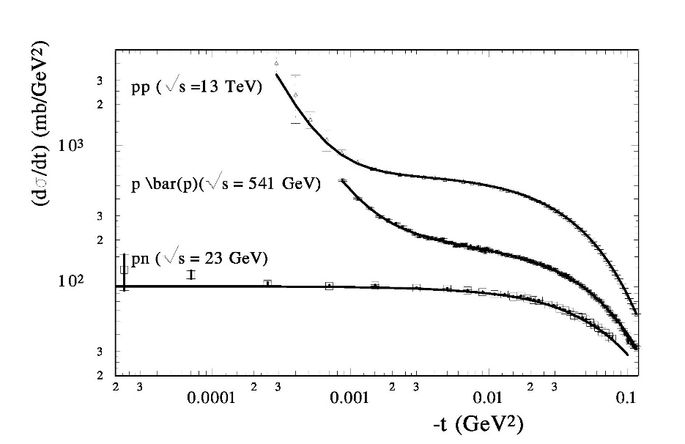

Slide 6
High Energy Generalized Structure (HEGS) model,
Generalized parton distributions;
electromagmetic and gravitomagnetic form factors,
differential cross sections (−t = 10 − 15 GeV)
and spin correlations AN(s, t)
a feature of the differential cross sections at high energies;
hadron potential at large distance and
Developed two new methodics, and discover two new effects.

Slide 7
SIMPLEX SIGILLUM VERI
(простота - знак истины)

Slide 8
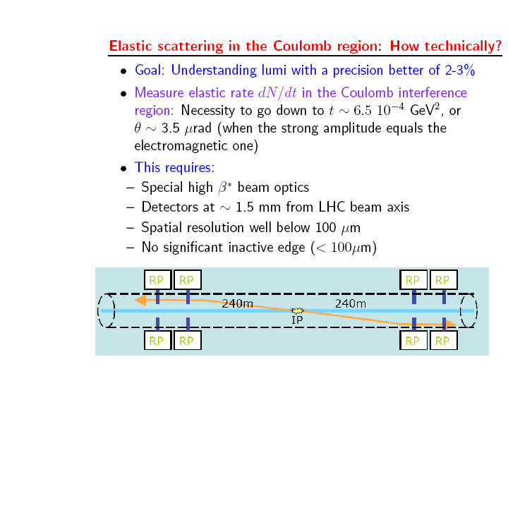

Slide 9
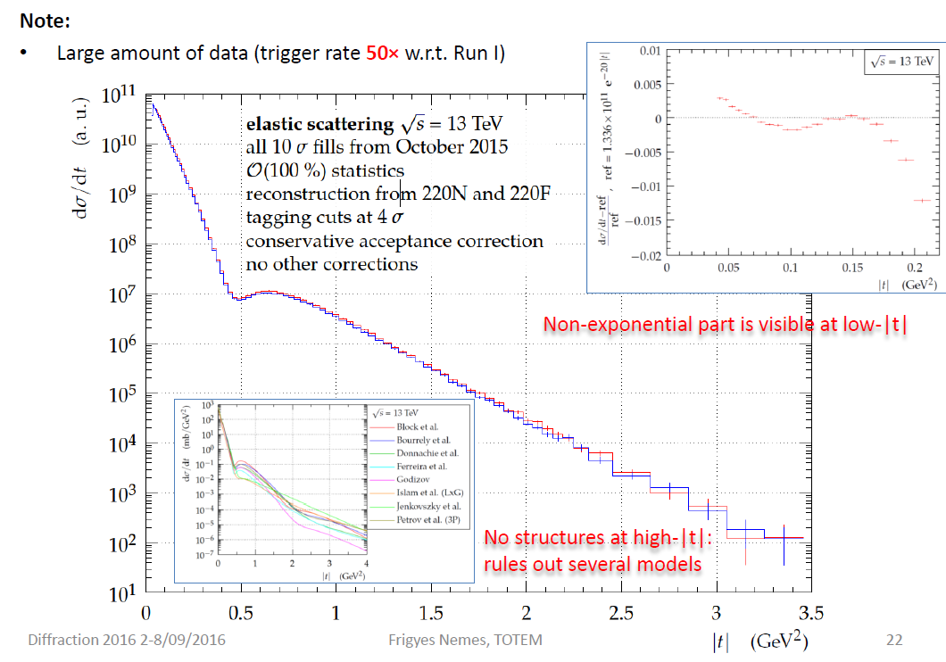
the new LHC data (elastic scattering)
at 7 and 8 TeV
7 TeV (TOTEM) - t [0.00515 – 0.371] 17.08.2012
7 TeV (ATLAS) - t [0.0062 – 0.3636] 25.08.2014
8 TeV (TOTEM) - t [0.028500 – 0.1947] 12.09.2015
8 TeV (TOTEM) - t [0.000741 – 0.201] 11.12.2015
8 TeV (ATLAS) - t [0.01050 – 0.3635] 25.06.2016

Slide 10
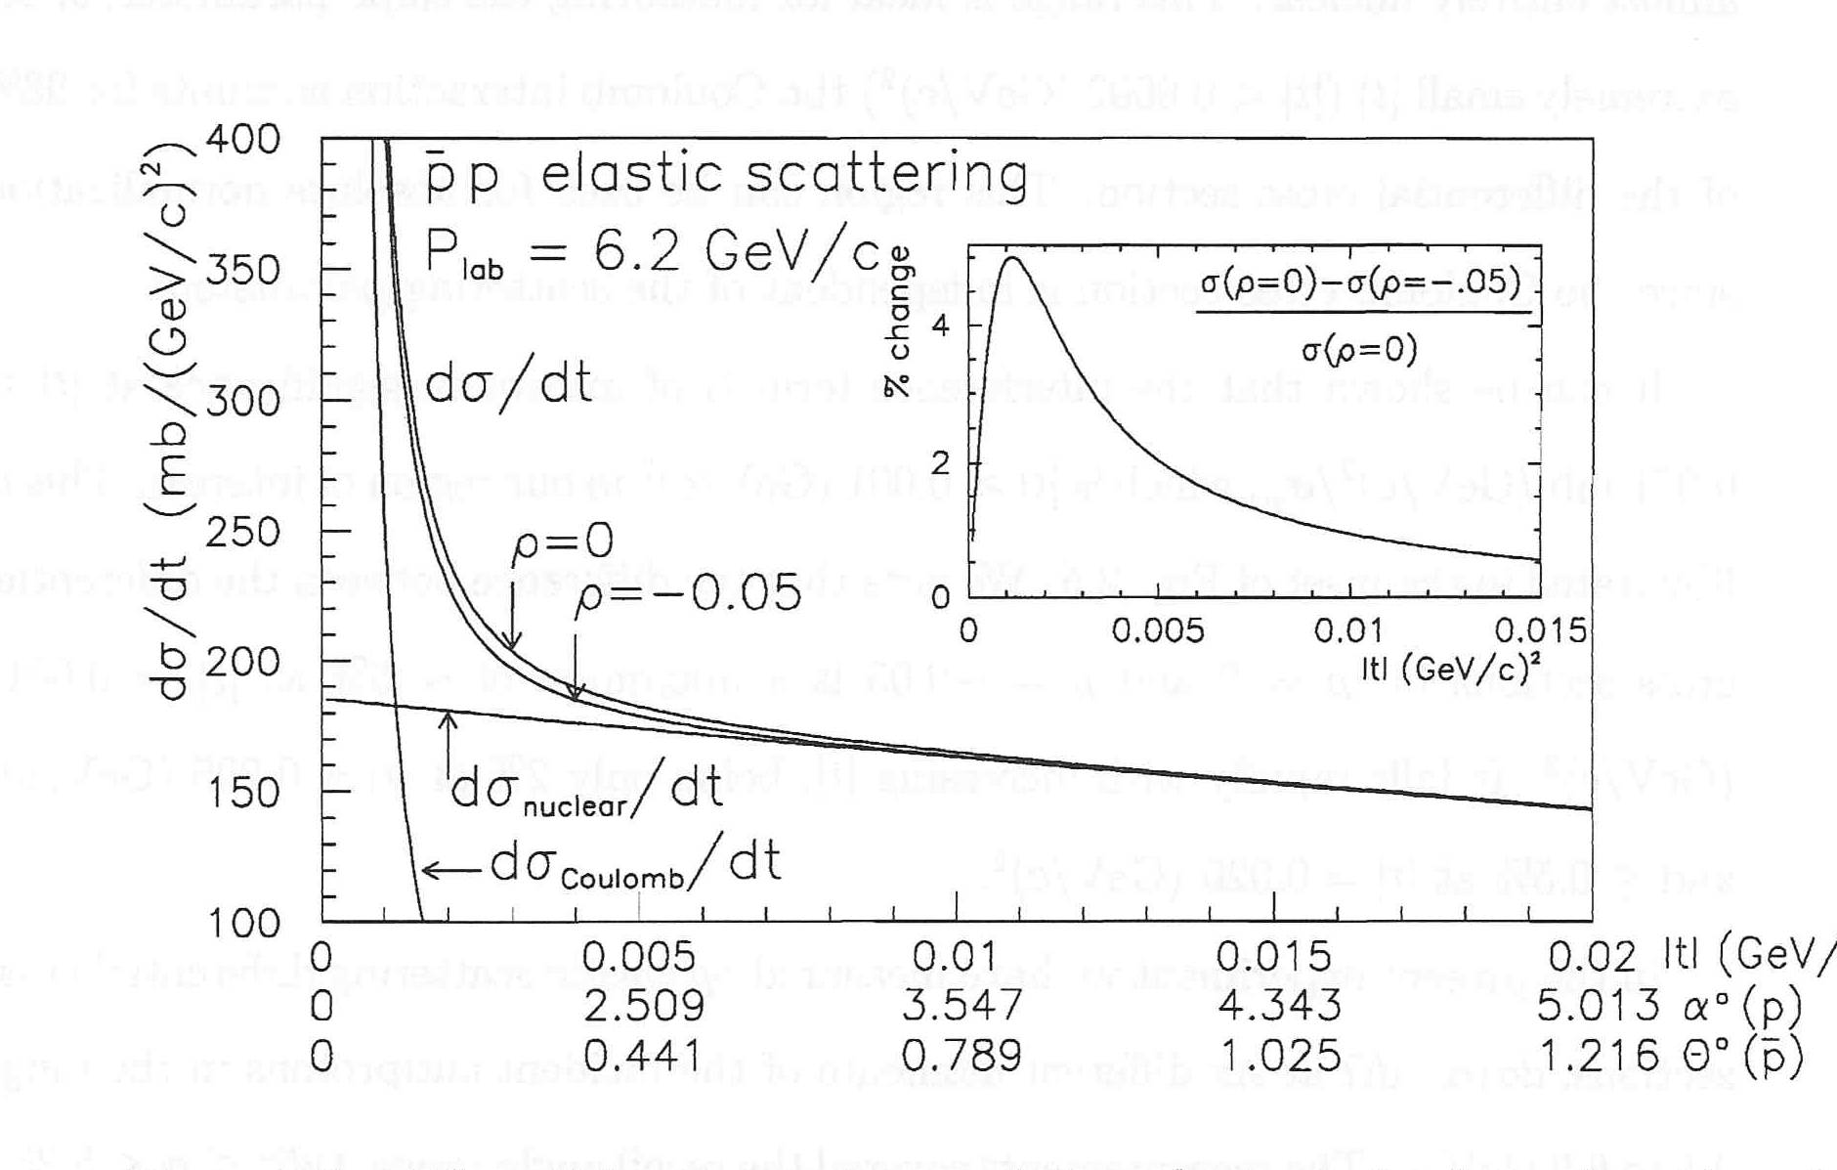

Slide 11
General properties associated with the phenomenon of diffraction:
1. Froissart – Martin bound
2. Derivative dispersion relation
3. Auberson-Kinoshita-Martin scaling
4. Crossing even
Frankfurt, Strickman, Weiss, and Zhalov (hep-ph/0412260)

Slide 12
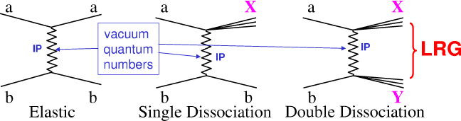
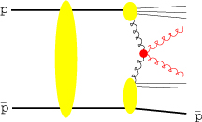
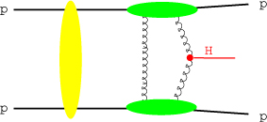

Slide 13
The Very Low t Region
around t ~ −10⁻³ (GeV/c)² A_{hadronic} ≈ A_{Coulomb}
⇒ INTERFERENCE
CNI = Coulomb – Nuclear Interference
scattering amplitudes modified to include also electromagnetic contribution
hadronic interaction described in terms of Pomeron (Reggeon) exchange
electromagnetic single photon exchange
σ = |A_{hadronic} + A_{Coulomb}|²
unpolarized ⇒ clearly visible in the cross section dσ/dt
polarized ⇒ “left – right” asymmetry A_{N}
P
+
γ

Slide 14
Hadron elastic scattering amplitude

Slide 15
Scattering process described in terms of Helicity Amplitudes φ_{i}
All dynamics contained in the Scattering Matrix M
(Spin) Cross Sections expressed in terms of
spin non–flip
double spin flip
spin non–flip
double spin flip
single spin flip
?
⟨ M ⟩
observables:
3 ×-sections
5 spin asymmetries
identical spin ½ particles
- GPDs → electromagnetic FF
- GPDs → gravimagnetic FF
15

Slide 17
Form factors
Mittenen (1973) – “matter distribution”
Bourrely-Soffer-Wu (1978) -
G(t) –”stands for the proton “nuclear form factor” parameterized like the e-m form factor, as a two poles, the slowly varying function reflect the approximate proportionality between the charge density and hadronic matter distribution inside a proton.”
Broniowski – Arriola (2008)
"..The gravitation form factors, related to the matrix
elements of the energy-momentum tensor [1] in a hadronic
state and thus providing the distribution of matter within
the hadron..."

Slide 18
GPDs
Общенные партонные распределения
X.Ji Sum Rules (1997)
F_{x=0} (x;t) = F (x;t)
H^{q}(x;t) = H ^{q}(x,0,t) + H ^{q}(-x,0,t)
E^{q}(x;t) = E ^{q}(x,0,t) + E ^{q}(-x,0,t)

Slide 19
Martin – 2002 // H. KHANPOUR..-2012 (1205.5194)
Pumplin et al. 2002 (CTEQ6M)
Martin et al. 2002 (MRST02) .– Martin -2009 (LO, NLO, NNLO)
Gluck-Pisano 2008
Alekhin et al. 2012 (ABM12)

Slide 20
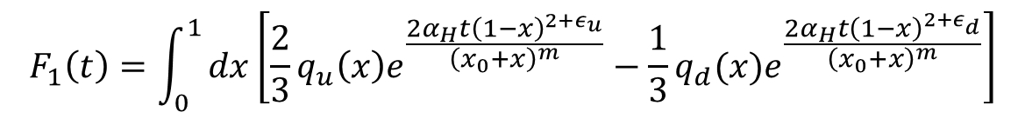
$$F_{1}\left(t\right)=\int_{0}^{1}{dx\left[\frac{2}{3}q_{u}\left(x\right)e^{\frac{2α_{H}t{\left(1−x\right)}^{2+ε_{u}}}{{\left(x_{0}+x\right)}^{m}}}−\frac{1}{3}q_{d}(x)e^{\frac{2α_{H}t{\left(1−x\right)}^{2+ε_{d}}}{{\left(x_{0}+x\right)}^{m}}}\right]}$$
$A\left(t\right)=\int_{0}^{1}{xdx\left[q_{u}\left(x\right)e^{\frac{2α_{H}t{\left(1−x\right)}^{2+ε_{u}}}{{\left(x_{0}+x\right)}^{m}}}+q_{d}\left(x\right)e^{\frac{2α_{H}t{\left(1−x\right)}^{1+ε_{d}}}{{\left(x_{0}+x\right)}^{m}}}\right]}$,

Slide 21
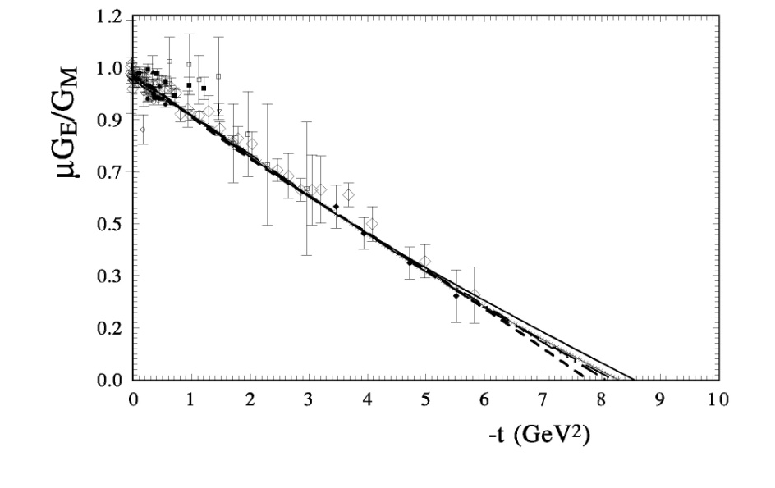
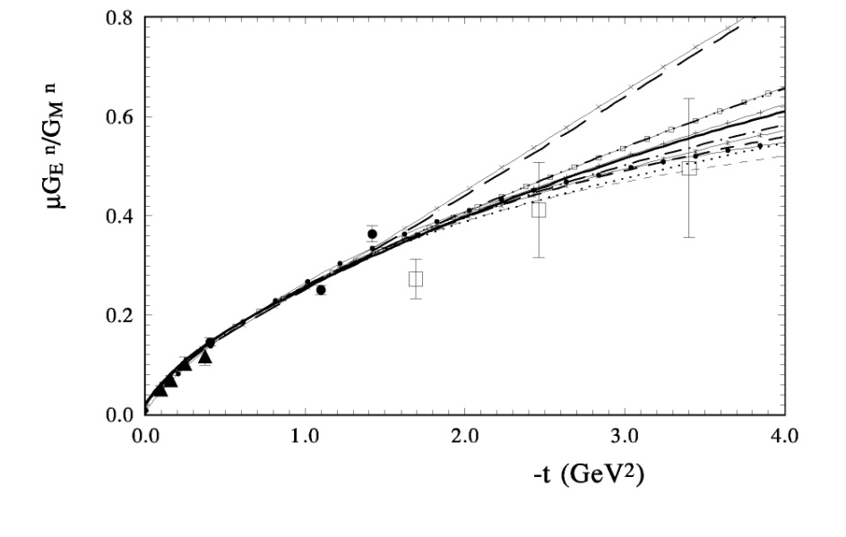
O.V.S., Phys. Rev., D 89, 093007-22, 2014

Slide 22
The differential cross section for that reaction can be written as

Slide 23
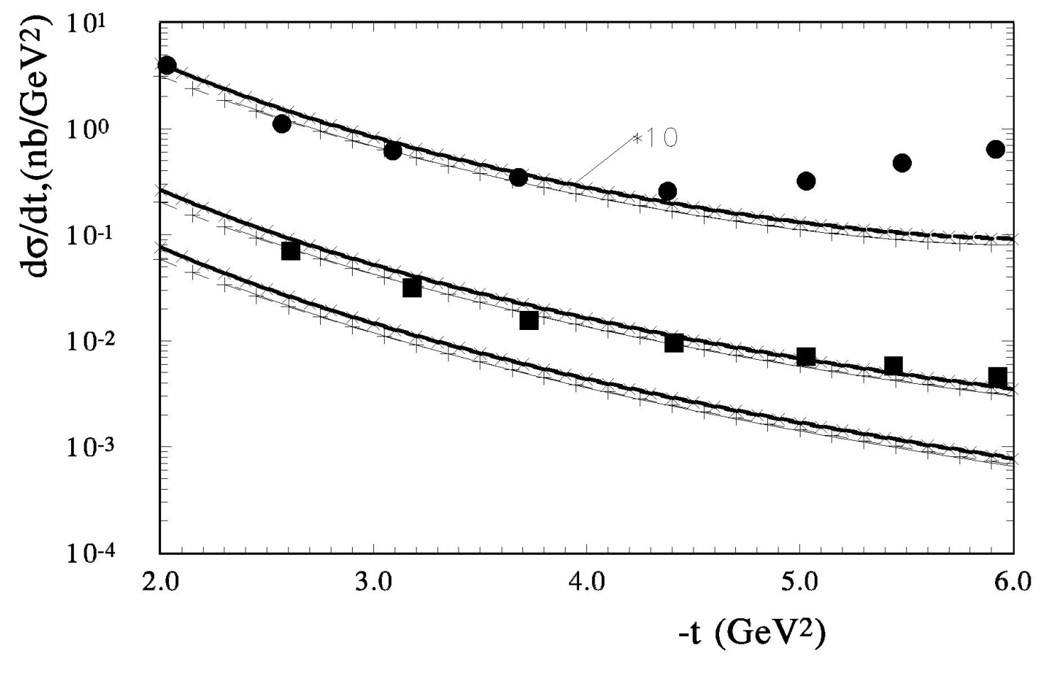
O.V.S., Phys. Rev., D 89, 093007-22, 2014

Slide 24
H. Pagels, Phys.Rev., v.144, (1966)
“Energy-Momentum Structure Form Factors of Particles”
“in analogy to the condition

Slide 26
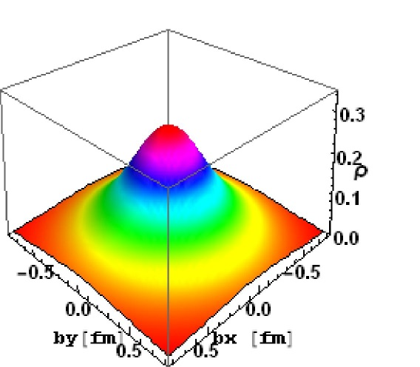
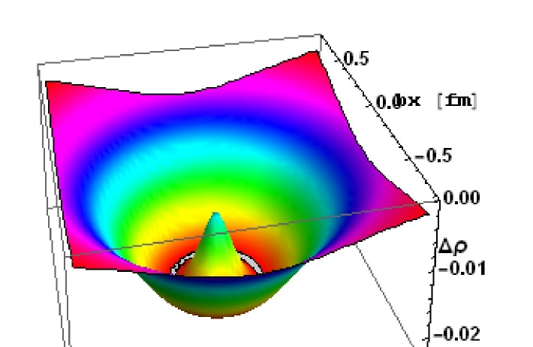
[left] Charge density of u-quark b) [right] charge density of d-quark

Slide 27
O.V.S., O. Terayev, Phys.Rev.D79:033003,2009
Transverse density ρGr_{T} (~b) − ρGr 0 (b)
the difference of the forms of charge density F₁^{P} and matter density (A)

Slide 28
σ_{tot}(s)~
Regge theory
Simple pole – (s/s₀)^{α}
α = 0.08
Landshoff 1984 – soft P
Double pole – Ln (s/s₀)
Triple pole – Ln²(s/s₀) +C
1976 BFKL (LO) - P -α₂ = 0.4
α₂ = 0.45
1988 HERA data (Landshoff ) – hard P
2005 – Kovner – 7 P -α_{ι} = 0. ..0.4. .0.8

Slide 29
Hard Pomeron in the HEGS model calculation
O.V.S., Nucl.Phys. A 903 (2013) 54-64; arxiv[1205.5867]
Donnachie, P.V. Landshoff- arXiv:1112.2485 (hard Pomeron); arxiv[1309.1292] – “Although a satisfactory fit can also be obtained with the hard pomeron included, our results show
that is not necessary.”

Slide 30
t = 0
The Froissart bound

Slide 31
O.V. Selyugin, Phys.Rev. D 91, 113003 (2015)
Обобщенные партонные распределения
Generalized Parton Distributions -GPDs
Electromagnetic form factors
(charge distribution)
Gravitomagnetic
form factors
(matter distribution)

Slide 32
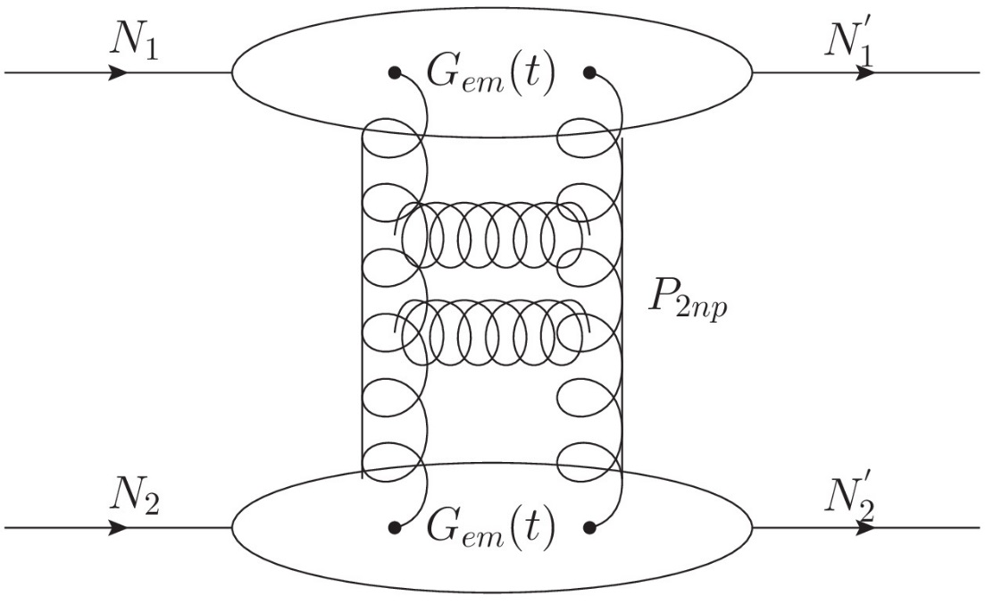
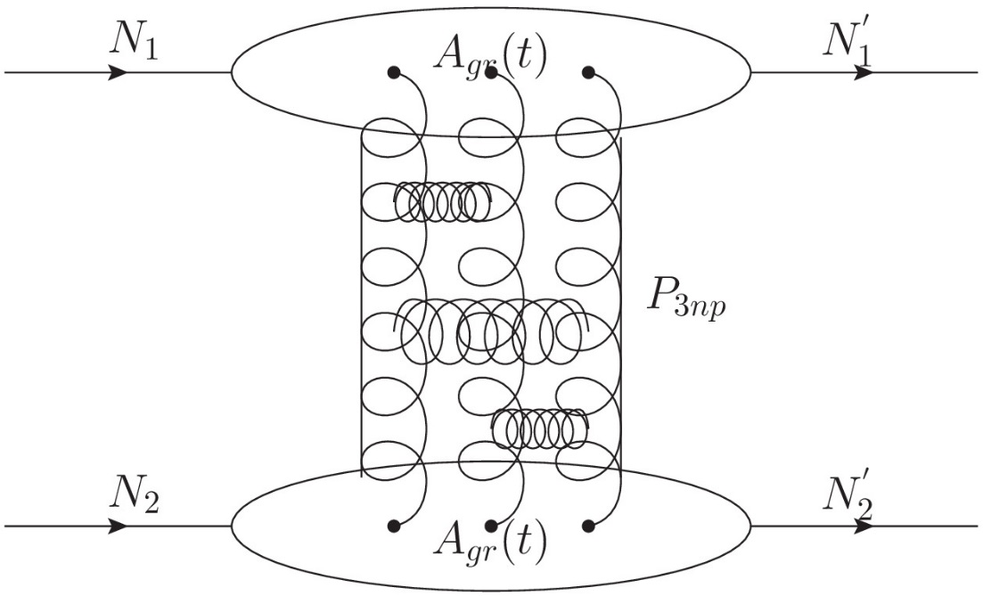

Slide 33
Extending of model (HEGS2) – O.V. S. Phys.Rev. D 91, (2015) 113003
O.V. S., Phys. At. Nucl. V. 87, (2024)

Slide 34
The model used in fitting procedure only statistical errors,
the systematical errors used as additional normalization coefficient which is the same for experimental data of one set.
We do not use the ‘data” of and
As they extract from the differential cross sections with some model approximations.

Slide 35
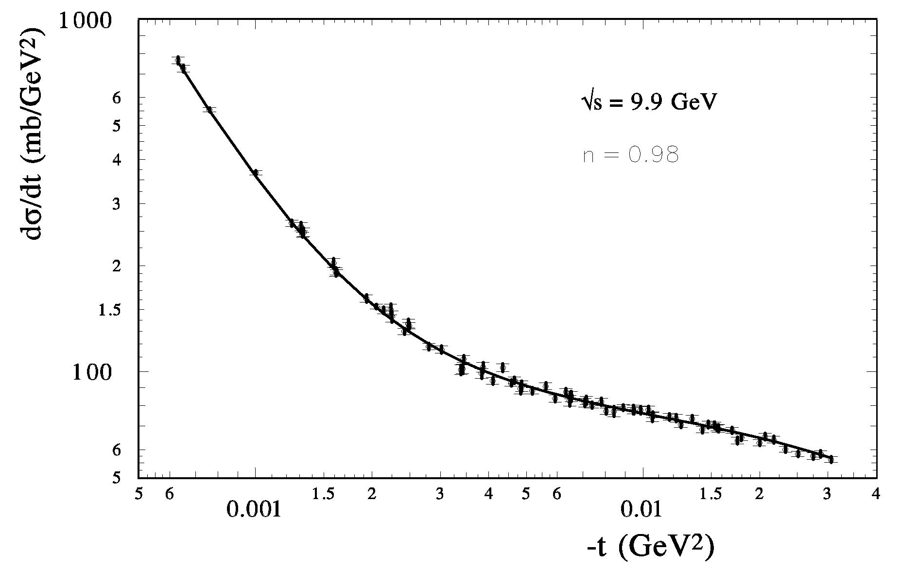

Slide 36
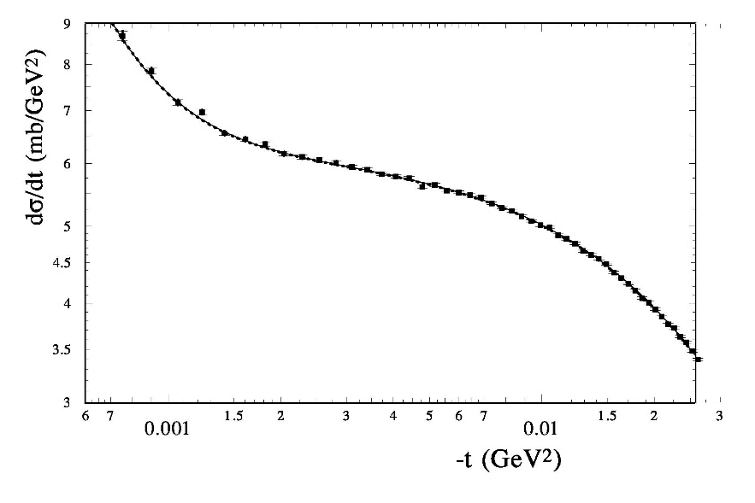
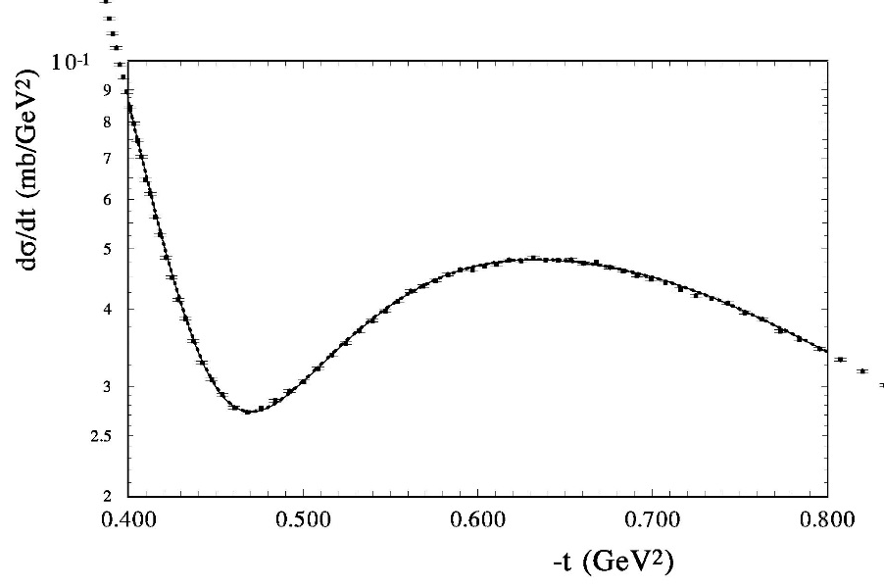
Nemez, talk on workshop , May 28 (2018)

Slide 37
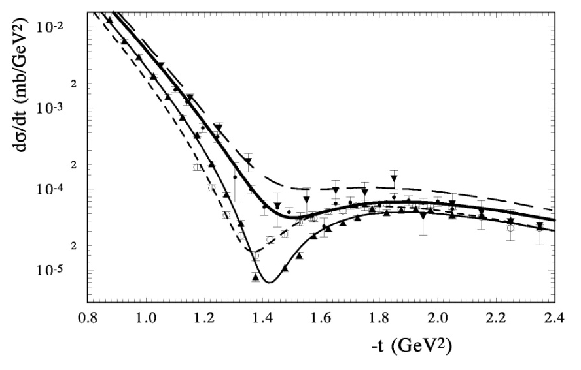

Slide 38
Diffraction (2018) Odderon and LHC data

Slide 39
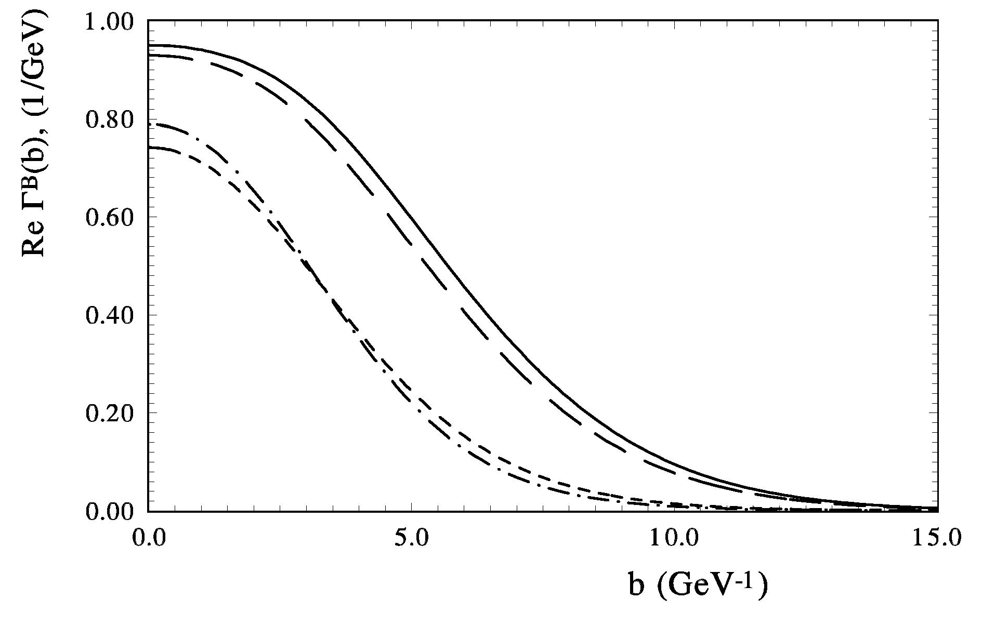

Slide 40
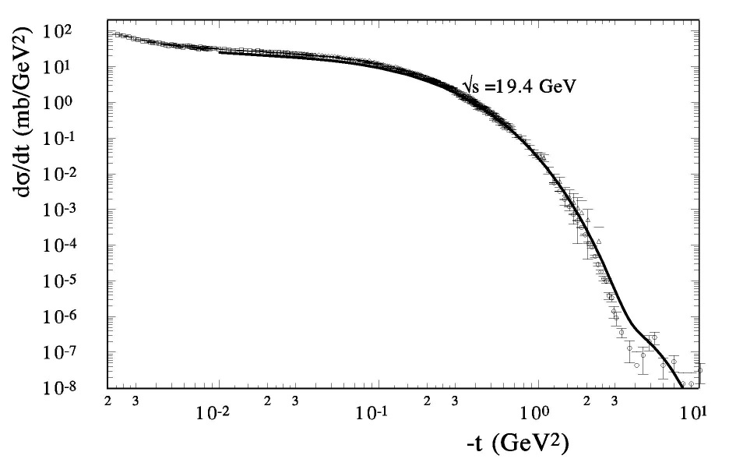
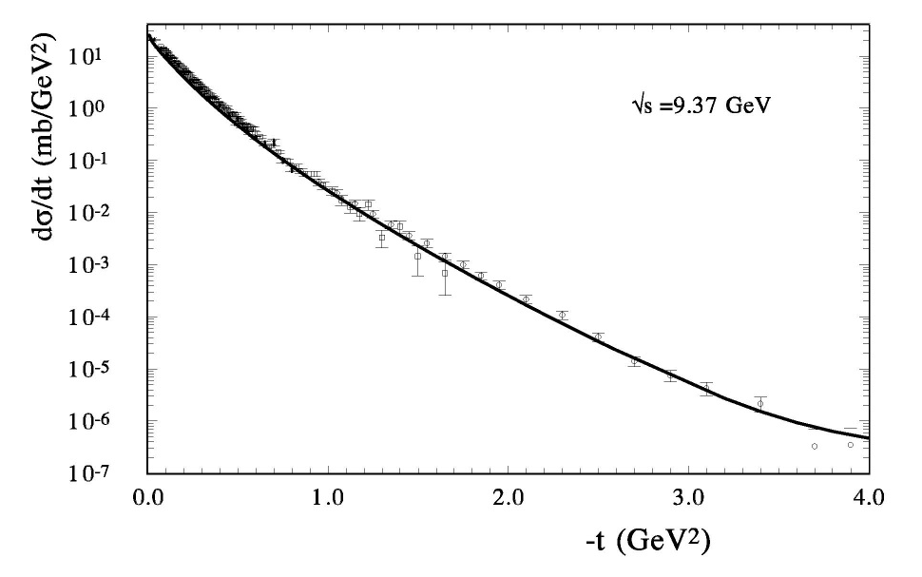
Pion – proton elastic scattering
Pi⁻P
Pi⁺P

Slide 41
Analysing power
9

Slide 42
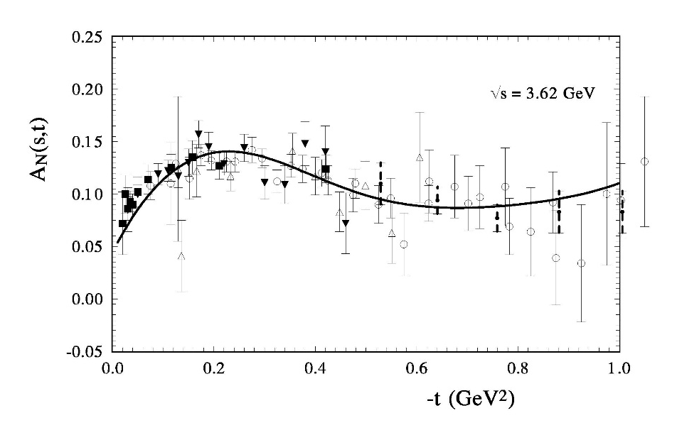
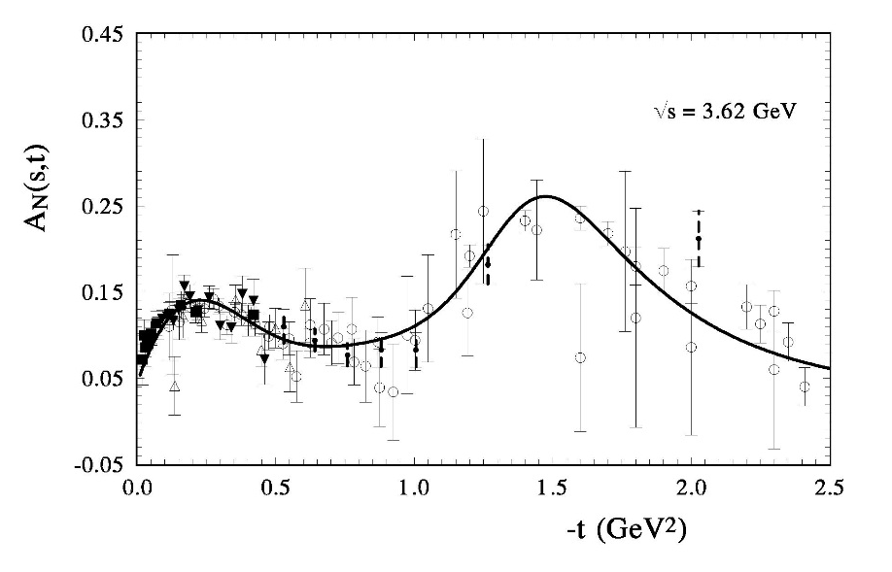
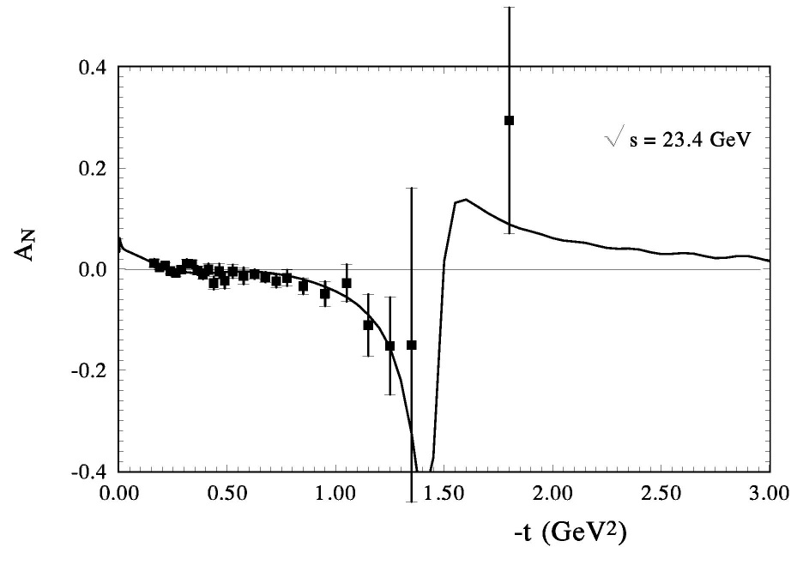
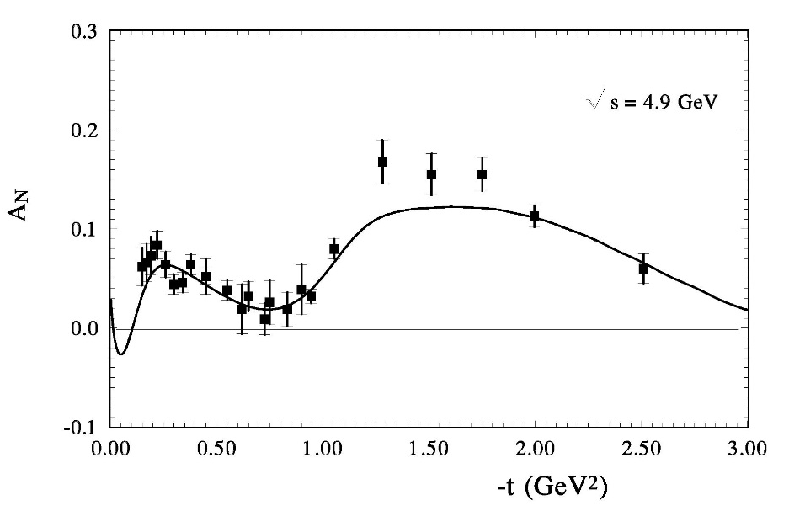

Slide 43
Non-exponential behavior (origins)
1. Non-linear Regge trajectory
a) Contributions of the meson cloud (J.Pumplin, G.L. Kane; O.V.S.)
b) Pion loops (Anselm, Gribov, Khoze, Martin; Jenkovski et al.)
2. Different slopes of the other contributions
(real part, odderon, spin-flip amplitude)
3. Unitarization

Slide 44
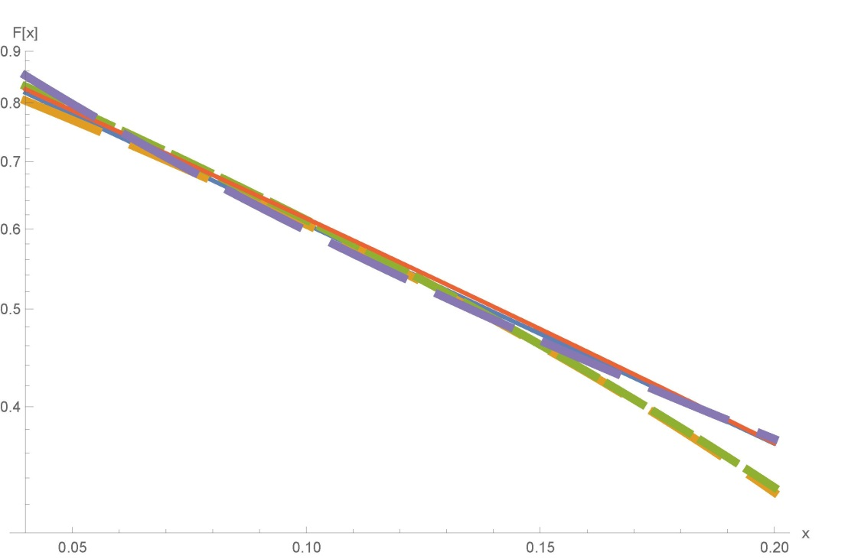
Notes:
Diffraction-2018 (Regio Calabria)

Slide 45
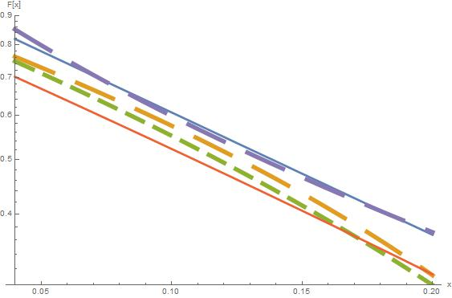

Slide 46

arXiv: 2009.10129 [hep-ph, hep-ex] (2020).
(Mod.Phys.Lett. A)
The result was obtained with a sufficiently large addition coefficient of
the normalization n = 1/k = 1.135. It can be for a large momentum transfer, but
unusual for the small region of t.
Let us put the additional normalization coefficient to unity and continue
to take into account in our fitting procedure only statistical errors.
We examined two different forms. One is the simple exponential form
The parameters of the additional term are well defined
hd = 1.07 ± 0.02 ; d = 0.516 ± 0.018;
$$α$$

Slide 47
The amplitude F_dop(b) in the impact parameter representation
hard line – the real part; dashed line – the imaginary part

Slide 48
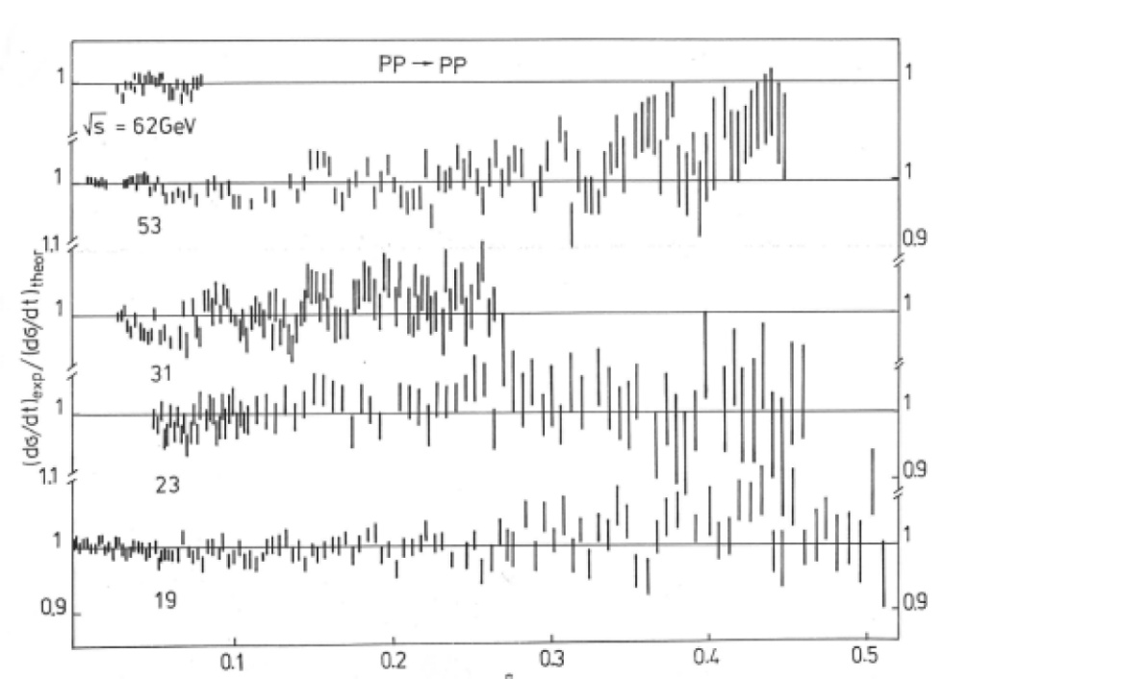
-t GeV²

Slide 49
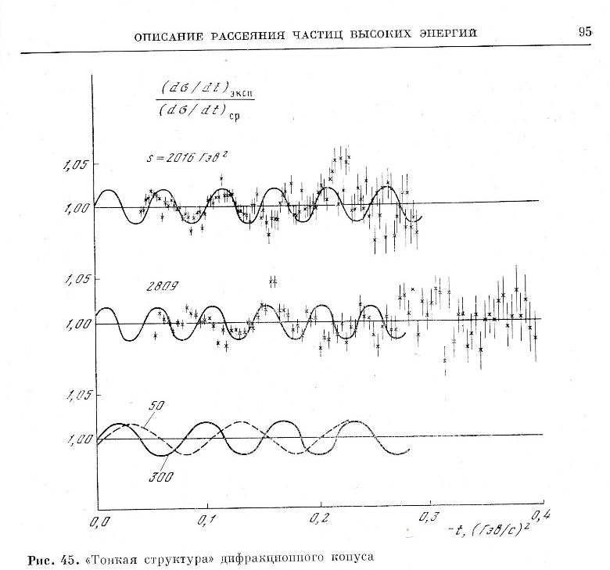
V.A. Tzarev
Model of complex Regge poles
Preprint NAL-Pub-74/17, 1974; DAN-USSR, v.95 (1977)

Slide 50
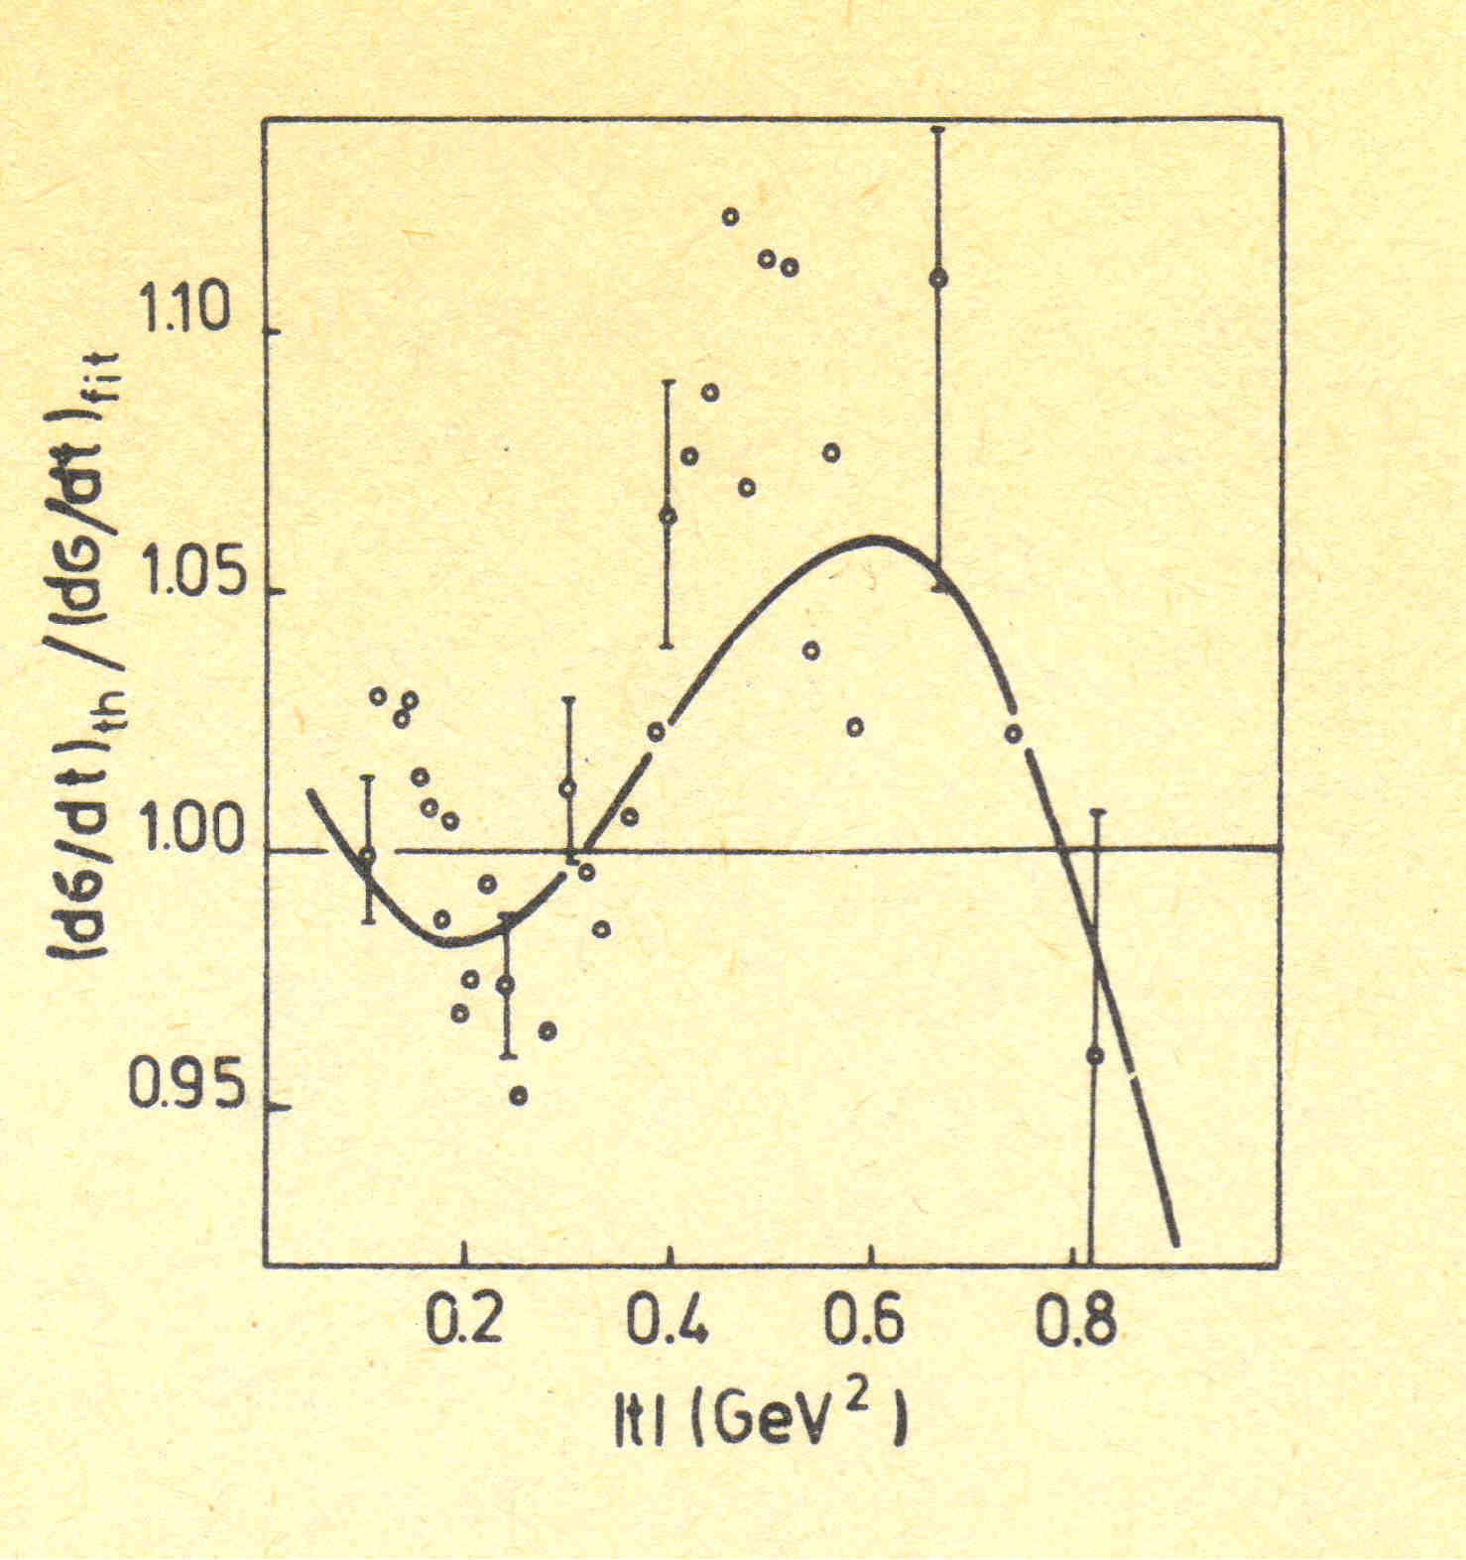
Yu.M. Antipov et al.,
Preprint IHEP (Protvino) 76-95 (1976)
Problem:
Compare non-exponential and
exponential forms
O.V. Selyugin
Int.workshop, Protvino (1982)

Slide 52
Potential of rigid string
O.V. Selyugin
Fit over (q)
Ukr.J. Phys., v.41 (1996)

Slide 53
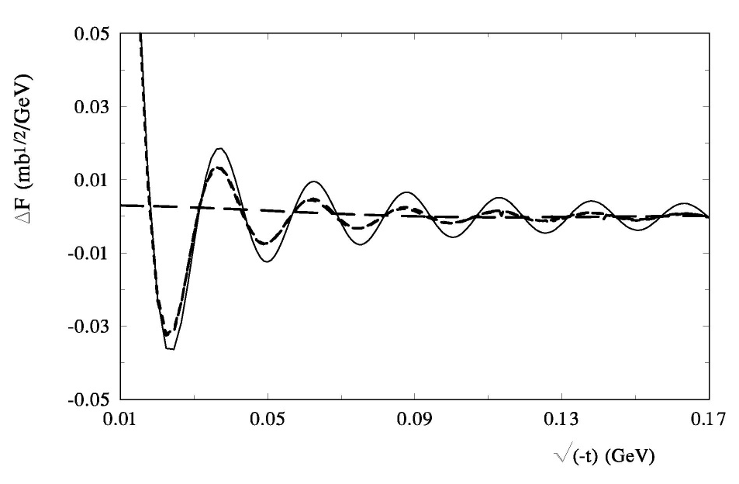
In the case of cutting the potential, for exampleby the θ-function, we shall get a strongly oscillating expression as t →0 with the period, which is approximately proportional t, and with the amplitude, which is suppressed as t grows.
The potentialswith the peculiarities at the determined distance,considered
in A.T. Filippov, Part.&Nucl., 10, (1979) 501.
Using the standard Fourier transform of the potential V (~r), one can
obtain the Born term of the scattering amplitude.
If the potential has the spherical symmetry, the Born amplitude can be calculate as

Slide 54
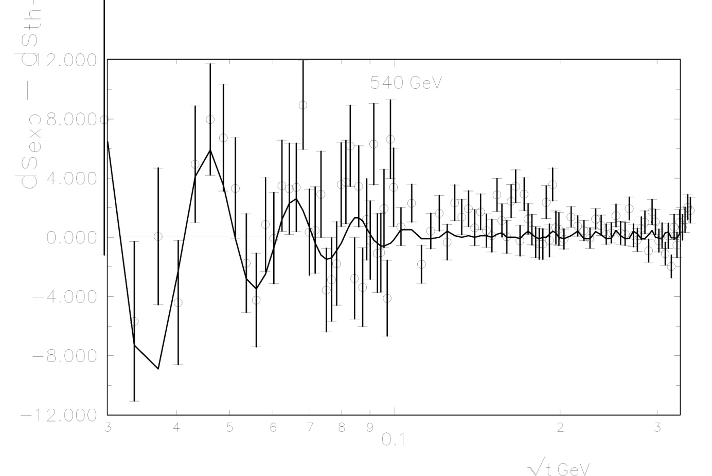
Experimental data UA4/2

Slide 56
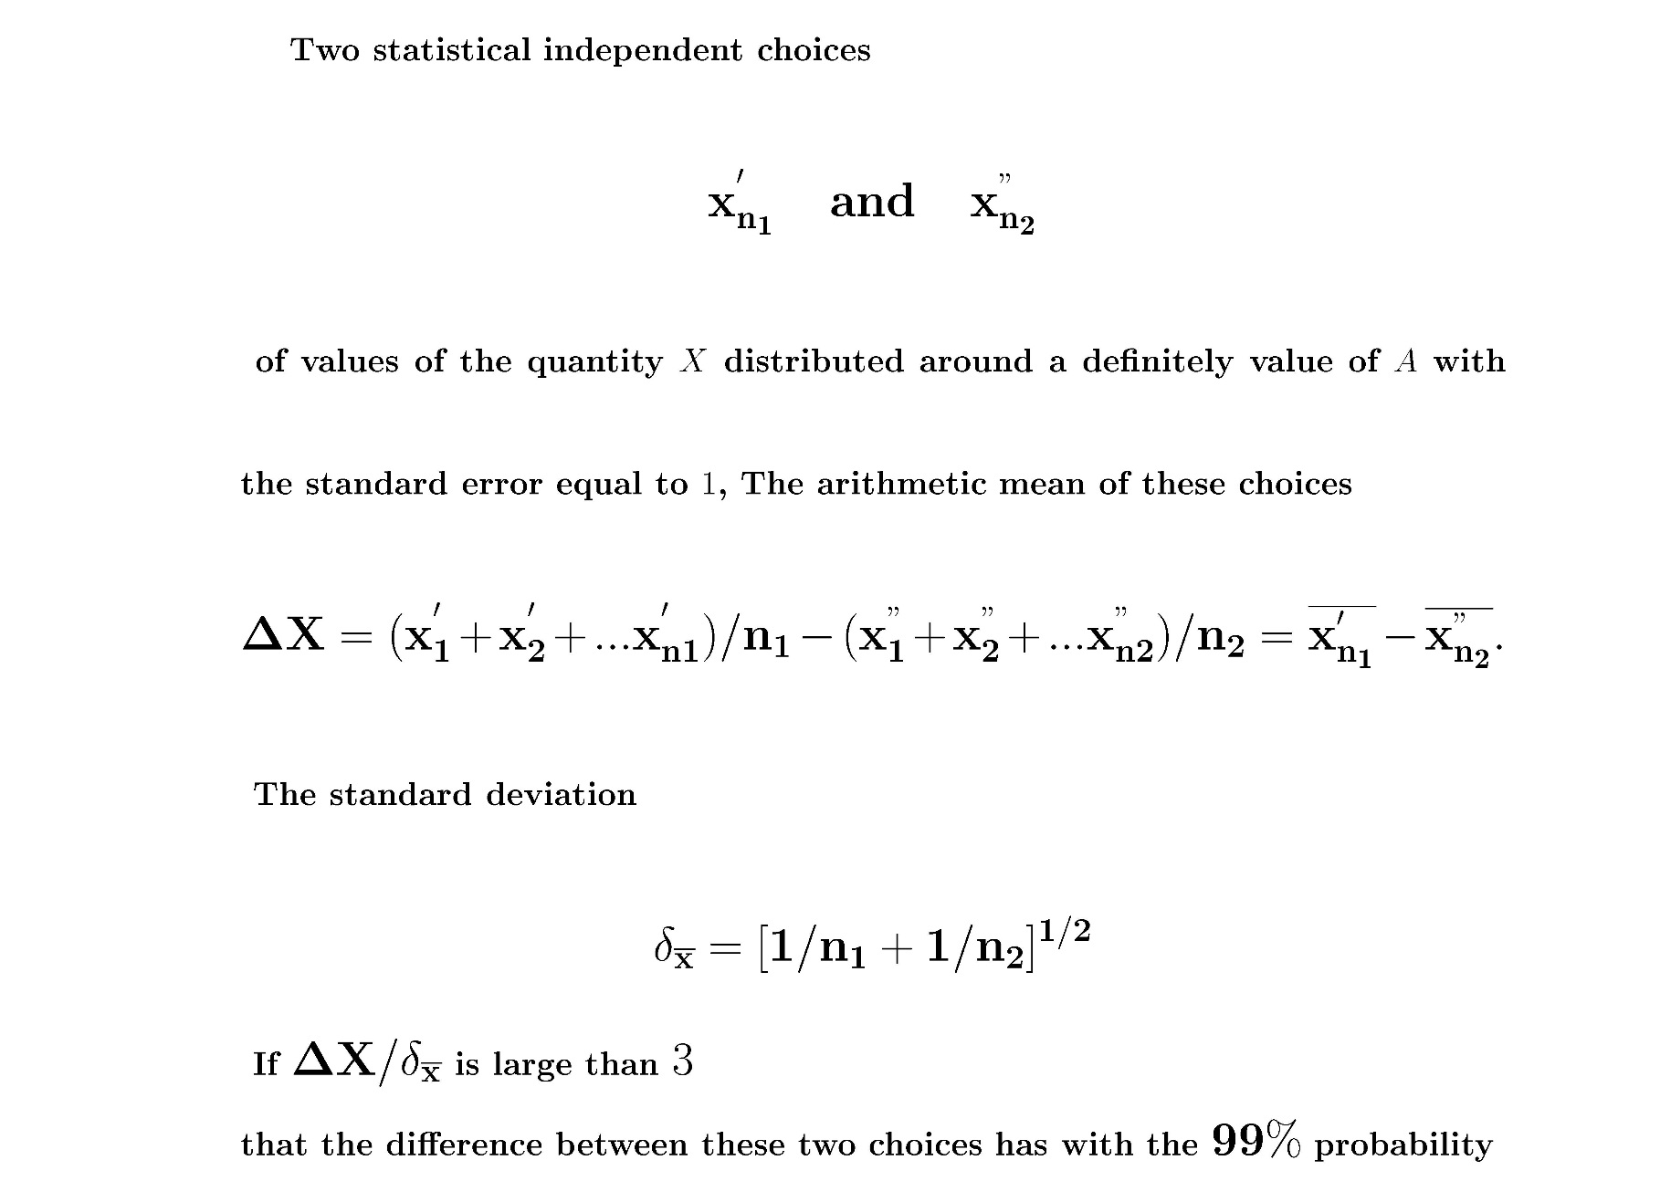

Slide 57
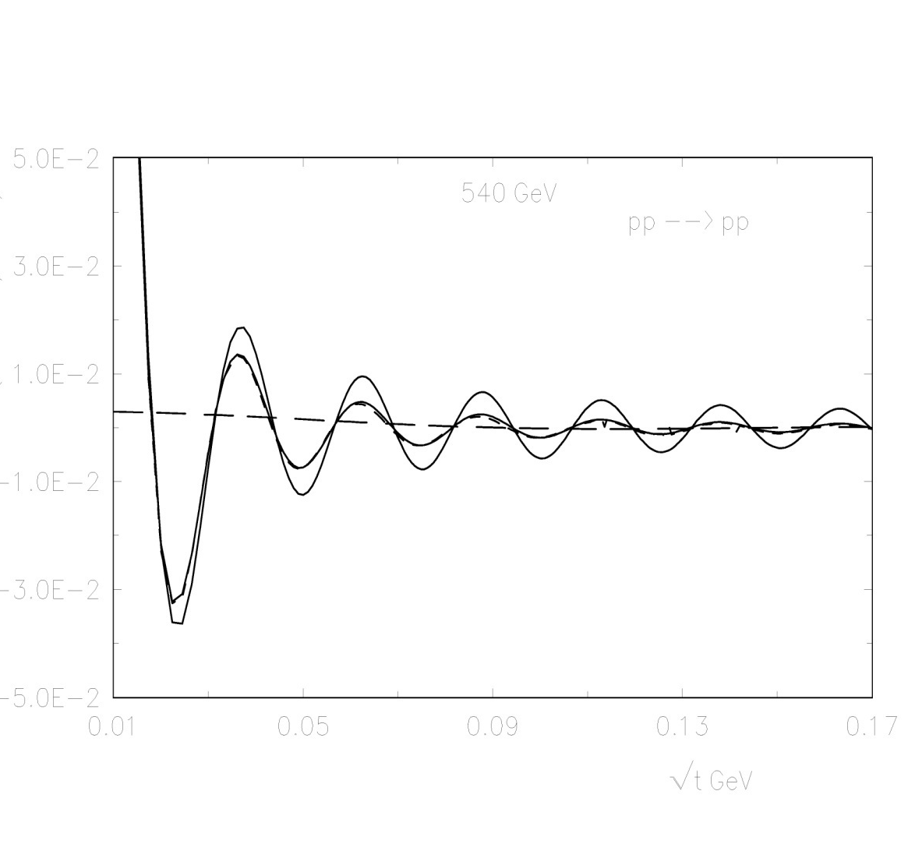
1 1 1 1 1 1 1
2 2 2 2 2 2 2

Slide 58
Statistical analysis

Slide 59
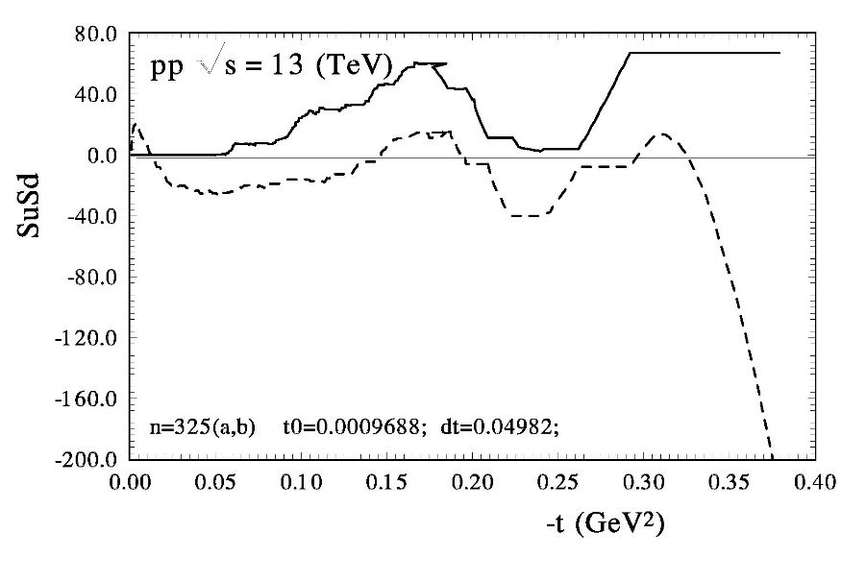
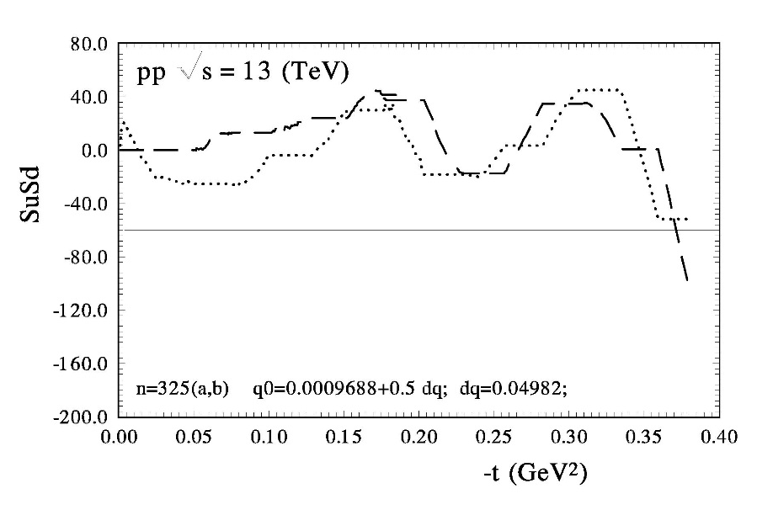
O.V. Selyugin, Phys.Lett. B 797, 134870 (2019).

Slide 60
HEGS model analysis
Results:
with F(osc)
Witout F(osc)

Slide 61
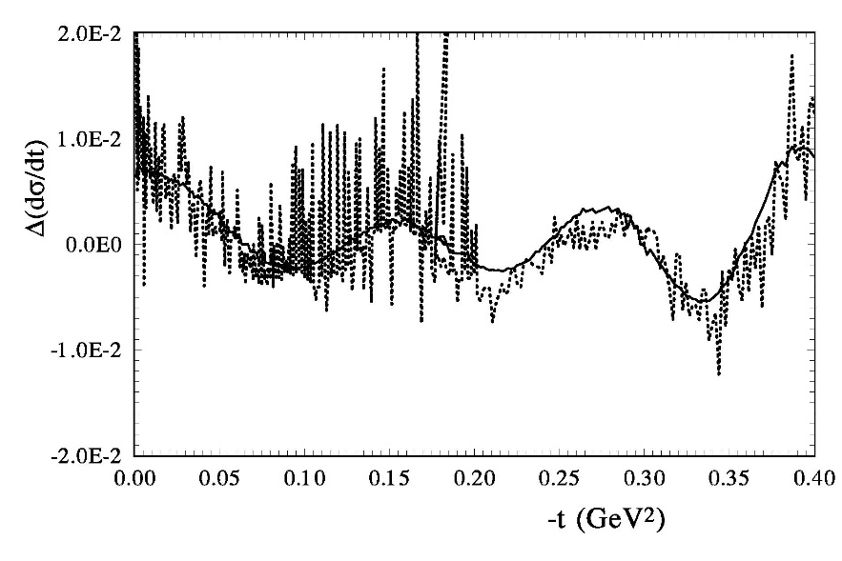
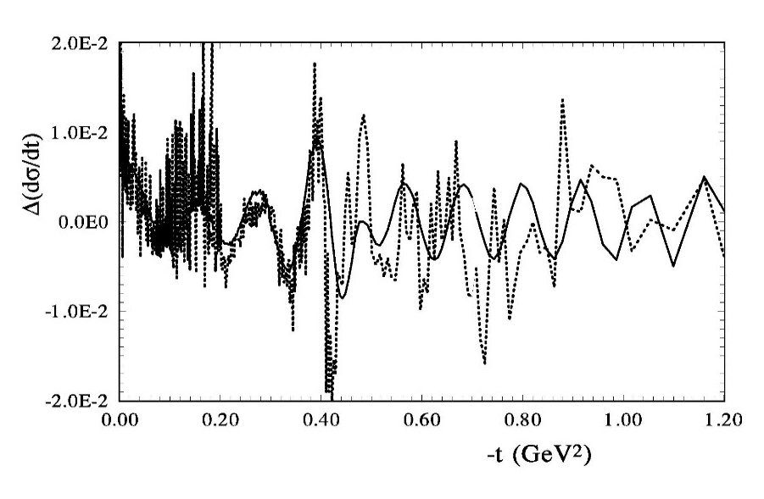

Slide 62
K. Chadan, A. Martin: “Scattering theory and dispersion relations for a class of long-range oscillating potentials”, CERN (1979)
2. a) Van-der-Waals potential V_{ad} ~ h/r⁴
b) F. Ferrer, M. Nowakowski (1998)
(Golstoun boson – long range forces) V_{ad} ~ h/r³
3. S-L interaction
N-dimensional gravipotential (ADD-model) Oscillations”- I. Aref’eva [1007.4777:arXiv-hep-ph]
Universal scenario?

Slide 63
outcome
The new Regge-eikonal model of hadron interaction based
on the analyticity of the scattering amplitude
with taking into account the hadron structure.
The main features of the model are:
a unique energy dependence of the basic asymptotic terms of the Born amplitude
(all Born terms have one fixed intercept) and fixed slopes;
the real part of the hadronic elastic scattering amplitude is determined only
through the complex Mandelstam variable S, satisfying the dispersion relations;
The elastic scattering reflects the generalized structure of the hadron. The model
use of two fixed forms of factors determined by different momenta of the same
Generalized Parton Distribution (GPDs).
The model used in fitting procedure only statistical errors,
the systematical errors used as additional normalization coefficient which is the same for experimental data of one set.

Slide 64
An additional term with large slope is require for the quantitatively
description of the experimental data in the case of the standard normalization of 13 TeV data. The analysis of whole sets
of high energy experimental data support the existence such anomalous term
The experimental data show some periodical structure in the Coulomb-hadron interference region of t and in a wide energy region.1
The small period of the “oscillation” is related with the long hadron screening potential at large distances
The non-fitting (statistical) method can show the existence of some oscillations in the differential cross sections and help to check the values of B, ρ ,
In the framework of the model the contribution
of the hard pomeron do not feeling.
The extending variant of the model shows the contribution
of the “maximal” odderon with specific kinematic properties.
Its contribution is important at 13 TeV.

Slide 65
The model shows the small contribution of the energy independence
spin-flip amplitude . (It is require the further researches
with take into account the polarization data)
We do not see the contributions of the second Reggions with large slope and intercept essentially above 0.6 (near 0.8).
More experimental data in the Coulomb-hadron interference region are needed. [NICA (low energy) and LHC(high energy)] .
It is crucial that the experiments measure – and simultaneously.
The forward experiments at NICA can give valuable information for the improvement of our theoretical understanding the strong hadrons interaction.
This is especially true for the experiment at NICA with polarized beams.
The calculations of the model are used in the works under the grant of RSF
for the theoretical preparation of experiments at the NIKA research center.
THANKS For your attention

Slide 66
Спасибо за внимание

Slide 67
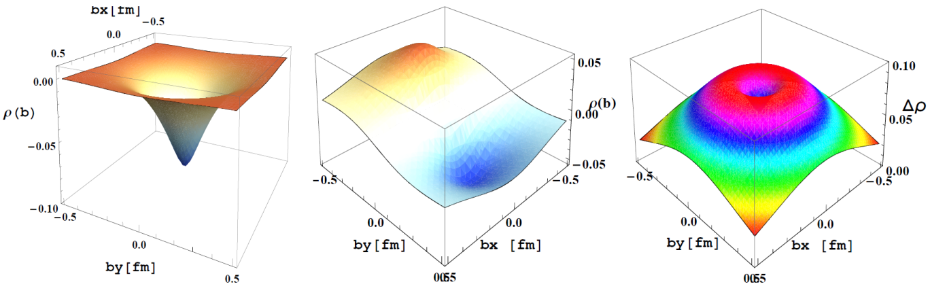
Quark transverse charge density ρ^{n}₀(b) (left);
the angle dependence of the transverse charge density distribution of the proton ρ^{p}_{T}(b)-ρ^{p}₀(b )(middle);
the difference of the forms of charge density F₁^{P} and matter density (A) (right).

Slide 69
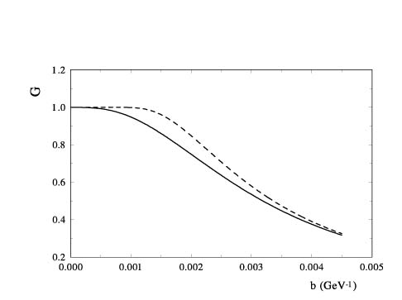
UNITARIZATION → eikonal representation

Slide 70
General Parton Distributions (GPDs)
Sanielevici-Valin (1984) –Valon model – Phys.Rev.D29 (1984).
“matter form factor” (MFF) measures the interaction of a gluonic probe with the excited matter of the overlapping hadrons and should incorporate the static matter distributions of the participating hadrons…”

Slide 71
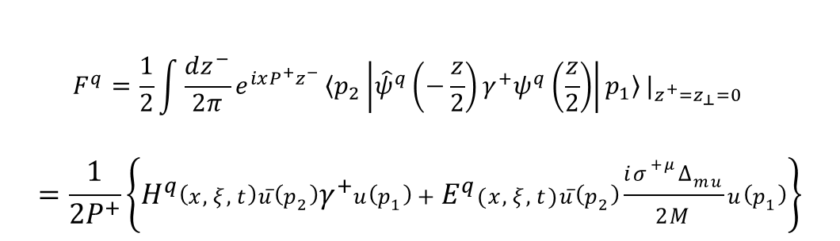
Общенные партонные распределения
General Parton Distributions (GPDs)
Можно определить как Фурье-преобразование нелокального матричного элемента
$$F^{q}=\frac{1}{2}\int{\frac{dz^{−}}{2π}}e^{ixP^{+}z^{−}}{〈p_{2}\left|{\hat{ψ}}^{q}\left(−\frac{z}{2}\right)γ^{+}ψ^{q}\left(\frac{z}{2}\right)\right|p_{1}〉|}_{z^{+}=z_{⊥}=0}$$
$$=\frac{1}{2P^{+}}\left\{H^{q}\left(x,ξ,t\right)\overline{u}\left(p_{2}\right)γ^{+}u\left(p_{1}\right)+E^{q}(x,ξ,t)\overline{u}\left(p_{2}\right)\frac{iσ^{+μ}∆_{mu}}{2M}u\left(p_{1}\right)\right\}$$

Slide 72
Screening long range potential

Slide 73
GPDs
Общенные партонные распределения
General Parton Distributions (GPDs)
X.Ji Sum Rules (1997)
H^{q}(x;t) = H ^{q}(x,0,t) + H ^{q}(-x,0,t)
E^{q}(x;t) = E ^{q}(x,0,t) + E ^{q}(-x,0,t)

Slide 74
M. Polyakov, Phys.Lett., B555 (2003);
K. Goeke, … M. Polyakov, Phys.Rev. , D78 (2008)
“Nucleon form-factors of the energy momentum tensor in CQSM model

Slide 75
Our ansatz
O.V.S., O. Terayev, Phys.Rev.D79:033003,2009
Found.Phys.40:1042,2010
1. Simplest;
2. Not fare from Gaussian representation
3. Satisfy the (1-x)^{n} (n>= 2)
4. Valid for large t
q(x) is based on the MRST2002

Slide 76
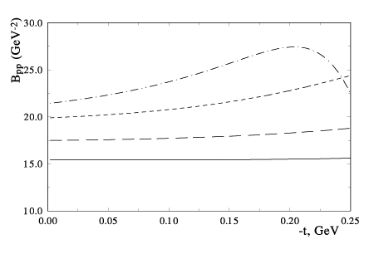
Slope of the differential cross sections
Eikonal represantation

Slide 77
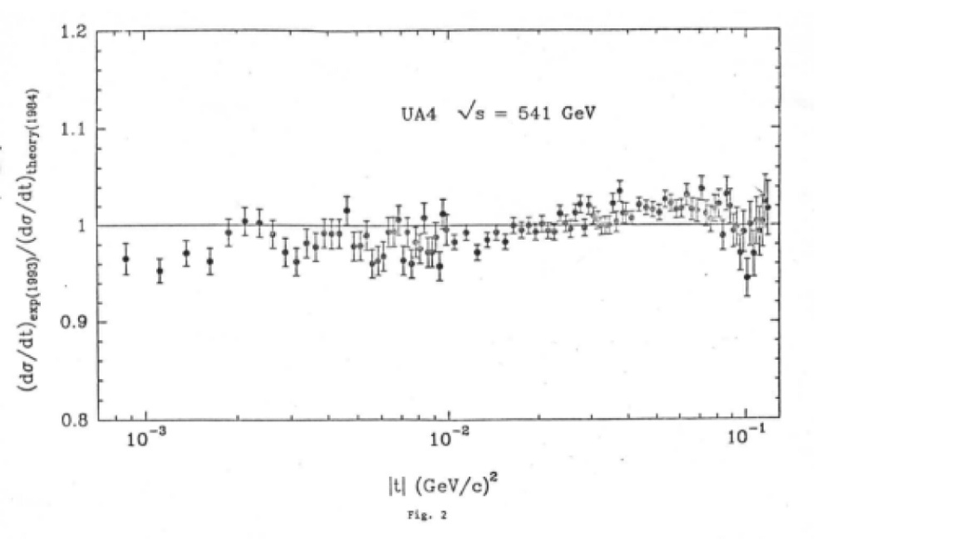

Slide 79
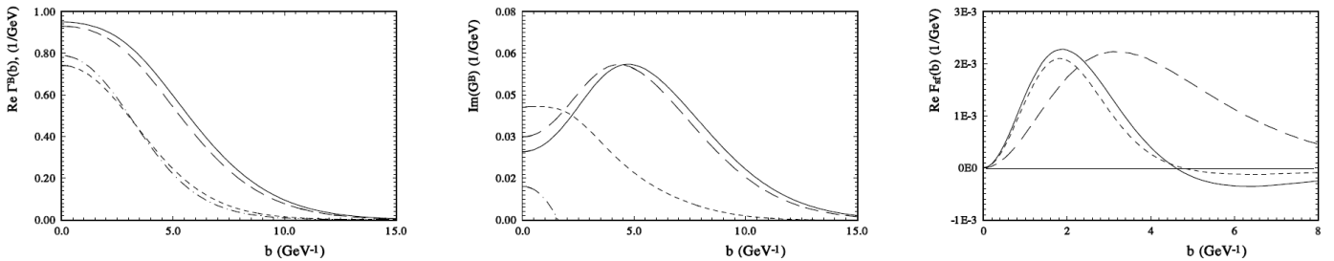
The profile function Г(s,b): the real part (left) and imaginary part (middle)
at energies s=9.8 GeV (dashed line), s=52.8 GeV (dash-dotted line),
s=7 TeV (long dashed line), s=14 TeV (solid line).
he spin-flip amplitude in the b- representation (right) (solid line - eq.(12),
dashed line - eq.(13) long dashed line - with q factor and normal exponential form

Slide 80
BSW_1 | BSW_2 | AGN | MN | HESG0 | HESG1
369 | 955 | 1728+238 | 2600+300 | 980 | 3090
7+Regge | 11 | 36 | 36+7 | 3+2 | 6+3
23.4-630 | 13.4 -1800 | 9.3-1800 | 5-1800 | 52-1800 | 9-7000
 | 0.1 - 5 | 0,1- 2.6 | 0.1- 16 | 0.000875- 10 | 0.00037- 15
4.45 | 1.95 | 1.16 | 1.23 | 2. | 1.28
N_exp.
n_par.

Slide 81
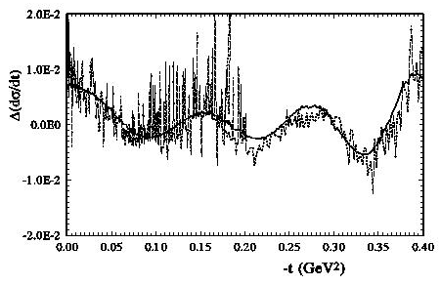

Slide 82
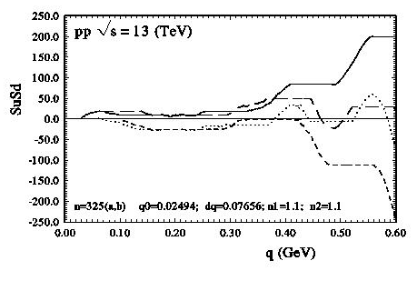
O.V. Selyugin, Phys.Lett. B 797, 134870 (2019).

