Slide 1
On Hyperon Production and Polarization in HIC
G. Musulmanbekov
genis@jinr.ru

Slide 2
Content
Motivation
Strangeness Enhancement: From subthreshold yield of K⁺-s to ‘Horn’-effect
New interpretation of Strangeness Enhancement
Hyperon Polarization in HIC
Global Polarization of Hyperons
  Effects of Strong magnetic field in HIC
  Effects of Angular Momentum and Vorticity in HIC
Conclusion
Notes:
In heavy ion collisions, and in particular when a QGP is formed, it has long been predicted
that there should be no polarization [9–11]. The essence of the models is that when a QGP has
been formed, a hyperon (for example, a ) would be formed by coalescence of three random
u, d and s quarks. The spins therefore have no preferred axis, and there is no net polarization.

Slide 3
Does a Phase Transition take place in central Heavy Ion Collisions (HIC)?
Which one of the following scenario is realized?

Slide 4
Mixed Phase? Critical Endpoint?
T
Quark-
Gluon
Critical endpoint ?
Plasma
Chiral symmetry
restored
Hadronic
matter
1st order line ?
Chiral symmetry
broken
Colour
superconductor
Nuclei
Neutron stars
μ_{B}

Slide 5
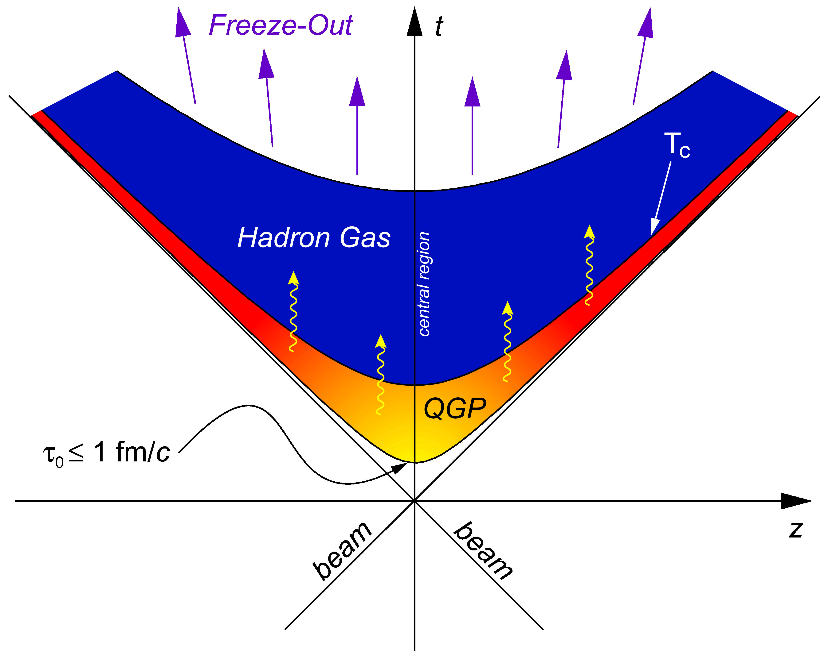

Space-time Evolution of HIC
~ 10 fm/c
?
Notes:
The question is ‘Does transition from HP to QGP is realized in HIC and does CP exist?’
If yes, “Does NICA-FAIR energy range cover CP?”,
If not, “Which states of nuclear matter we observe in low SPS energies?”

Slide 6
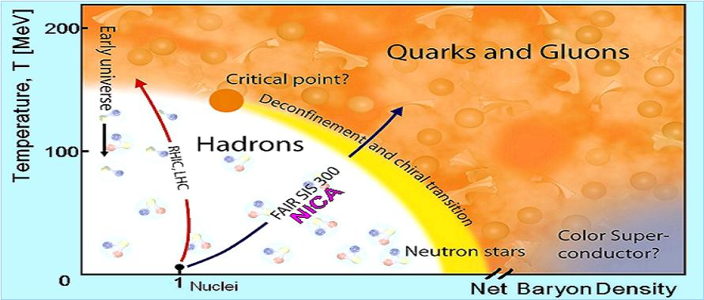
Phase diagram – artist’s view
L-G
●
Phases of strongly interacting nuclear matter

Slide 7
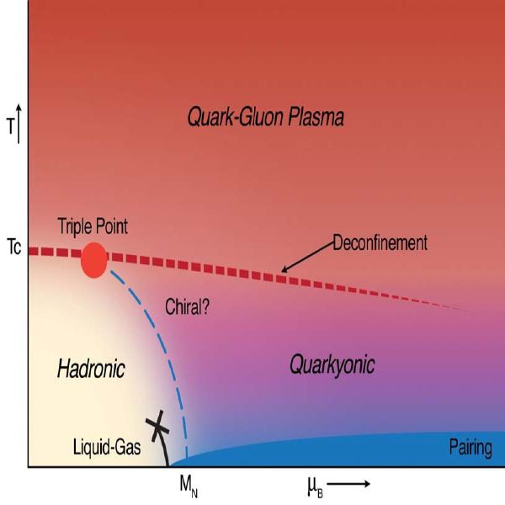
Phase diagram with triple critical point
●

Slide 8

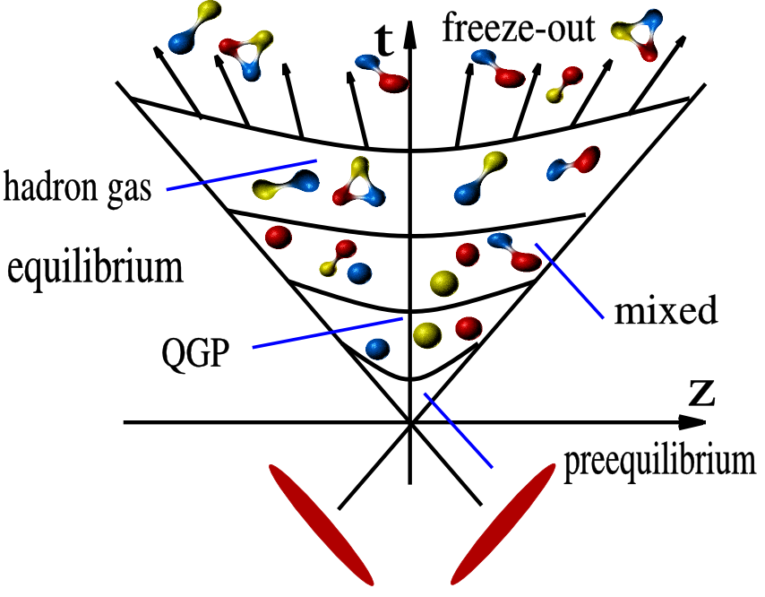
Space-time Evolution of HIC
expansion

Slide 9
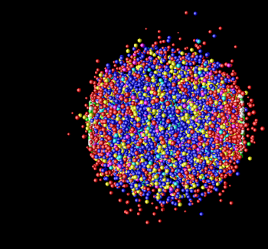
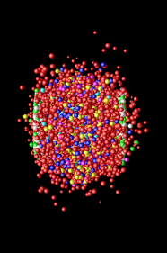
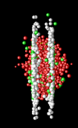
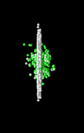
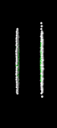
Space-time Evolution of HIC
time
π
π
p
K
π
π
Λ
γ
jet
J/Ψ
γ
e
Freeze-out
→ Expansion →
Hadron-Resonance
Gas
Hard Scattering
space
Au
Au

Slide 10
What are we searching for?
Signatures of phase transition and/or mixed phase
QCD critical (triple)endpoint
Onset of chiral symmetry restoration at high ρ_{B}
The equation-of-state at high ρ_{B}

Slide 11
Observables
Signatures of phase transition and/or mixed phase
excitation function of particle yields and ratios (π, K, Λ, Σ, Ξ, Ω)
transverse mass spectra of kaon
particle correlations
QCD critical endpoint
excitation function of event-by-event fluctuations (multiplicities, K/π, transverse momenta, …)
Onset of chiral symmetry restoration at high ρ_{B}
dilepton yield (ρ, ω, φ → e+e-(μ+μ-))
The equation-of-state at high ρ_{B}
collective flow of hadrons
strange particle production at a threshold

Slide 12
Signatures of phase transition
and/or mixed phase
PT in HIC is not stable state but transient one
PT evolves in finite space/time
● There is not a crucial signal of PT
● Every signal is essentially washed out due to subsequent interactions

Slide 13
Excitation function of particle yields and ratios (π, K, Λ, Σ, Ξ, Ω)
Energy range: √s = 2 – 11 GeV most interesting!
Enhanced yield of K⁺
experiments: KaoS at SIS, AGS, NA49
Horn Effect (irregular behaviour of K⁺/π⁺ )
Kink in Inverse Slope of Kaon p_{t} Distributions
experiments: NA49, STAR (BES RHIC program)

Slide 14
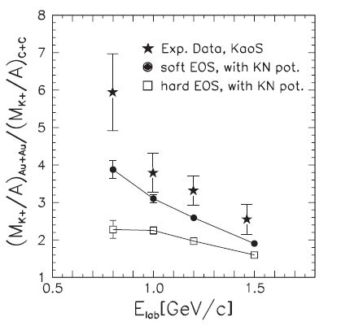
Enhanced yield of K⁺ in subthreshold kaon production
Transport models with NN-interactions
underestimate yield of K⁺ by a factor of 6
overestimate yield of K⁻
KaoS at SIS
J. Phys. G: Nucl. Part. Phys. 27 (2001) 275
RQMD:
K⁺ N repulsive potential
K⁻ N attractive potential
Momentum dependent Skyrme forces
Compression parameter
  soft – 200 MeV
  hard – 380 MeV
Notes:
Calculations were performed with two values for the compression modulus: =
200 MeV (solid line) and = 380 MeV (dashed line) corresponding to a “soft” or to
a “hard” nuclear equation-of-state, respectively. The RQMD transport model takes
into account a repulsive K+N-potential and uses momentum-dependent Skyrme forces
to determine the compressional energy per nucleon (i.e. the energy stored in the
compression).
K+ yield is sensitive to the EOS with increasing system mass and with decreasing beam energies.

Slide 15
Excitation functions of K⁺/π⁺, K⁻/π⁻ and (Λ+Σ⁰)/π ratios
Phys.Rev. C69 (2004) 015202 PRL 92 (2004) 013302
Clear evidence for “horn” structure in K+/pi+ and Lambda/pi+ at ~30 A GeV !
Non-horn structure in K-/pi-
“horn” is not reproduced by hadronic transport models
New degrees of freedom?

Slide 16
Inverse T slopes of K⁺ and K⁻ spectra
Phys.Rev. C69 (2004) 015202 PRL 92 (2004) 013302
Inverse slope is not reproduced by hadronic transport models
New degrees of freedom?

Slide 17
Is ‘horn’-effect a signal of PT?
J. Rafelski, Phys. Rep. 88 (1982) 331
Strangeness as a good signal of deconfinement
Strangeness production
In a hadronic matter:
N+N -> N+Λ+K requires ΔE = 670 MeV
π+N -> Λ+K requires ΔE = 535 MeV
In QGP
- quarks requires ΔE = 300 MeV - cheaper !
Notes:
The data can be interpreted in the framework of the Statistical Model of the Early Stage (SMES) [8]. In
this model it is assumed that the primordial particle production follows the prescription of statistical equilibrium.
The increase of the hK+i/h+i ratio at low collision energies is a consequence of an enhanced strangeness
content due to a larger energy deposit. The sharp decrease of the ratio above the beam energy of 30 AGeV
is connected with a first order phase transition between hadronic and deconfined phases. The decreasing part
of the excitation function corresponds to the mixture of the two phases, while the flat dependence at high energies
is realized in the deconfined phase.

Slide 18
Models
SMES: with PT M. Gazditzki, M. Gorenstein, 1999.
Thermal-Statistical HRG Model
  P. Brawn-Munzinger, et al. (one-component hadronic core with artificial heavy resonances)
  K. Bugaev, et al. (multi-component hadronic cores)
  Others
Hadronic Kinetic Model E. Kolomeitsev, B. Tomasic
Notes:
The data can be interpreted in the framework of the Statistical Model of the Early Stage (SMES) [8]. In
this model it is assumed that the primordial particle production follows the prescription of statistical equilibrium.
The increase of the hK+i/h+i ratio at low collision energies is a consequence of an enhanced strangeness
content due to a larger energy deposit. The sharp decrease of the ratio above the beam energy of 30 AGeV
is connected with a first order phase transition between hadronic and deconfined phases. The decreasing part
of the excitation function corresponds to the mixture of the two phases, while the flat dependence at high energies
is realized in the deconfined phase.

Slide 19
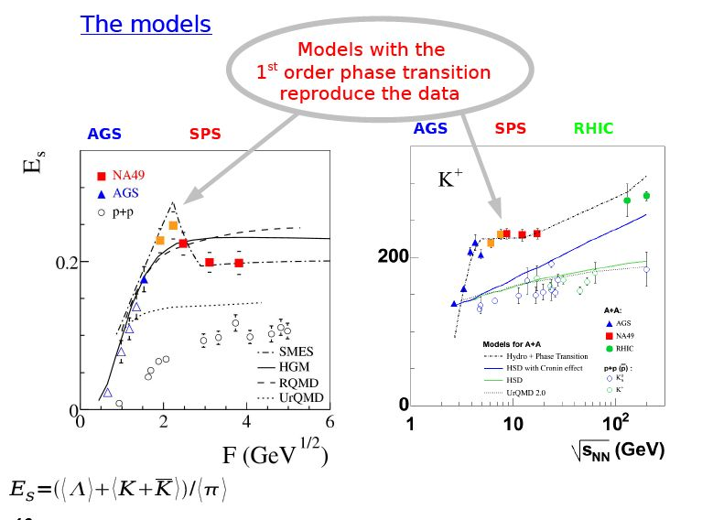
Models
SMES M. Ga´zdzicki, M.I. Gorenstein, Acta Phys. Polon. B 30 (1999) 2705
Notes:
The data can be interpreted in the framework of the Statistical Model of the Early Stage (SMES) [8]. In this model it is assumed that the primordial particle production follows the prescription of statistical equilibrium. The increase of the K+/pi+ ratio at low collision energies is a consequence of an enhanced strangeness content due to a larger energy deposit. The sharp decrease of the ratio above the beam energy of 30 AGeV is connected with a first order phase transition between hadronic and deconfined phases. The decreasing part
of the excitation function corresponds to the mixture of the two phases, while the flat dependence at high energies is realized in the deconfined phase.

Slide 20
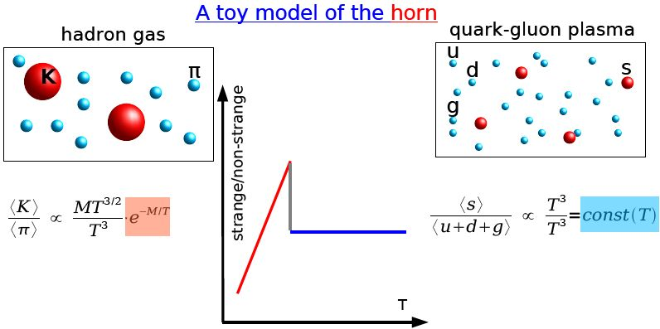
Models
SMES M. Gazditzki, M. Gorenstein
Notes:
The data can be interpreted in the framework of the Statistical Model of the Early Stage (SMES) [8]. In
this model it is assumed that the primordial particle production follows the prescription of statistical equilibrium.
The increase of the hK+i/h+i ratio at low collision energies is a consequence of an enhanced strangeness
content due to a larger energy deposit. The sharp decrease of the ratio above the beam energy of 30 AGeV
is connected with a first order phase transition between hadronic and deconfined phases. The decreasing part
of the excitation function corresponds to the mixture of the two phases, while the flat dependence at high energies
is realized in the deconfined phase.

Slide 21

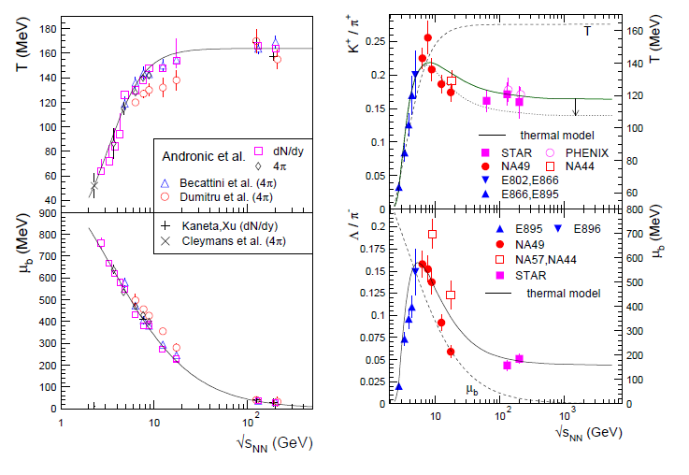
Models
HRG P. Brawn-Munzinger, et al.
One-component, with artificial heavy resonances
parameters are the chemical freeze-out temperature
T, the baryo-chemical potential μ_{b}, and the fireball volume V.

Slide 22
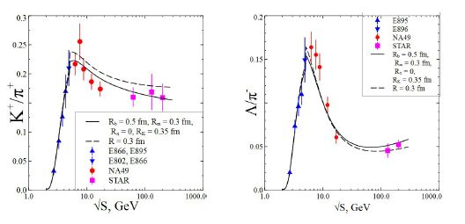
Models
K. Bugaev, et al.
HRG model with multi-component hard-core radii R_{π}, R_{K}, R_{B}, R_{m}

Slide 23
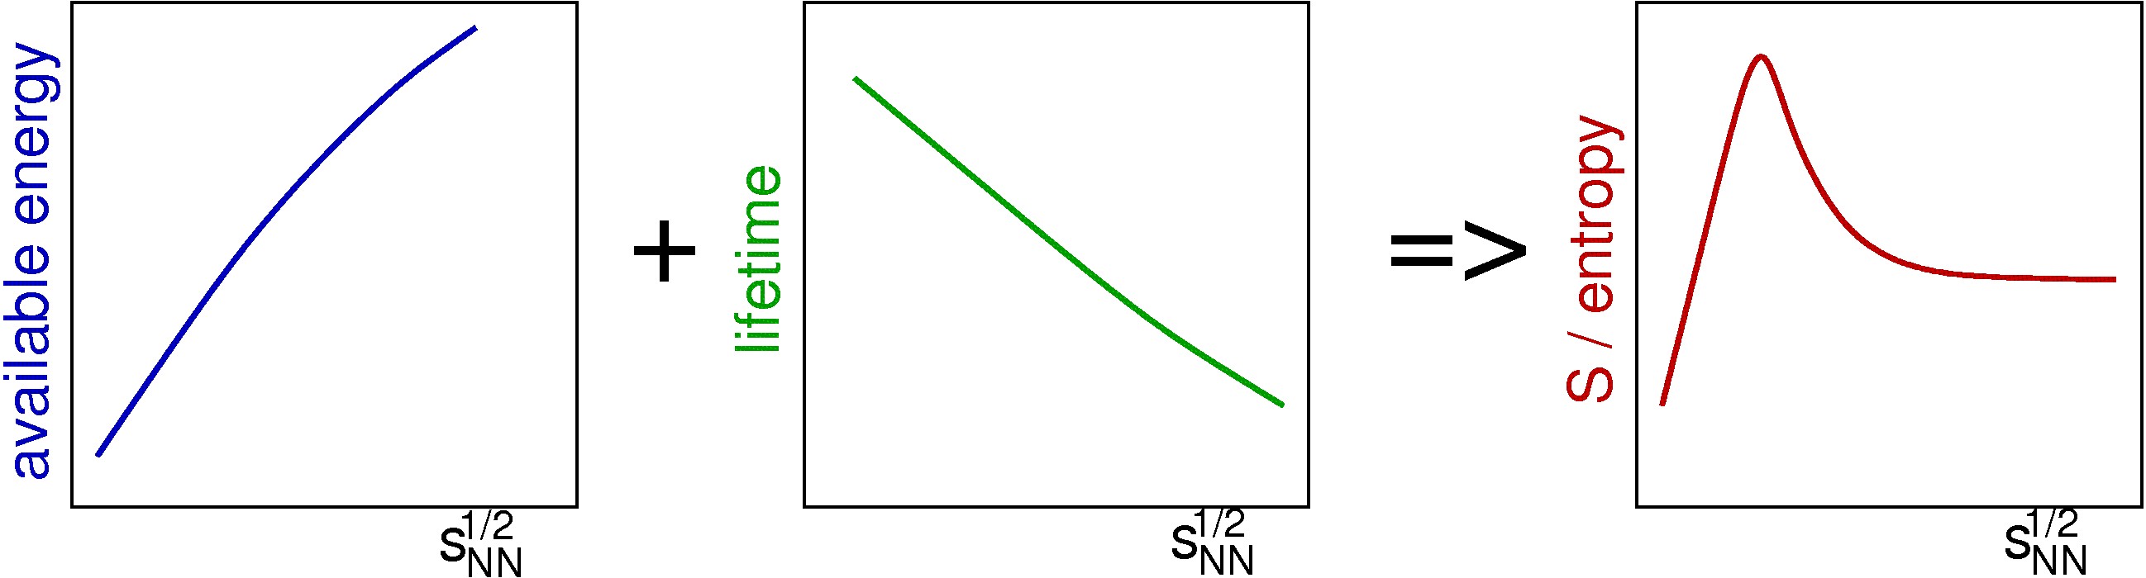
Models
Non-equilibrium Kinetic Model E. Kolomeitsev, B. Tomasik
The strangeness production in a HIC is controlled by
fireball expansion
available energy (energy density) for strangeness production ~ collision energy
temporal evolution of a HIC (fireball lifetime)
Notes:
Our findings are based on the assumption that the lifetime of a fireball becomes shorter as one moves to higher beam energies.

Slide 24
Inputs
Initial K+ content estimated from pp (pn, nn) collisions
Rescattering, production and annihilation in binary collisions
Fireball freezout : fix the final state ε_{FO}, ρ_{B,FO}
Parameters: the initial ε₀ and the lifetime τ_{T}
The time needed for a strangeness production, τ_{T} , is about 15-20 fm/c.
In hydro the typical expansion time is <10 fm/c.

Slide 25
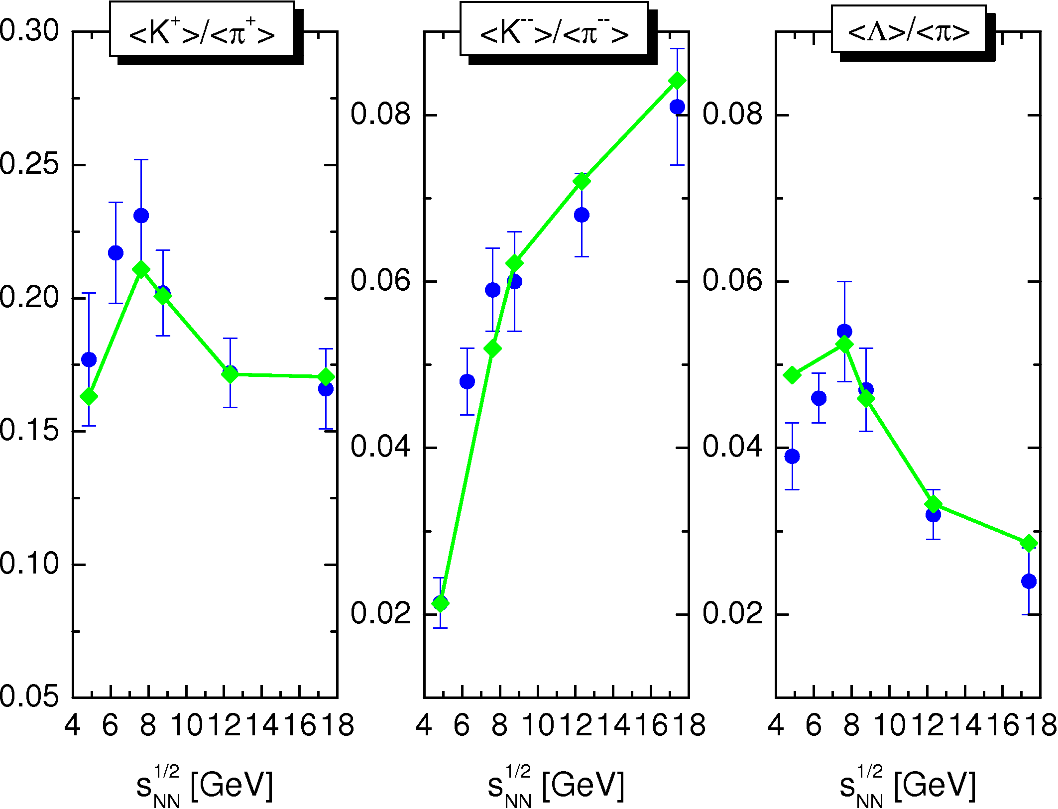
Models
Non-equilibrium Kinetic Model E. Kolomeitsev, B. Tomasik
Notes:
Our findings are based on the assumption that the lifetime of a fireball becomes shorter as one moves to higher
beam energies.

Slide 26
FAIR–NICA Energy Range
“Horn” and “Kink” effects are of most interest!
Are them a manifestation of phase transition from HP to QGP?
Not likely!
Then of what?
How nucleons behave under high compression and do they change their properties? Like ρ, ω, φ.
Conjecture:
Nucleons transit to hypronic states!

Slide 27
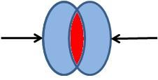
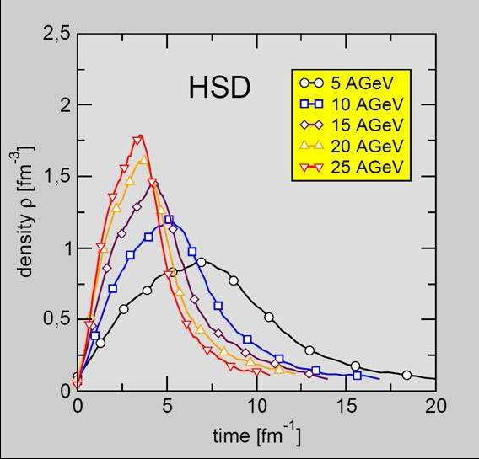
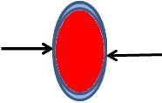
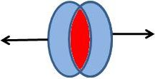
Central HIC
Baryon density evolution
In overlap region nucleons are suppressed and forced to occupy much less space volume.
Overlap time
τ_{O} = [2R_{A}/(γβ)]·b_{SP}
For central AuAu-collisions at energies below ‘horn’
τ_{O} ≥ 1 fm⁻¹
Above ‘horn’
τ_{O} → 0

Slide 28
Nucleon Transition into Hyperon Phase
How do nucleons transform into hyperons?
Inside compressed nuclear matter a strange quark-antiquark condensate is created.
And:
u and d quarks in nucleons are replaced by s quarks and antiquarks binding with the formers form kaons:
p, n → hyperons + kaons
the heavier quark content of a baryon, the less spatial dimensions it occupies
Produced kaons are rejected from the compressed zone

Slide 29
Initial stage of a central fireball formation
Nucleons transformation to hyperons
~ (τ_{O} / τ_{re})^{α} f(ρ)
τ_{O} - overlap time
τ_{re} ~ 1fm⁻¹ - rearrangement time
f(ρ) – nucleon → hyperon probability
Expansion of the central fireball
Non-equilibrium kinetic mechanism
~ 1/λ_{int} ~ ρσ_{hN}
λ - mean free path
σ_{hB} - hadron-baryon cross section

Slide 30
Enchancment Mechanism in HIC
K/π and Λ/π ratio
Baryon Density
Overlap Time
K/π, Λ/π
Collision Energy

Slide 31
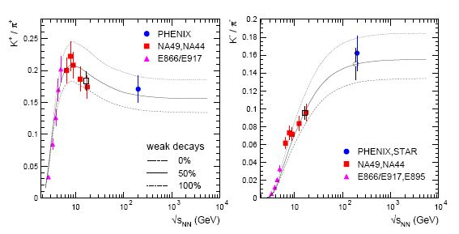
But why ‘horn’ structure takes place for K⁺/π⁺ but not for K⁻/π⁻ ?
!
?
K⁺/π⁺
K⁻/π⁻

Slide 32
Proton Transformations channels
Only K⁺ and K⁰ are produced
No one K⁻ is created!

Slide 33
Neutron Transformations channels
Only K⁺ and K⁰ are produced
No one K⁻ is created!

Slide 34
Higher Collision Energies
Only K⁺ and K⁰ are produced
No one K⁻ is created!

Slide 35
Higher Collision Energies
Only K⁺ and K⁰ are produced
No one K⁻ is created!

Slide 36
Hyperon Resonances Decay

Slide 37
Stangeness Production in central HIC
AGS: Kinetic + Transition mechanisms
Nucleons transform to Δ- isobars and hyperons + kaons
(τ_{o}/τ_{re}) > 1,
NICA, CBM, low SPS: Kinetic + Transition mechanisms
Nucleons transform to (multi)strange hyperons + kaons 1 ≤ (τ_{o}/τ_{re}) ≤ 1
RHIC, LHC: Kinetic mechanism
(τ_{o}/τ_{re}) « 1

Slide 38
What could be studied in BM&N-NICA-FAIR energy region
Enhanced yield of positive and neutral kaons near threshold.
Enhanced yield of one, double and triple strange baryons near threshold.
Electromagnetic and weak decays of hyperons below threshold
EoS near threshold
Correlation of kaons with hyperons
Elliptic and direct flows of hyperons
Possible Polarization of hyperons

Slide 39
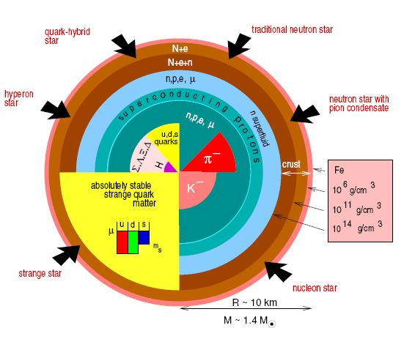
Neutron star
Gravitational compression
NS core
Nuclear matter
Δ- isobar matter
Hyperonic matter
…
compression
Notes:
The behaviour of strange particles in dense nuclear matter plays a crucial role in the dynamics of supernovae and in the stability of neutron stars

Slide 40
On Hyperon Polarization in Heavy Ion Collisions

Slide 41
Content
Introduction
Global polarization (GP) in HIC
Effects of Strong magnetic field in HIC
Effects of Angular Momentum and Vorticity in HIC
Measurement of Global Polarization of Hyperons
Notes:
In heavy ion collisions, and in particular when a QGP is formed, it has long been predicted
that there should be no polarization [9–11]. The essence of the models is that when a QGP has
been formed, a hyperon (for example, a ) would be formed by coalescence of three random
u, d and s quarks. The spins therefore have no preferred axis, and there is no net polarization.

Slide 42

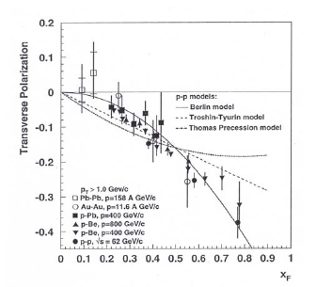
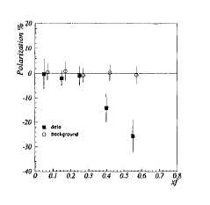
Introduction
Polarization of Hyperons in unpolarized pp and pA experiments
FNAL: p + Be → Λ + X at E_{p} = 300 GeV G.Bunce, et. al, PRL, 36, 1113.
Are Hyperons polarized in HIC experiments?
E896 (AGS) Au+Au at E = 11 AGeV R. Bellwied et al., Nucl. Phys., A698 (2002) 499c.
Polarization in Au+Au is the same as in pp and pA !
E896
Recombination Models: Lund, DeGrand&Miettinen
Notes:
The polarization effect of Lambda was first detected in 1976 at FNAL in 300 GeV/c proton on Beryllium collisions. Polarization increases with high p_t and x_f.
The fact that the polarization is formed in these heavy-ion collisions is at the level of polarization measured in р-induced reactions indicates that the production mechanism of Lambdas is similar. The results show that in the heaviest collision systems the produced Lambdas are still polarized at freeze-out which means the spin direction is only little affected Ьy the rescattering phase after hadronization.
However, there was no scan over the centrality in this experiment.

Slide 43
Introduction
Polarization of Λ’s in unpolarized pp, pA and AuAu experiments was detected w,r,t, the production plane.
Mechanism of polarization in all processes is the same.
Hyperons formed in QGP
Liang Z and Wang X N 2005 Phys. Rev. Lett. 94 102301
Global Polarization of Hyperons:
polarization w.r.t. the reaction plane
Notes:
In a quark–gluon plasma state the (anti-)quarks can be polarized due to the coupling of the quark spins to the total orbital momentum L of a non-central collision system. This polarization
might survive hadronization and would thus be observable as a global polarization of the
measured hadrons relative to L.

Slide 44
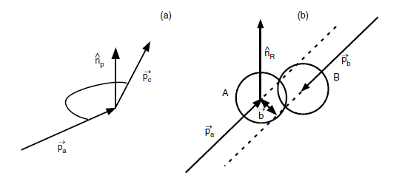
Production Plane
Definitions
Reaction Plane
Au + Au
Λ → pπ⁻
Notes:
(1) The global polarization of hyperons can be determined from the angular distribution of hyperon decay products relative to the system orbital momentum L or magnetic field B:
where P_H is the hyperon global polarization, alpha is the hyperon decay parameter, and tetha is the angle in the hyperon
rest frame between the system orbital momentum (magnetic field) L (B) and the 3-momentum of the baryon daughter from the hyperon decay.
Since the system angular momentum (magnetic field) L (B) is perpendicular to the reaction plane, the global polarization can be measured via the distribution of the azimuthal angle of the hyperon decay baryon (in the hyperon rest frame) with respect to the reaction plane.
(2) By definition of the global polarization: The angle brackets in this equation denote averaging over the solid angle of the hyperon decay baryon 3-momentum in the hyperon rest frame and over all directions of the system orbital momentum L, or, in other words, over all possible orientations of the reaction plane.
(3) We can write an equation for the global polarization in terms of the reaction plane angle Psi_RP and the azimuthal
angle psi*_p of the hyperon decay baryon 3-momentum in the hyperon’s rest frame:
(4) Reaction Plane orentation can be defined by measurement of direct flow v_1

Slide 45
Global Hyperon Polarization
in AuAu/PbPb – collisions
  NA49 (SPS, √s = 17.2 GeV) - no evidence
  STAR (RHIC, √s = 62, 200 GeV) - no evidence
Interpretation:
Formation of QGP randomizes orientation of u, d, s – quarks spins. Therefore the spins of hyperons have no preferred direction.
However at NA49 and STAR
  Hyperon polarization was not measured w.r.t. the production plane!
  Should exist in HIC, like in pp and pA collisions (E896 atAGS) .
Notes:
Idea: in a quark–gluon plasma state the (anti-)quarks can be polarized due to the coupling of the quark spins to the total orbital momentum L of a non-central collision system. This polarization might survive hadronization and would thus be observable as a global polarization of the measured hadrons relative to L.
The essence of the models is that when a QGP has been formed, a hyperon (for example, a ) would be formed by coalescence of three random u, d and s quarks. The spins therefore have no preferred axis, and there is no net polarization.

Slide 46
Global Hyperon Polarization
Conjecture: Global polarization in HIC could take place at lower energies (CBM, NICA, BES RHIC).
HIC at CBM, NICA, BES RHIC Energies
Maximal density of baryonic matter
Hyperons are created at the initial state (hyperon PT)
Possible reasons of the global polarization
Strong magnetic field in semi-central events.
Very large angular momentum of a nuclear matter in semi-central events.
)
Notes:
Idea: in a quark–gluon plasma state the (anti-)quarks can be polarized due to the coupling of the quark
spins to the total orbital momentum L of a non-central collision system. This polarization
might survive hadronization and would thus be observable as a global polarization of the
measured hadrons relative to L.
The essence of the models is that when a QGP has
been formed, a hyperon (for example, a ) would be formed by coalescence of three random
u, d and s quarks. The spins therefore have no preferred axis, and there is no net polarization.

Slide 47
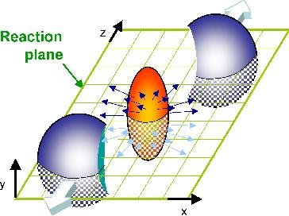
Global Polarization induced by Magnetic Field created in HIC ?
Au + Au: A = 197, Z = +79
Strong Magnetic Field
B_{y}

Slide 48
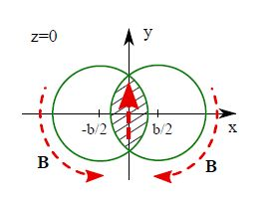
Magnetic Field created in HIC
Notes:
In a quark–gluon plasma state the (anti-)quarks can be polarized due to the coupling of the quark
spins to the total orbital momentum L of a non-central collision system. This polarization
might survive hadronization and would thus be observable as a global polarization of the
measured hadrons relative to L.

Slide 49
Particle polarization in presence of magnetic field

Slide 50
Hyperon polarization in presence of magnetic field
√s = 4 -11 GeV
T ~ 100 MeV
Magnetic Field : By ≈ 1012 Tesla V. Skokov et. al, Mod.Phys.Lett., 2009
Nuclear magneton: μN = 3.15·10-14 MeV/Tesla
E=-μh B
part | p | Λ | Σ⁺ | Σ⁻ | Ξ⁰ | Ξ⁻ | Ω⁻
|μ_{h} B_{y}|, (MeV) | 0.091 | 0.019 | 0.077 | 0.037 | 0.039 | 0.020 | 0.064
P, (%) | 0.2 | 0.04 | 0.15 | 0.07 | 0.07 | 0.04 | 0.13
Polarization induced by the magnetic field created in HIC is rather small!.

Slide 51
Global Hyperon Polarization induced by Orbital Angular Momentum?
Large Orbital Angular Momentum
L_{y}
No evidence for Polarization at RHIC
Proposal:
Hyperon Polarization could be
observed at NICA, CBM and
BES RHIC
Notes:
The system produced in non-central relativistic heavy ion collisions possesses large orbital
angular momentum. Due to the spin-orbit coupling of QCD, this orbital motion may
result in a net polarization of the produced particles along the direction of the initial angular
momentum, that is, perpendicular to the reaction plane, yielding a global hadronic
polarization in the final state [1,2]. In a quark–gluon plasma state the (anti-)quarks can be polarized due to the coupling of the quark spins to the total orbital momentum L of a non-central collision system. This polarization
might survive hadronization and would thus be observable as a global polarization of the
measured hadrons relative to L.

Slide 52
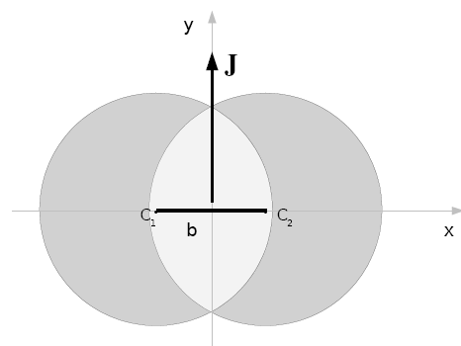
Orbital Angular Momentum in HIC
L_{y}
A₁
A₂
Notes:
The net momentum density at each point (x, y) of the overlap region in the transverse plane reads:
Nucleon Density profile function
Total orbital angular momentum is integral

Slide 53
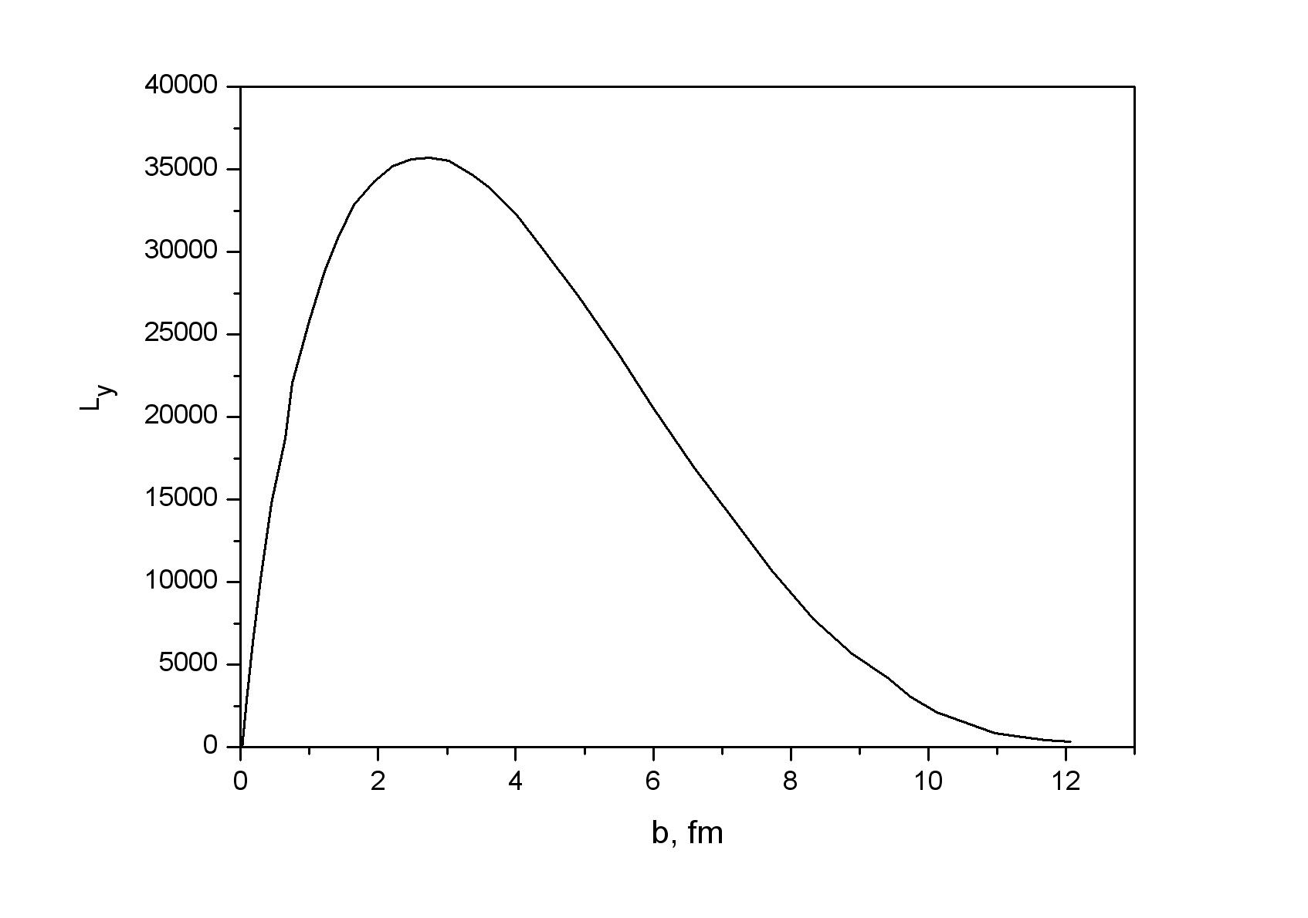
Orbital Angular Momentum vs impact parameter
AuAu-collisions at √s = 9 GeV

Slide 54
Global orbital angular momentum
Gradient in pz-distribution along the x-direction
x
impact
parameter
z
Notes:
The existence of the global orbital angular momentum of the system
implies a finite transverse (along ˆx) gradient of the longitudinal flow velocity.
The orbital angular momentum of colliding particles can be converted into the spin angular This relates to non-central nucleus-nucleus collisions as well.
Hadrons can be polarized due to the coupling of their spins to the total orbital momentum L of a non-central collision system. This polarization
could be observable as a global polarization of the measured hadrons relative to L.

Slide 55
Local Orbital Angular Momentum
Liang & Wang, arXive:nucl-th/0410079, 2004
, ω
x
Hydrodynamic analog:
non-vanishin local vorticity
Notes:
The existence of the global orbital angular momentum of the system discussed above implies a finite transverse (along ˆx) gradient of the longitudinal flow velocity that can be treated as a local angular momentum or vorticity.

Slide 56
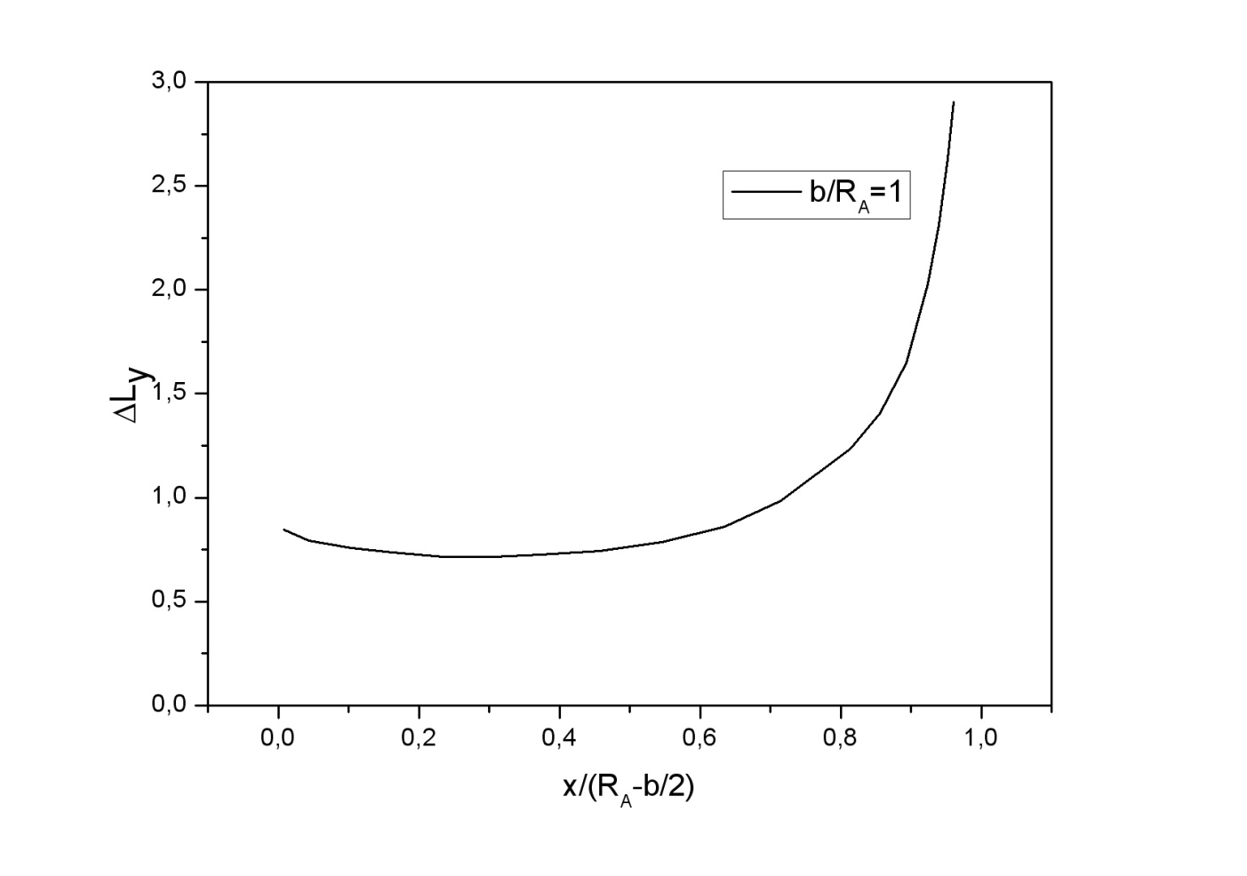
Local Orbital Angular Momentum
Au+Au at √s = 9 GeV, b = 6 fm
Notes:
Can such a local orbital angular momentum be transferred to the polarization of quark or anti-quark through the interactions between the partons in a QGP?

Slide 57
Hyperon polarization in HIC
Particles in the overlap region of two colliding nuclei could be polarized due to the large orbital momentum created in the non-central HIC.
Proposal:
Hyperon Polarization can be observed at NICA, CBM and
BES RHIC
Why?

Slide 58
Global Polarization Hyperons in Non-Central HIC
Hyperons could be polarized due to the large orbital momentum, created in the non-central HIC.
Preferable (measurable) types of hyperons – Λ, Ξ⁻, Ω⁻:
  Λ → pπ⁻
  Ξ⁻ → Λπ⁻
  Ω⁻ → ΛK⁻ (B.R. 68%)
Global polarization are measured w.r.t. the reaction plane.
Reaction plane is defined by a directed flow.

Slide 59

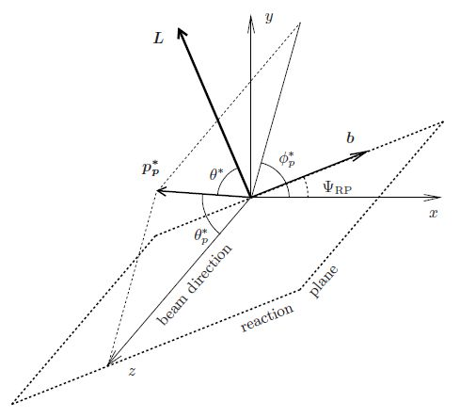


Measurement of Global Polarization
Notes:
(1) The global polarization of hyperons can be determined from the angular distribution of hyperon decay products
relative to the system orbital momentum L or magnetic field B:
where P_H is the hyperon global polarization, alpha is the hyperon decay parameter, and tetha is the angle in the hyperon
rest frame between the system orbital momentum (magnetic field) L (B) and the 3-momentum of the baryon daughter from the hyperon decay.
Since the system angular momentum (magnetic field) L (B) is perpendicular to the reaction plane, the global polarization can be measured via the distribution of the azimuthal angle of the hyperon decay baryon (in the hyperon rest frame) with respect to the reaction plane.
(2) By definition of the global polarization: The angle brackets in this equation denote averaging over the solid angle of the hyperon decay baryon 3-momentum in the hyperon rest frame and over all directions of the system orbital momentum L, or, in other words, over all possible orientations of the reaction plane.
(3) We can write an equation for the global polarization in terms of the reaction plane angle Psi_RP and the azimuthal
angle psi*_p of the hyperon decay baryon 3-momentum in the hyperon’s rest frame:
(4) Reaction Plane orentation can be defined by measurement of direct flow v_1

Slide 60
Reaction Plane vs. Collective Flow
Y
z
Y
x
Non-central HIC interaction in overlap region results in a pressure gradient =>
spatial asymmetry is converted to an asymmetry in momentum space => collective flow

Slide 61
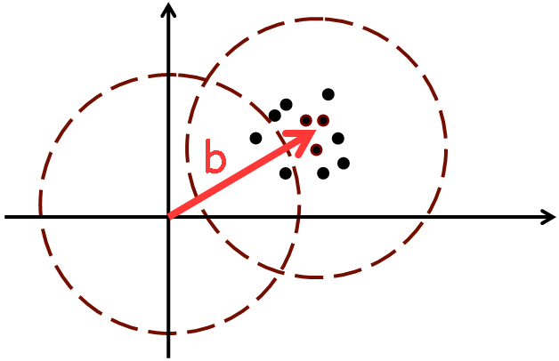
Definitions: Flows
ψ_{R}
1-st Fourier harmonics, v1 → directed flow
2-nd Fourier harmonics, v2 → elliptic flow
Ψr - Reaction Plane
2vn cos[n(φ – Ψr)] - azimuthal asymmetry
v1 = <cos[(φ – Ψr)]> - direct flow
v2 = <cos[2(φ – Ψr)]> - elliptic flow
Notes:
61

Slide 62
Conclusion
Enhanced yield of Strangeness at √s ~ 2 ÷ 10 GeV may be a manifestation of the nucleon – hyperon phase transition in a dense baryonic matter.
Global hyperon polarization could be preferably detected at this energy range (only!).

Slide 63
Thank you for your attention!

Slide 64
Dileptons Yield
Dileptons are an ideal probe for vector meson spectroscopy in the nuclear medium and for the nuclear dynamics !
Λ
π
n
p
p
π
Δ⁺⁺
ρ
e⁺, μ⁺
e⁻, μ⁻
no measurements between
2-40 AGeV beam energy yet!

Slide 65
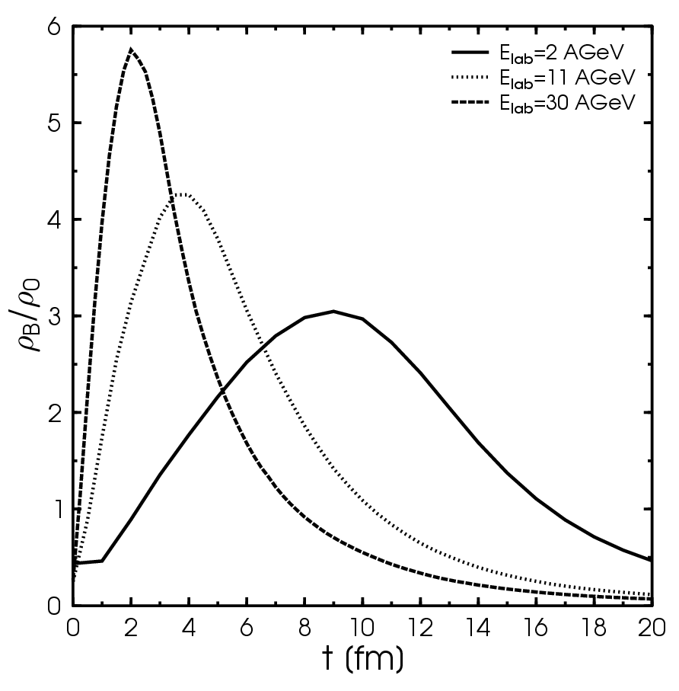
Physics Motivation
Are we able to observe unambiguous signals from the most compressed region of the system?
in-medium modifications of hadrons [ρ,ω,φ →e⁺e⁻(μ⁺μ⁻)]
Central Au+Au/Pb+Pb collisions

Slide 66
Modelling of in-medium spectral functions for vector mesons
In-medium scenarios:
dropping mass collisional broadening dropping mass + coll. broad.
m*=m₀(1-α ρ/ρ0) Γ(M,ρ)=Γ_{vac}(M)+Γ_{CB}(M,ρ) m* & Γ_{CB}(M,ρ)
Collisional width Γ_{CB}(M,ρ) ~ γ ρ σ_{VN}^{tot}
ρ−meson spectral function:
Note: for a consistent off-shell transport one needs not only in-medium spectral functions but also in-medium transition rates for all channels with vector mesons, i.e. the full knowledge of the in-medium off-shell cross sections σ(s,ρ)
E.L.B., NPA 686 (2001), E.L.B. &W. Cassing, NPA 807 (2008) 214

Slide 67
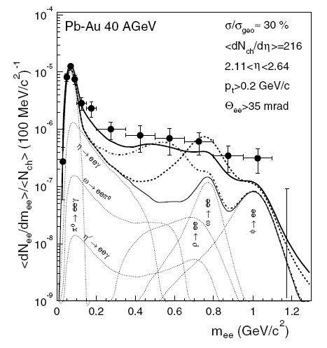
Hadronic Cocktail
+
π+π → ρ → e⁺ + e⁻
√S = 9 GeV
+
in-medium ρ – mass drop (B-R scaling)
+
in-medium ρ – width spread

