Slide 1

Thermodynamic and Transport Properties of Strongly-Coupled Degenerate Electron-Ion Plasma by First-Principle Approaches
JIHT
RAS
Levashov P.R.
Joint Institute for High Temperatures, Moscow, Russia
Moscow Institute of Physics and Technology, Dolgoprudny, Russia
*pasha@ihed.ras.ru
In collaboration with: Minakov D.V.
Knyazev D.V.
Chentsov A.V.
Khishchenko K.V.

Slide 2
Outline
JIHT
RAS
Strongly coupled degenerate plasma
Ab-initio calculations
Quantum-statistical models
Density functional theory
Quantum molecular dynamics
Path-Integral Monte Carlo
Wigner dynamics
Conclusions

Slide 3
Ab-initio calculations
JIHT
RAS
Thermodynamic, transport and optical properties
Use the following information:
  fundamental physical constants
  charge and mass of nuclei
  thermodynamic state

Slide 4
Extreme States of Matter
JIHT
RAS
Kirzhnits D.A., Phys. Usp., 1971
Atomic system of units:
  m_{e} = ħ = a₀ = 1
Extreme States of Matter (Kalitkin N.N.)
Hypervelocity impact, laser, electronic, ionic beams,
powerful electric current pulse etc.

Slide 5
Coupling and Degeneracy in Plasma
JIHT
RAS
Coupling parameter:
Degeneracy parameter
(for electronic subsystem)
- Strong coupling
- Strong degeneracy
Strongly coupled degenerate non-relativistic plasma
(warm dense matter)
-

Slide 6
EOS: Traditional Form
JIHT
RAS
Adiabatic (Born-Oppenheimer) approximation (m_{e} << m_{i})
Free energy of
electrons in the
field of fixed ions
Free energy of ions
interacting with potential depending on V and T
Traditional form of semiempirical EOS. Free energy
Cold curve
Thermal contribution
of atoms and ions
Thermal contribution
of electrons
Semiempirical
expressions
DFT, mean atom models
Mean atom models or DFT calculations might help
to decrease the number of fitting parameters

Slide 7
Electronic Contribution to Thermodynamic Functions:
Hierarchy of Models
JIHT
RAS
Exact solution of the 3D multi-particle Schrödinger equation
Atom in a spherical cell
Hartree-Fock method (1-electron
wave functions)
Hartree-Fock-Slater method
Hartree method (no exchange)
Thomas-Fermi method
Ideal Fermi-gas
r₀
Z

Slide 8
Finite-Temperature Thomas-Fermi Model
The simplest mean atom model
The simplest (and fully-determined) DFT model
Correct asymptotic behavior at low T and V (ideal Fermi-gas)
and at high T and V (ideal Boltzmann gas)
r₀
Poisson equation
Z
Thomas-Fermi model is realistic but crude at relatively low temperatures and pressures.
Thermal contributions to thermodynamic functions is a good approximation.
Feynman R., Metropolis N., Teller E. // Phys. Rev. 1949. V.75. P.1561.

Slide 9
HARTREE-FOCK-SLATER MODEL AT T>0
Nikiforov A.F., Novikov V.G., Uvarov V.B. Quantum-statistical models of high-temperature plasma. M.: Fizmatlit, 2000.
Atom with mean populations
ε_{nl} – energy levels in V(r)
Potential:
From the radial Schrödinger equation
Poisson equation solution:
Exchange potential:
Iterative procedure for determination of ρ(r), ε_{nl} and V(r)

Slide 10
RADIAL ELECTRON DENSITY r²ρ (r)
BY HARTREE-FOCK-SLATER MODEL
Hartree-Fock-Slater
Au
ρ = 10⁻³ g/cm³
Thomas-Fermi
4·10⁵ K
4·10² K

Slide 11
Density Functional Theory
JIHT
RAS
Thomas-Fermi theory is the density functional theory:
kinetic energy
external potential
exchange energy
Hartree energy
Is it a general property?

Slide 12
Density Functional Theory
JIHT
RAS
For systems with Hamiltonian
the following theorems are valid:
Theorem 1. For any system of interacting particles in an external potential V_{ext}(r) the potential V_{ext}(r) is determined uniquely, except for a constant, by the ground state particle density of electrons n₀(r).
Therefore, all properties are completely determined given only the ground state electronic density n₀(r).
Theorem 2. A universal functional for the energy E[n] in terms of the density n(r) can be defined, valid for any external potential V_{ext}(r). For any particular V_{ext}(r), the exact ground state energy of the system is the global minimum value of this functional, and the density n(r) that minimizes the functional is the exact ground state density n₀(r).
Hohenberg, Kohn, 1964

Slide 13
Kohn-Sham Functional
JIHT
RAS
The system of interacting particles is replaced by the system of non-interacting particles:
kinetic energy
ion-ion
interaction
exchange-
correlation
functional
All many-body effects of exchange and correlation are included into E_{XC}[n]
true system
non-interacting system
The minimization of E_{KS} leads to the system of
Kohn-Sham equations
Kohn, Sham, 1965

Slide 14
Minimization in HFS and DFT
JIHT
RAS
In Hartree-Fock(-Slater) method we find
In DFT we find

Slide 15

Density Functional Theory: All-Electron and Pseudopotential Approaches
JIHT
RAS
Full-potential approach: all electrons are taken into account (FP-LMTO)
(S. Yu. Savrasov, PRB 54 16470 (1996),
G. V. Sin'ko, N. A. Smirnov, PRB 74 134113 (2006)
At T > 0: occupancies are
Pseudopotential approach: the core is replaced by a pseudopotential, the Kohn-Sham equations are solved only for valent electrons (VASP)
G. Kresse and J. Hafner, Phys. Rev. B 47, 558 (1993); 49, 14251 (1994).
G. Kresse and J. Furthmuller, Phys. Rev. B 54, 11169 (1996).
E_{F}
E_{F}
Core
electrons
T = 0
T > 0
Calculations were made in the unit cell at fixed ions and heated electrons

Slide 16
Aluminum. Cold Curve
JIHT
RAS
Al is more compressible
in VASP calculations
than in FP-LMTO
FP-LMTO
Pressure (Mbar)
VASP
Compression ratio
Levashov P.R. et al., JPCM 22 (2010) 505501

Slide 17
Potassium. Cold Curve
JIHT
RAS
3s, 3p, 4s
K is less compressible
in VASP calculations
than in FP-LMTO
Less number of valent
electrons leads to
bigger disagreement
with FP-LMTO
VASP
FP-LMTO
3p, 4s
Levashov P.R. et al., JPCM 22 (2010) 505501

Slide 18
DFT-calculations of F_{e}(T_{e}, V)
JIHT
RAS
Why can we use DFT for thermodynamic properties of electrons?
Heat capacity of W, V₀
Thomas-Fermi with corrections
bcc
fcc
24x24x24 mesh of k-points
N_{bands} = 94
E_{cut} = 1020 eV
Cold ions, hot electrons
Heat capacity is very close for fcc and bcc structures of W
It should be close to unordered phase at the same density

Slide 19
Tungsten, T_{i} = 0, V = V₀.
Electron Heat Capacity
JIHT
RAS
Core electrons become
excited at ~3 eV
FP-LMTO
Thomas-Fermi
VASP
IFG, Z = 6
IFG, Z = 1
Levashov P.R. et al., JPCM 22 (2010) 505501

Slide 20
Tungsten, T_{i} = 0, V = V₀.
Thermal Pressure
JIHT
RAS
Pressure is determined
by free electrons only
Interaction of electrons
should be taken into
account
Thomas-Fermi
FP-LMTO
VASP
IFG, Z = 6
IFG, Z = 1
Levashov P.R. et al., JPCM 22 (2010) 505501

Slide 21
Thermal contribution of ions
JIHT
RAS
Ab-initio molecular dynamics (AIMD) simulations
From AIMD
From AIMD
From DFT
Analytic
expression
But it’s better to use AIMD to calibrate the EOS by changing fitting parameters
Desjarlais M., Mattson T.R., Bonev S.A., Galli G., Militzer B., Holst B., Redmer R.,
Renaudin P., Clerouin J. and many others use AIMD to compute EOS for many substances
Notes:
Collins, Gupta, Mishra

Slide 22
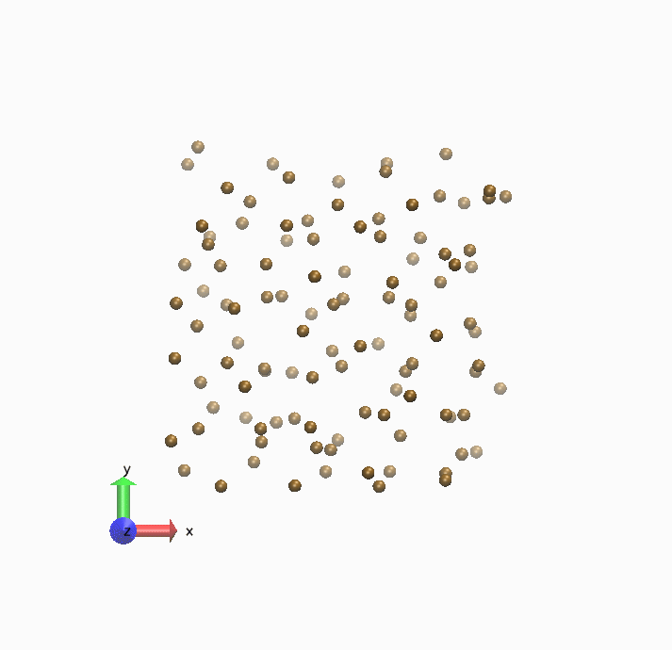
Details of the AIMD simulations
JIHT
RAS
We use VASP (Vienna Ab Initio Simulation Package) - package for performing ab-initio quantum-mechanical molecular dynamics (MD) using pseudopotentials and a plane wave basis set.
Generalized Gradient Approximation (GGA) for Exchange and Correlation functional
Ultrasoft Vanderbilt pseudopotentials (US-PP)
One point (Γ-point) in the Brillouin zone
The QMD simulations were performed for
108 atoms of Al
The dynamics of Al atoms was simulated
within 1 ps with 2 fs time step
The electron temperature was equal to the
temperature of ions through the
Fermi–Dirac distribution
0.1 < ρ / ρ₀ < 3, T < 75000 K
G. Kresse and J. Hafner, Phys. Rev. B 47, 558 (1993); 49, 14251 (1994).
G. Kresse and J. Furthmuller, Phys. Rev. B 54, 11169 (1996).

Slide 23
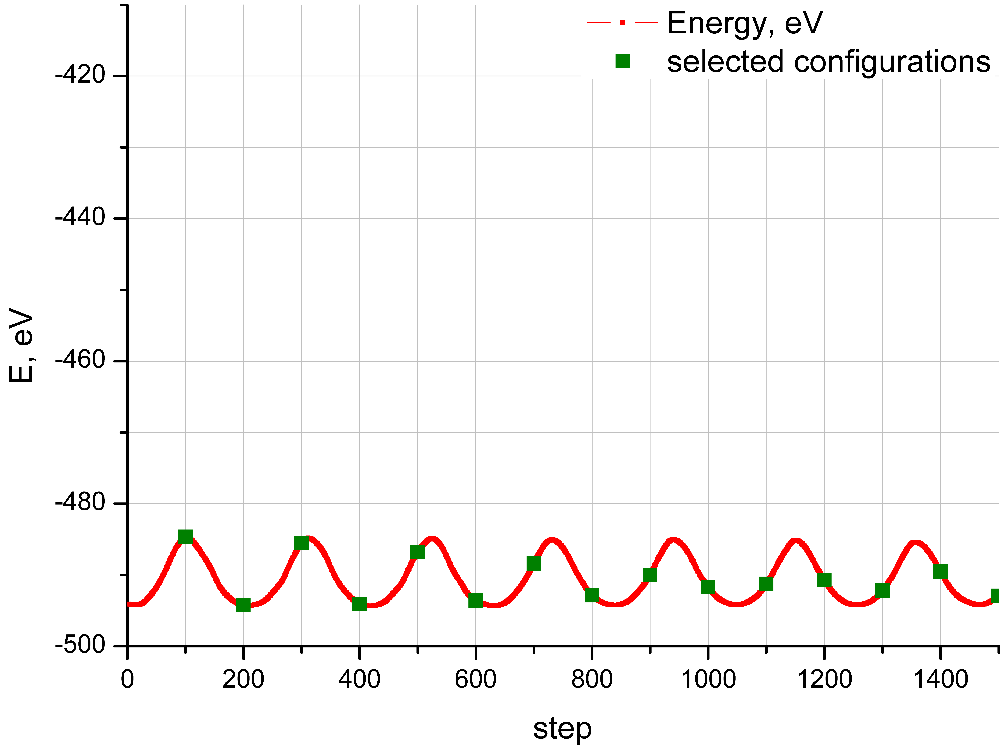
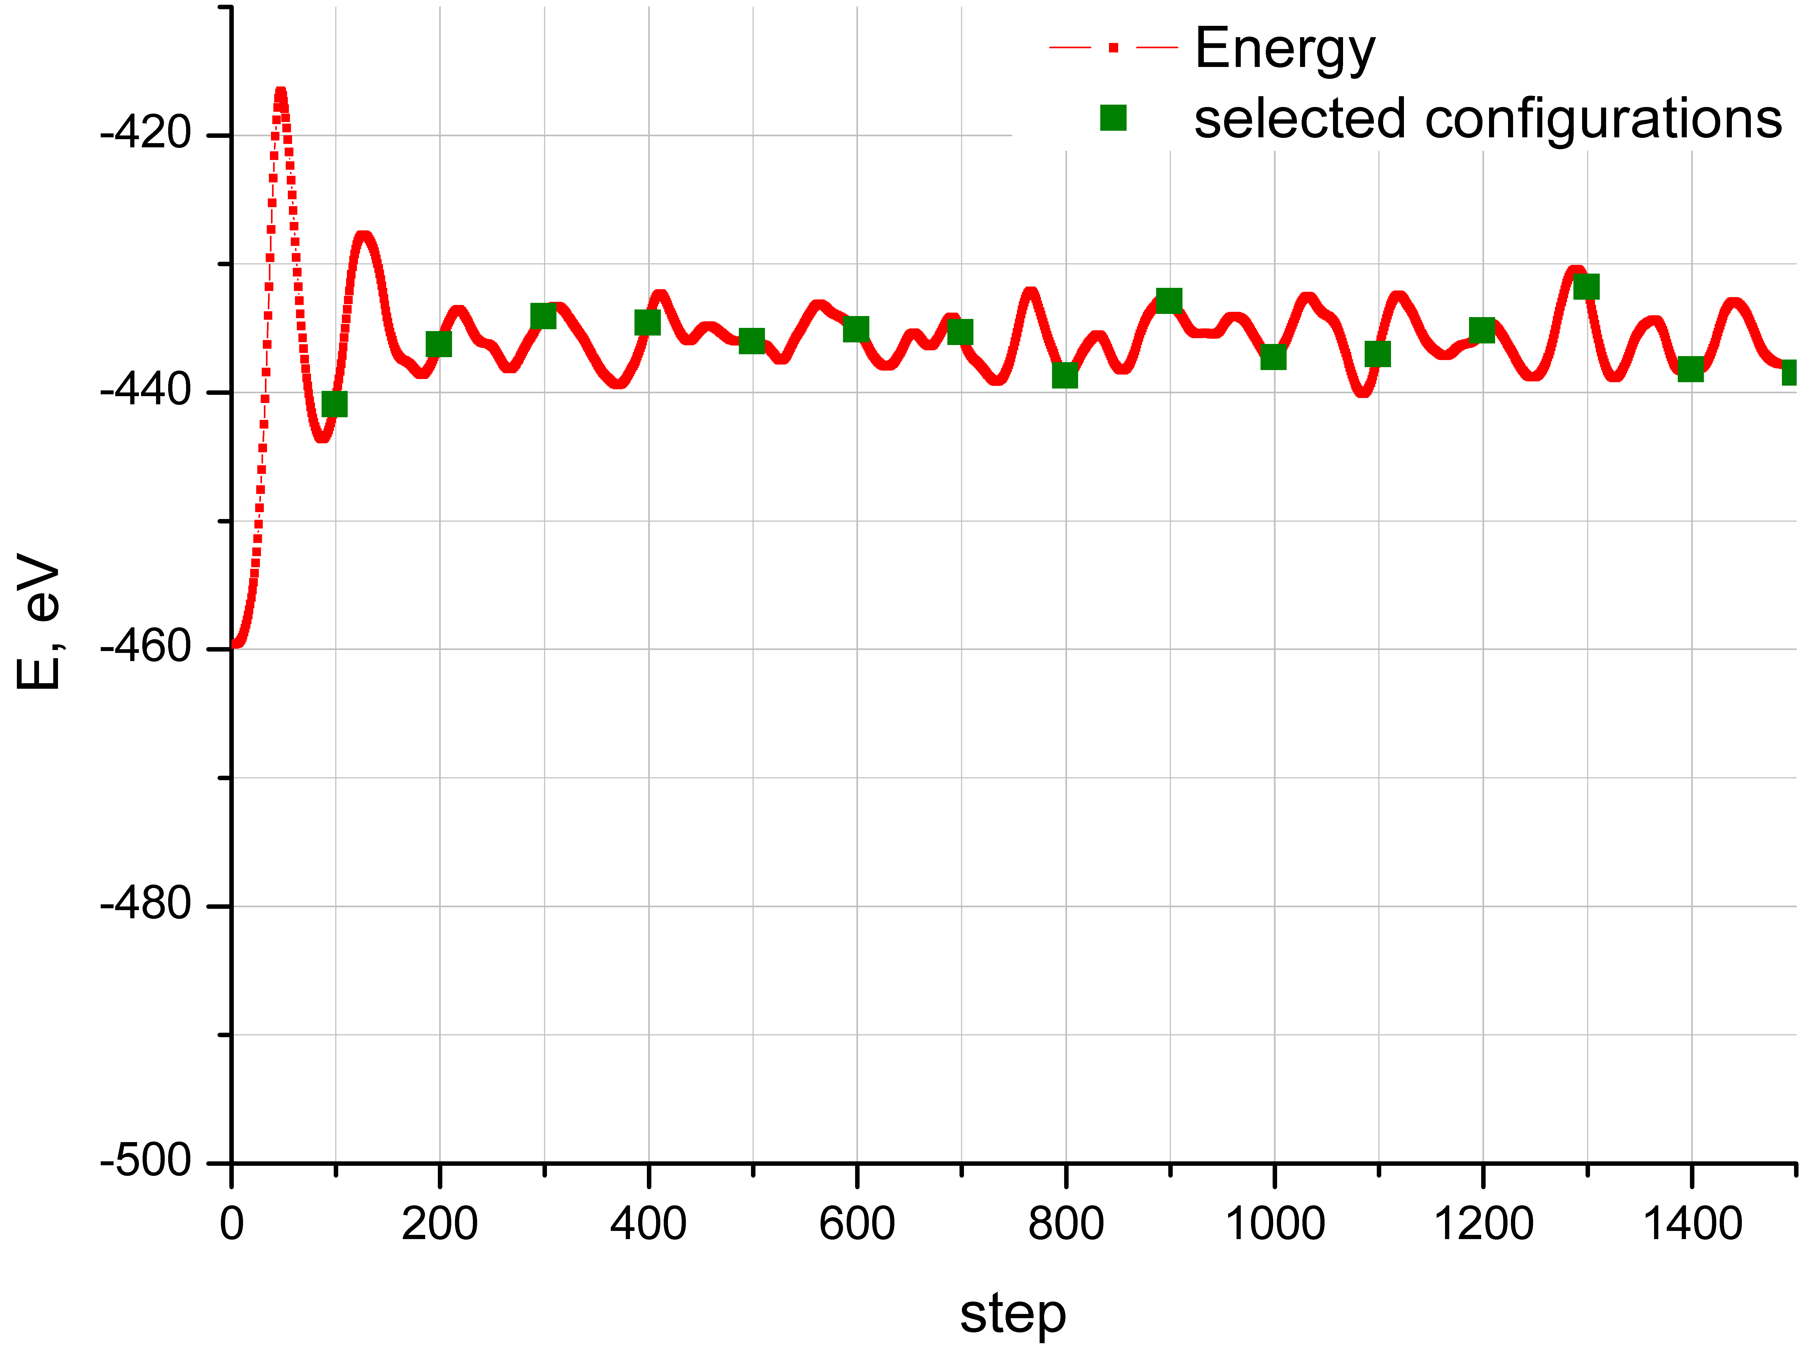
Al, ionic configurations
JIHT
RAS
Full energy during the simulations
Normal conditions, solid phase
T=1550 K; ρ=2.23 g/cm³; liquid phase
108 atoms US pseudopotential; 1 k-point in the Brillouin zone; cut-off energy 100 eV; 1 step – 2 fs
Configurations for electrical conductivity calculations are taken after equilibration

Slide 24
Isotherm T = 293 K for Al
QMD results show good agreement with experiments and calculations for fcc.

Slide 25
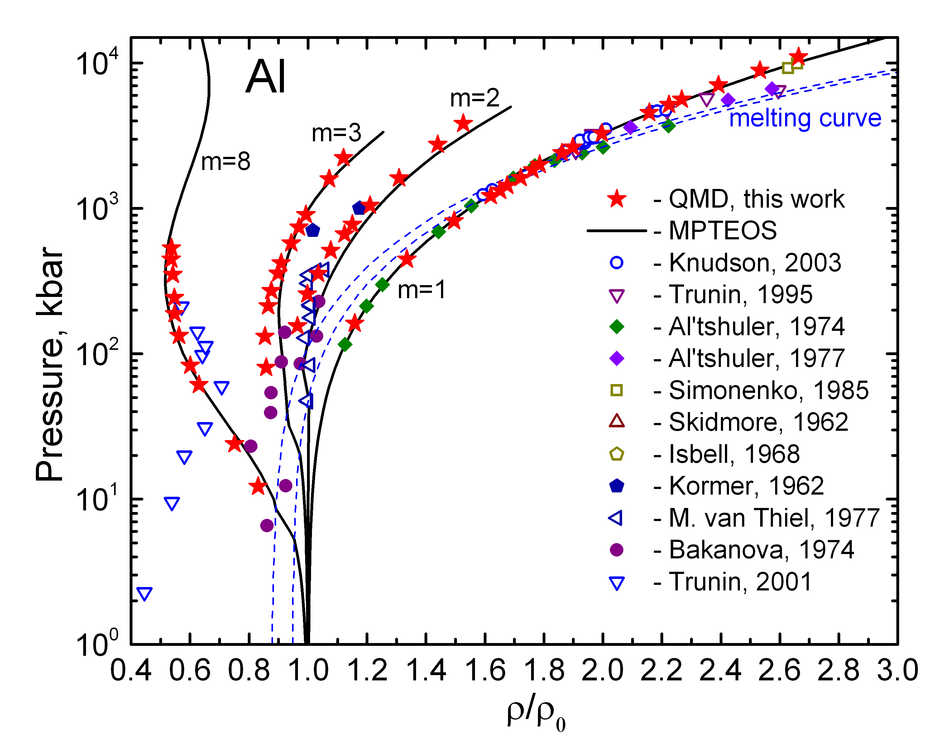
Shock Hugoniots of Al
Pressure – compression ratio

Slide 26
Shock Hugoniot of Al. Melting
Higher melting temperatures by QMD calculations might be caused by a small number of particles
NB: we can trace phase transitions in 1-phase simulation

Slide 27
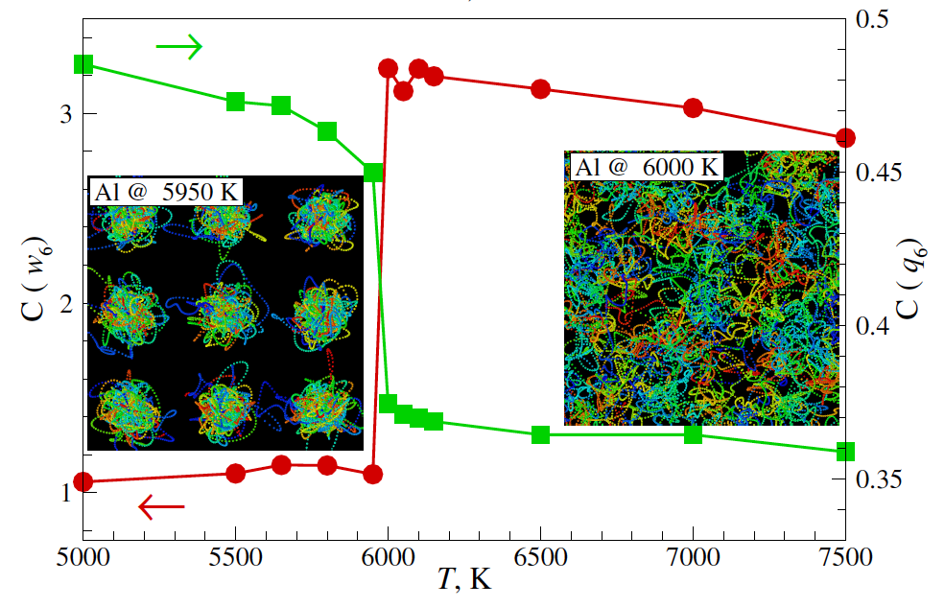

Melting criterion for aluminum
Equilibrium configurations of Al ions at 5950 and 6000 K
Cumulative distribution functions C(q₆) and C(w₆) are extremely sensitive measure of the local orientation order
This criterion may be applied to other structural phase transitions
Rotational invariants of 2nd (q₆) and 3rd (w₆) orders
Klumov B.A., Phys. Usp. 53, 1045 (2010)
Steinhardt P.J. et al, PRL 47, 1297 (1981)

Slide 28
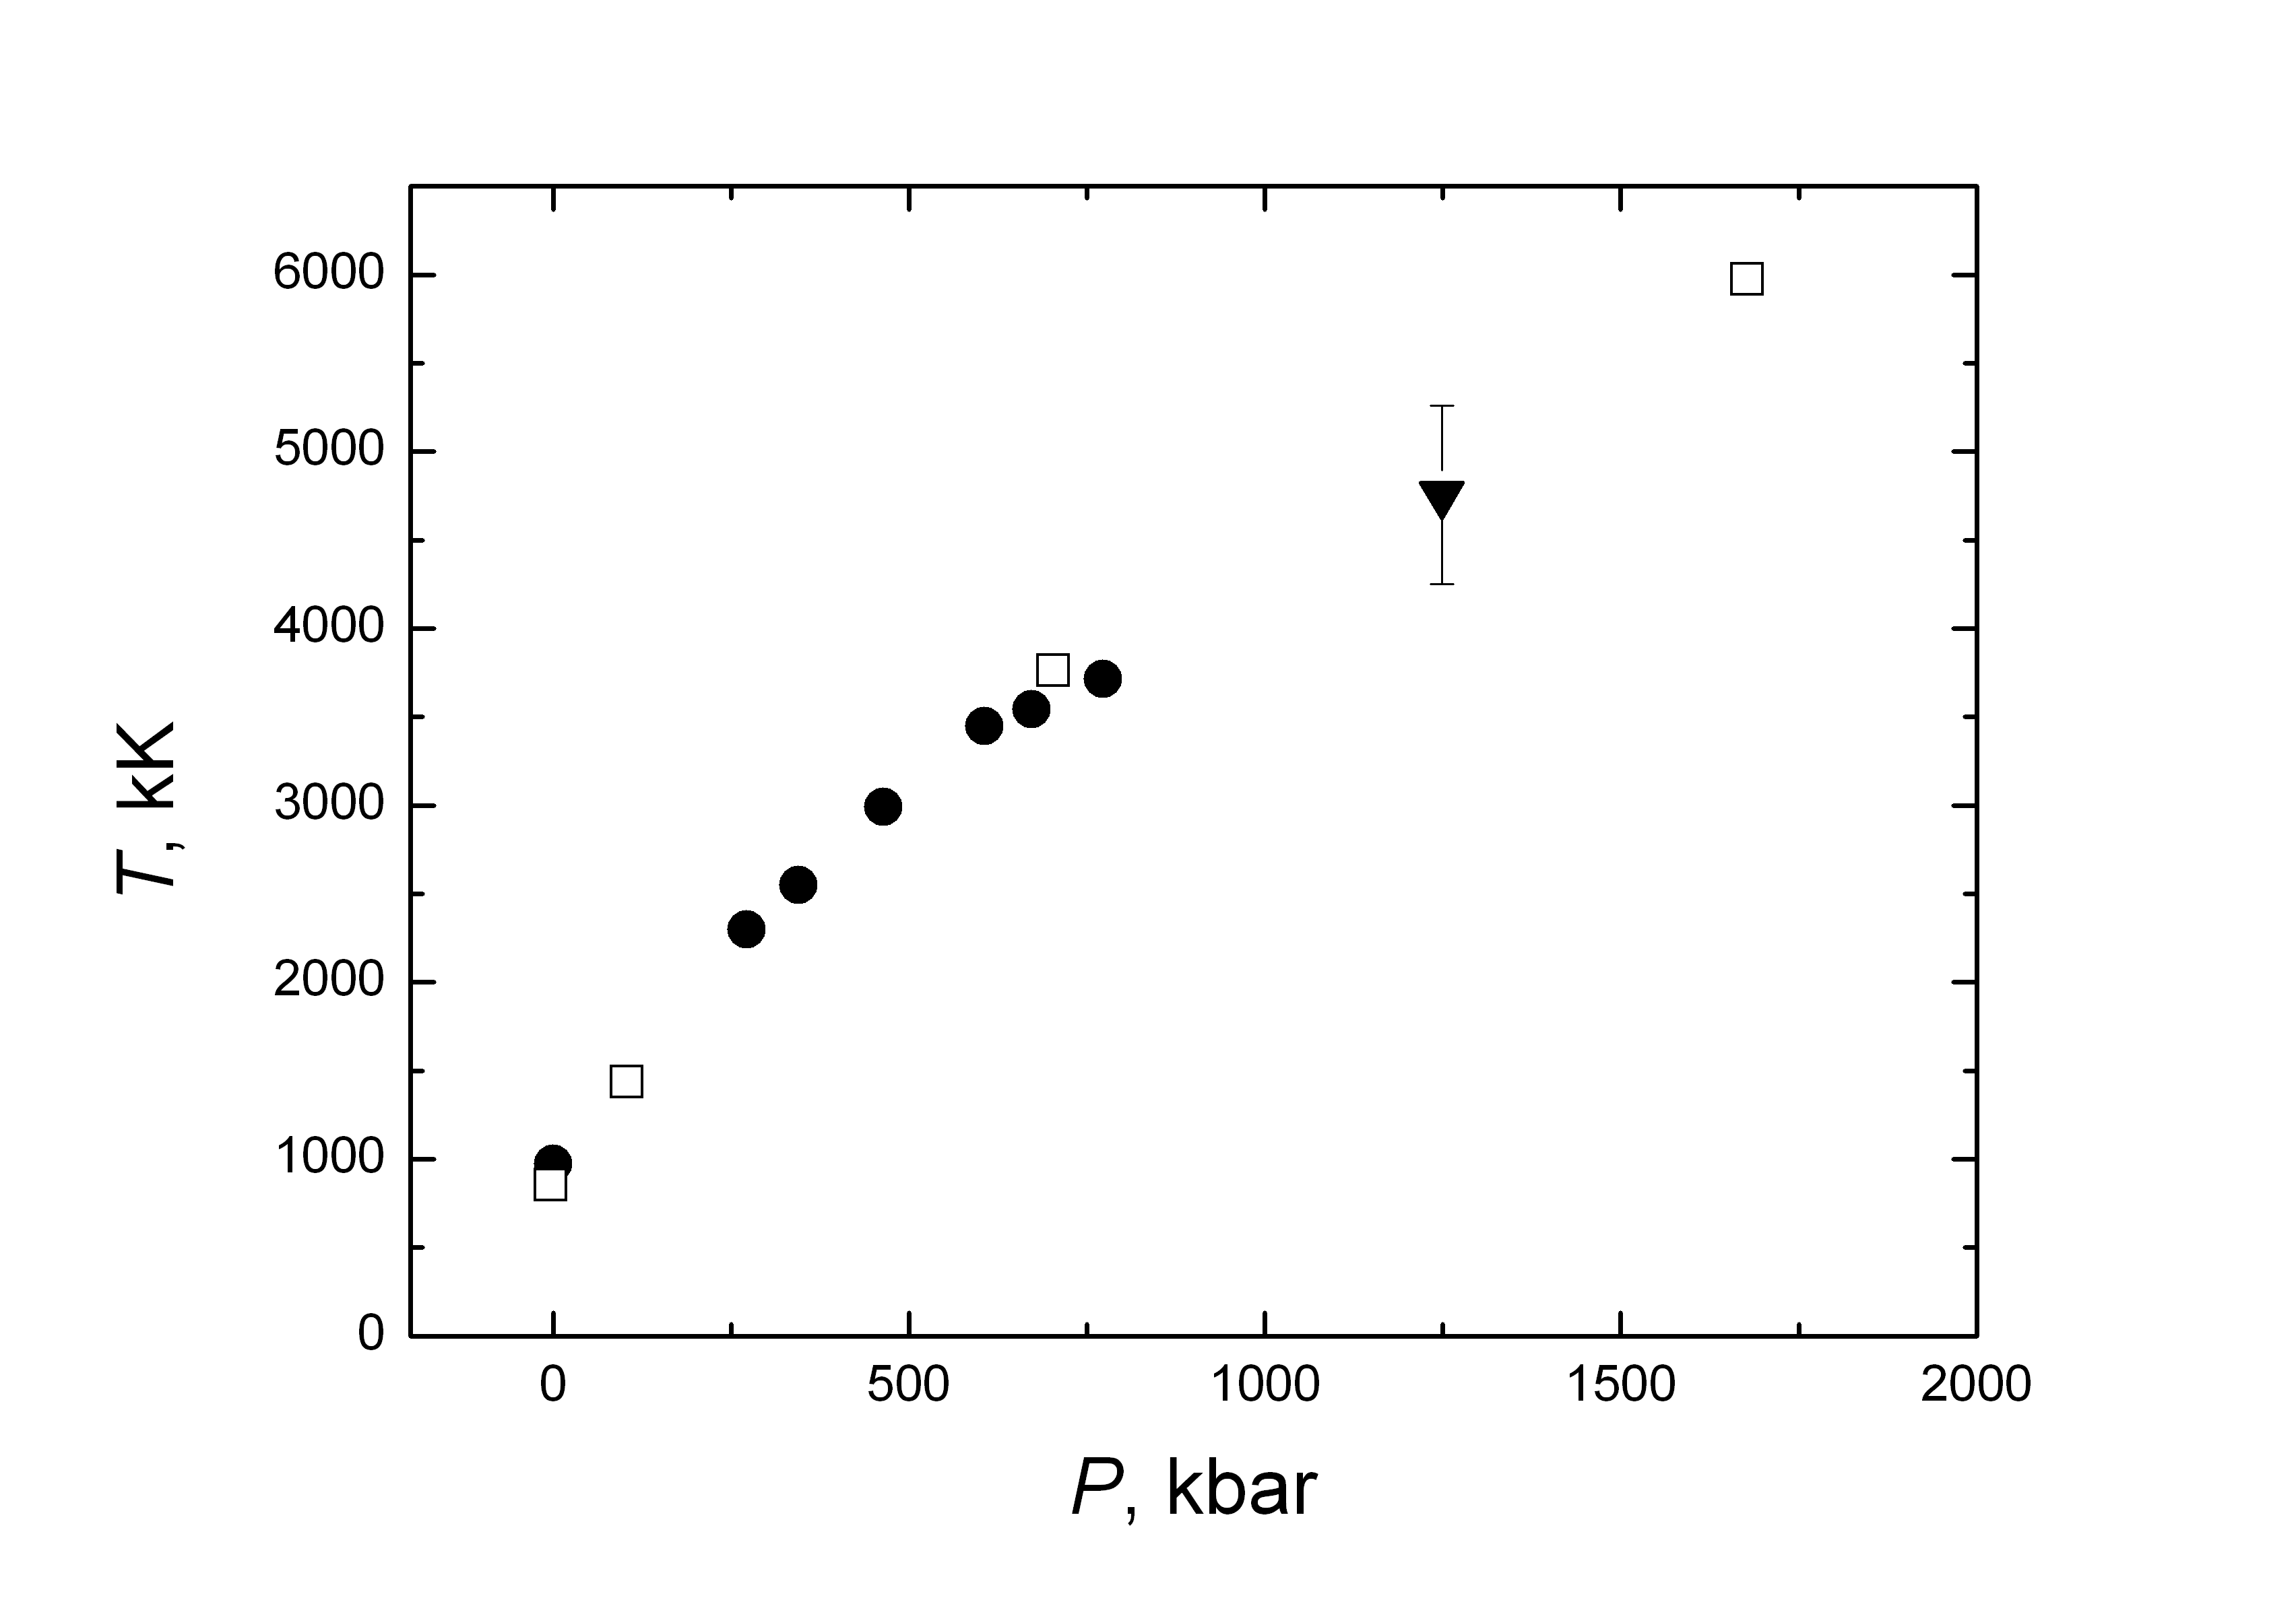
Melting curve of aluminum
Shock-wave
Shaner et al., 1984
DAC
QMD
QMD, 108 particles, equilibrium configurations analysis
Size effect should be checked
Boehler R., Ross M. Earth Plan. Sci. Lett. 153, 223 (1997)

Slide 29
Release Isentropes of Al
JIHT
RAS
correspond to the experiments from
M. V. Zhernokletov et al. // Teplofiz. Vys. Temp. 33(1), 40-43 (1995) [in Russian]

Slide 30
Release Isentropes of Al
JIHT
RAS
correspond to the experiments from
Knudson M.D., Asay J.R., Deeney C. // J. Appl. Phys. V. 97. P. 073514. (2005)

Slide 31
Sound Velocity in Shocked Al
JIHT
RAS
Oscillations are caused by errors of interpolation

Slide 32
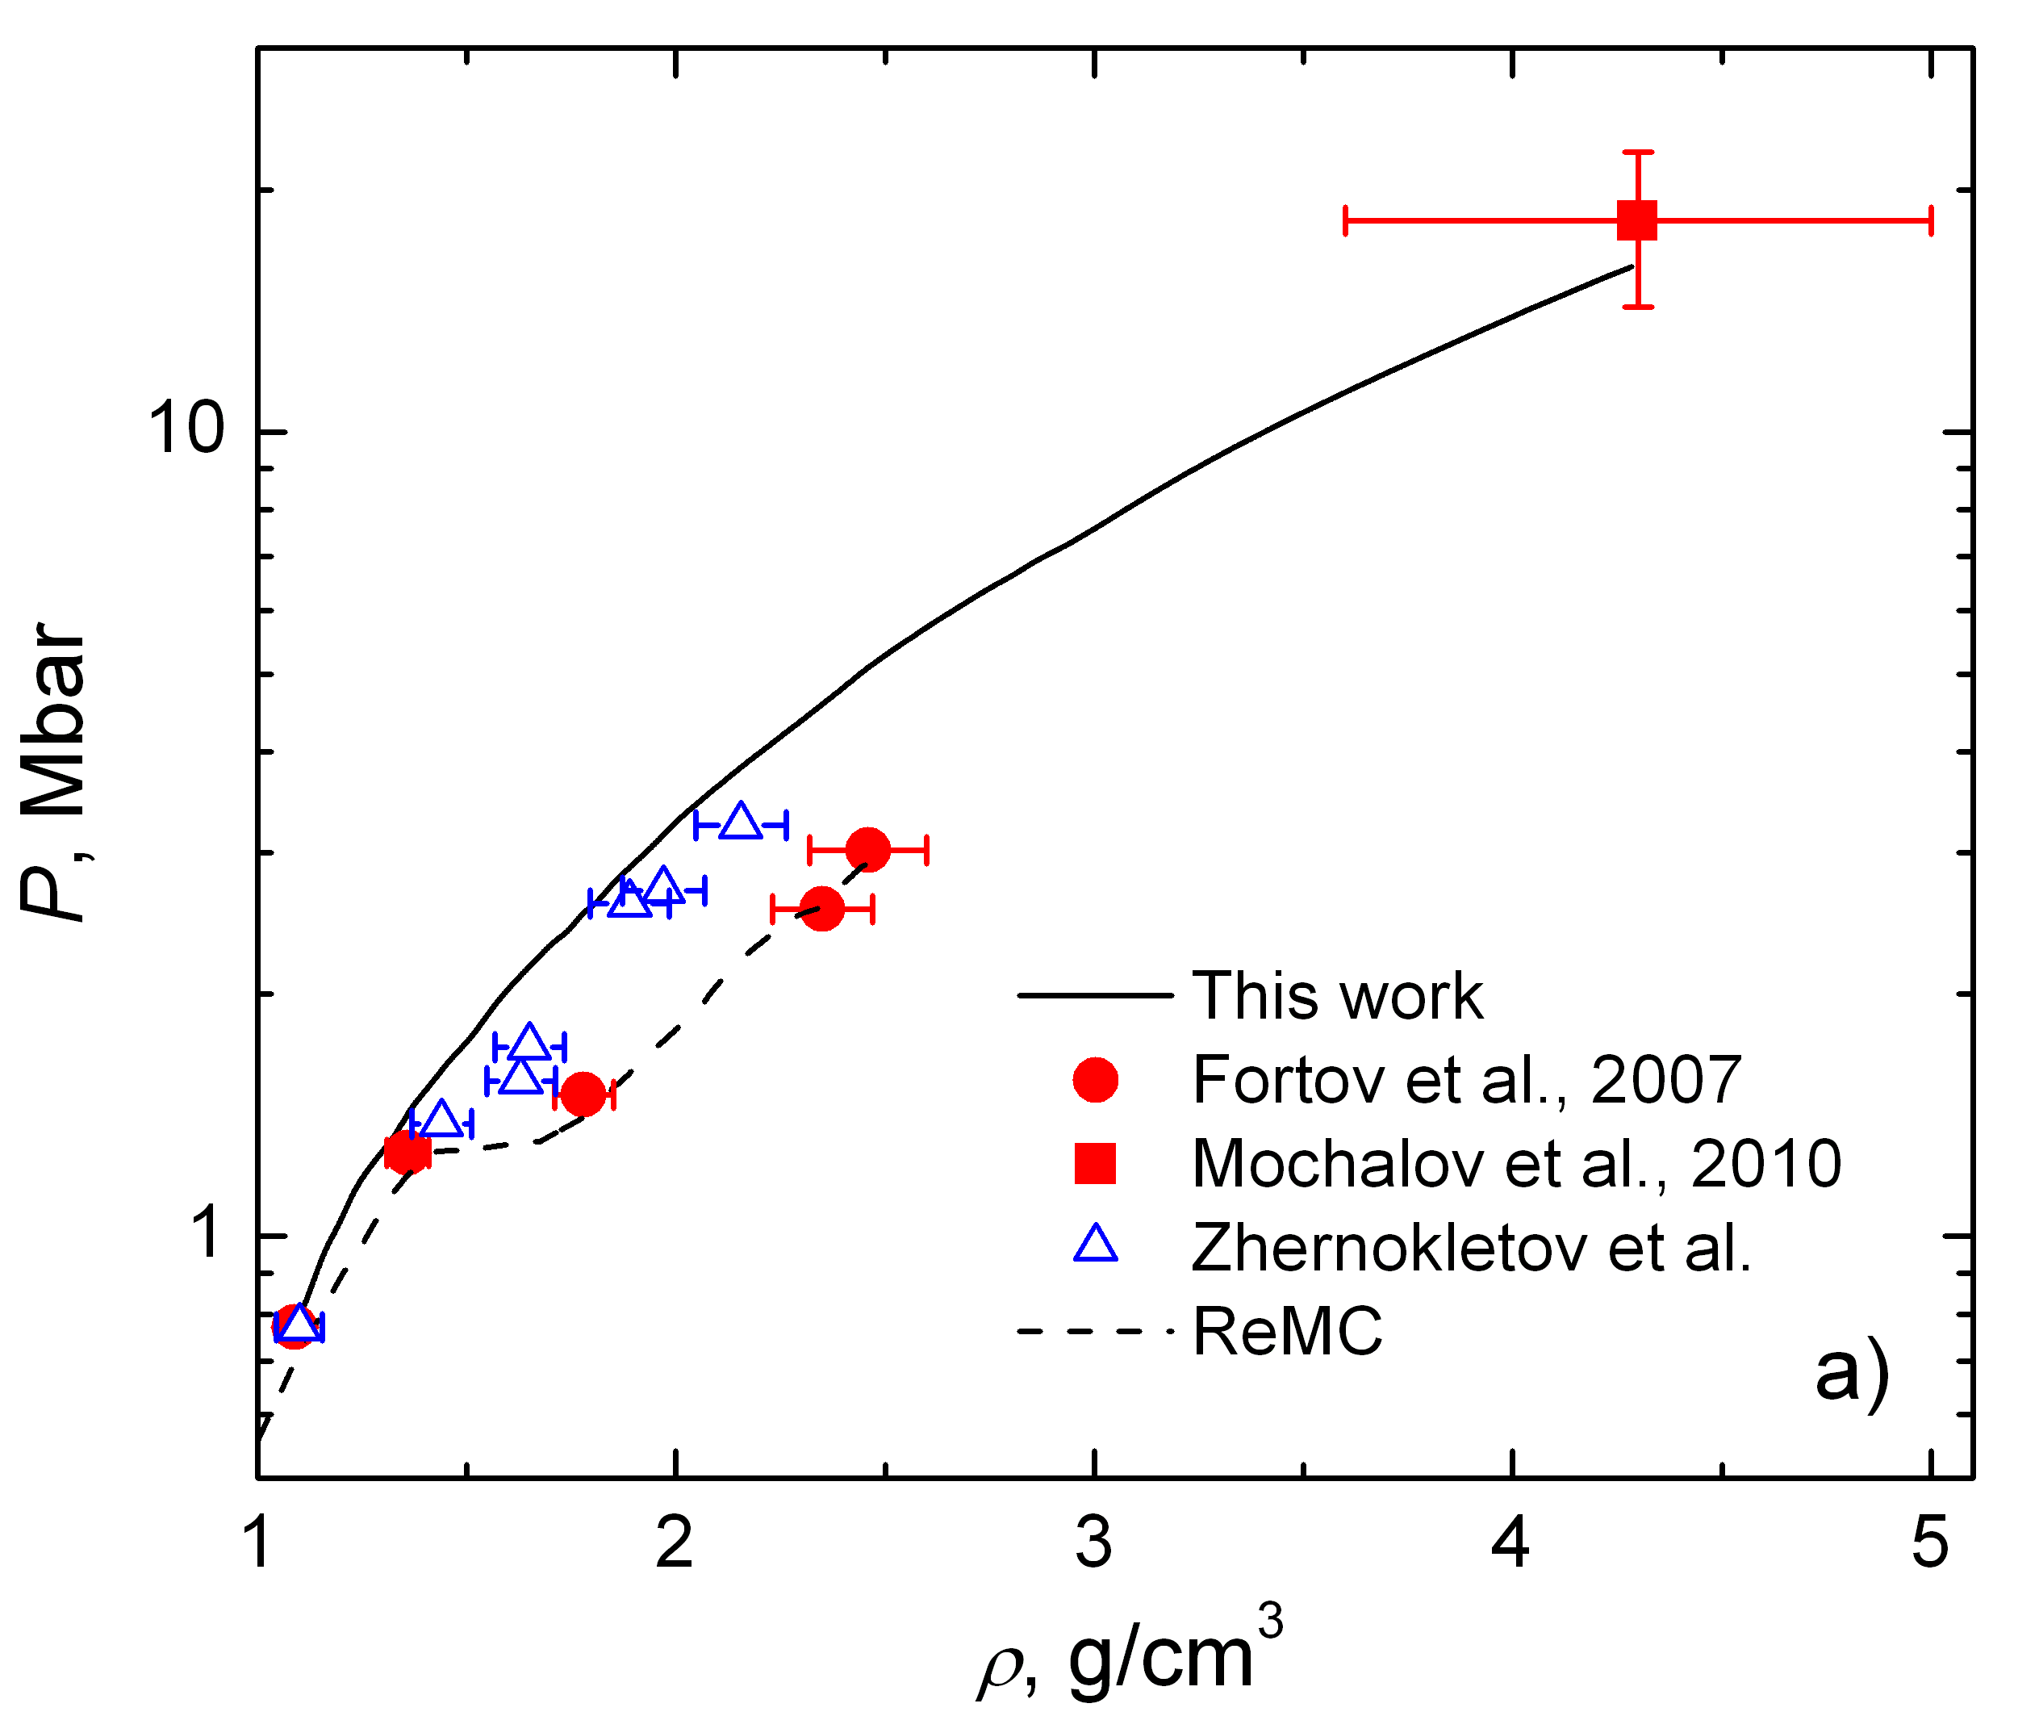
Compression Isentrope of Deuterium
Deuterium
T₀ = 7.6 kK (AIMD)
T₀ = 3.1 kK (EOS)
T₀ = 2.1 kK (SAHA-D)
T₀ = 1 kK (ReMC)

Slide 33
Ab initio complex electrical conductivity
JIHT
RAS
Complex electrical conductivity:
electrical field
strength
current
density
The real part of conductivity is responsible for energy absorption by electrons and is calculated by Kubo-Greenwood formula:
occupancies for the
energy level ε
broadening is required
Kubo-Greenwood formula includes matrix elements of the velocity operator, energy levels and occupancies calculated by DFT
The imaginary part of conductivity is calculated by the Kramers-Kronig relation:
L.L. Moseley, T. Lukes, Am.J.Phys, 46, 676 (1978)
Notes:
33
33

Slide 34
JIHT
RAS
Transport properties:
Onsager coefficients
Definition of Onsager coefficients L_{mn}:
electric field
strength
temperature
gradient
current
density
L₁₁ – electrical conductivity
heat flow
density
Onsager coefficients are symmetric:
L₁₂ = L₂₁
at
Using the Onsager coefficients the thermal conductivity coefficient becomes:
thermoelectric term
Wiedemann-Frantz law:
Lorentz number

Slide 35
Optical properties
Imaginary part of electrical conductivity is calculated from the real one by the Kramers-Kronig relation:
Real and imaginary parts of complex dielectric function:
Complex index of refraction:
Reflectivity:
Static electric conductivity is calculated by linear extrapolation (by 2 points) of dynamic electrical conductivity to zero frequency
Notes:
35

Slide 36
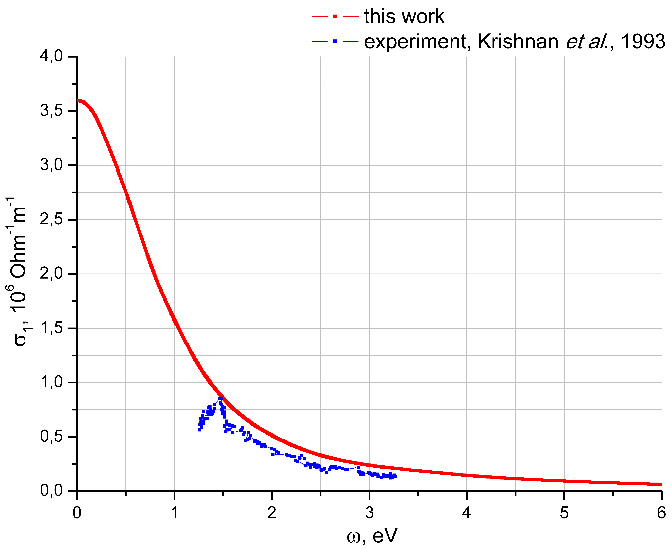
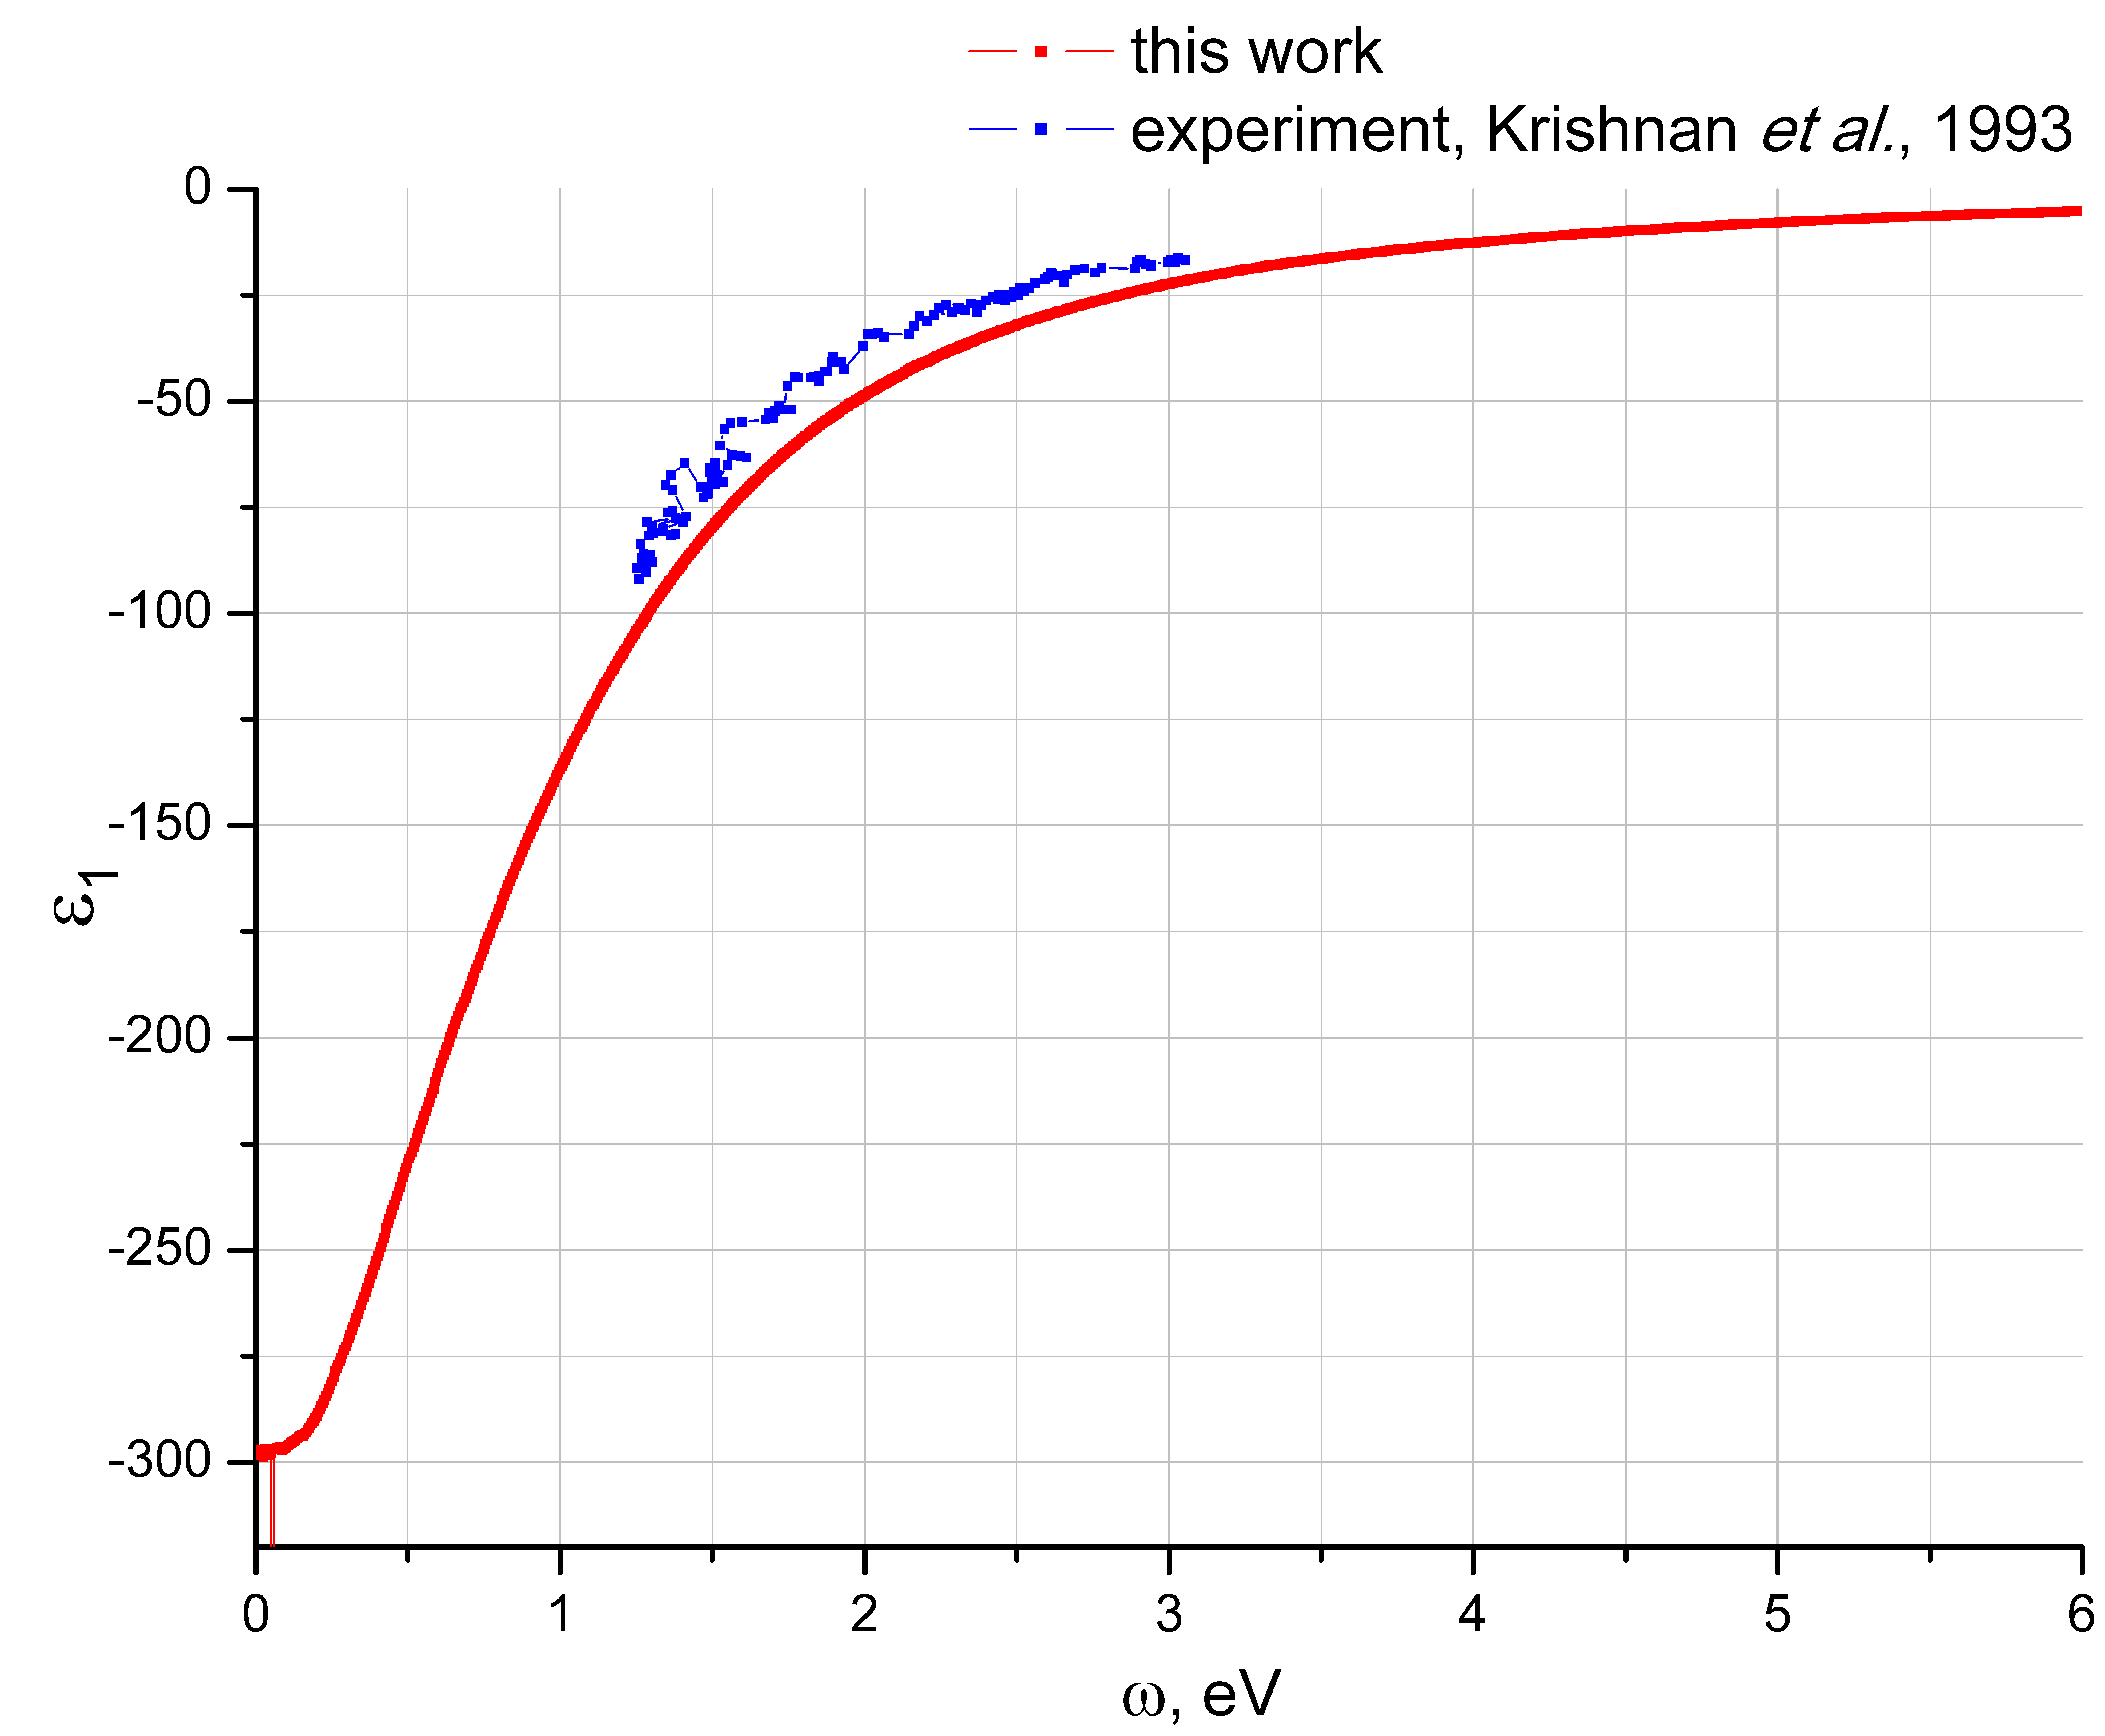
Al, T=1550 K, ρ=2.23 g/cm³
Real part of electrical conductivity
Real part of dielectric function
256 atoms; US pseudopotential; 1 k-point in the Brillouine zone; cut-off energy 200 eV;
δ-function broadening 0.1 eV; 15 configurations; 1500 steps; 1 step – 2 fs
In liquid phase the dependence of electrical conductivity is Drude-like.
The agreement with reference data is good
Krishnan et al., Phys. Rev. B, 47, 11 780 (1993)

Slide 37
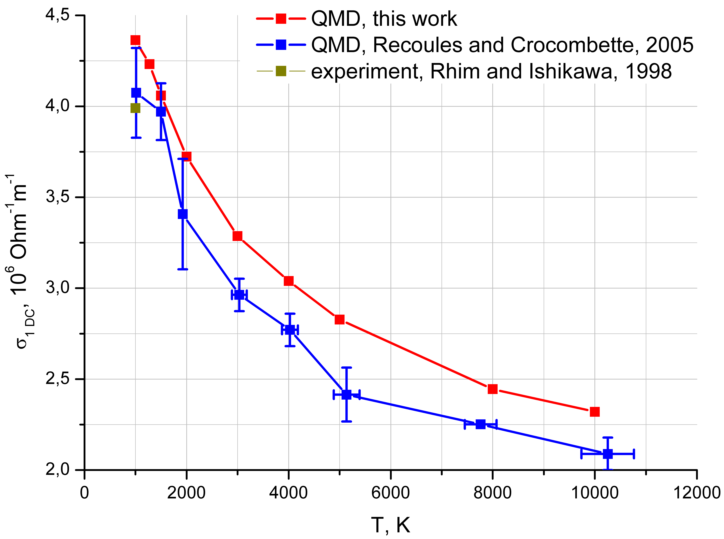
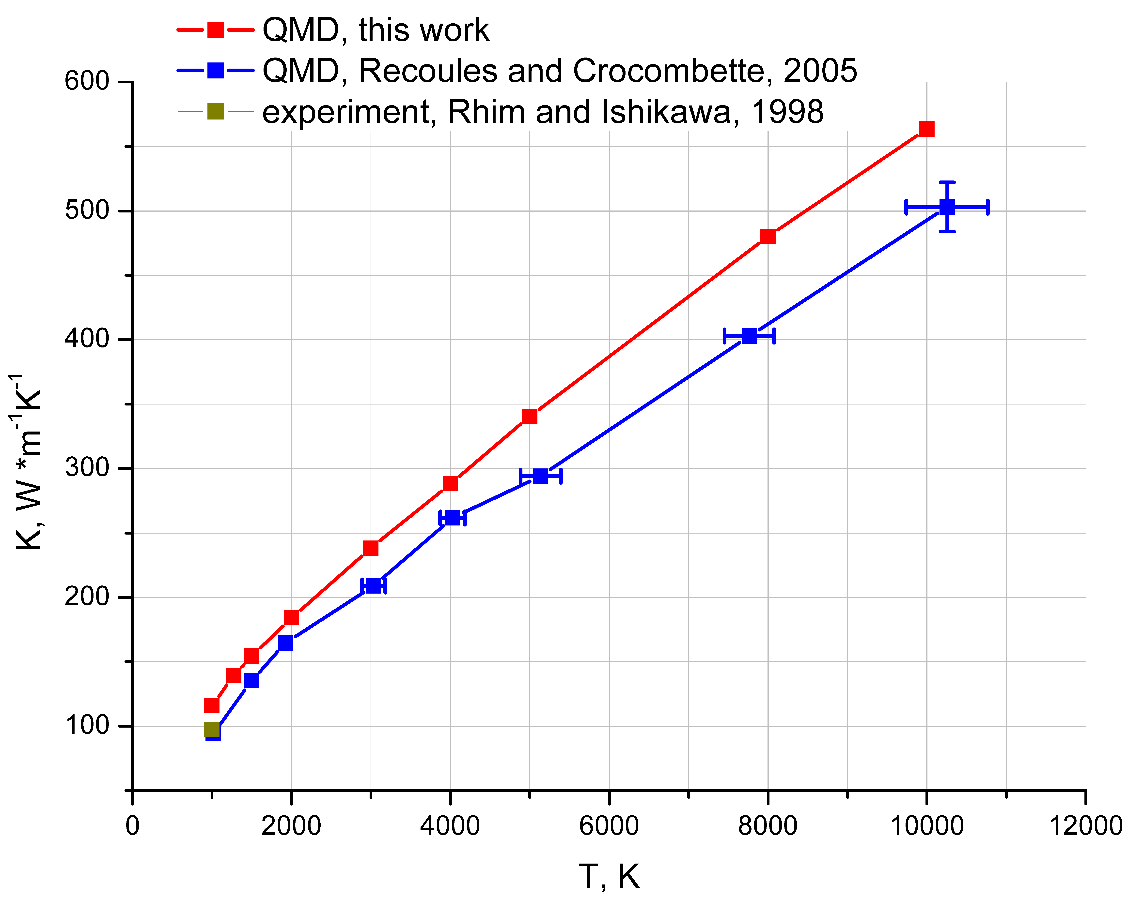
Al, 1000 K – 10000 K, ρ = 2.35 g/cm³
Static electrical conductivity
Thermal conductivity coefficient
108 particles
108 particles
256 particles
256 particles
256 atmos; US pseudopotential; 1 k-point in the Brillouin zone; energy cut-off 200 eV; δ-function broadening 0.07 eV - 0.1 eV ; 15 configurations; 1500 steps; 1 step – 2 fs
Thermoelectric correction is not more than 2% at T < 10 kK
Recoules and Crocombette, Phys. Rev. B, 72, 104202 (2005)
Rhim and Ishikawa, Rev. Sci. Instrum., 69, 10, 3628-3633 (1998)

Slide 38
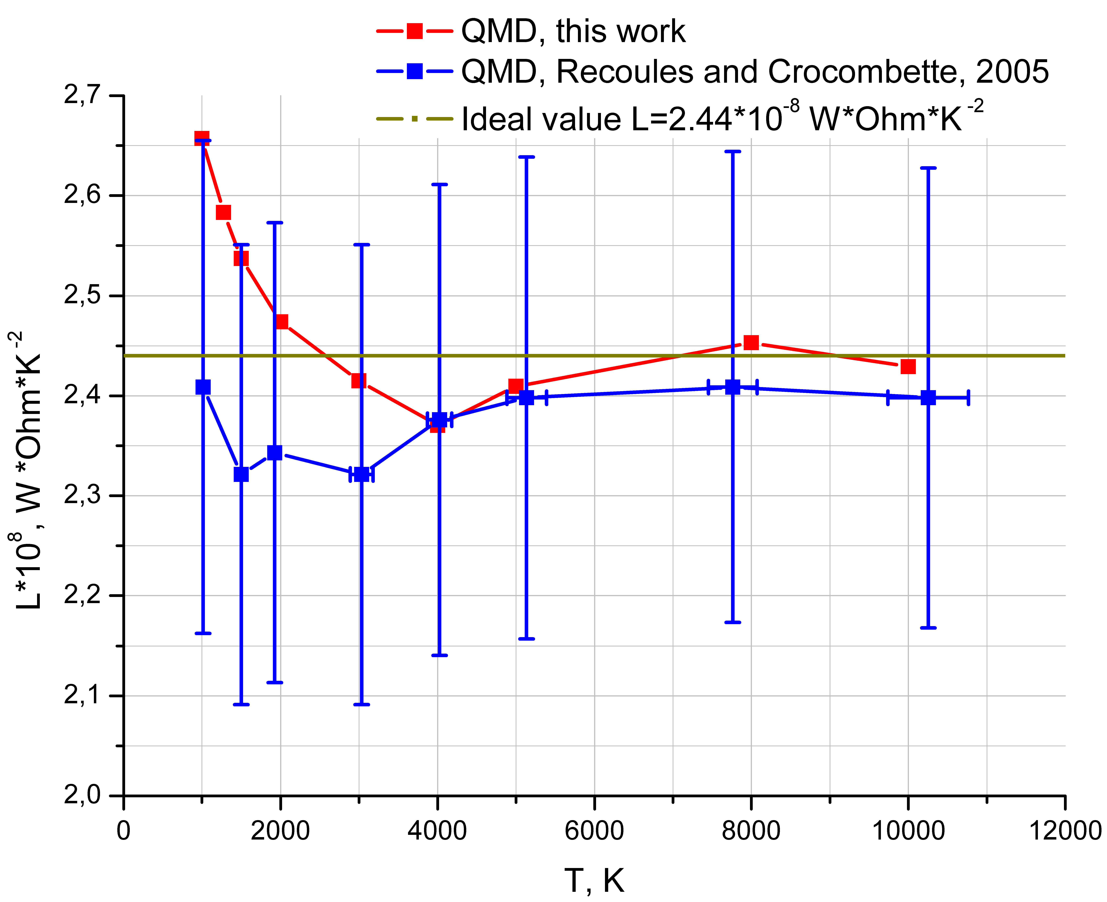
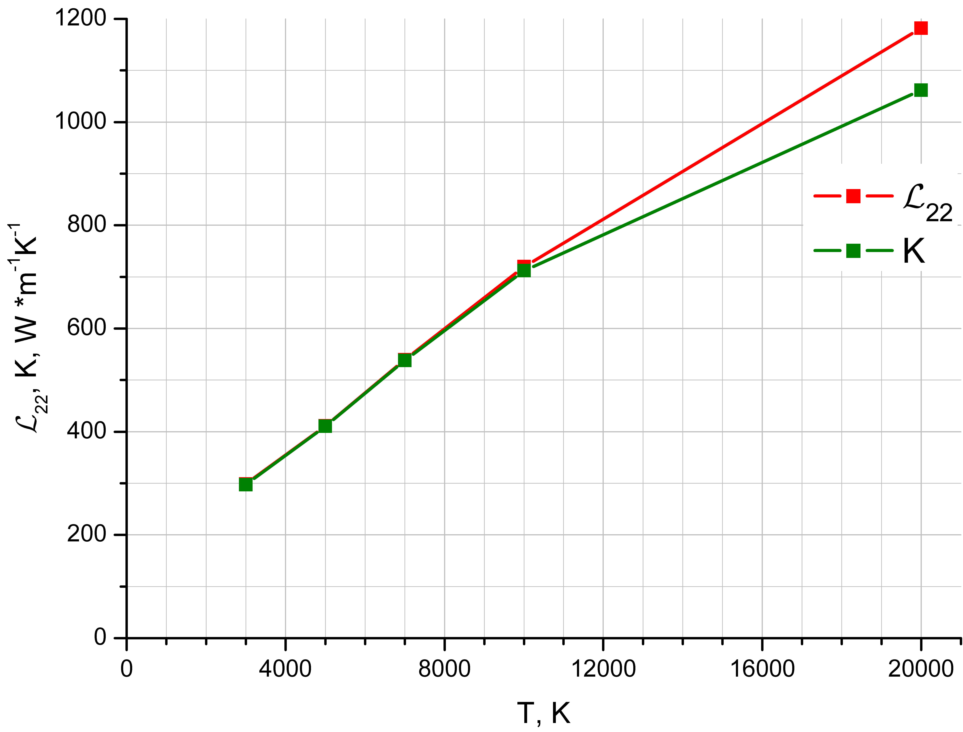
JIHT
Al, 1000 K – 20000 K, 2.35-2.70 g/cm³
RAS
Dependence of Lorentz number
on temperature
Thermal conductivity and Onsager L₂₂ coefficient, temperature dependence
Thermoelectric
Correction, ~10%
Al ρ=2.35 г/см³
Al ρ=2.70 г/см³
256 atoms; US pseudopotential; 1 k-point in the Brillouin zone; energy cut-off 200 eV; δ-function broadening
0.07 eV - 0.1 eV; 15 configurations; 1500 steps; 1 step – 2 fs
Distinction of Lorentz number from the ideal value is about 20%.
Thermoelectric correction is substantial only at 20 kK (10%).
Recoules and Crocombette, Phys. Rev. B, 72, 104202 (2005)

Slide 39
Beyond DFT and Mean Atom: Path Integral Monte Carlo and Wigner Dynamics

Slide 40
JIHT
PATH INTEGRAL MONTE-CARLO METHOD
for degenerate hydrogen plasma
(V. M. Zamalin, G. E. Norman, V. S. Filinov, 1973-1977)
RAS
Binary mixture of N_{e} quantum electrons,
N_{i} classical protons
Partition function:
Density matrix:
n+1

Slide 41
JIHT
PATH INTEGRAL MONTE-CARLO METHOD
RAS
electron
e_{b}
r⁽²⁾
P_{a}
λ_{e}
λ_{Δ}
r^{(n+1)} = r
σ’ = σ
r^{(n)}
r⁽¹⁾ = r + λ_{Δ}ξ⁽¹⁾
q_{a}
proton
r
r_{b}
parity of
permutation
thermal
wavelengths of
electron and ion
permutation
operator
spin
matrix

Slide 42
JIHT
PATH INTEGRAL MONTE-CARLO METHOD
RAS
Path integral representation of density matrix:
spin
matrix
permutation
operator
,
kinetic part
of density
matrix
exchange
effects

Slide 43
KELBG PSEUDOPOTENTIAL
JIHT
RAS
First order perturbation theory solution of two-particle Bloch equation
for density matrix in the limit of weak coupling
Diagonal Kelbg potential:
Ebeling et al., Contr. Plasma Phys., 1967

Slide 44
JIHT
ACCURACY OF DIRECT PIMC
RAS
n+1
1 at n -> ∞
Error ~ (β / n)² for every multiplier
Total error Δρ ~ β² / n -> 0 at n->∞
High-temperature
pseudopotential

Slide 45
JIHT
TREATMENT OF EXCHANGE EFFECTS
RAS
Inside main cell –
exchange matrix
Outside main cell –
by perturbation theory
λ_{e}
e
Main
MC cell
Accuracy control –
comparison with ideal
degenerate gas
e
Filinov V.S. // J. Phys. A: Math. Gen. 34, 1665 (2001)
Filinov V.S. et al. // J. Phys. A: Math. Gen. 36, 6069 (2003)

Slide 46
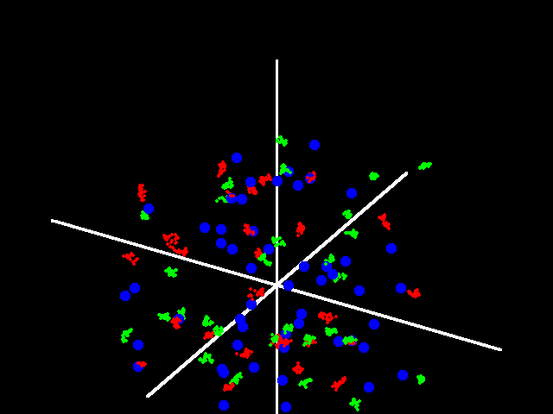
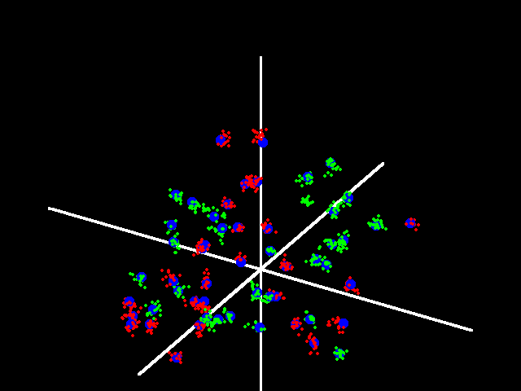
HYDROGEN, PIMC-SIMULATION, n = 10²¹ cm⁻³
N_{e} = N_{i} = 56, n = 20
T = 50 kK
ρ = 1.67x10⁻³ g/cm³
Γ = 0.54
nλ³ = 3.7 x10⁻²
T = 10 kK
Γ = 2.7
nλ³ = 0.41
- proton
- electron
- electron

Slide 47
HYDROGEN, PIMC-SIMULATION AND CHEMICAL PICTURE, n_{e} = 10²⁰, 10²¹ cm⁻³
Pressure
Energy
D. Saumon, G. Chabrier, H.M. Van Horn, Astrophys. J. Suppl.Ser. 1995. V.99. P.713

Slide 48
DEUTERIUM SHOCK HUGONIOTS
2000
- NOVA
Grishechkin et al. Pis’ma
v ZhETF. 2004. V.80. P.452
(hemishpere)
1000
- NOVA
800
600
- gas gun
400
- Z-pinch
- Mochalov
200
- Mochalov
, GPa
- Trunin
100
- REMC
P
80
60
- DPIMC
40
20
0.171 g/cm³
2720 bar
10
0.153 g/cm³
2000 bar
8
6
ρ
, g/cm
3
0.1335 g/cm³
1550 bar
4
3
0,4
0,6
0,8
1,0

Slide 49
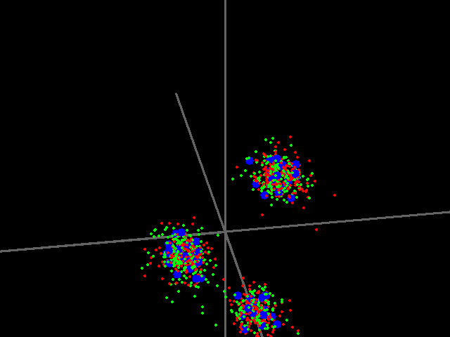
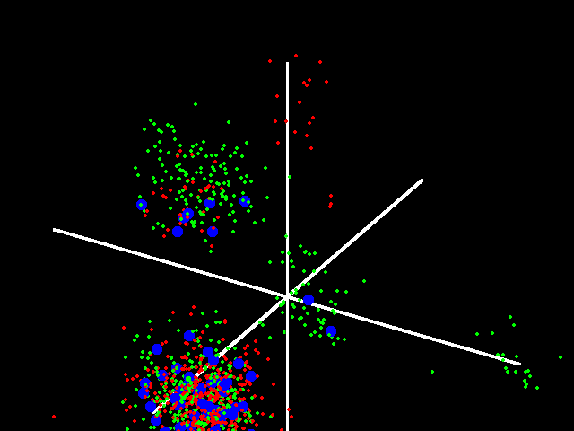
HYDROGEN, PIMC-SIMULATION, T = 10000 K
N_{e} = N_{i} = 56, n = 20
n = 3x10²² cm⁻³
ρ = 0.05 g/cm³
Γ = 8. 4
nλ³ = 12.4
n = 10²³ cm⁻³
ρ = 0.167 g/cm³
Γ = 12.5
nλ³ = 41
- proton
- electron
- electron

Slide 50
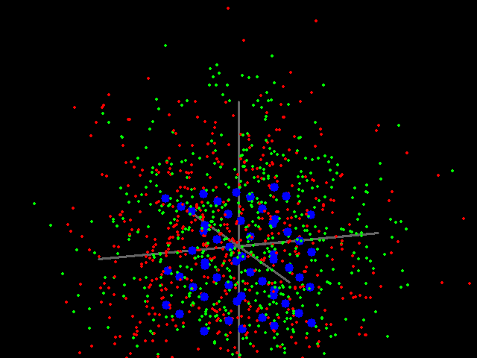
PIMC SIMULATION
- proton
N_{e} = N_{i} = 56, n = 20
- electron
protons ordering
- electron
5
30r²g_{ee}
4
3
g_{ii}
g_{ee}
2
T = 10000 K,
n = 3x10²⁵ cm⁻³,
ρ = 50.2 g/cm³
Γ = 84
nλ³ = 12400
g_{ei}
1
0
0.1
0.2
r/a_{B}
JETP Letters 72, 245 (2000)
50

Slide 51

ELECTRON DENSITY DISTRIBUTION IN TWO-COMPONENT DEGENERATE SYSTEM
IN COULOMB CRYSTAL
- hole
m_{h}= 800
m_{e}= 2.1
<r>/a_{B} = 3
ρ = 25
T / E_{b} = 0.002
- hole
- electron
top view
side view
- electron
51

Slide 52
QUANTUM DYNAMICS IN WIGNER REPRESENTATION
Quasi-distribution function in phase space for the quantum case
Density matrix:
Wigner function:
Evolution equation:
Classical limit ħ -> 0:
Characteristics (Hamilton equations):

Slide 53
SOLUTION OF WIGNER
EQUATION
Dynamical trajectories:
Propagator:

Slide 54

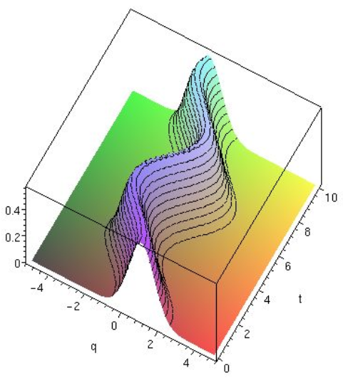
Quantum dynamics
in Wigner representation
Dynamic conductivity
T = 2·10⁴ K
r_{s} = 43.2
Veysman et al.
Tkachenko et al.
Bornath et al
λ
initial quantum
distribution
QD
hν = Ry
ω / ω_{p}
5000-20000 configurations
random
+ momentum
jumps
QD
T = 2·10⁴ K
r_{s} = 5
hω = Ry
QD
Bornath et al.
Ternovoi et al.
ω / ω_{p}

Slide 55
Conclusions
Ab initio methods are useful for calculation of different properties of matter at high energy density
The main goal of ab initio methods is to replace experiment; in some cases it’s already possible
Growth of computational possibilities will allow to apply more general approaches for calculation of plasma properties (quantum filed theory)
Currently, however, semiempirical approaches are main workhorses; ab initio methods are used for calibration of such models

Slide 56
Thermodynamic Functions of Thomas-Fermi Model
Free energy:
ϕ - dimensionless atomic potential, φ = ϕ / (u²T), υ_{a} – cell volume, u = (r / r₀)^{1/2}
Expressions for 1st derivatives of F (P and S) are known.
Second derivatives of free energy
Shemyakin O.P. et al., JPA 43, 335003 (2010)

Slide 57
Second Derivatives of the Thomas-Fermi Model
The number of particles and potential are the functions of the grand canonical ensemble variables, which are in turn depend on the variables of the canonical ensemble:
From the expressions for (N’_{T})_{N,υ}, (ϕ’_{T})_{N,υ} и (N’_{υ})_{T,N} one can obtain:
We need
6 derivatives in the grand canonical ensemble
Shemyakin O.P. et al., JPA 43, 335003 (2010)

Slide 58
TF Potential and its Derivatives on μ, υ and T
Poisson equation
Derivative of the Poisson equation on υ:
Derivative on μ:
Derivative on T:

Slide 59
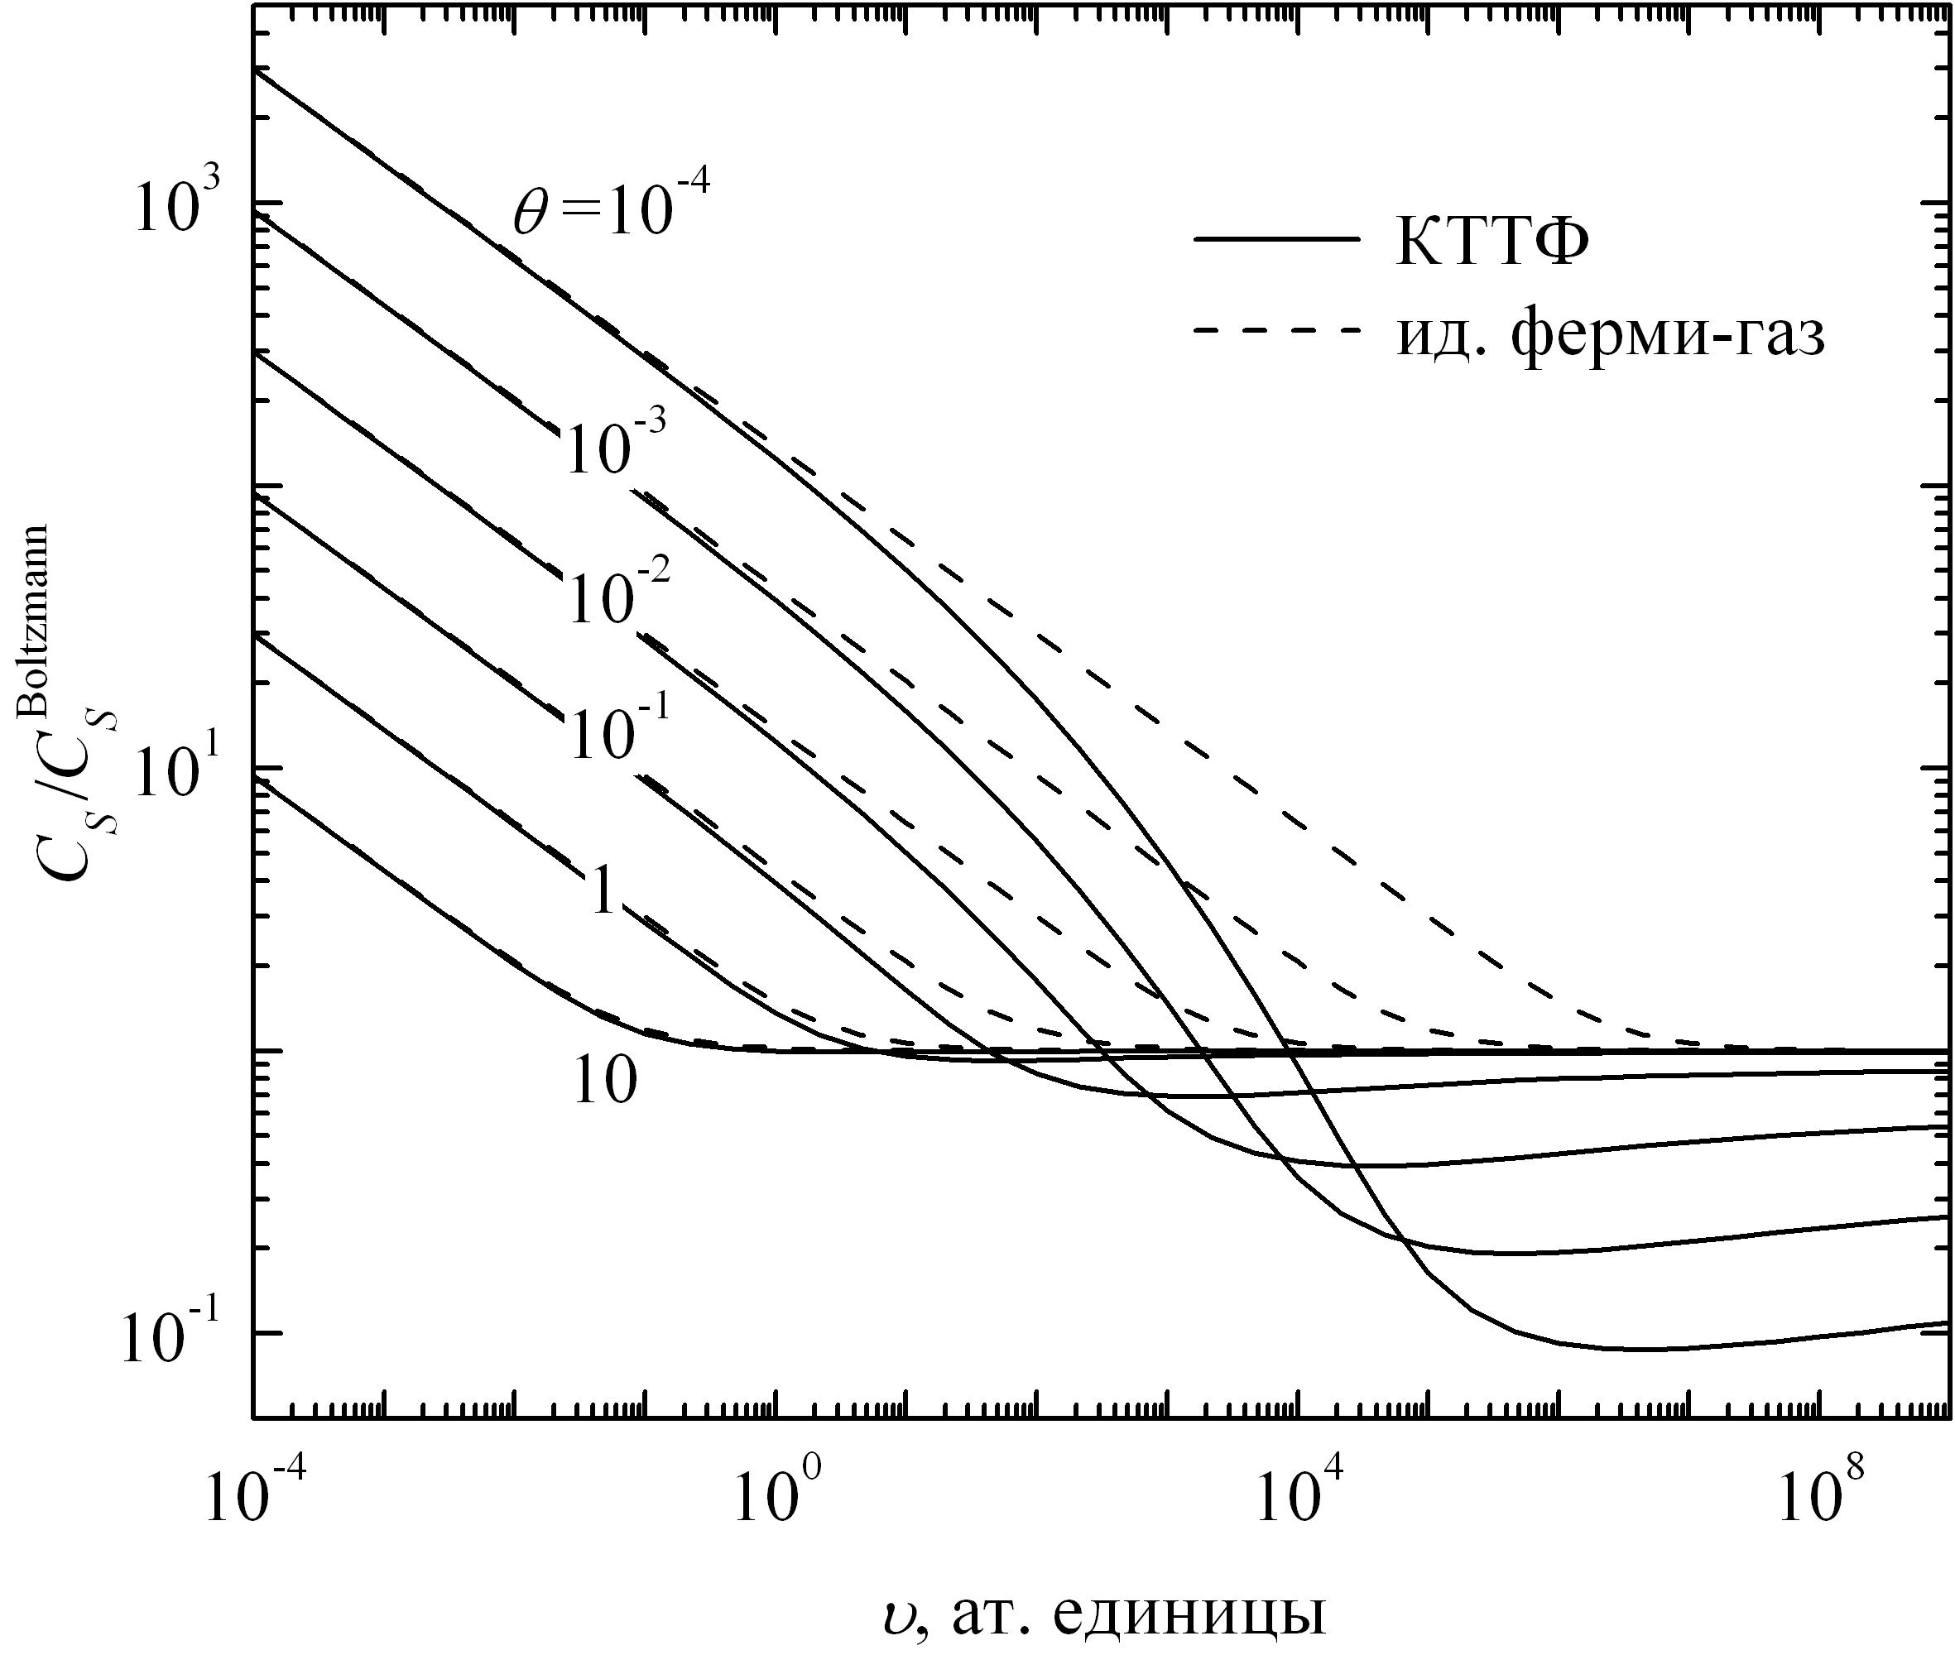
Adiabatic Sound Velocity by Thomas-Fermi Model
Isotherms
V
Ideal Fermi-gas
V, atomic units

Slide 60
PROBLEMS OF TF MODEL
Thomas-Fermi method is quasiclassical; if one calculates energy levels in V_{TF}(r) using the Shrödinger equation and then electron density ρ_{quant}(r), it will differ from the original TF electron density ρ(r)
Mean ion charge is roughly determined
The solution is to make ρ (r) self-consistent and use the corrected potential and electron density

Slide 61
MEAN ION CHARGE (HFS)
ρ = const
Al
ρ = 10⁻³ g/cm³
Thomas-Fermi
Chemical plasma
model
Hartree-Fock-Slater

Slide 62
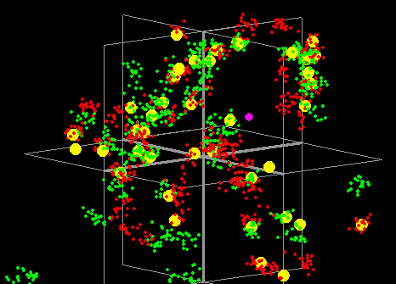
TYPICAL CONFIGURATION OF PARTICLES
H + He mixture, T = 10⁵ K, n_{e} = 10²³ cm⁻³
40 α-particles, 2 protons, 82 electrons
α-particle
proton
electron, ⬆
He⁺
electron, ⬇
He

Slide 63
ENERGY IN H + He MIXTURE ON ISOTHERMS
200 kK
Ideal, 100 kK
100 kK
50 kK
40 kK
D. Saumon, G. Chabrier, H.M. Van Horn, Astrophys. J. Suppl.Ser. 1995. V.99. P.713

Slide 64
ELECTRON-HOLE PLASMA. PIMC SNAPSHOT
crystal, m_{h}(eff) = 800, m_{e}(eff) = 1
<r>/a_{B} = 0.63
T = 0.064E_{b}
- hole
- hole
- electron
- electron
64

Slide 65
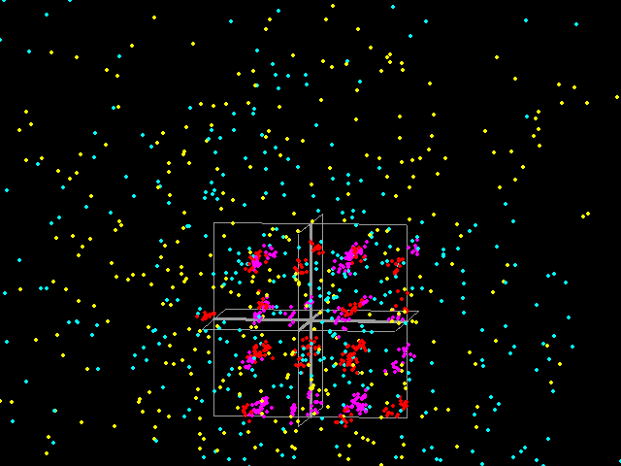
ELECTRON-HOLE PLASMA. PIMC SNAPSHOT
still crystal, m_{h}(eff) = 100, m_{e}(eff) = 1
<r>/a_{B} = 0.63
T = 0.064E_{b}
- hole
- hole
- electron
- electron
65

Slide 66
ELECTRON-HOLE PLASMA. PIMC SNAPSHOT
liquid, m_{h}(eff) = 25, m_{e}(eff) = 1
<r>/a_{B} = 0.63
T = 0.064E_{b}
- hole
- hole
- electron
- electron
66

Slide 67
ELECTRON-HOLE PLASMA. PIMC SNAPSHOT
unordered plasma, m_{h}(eff) = 1, m_{e}(eff) = 1
<r>/a_{B} = 0.63
T = 0.064E_{b}
- hole
- hole
- electron
- electron
67

Slide 68
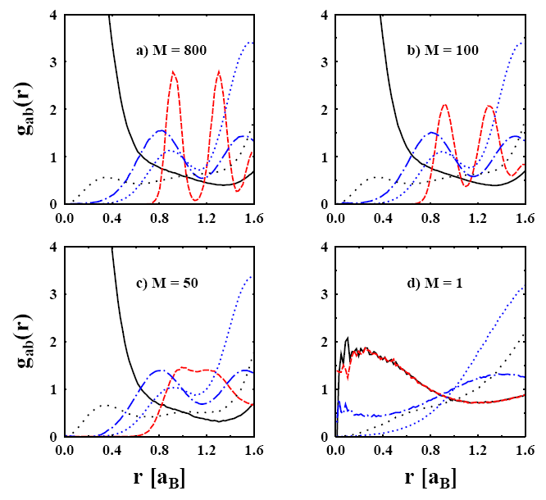
PAIR DISTRIBUTION FUNCTIONS. QUANTUM MELTING
<r>/a_{B} = 0.63
e-e
h-h
e-e
T = 0.064E_{b}
h-h
M = m_{h} / m_{e}
e-e
e-e
h-h
h-h
68

Slide 69
PSEUDOPOTENTIALS IN DFT
Diminish the number of plane waves necessary for the good representation of inner electrons wave functions
Part of electrons are considered as a core, part as valent
Pseudopotential is constructed at T = 0 and doesn’t depend on pressure and temperature
Pseudopotential approach
Full-potential approach
muffin-tin orbitals
for all electrons
Valent
electrons
(plane waves)
Core
electrons
(pseudopotential)

Slide 70
APPROXIMATIONS IN PSEUDOPOTENTIAL APPROACH
  Pseudopotential describes electrons with energies less than the Fermi energy – errors at relatively high temperatures
E_{F}
E_{F}
T = 0
T > 0
  Spatial distribution of core electrons in a pseudopotential is unchanged – errors at relatively high pressures
P = 0
P > 0

Slide 71
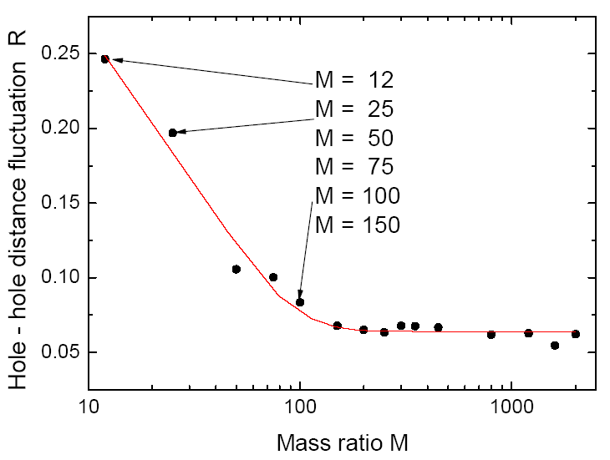
  HOLE-HOLE DISTANCE FLUCTUATIONS
Lindemann criterion
71

Slide 72
Electron Heat Capacity for W at T = 11eV. Return of Free Electrons into 4f-state under Compression
JIHT
RAS
W, bcc
W, bcc, T = 11 eV
Electron heat capacity
Fraction of f-electrons
C_{V} / C_{V}(ρ₀)
Number of
returned electrons (%)
Compression ratio
Compression ratio
Electrons return to 4f state under compression

