Slide 1
Mass renormalization of Majorana neutrinos
in nuclei and its phenomenological consequences
M. I. Krivoruchenko (ITEP, Moscow)
coauthored with S. G. Kovalenko (USM,Valparaiso)
and F. Simkovic (JINR, Dubna)
Low energy 4-fermion ΔL ≠ 0 Lagrangian
In-medium Majorana mass of neutrino
0νββ constraints on the universal scalar couplings
Seminar BLTF, JINR
Dubna, 31 October 2013

Slide 2
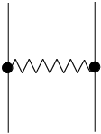
Introduction
gO_{A}
gO’_{A}
χ
q
ν
scalar boson (naively)
oscillation experiments
&
tritium β-decay:
0νββ-decay:
density →
q
χ

Slide 3
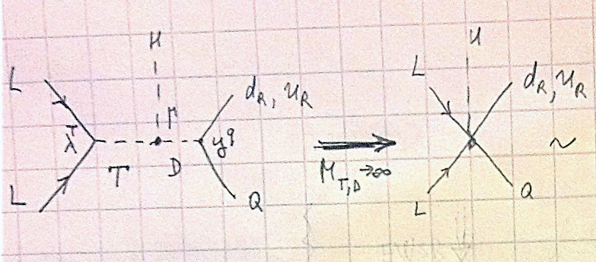
Introduction
EW group content

Slide 4
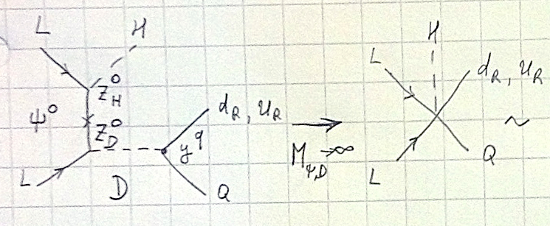
Introduction
EW group content

Slide 5
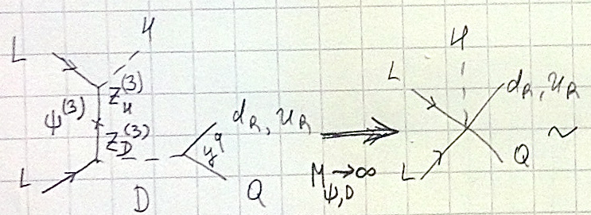
Introduction
EW group content

Slide 6
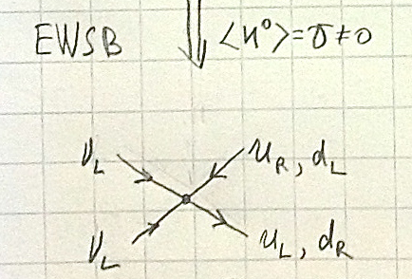
Introduction

Slide 7
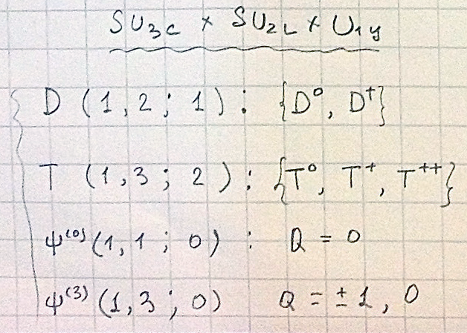
Introduction
A similar
is also generated
by vector
leptoquarks

Slide 8
Non-standard interactions might be more easily detected in nuclei rather than in the vacuum.
Plan:
Classification of the vertices gO_{A} and gO’_{A}
Evaluation of the in-medium Majorana mass of neutrino:
m_{ν}^{eff} =
Derive constraints for gO_{A} and gO’_{A} and m_{χ}
using the 0νββ decay constraints
q
gO_{A}
χ
gO’_{A}

Slide 9
Classification of the vertices gO_{A} and gO’_{A}
in terms of two-neutrino currents:
Permutations:
where Therefore
Similar to: Schepkin and Zaboronsky, 1993
M.I.K. et al., 2011

Slide 10
Classification of the vertices gO_{A} and gO’_{A}
General expansion:
where d_{AB} are numbers,
even

Slide 11
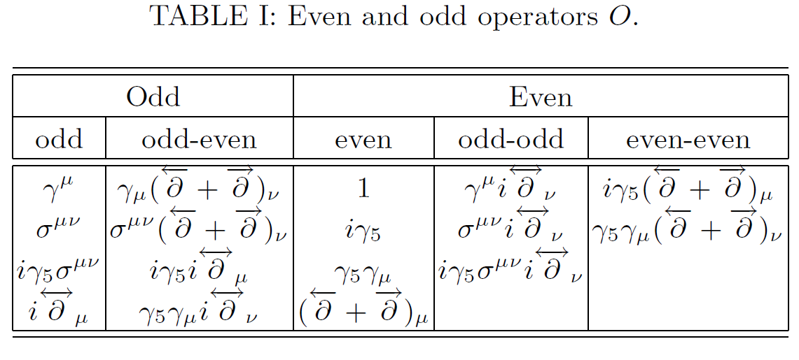
Classification of the vertices gO_{A} and gO’_{A}

Slide 12
Classification of the vertices gO_{A} and gO’_{A}
In nuclei, mean fields are created by scalar and vector currents. Vector currents do not flip the spin of neutrinos and do not contribute the 0νββ decay.
Of all the expressions we choose the scalar combinations:

Slide 13
Classification of the vertices gO_{A} and gO’_{A}
with Majorana neutrinos:
gª_{ij} are real symmetric for a = 1,2,3,4
and imaginary antisymmetric for a = 5,6.
is Lorentz scalar - flavor scalar: MF = S&V&I = 0

Slide 14
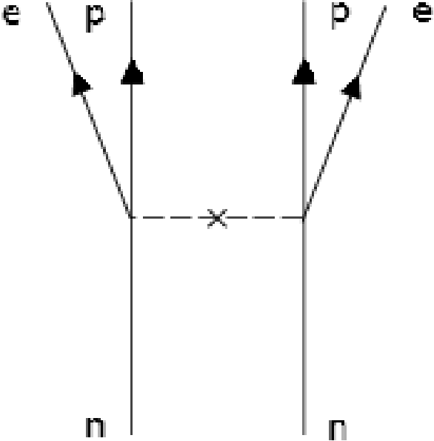
In-medium Majorana mass of neutrino
Vacuum 0νββ decay mechanism

Slide 15
In-medium Majorana mass of neutrino
Induced 0νββ decay mechanism
χ
χ

Slide 16
In-medium Majorana mass of neutrino
Induced 0νββ decay mechanism
In heavy nuclei: R ∼ 5 fm
The momentum transferred in the neutrino exchange
p_{F} ∼ 280 MeV = 1/(0.7 fm).
We work in the limit of R = ∞, justified for m_{χ} >> 40 MeV.
χ
χ

Slide 17
In-medium Majorana mass of neutrino
Mean field: and
from MIT bag model
To compare with weak interaction
NB: baryon vector charge of the nucleon = 1
baryon scalar charge of the nucleon ∼ 1/2

Slide 18
In-medium Majorana mass of neutrino
The effect depends on the product . Typical scale:
We expect
In the limit of R = ∞, the currents a = 3,5 vanish (total derivatives). These currents work, however, for R < ∞.

Slide 19
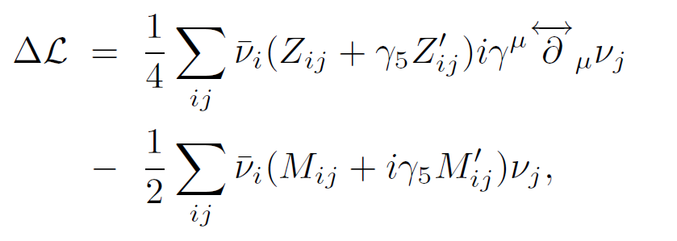
In-medium Majorana mass of neutrino
Lagrangian: free + 4-fermion in the MF approx.
where

Slide 20
In-medium Majorana mass of neutrino
→ diagonalized by a unitary matrix V :
→ diagonalized by the same (!) matrix V :
After rescaling: NB: ν’^{c} = ν’

Slide 21
In-medium Majorana mass of neutrino
M & M’ are real symmetric
still is invariant under with
→ like complex
symmteric
A, B, W are real
W → like unitary

Slide 22
In-medium Majorana mass of neutrino
gets finally diagonalized with

Slide 23
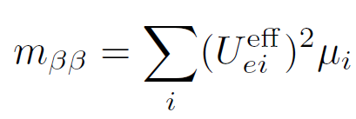
In-medium Majorana mass of neutrino
After the diagonalization
with
the in-medium takes the free form
The effective Majorana mass in the 0νββ decay:
in-medium part
Pontecorvo–Maki–Nakagawa–Sakata matrix

Slide 24
Experimental constraints
¹³⁶Xe: M. Auger et al.,
Phys. Rev. Lett. 109, 6 (2012).
⁷⁶Ge: H. V. Klapdor-Kleingrothaus
and I. V. Krivosheina,
Mod Phys Lett A 21, 1547 (2006).
³H: 95% CL V. N. Aseev et al.,
Phys Rev D 84, 112003 (2011) Ch. Kraus et al.,
Eur. Phys. J. C 40, 447 (2005).
CMB: S. Thomas, F. Abdalla, O. Lahav, Phys Rev Lett 105, 031301 (2010) P. A. R. Ade et al. [Planck Collaboration], arXiv:
1303.5076 [astro-ph.CO].

Slide 25
Universal scalar interaction
The effective Lagrangian is taken to the free form with
where
The in-medium neutrino masses

Slide 26
Universal scalar interaction
We adopt the more general Majorana condition
with The effective mass of the 0νββ decay
T
Effective mass of
Majorana neutrinos

Slide 27
Universal scalar interaction
3 cases:
g₁ ≠ 0
g₂ ≠ 0
g₄ ≠ 0
We adopt the more general Majorana condition
with The effective mass of the 0νββ decay
T
Effective mass of
Majorana neutrinos

Slide 28
Universal scalar interaction
Normal Spectrum (NS):
±(0.048 eV)²
(0.0086 eV)²
Inverted Spectrum (IS):

Slide 29
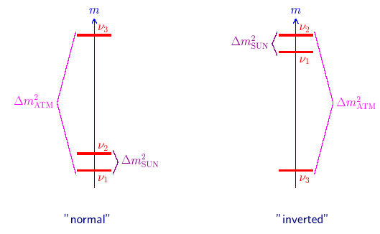
Universal scalar interaction

Slide 30
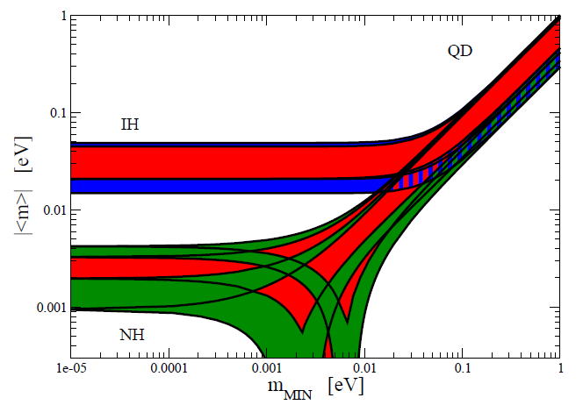
Universal scalar interaction
PDG (2012)

Slide 31
Universal scalar interaction g₁ = g₂ = 0 g₄ ≠ 0
The effect of is particularly simple:
The scale of the 0νββ amplitude is not fixed.
can be small and can be large, or vice versa

Slide 32
Universal scalar interaction g₄ = g₁ = 0 g₂ ≠ 0
The effect of can be derived from that of
g₁ = g₂ = g₃ = 0:
Suppose then
For m_{ββ} = 0.2 eV and m₀ = 0 ε₂ = 1/50.

Slide 33
Universal scalar interaction g₂ = g₄ = 0 g₁ ≠ 0
The effect of is studied numerically
ONE Dirac fermion with the mass m is the superposition of TWO Majorana fermions with masses ±m
The signs of the Majorana masses are no longer absorbed by the CP violating phases
-1 eV < ⟨χ⟩g₁ < 1 eV 2³ = 8/2 → 4

Slide 34
Universal scalar interaction g₂ = g₄ = 0 g₁ ≠ 0
The effect of is studied numerically
ONE Dirac fermion with the mass m is the superposition of TWO Majorana fermions with masses ±m
The signs of the Majorana masses are no longer absorbed by the CP violating phases
-1 eV < ⟨χ⟩g₁ < 1 eV 2³ = 8/2 → 4

Slide 35
Universal scalar interaction g₂ = g₄ = 0 g₁ ≠ 0
m > 0 is convention
In the Walecka model, we do have the universal scalar coupling, because σ-meson is the flavor singlet. Moreover,
otherwise we could have |m*_{p}| < |m_{p}| & |m*_{n}| > |m_{n}|, which is (very) reliably excluded. Also from the isospin symmetry m_{p} ≈ m_{n} → m_{p} ⋅ m_{n} > 0. For neutrinos we do not have such arguments… ⇒ (m₁m₂m₃) = (±±±)

Slide 36
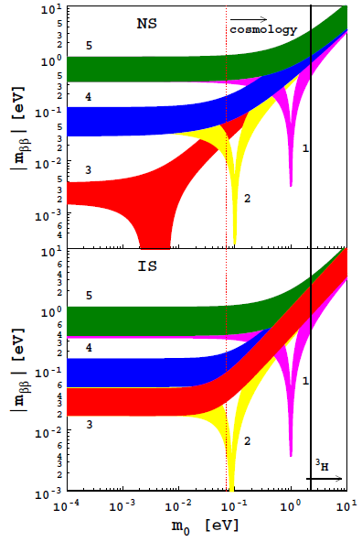
(m₁m₂m₃) = (+++) or (---)
Area ⟨χ⟩g₁
1 -1
2 -0.1
3 0
4 0.1
5 1
&
g₂ = g₄ = 0

Slide 37
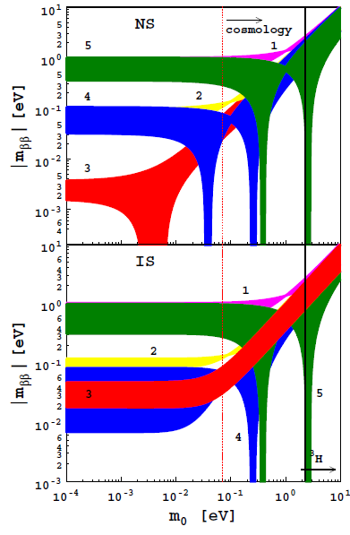
(m₁m₂m₃) = (-++) or (+--)
Area ⟨χ⟩g₁
1 -1
2 -0.1
3 0
4 0.1
5 1
&
g₂ = g₄ = 0

Slide 38
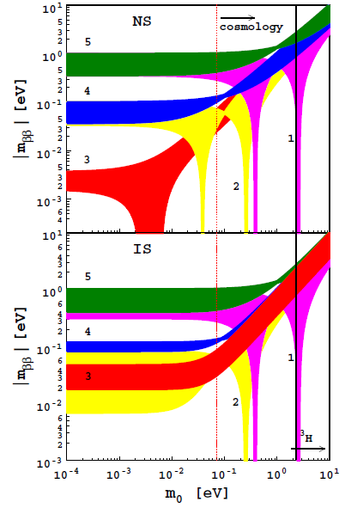
(m₁m₂m₃) = (+-+) or (-+-)
Area ⟨χ⟩g₁
1 -1
2 -0.1
3 0
4 0.1
5 1
&
g₂ = g₄ = 0

Slide 39
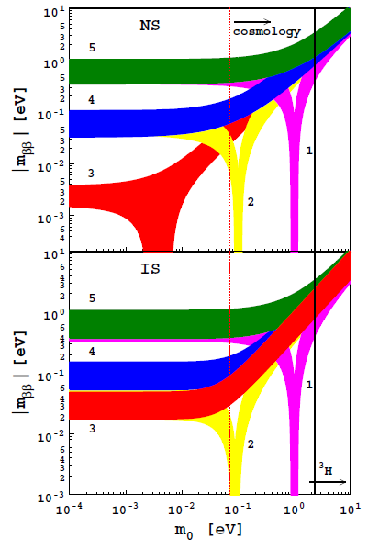
(m₁m₂m₃) = (++-) or (--+)
Area ⟨χ⟩g₁
1 -1
2 -0.1
3 0
4 0.1
5 1
&
g₂ = g₄ = 0

Slide 40
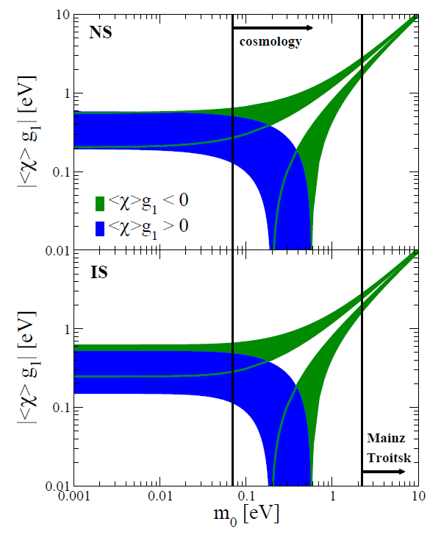
Regions of admissible values of ⟨χ⟩g₁ and m₀ for m_{ββ} = 0.2 eV
(m₁m₂m₃)=(+++) or (---)
m₀ = 0 ε₁ = 1/50-1/100,
ε₂ = 1/50.

Slide 41
New exotic channels
e⁺
π⁻
non-standard vertex
ν_{L}
standard
weak vertex
τ⁻
π⁺

Slide 42
New exotic channels
non-standard vertex
standard
weak vertex

Slide 43
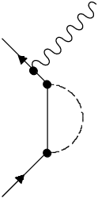
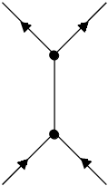
New exotic channels
to one loop
γ
e⁻
L
L^{c}
T
T
ν_{L}
L
L^{c}
μ⁻

Slide 44
Conclusions
Total lepton number violation can be associated with an exotic high-energy effective scalar interaction.
The mean scalar field in nuclei generates an additional contribution to the Majorana neutrino mass, which leads to a modification of the 0νββ decay probability.
Observation of 0νββ decay together with the more stringent constraints on the neutrino mass from cosmology and/or ³H β− decay would give an indication of the existence of a new type of interaction associated with an effective scalar.
The non-standard scalar interaction allows to determine the relative signs of the masses of Majorana neutrinos.

