Slide 1
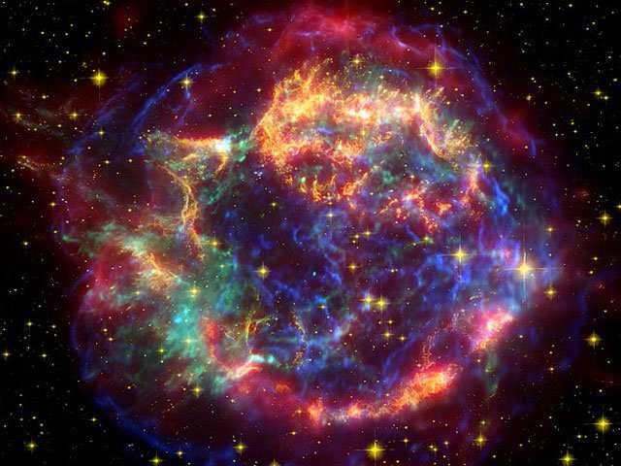
Neutron Star cooling &
Bayesian analysis for hybrid star
Hovik Grigorian:
JINR – Dubna
Yerevan State University
HISS-’NT&AA’ - 2017
Dubna 21 July
my co-authors: D.Blaschke, D.Voskresensky,
D. Alvarez-Castillo , A. Ayriyan, S. Typel
Notes:
1
1

Slide 2
Cooling Of Neutron Stars
Introduction to Cooling Simulation
Cooling regulators
Time Evolution of Temperature
Super conductivity & in-medium effects
Results for NS cooling
H. Grigorian, D. N. Voskresensky and D. Blaschke
Eur. Phys. J. A 52: 67 (2016).
Notes:
2

Slide 3
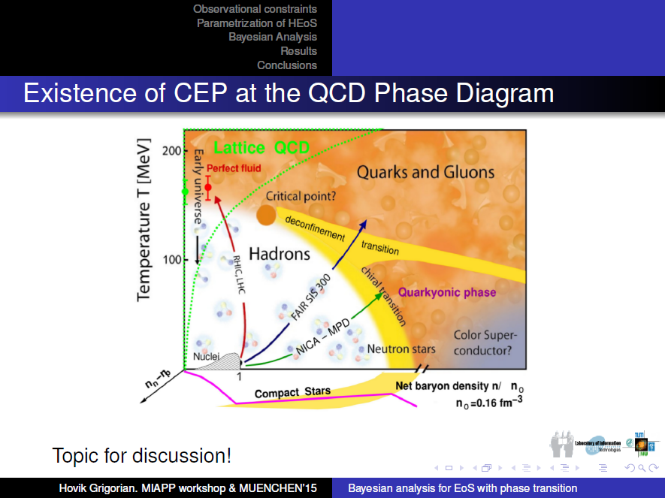
Phase Diagramm & Cooling Simulation
Description of the stellar matter - local properties (EoS of super-dense matter)
Modeling of the gravitationally self bound compact star - including the density profiles
Extrapolations of the energy loss mechanisms to higher densities and temperatures
Consistency of the approaches
Comparison with observational data

Slide 4
Phase Diagramm & Cooling Simulation
Description of the stellar matter - local properties (EoS of super-dense matter)
Modeling of the gravitationally self bound compact star - including the density profiles
Extrapolations of the energy loss mechanisms to higher densities and temperatures
Consistency of the approaches
Comparison with observational data

Slide 5
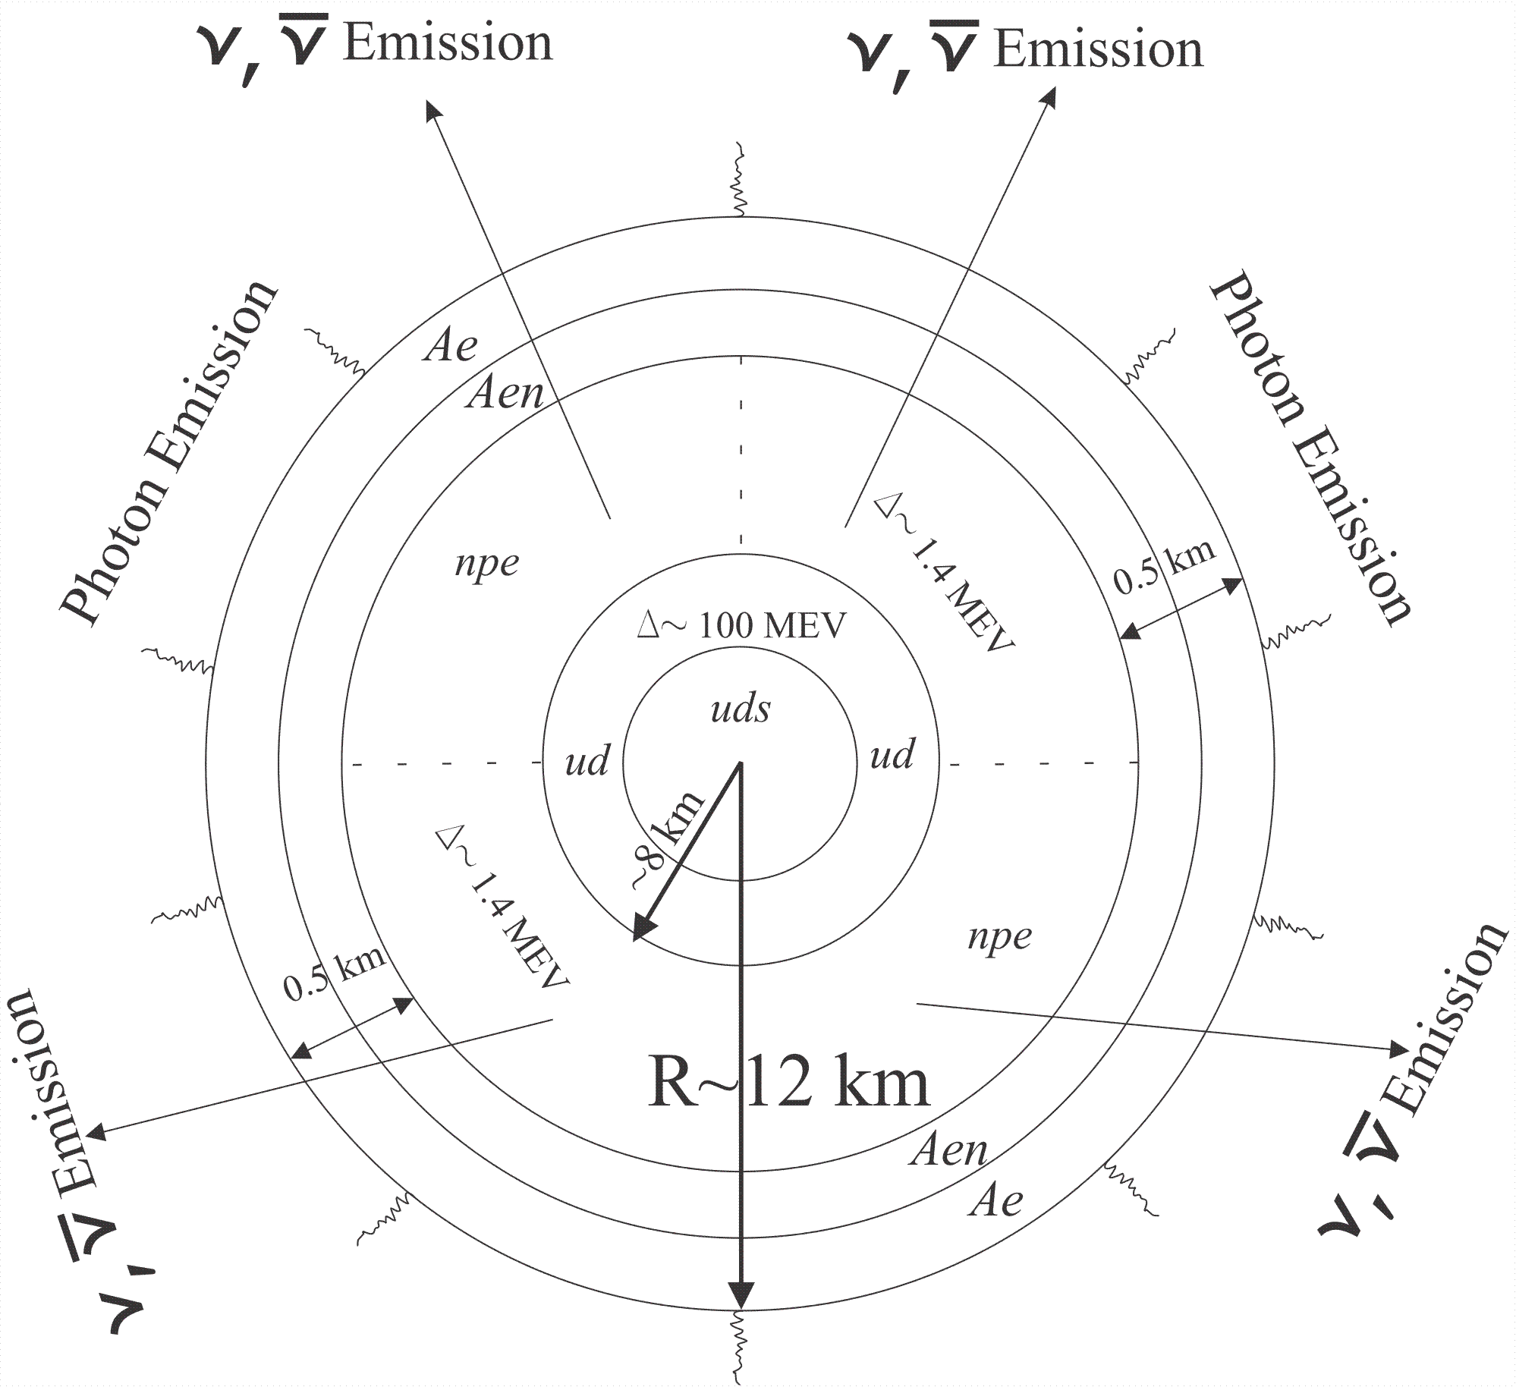
Structure Of Hybrid Star
1
1

Slide 6
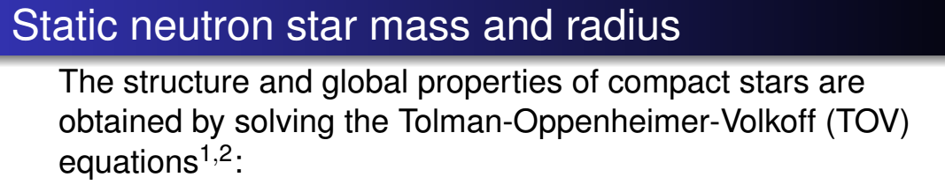
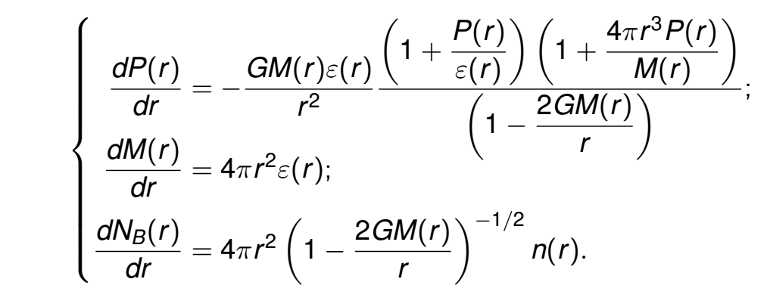


Slide 7
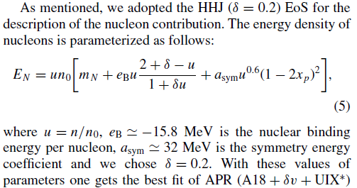

Modification of HHJ (HDD) parameterization of EoS
Introduction of the excluded volume

Slide 8
Stability of stars
HDD, DD2 & DDvex-NJL EoS model

Slide 9
Different EoS model Configurations for the same mass NS

Slide 10
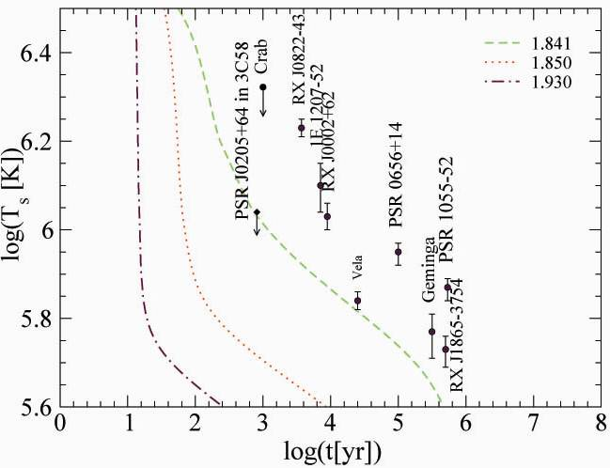
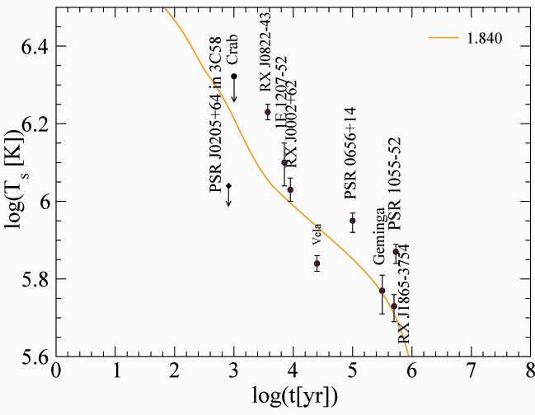
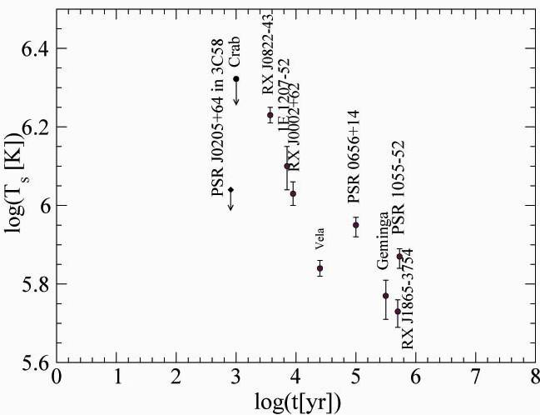
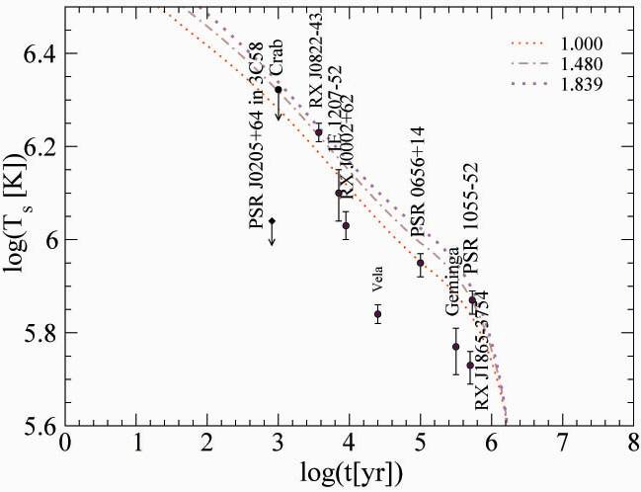


Surface Temperature & Age Data
Fast Coolers
Notes:
10

Slide 11
Data of NS on Magnetic Field
Magnetars
AXPs, SGRs
B = 10^14 -10^15 G
Radio-quiet
NSs
B = 10^13 G
Radio-pulsar
NSs
B = 10^12 G
Radio-pulsar
NSs
B = 10^12 G
H - spectrum

Slide 12
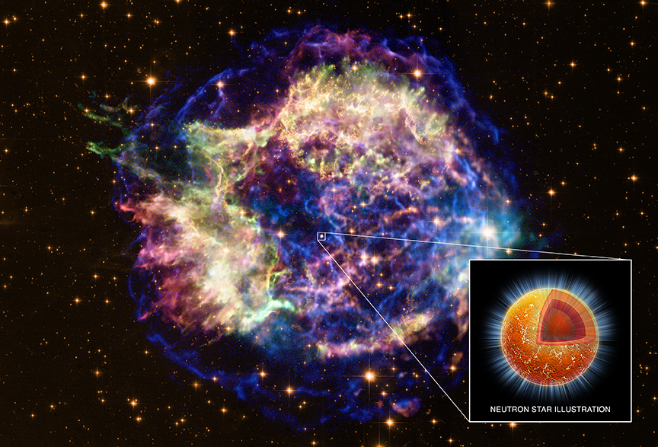
Neutron Star
in Cassiopeia A
16.08.1680 John Flamsteed, 6m star 3 Cas
1947 re-discovery in radio
1950 optical counterpart
T ∼ 30 MK
V exp ∼ 4000 − 6000 km/s
distance 11.000 ly = 3.4 kpc
picture: spitzer space telescope
D.Blaschke, H. Grigorian, D. Voskresensky, F. Weber,
Phys. Rev. C 85 (2012) 022802
e-Print: arXiv:1108.4125 [nucl-th]

Slide 13
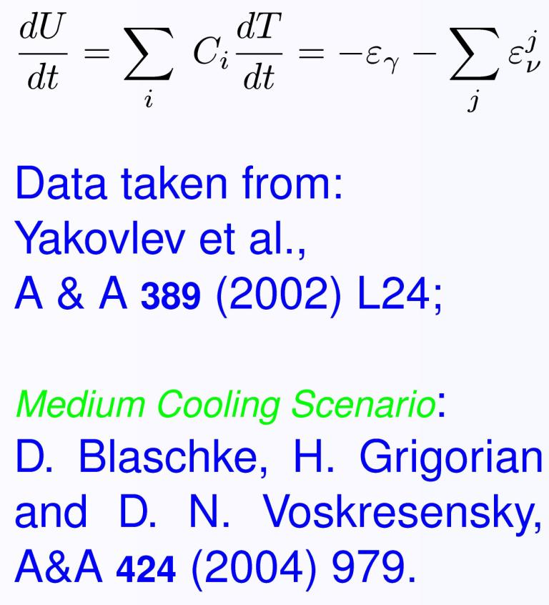
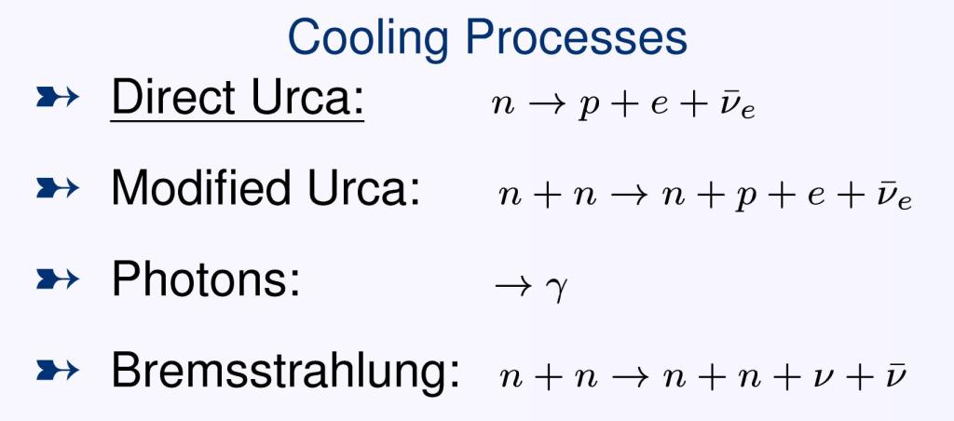
Cooling Mechanism
Notes:
13

Slide 14

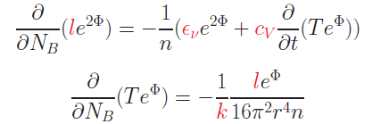

Cooling Evolution
The energy flux per unit time l(r) through a spherical slice at distance r from the center is:
The equations for energy balance and thermal energy transport are:
where n = n(r) is the baryon number density, NB = NB(r) is the total baryon number in the sphere with radius r
F.Weber: Pulsars as Astro. Labs ... (1999);
D. Blaschke Grigorian, Voskresensky, A& A 368 (2001)561.
Notes:
14

Slide 15
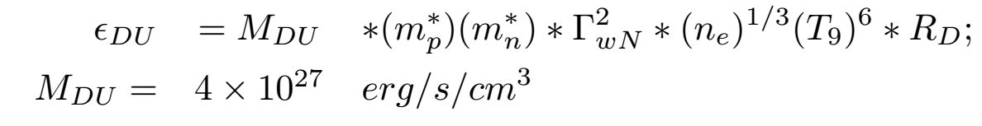
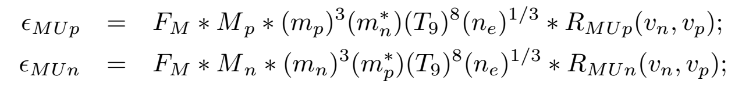
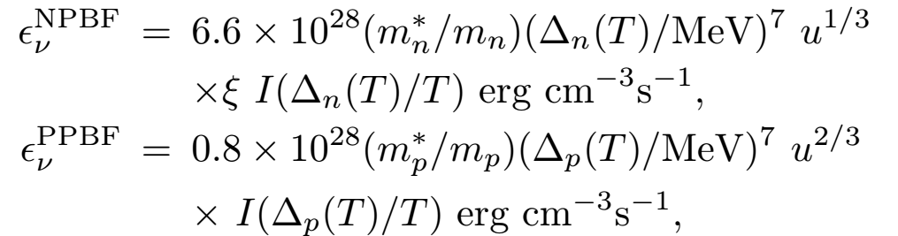
Neutrino emissivities in hadronic matter:
Direct Urca (DU) the most efficient processes
Modified Urca (MU) and Bremsstrahlung
Suppression due to the pairing
Enhanced cooling due to the pairing

Slide 16
The Mass constraint and DU - onsets

Slide 17
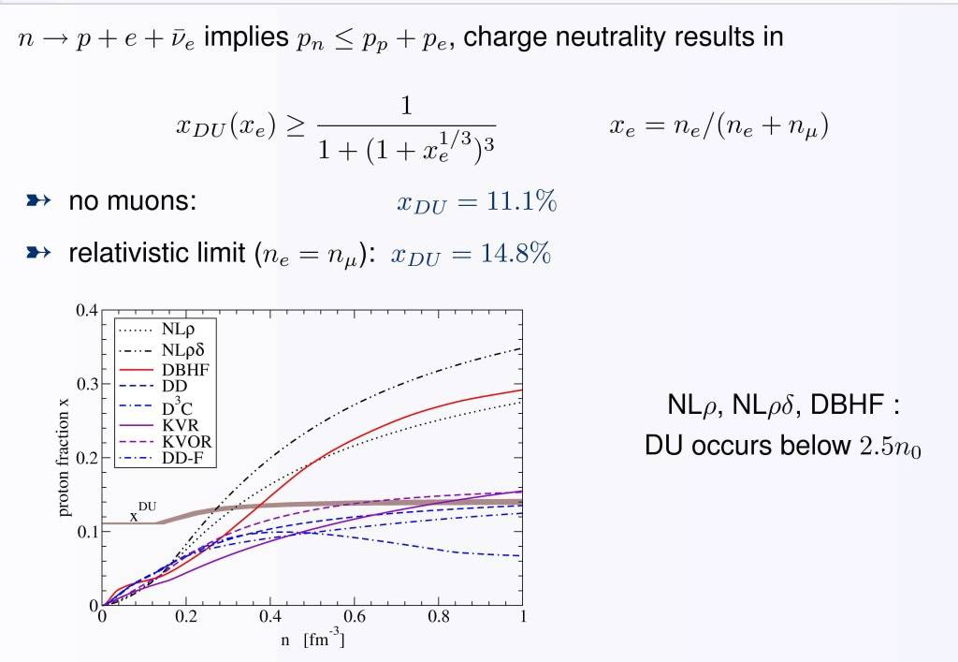
DU constraint
Notes:
17

Slide 18
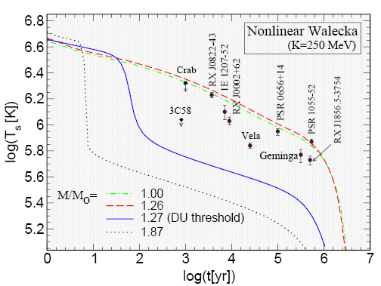
DU Problem & Constraint
Notes:
18

Slide 19
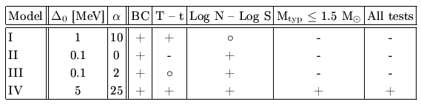
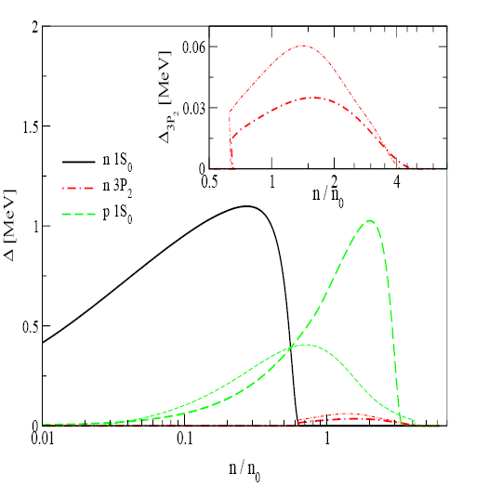
SC Pairing Gaps
2SC phase: 1 color (blue) is unpaired (mixed superconductivity)
Ansatz 2SC + X phase:
Pairing gaps for hadronic phase
(AV18 - Takatsuka et al. (2004))
Popov, Grigorian, Blaschke, PRC 74 (2006)
Notes:
19

Slide 20
SC Pairing Gaps
Notes:
20

Slide 21
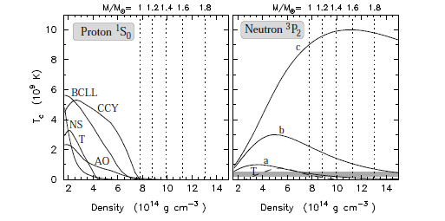
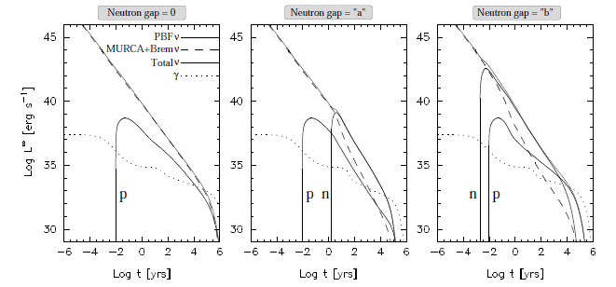
Influence Of SC On Luminosity
Critical temperature, Tc, for the proton 1S0 and neutron 3P2 gaps, used in PAGE, LATTIMER, PRAKASH, & STEINER Astrophys.J.707:1131 (2009)

Slide 22
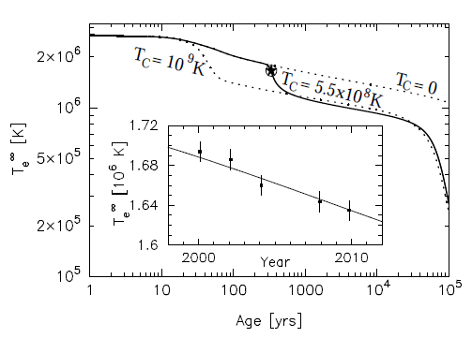
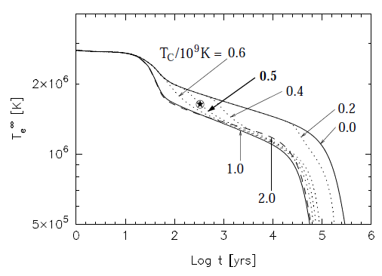
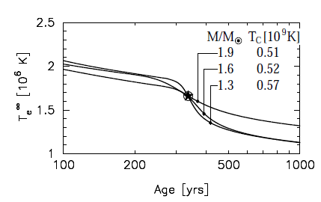
Tc ‘Measurement’ From Cas A
Assumed to be a star with mass = 1.4 M⊙
from the APR EoS
Rapidly cools at ages
∼ 30-100 yrs due to the thermal relaxation of the crust
Mass dependence
Page, Lattimer, Prakash, & Steiner Phys.Rev.Lett.106:081101,2011

Slide 23
Anomalies Because Of PBF Proccess
AV18 gaps, pi-condensate, without suppression of 3P2 neutron pairing - Enhanced PBF process
The gaps from Yakovlev at al. (2003)
Grigorian, Voskresensky Astron.Astrophys. 444 (2005)
Notes:
23

Slide 24
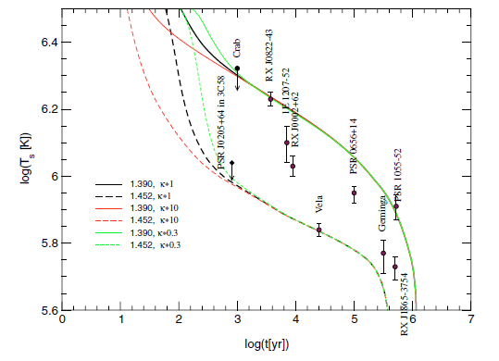
The Influence Of A Change Of The Heat Conductivity On The Scenario
Blaschke, Grigorian, Voskresensky, A& A 424, 979 (2004)

Slide 25
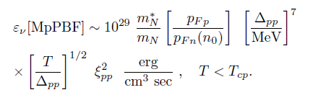
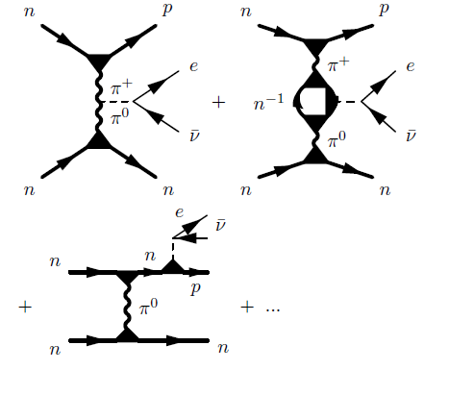
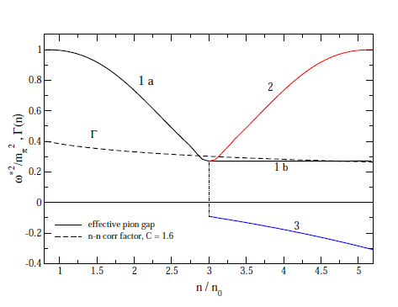

Medium Effects In Cooling Of Neutron Stars
Based on Fermi liquid theory ( Landau (1956), Migdal (1967), Migdal et al. (1990))
MMU – insted of MU
Main regulator in Minimal Cooling

Slide 26
Medium Effects In Cooling Of Neutron Stars

Slide 27
Contributions To Luminosities

Slide 28

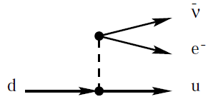

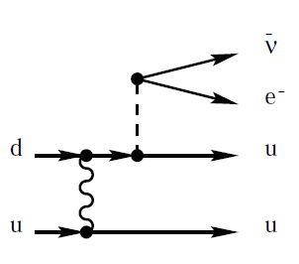

Neutrino emissivities in quark matter:
Quark direct Urca (QDU) the most efficient processes
Compression n/n0 ≃ 2 , strong coupling αs ≈ 1
Quark Modified Urca (QMU) and Quark Bremsstrahlung
Suppression due to the pairing
Enhanced cooling due to the pairing

Slide 29
Equations for Cooling Evolution
Notes:
29

Slide 30
Finite difference scheme
Z_i next step
Time direction
Z_i+1
Z_i initial
Z_i-1

Slide 31
Boundary conditions
L_conductivity
Outer Crust of NS
r = R
L_photons
L = 0
Center of NS
r = 0
L

Slide 32
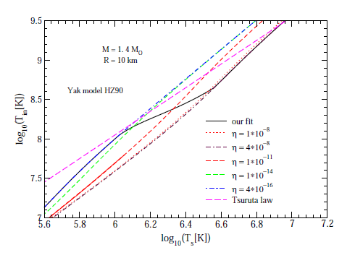

Crust Model
Time dependence of the light element contents in the crust
Blaschke, Grigorian, Voskresensky, A& A 368 (2001)561.
Page,Lattimer,Prakash & Steiner, Astrophys.J. 155,623 (2004)
Yakovlev, Levenfish, Potekhin, Gnedin & Chabrier , Astron. Astrophys , 417, 169 (2004)
Notes:
32

Slide 33
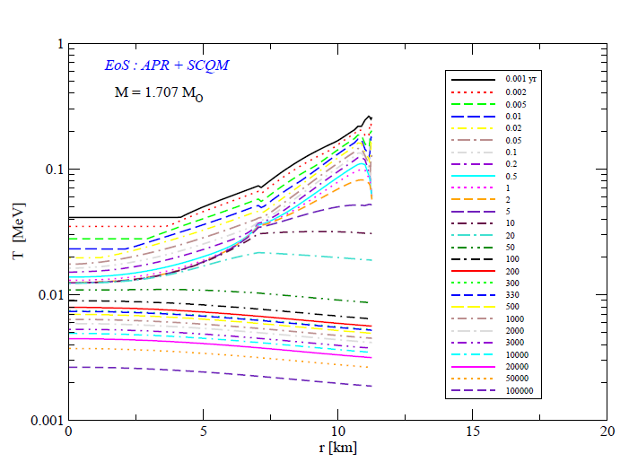
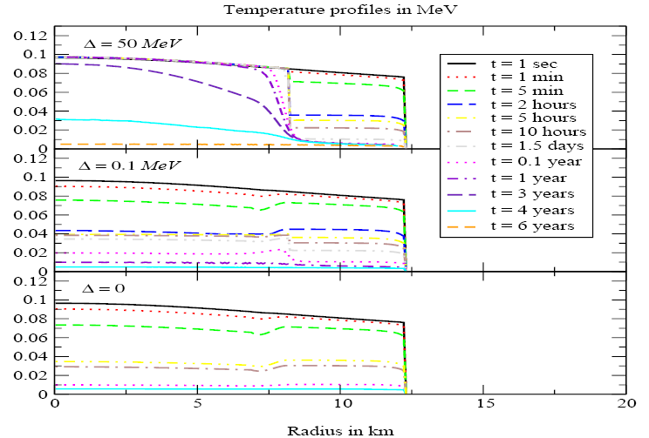
Temperature In The Hybrid Star Interior
Blaschke, Grigorian, Voskresensky, A& A 368 (2001) 561
Notes:
33

Slide 34
Temperature In The Hybrid Star Interior
Blaschke, Grigorian, Voskresensky, A& A 368 (2001) 561
Notes:
34

Slide 35
Cas A as an Hadronic Star

Slide 36
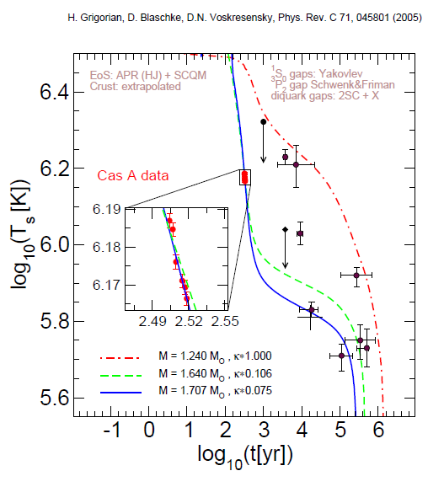
Cas A As An Hybrid Star

Slide 37
Possible internal structure of CasA

Slide 38
HDD – AV18 , Yak.
ME nc = 3 n0

Slide 39
DD2 – BCLL
ME-nc =1.5,2.0,2.5n0

Slide 40
DD2 – EEHOr
ME-nc=1.5,2.0,2.5n0

Slide 41
DD2- ME-nc = 3 n0
BCLL, EEHOr

Slide 42
DD2 vex-p40, AO
ME-nc = 2.0,2.5 n0

Slide 43
DD2 vex p40, BCLL
ME-nc = 1.5,2.0 n0

Slide 44
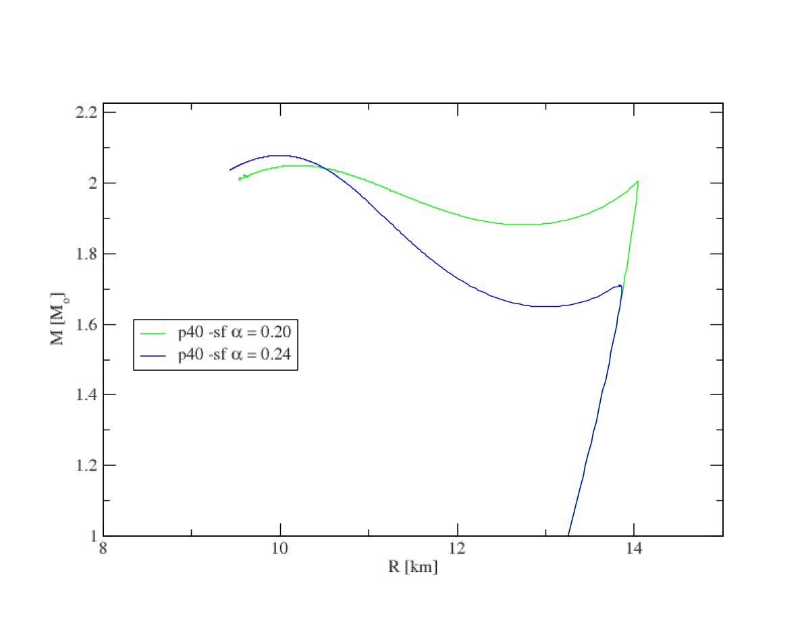
High Mass Twin CS

Slide 45
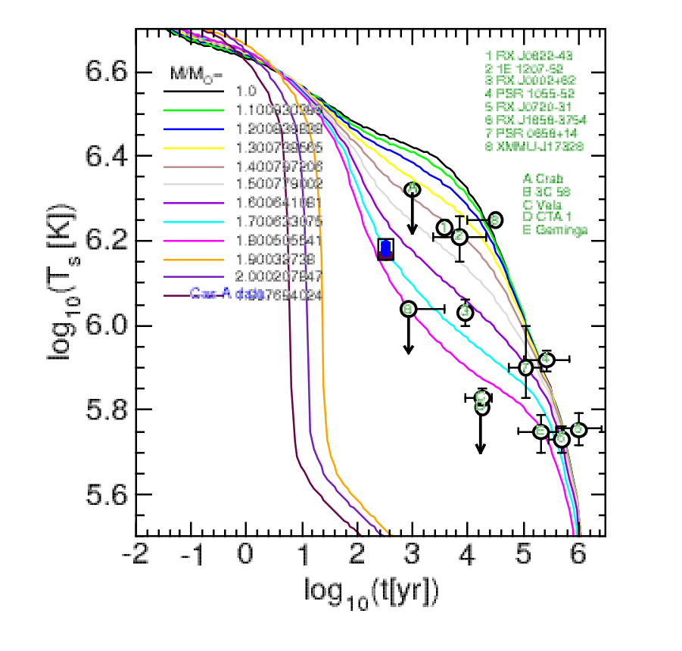
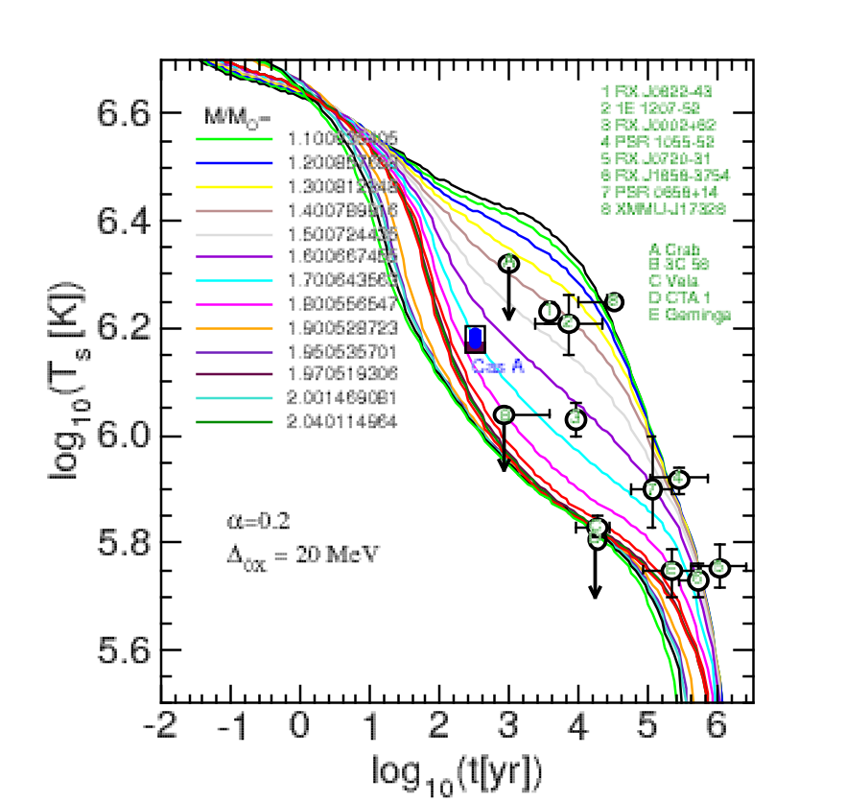
Cooling of Twin CS

Slide 46
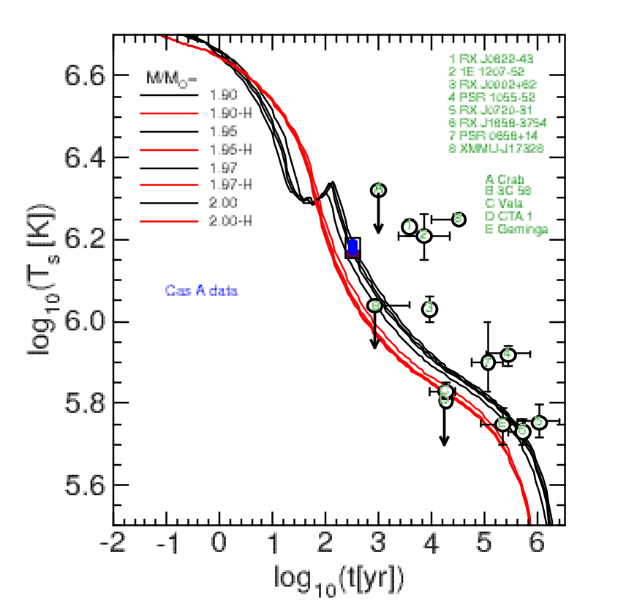
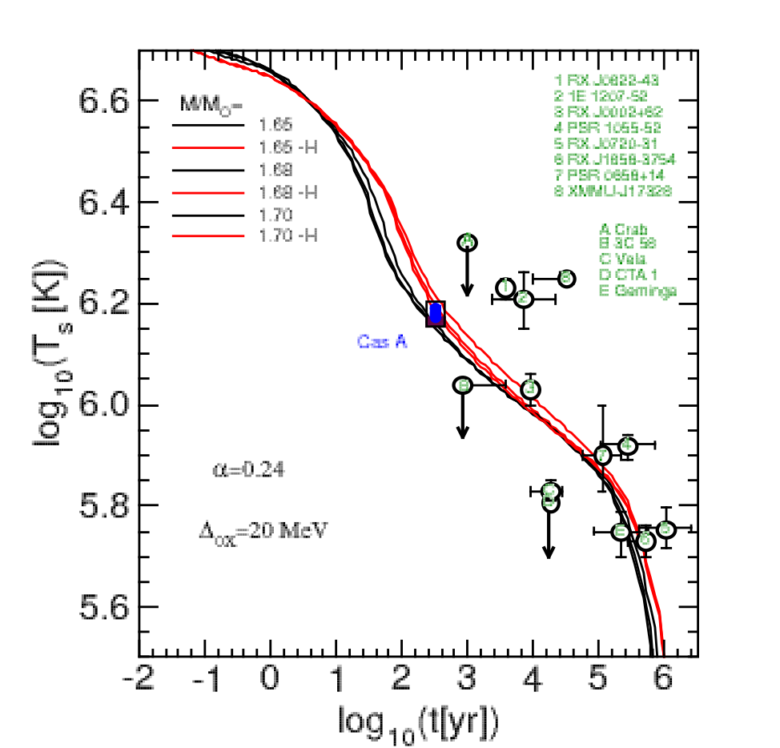

Slide 47
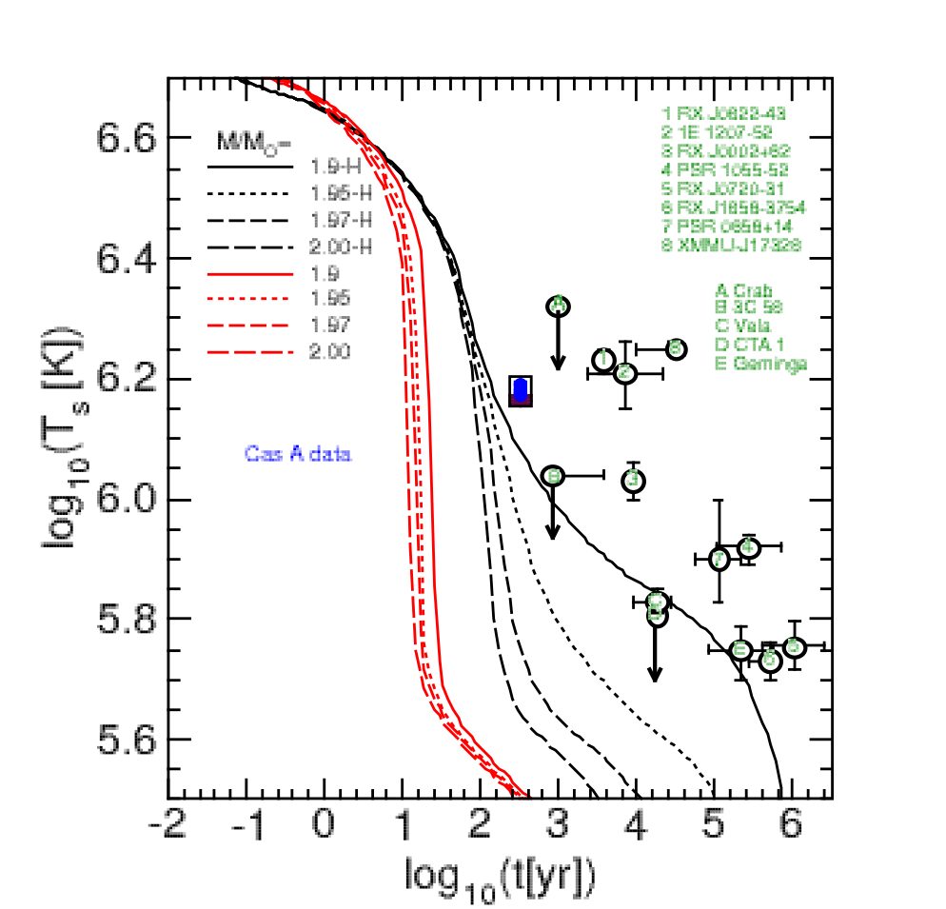

Slide 48
Conclusions
All known cooling data including the Cas A rapid cooling consistently described by the medium-modified superfluid cooling model
Both alternatives for the inner structure, hadronic and hybrid star, are viable (as well for Cas A; a higher star mass favors the hybrid model)
Influence of stiffness on EoS and cooling can be balanced by the choice of corresponding gap model.

Slide 49
Bayesian analysis for new class of hybrid star
EoS with M-R observations for neutron stars
Observational constraints
Bayesian Analysis
Idea of fictitious measuremets
Results
D. E. Alvarez-Castillo et al. Eur. Phys. J. A (2016) 52:69
A. Ayriyan et al. J. Phys. CS 668 (2016), 012038
A. Ayriyan et al. Phys. Part. Nucl. 46(5), 2015, 854-857
D. Blaschke et al. J. Phys. CS 496 (2014), 012002
Notes:
49

Slide 50
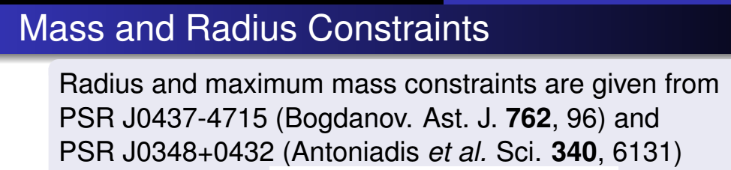
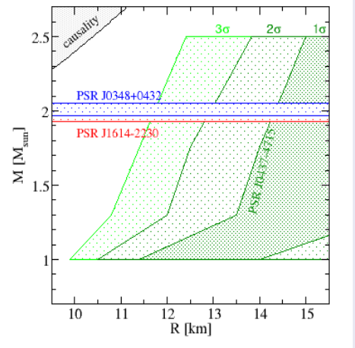

Slide 51
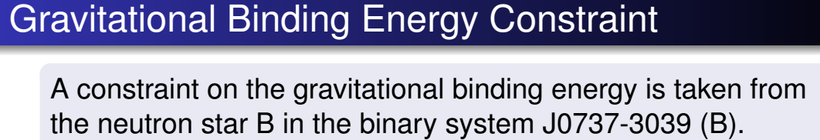
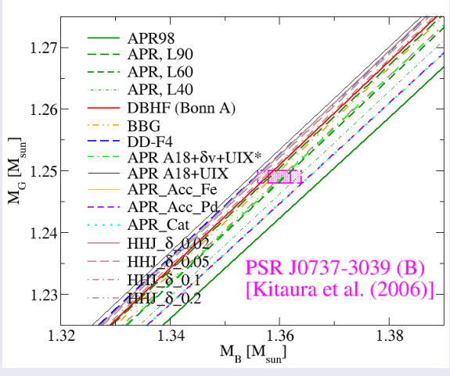

Slide 52
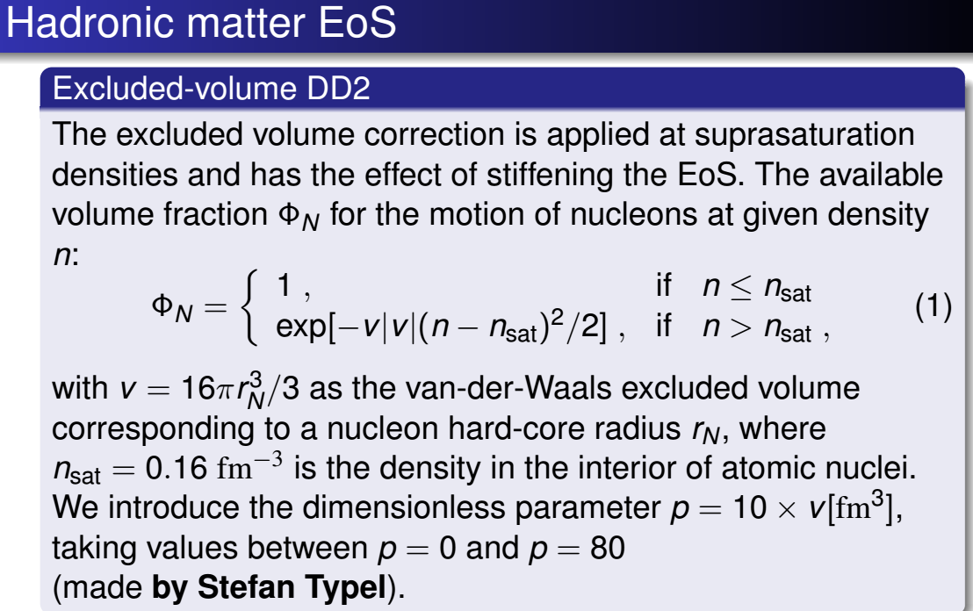
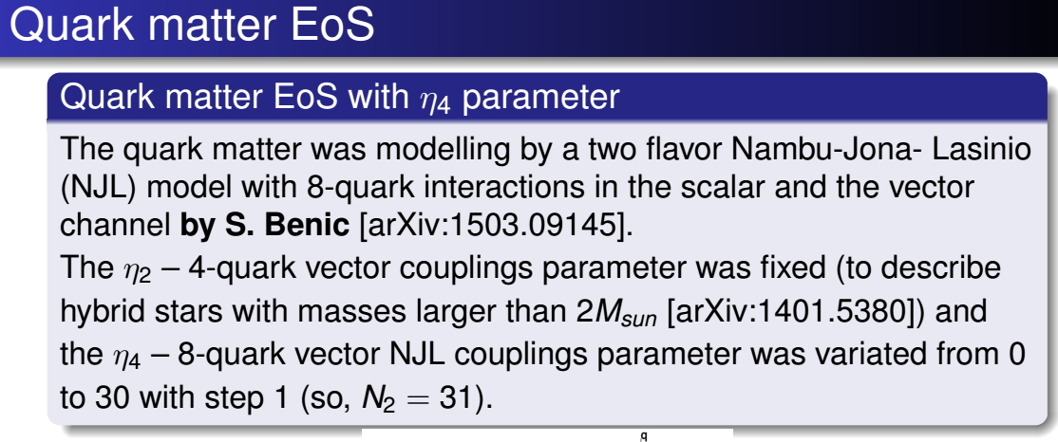

Slide 53
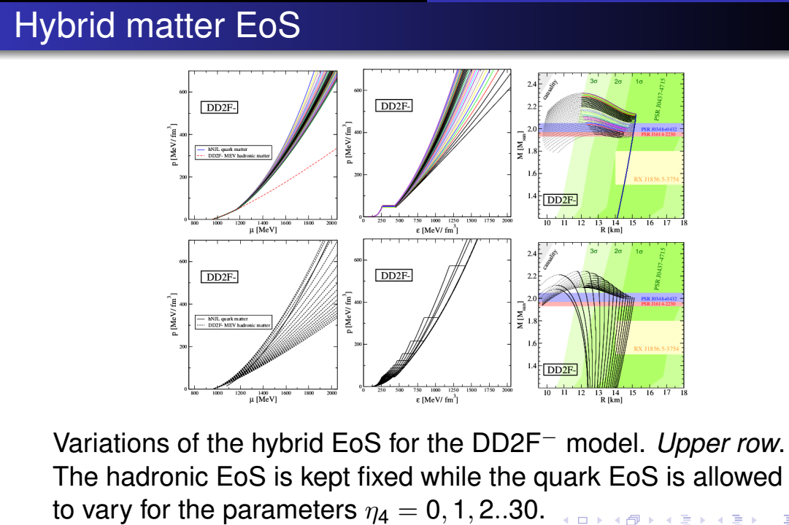

Slide 54
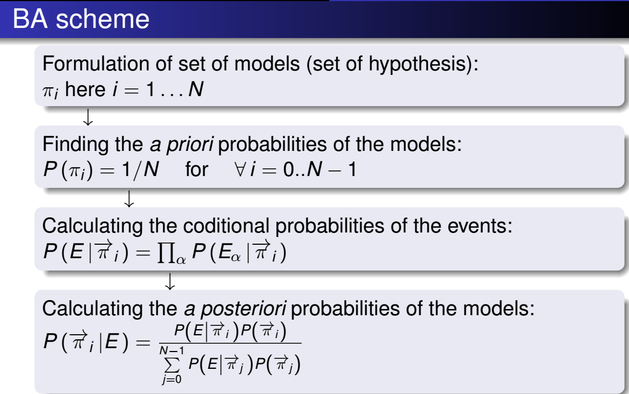


Slide 55




Slide 56


Slide 57


Slide 58


Slide 59


Slide 60


Slide 61
Thank YOU!!!!!

