Slide 1
"The cold superdense baryonic matter”
HMEC-2016
S.S. Shimanskiy (JINR, Dubna)
02.11.2016 Shimanskiy S.S.

Slide 2
PLAN
1. Cumulative processes - beginning.
2. DIS in the cumulative region.
3. High p_{T} processes.
4. Why CsDBM?
5. The multinucleon (multiquark) systems at SPIN&FODS(IHEP) now and MARUSYA(JINR), PANDA, J-PARC HI in the future.

Slide 3

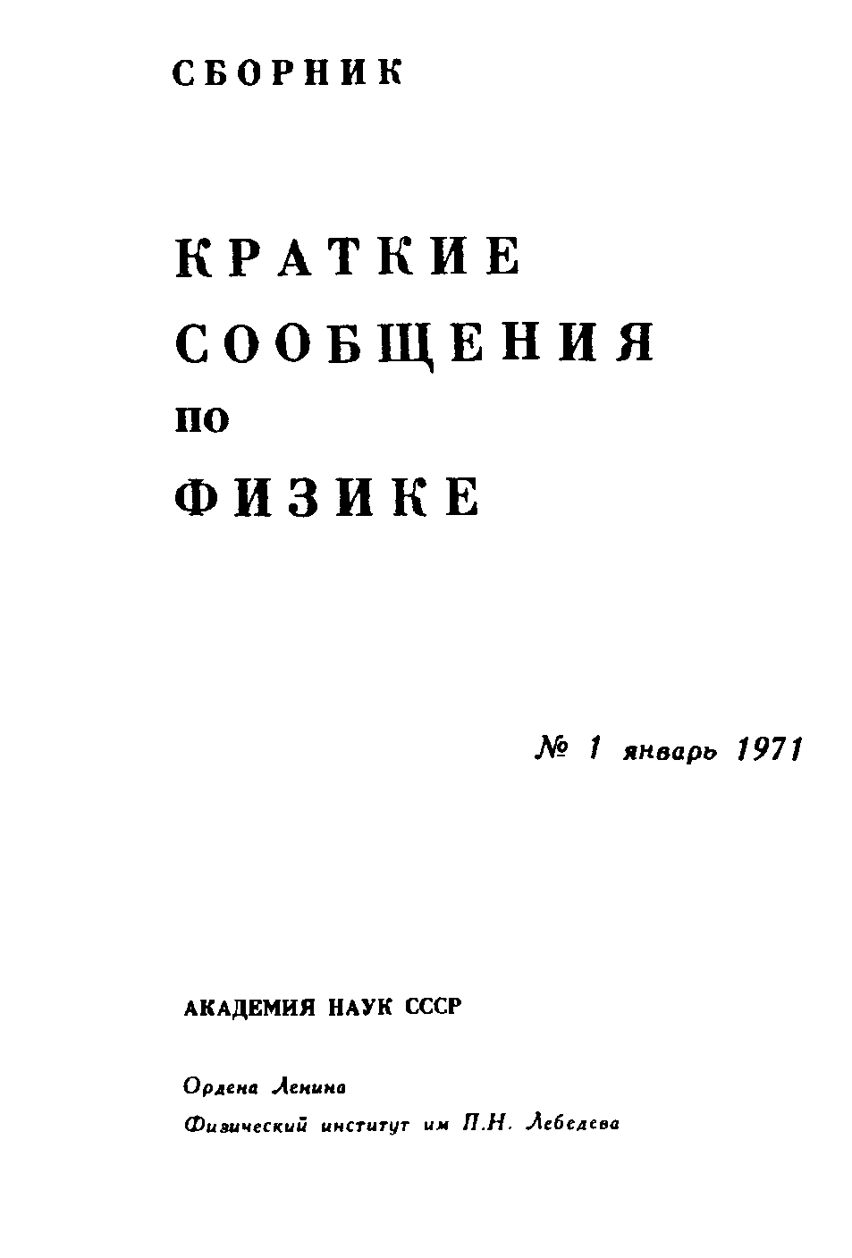
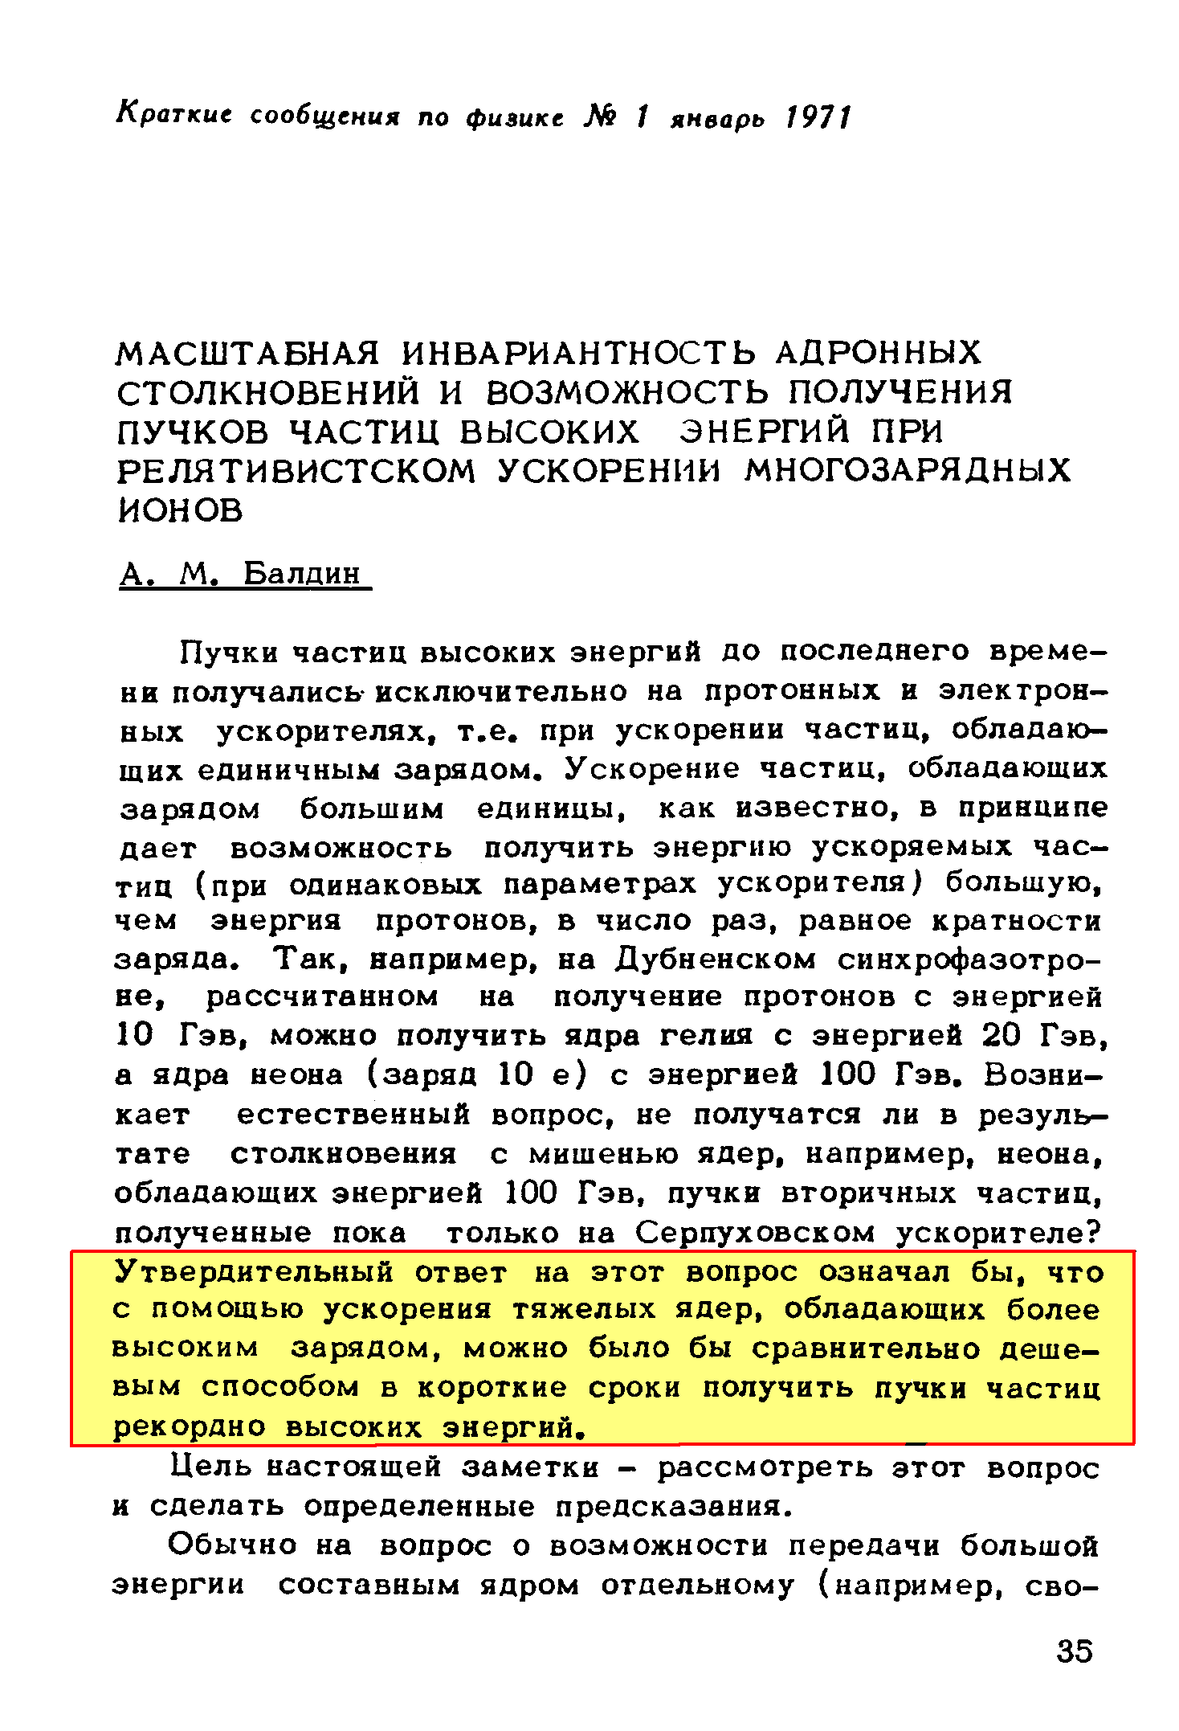

…с помощью ускорения тяжелых ядер, обладающих более высоким зарядом, можно было бы сравнительно дешевым способом в короткие сроки получить пучки частиц рекордно высоких энергий.
…it is possible to obtain the record high energy
particle beams by means of accelerating the heavy nuclei with large charges
январь 1971

Slide 4
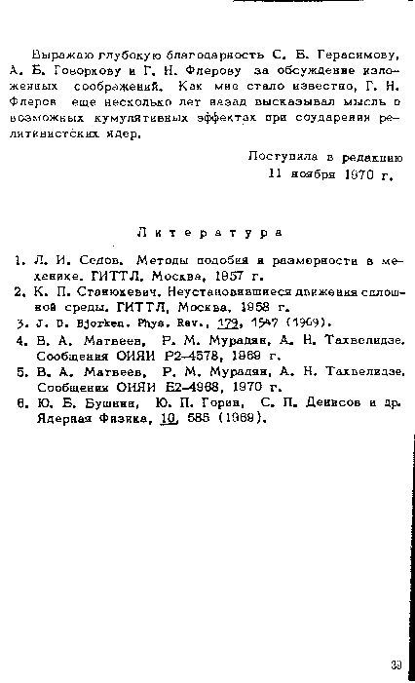
The first introduction of the term “cumulative effect”

Slide 5
Jim Baggott HIGGS
The Invention and Discovery of the ‘God Particle’
Oxford University Press, 2012
FOREWORD
by Steven Weinberg
“Like many other theorists, I did not fully accept the existence of quarks until the 1973 work of David Gross and Frank Wilczek, and David Politzer. They showed that in the theory of quarks and strong nuclear forces known as quantum chromodynamics, the strong force gets weaker with decreasing distance”.

Slide 6
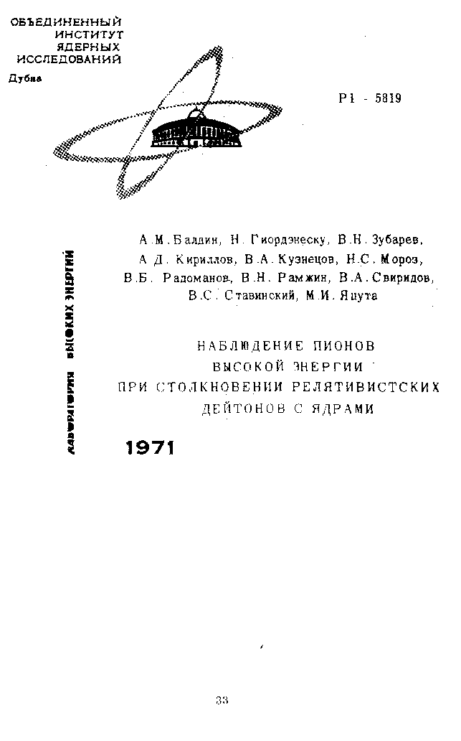
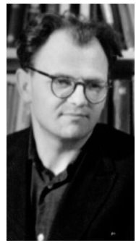
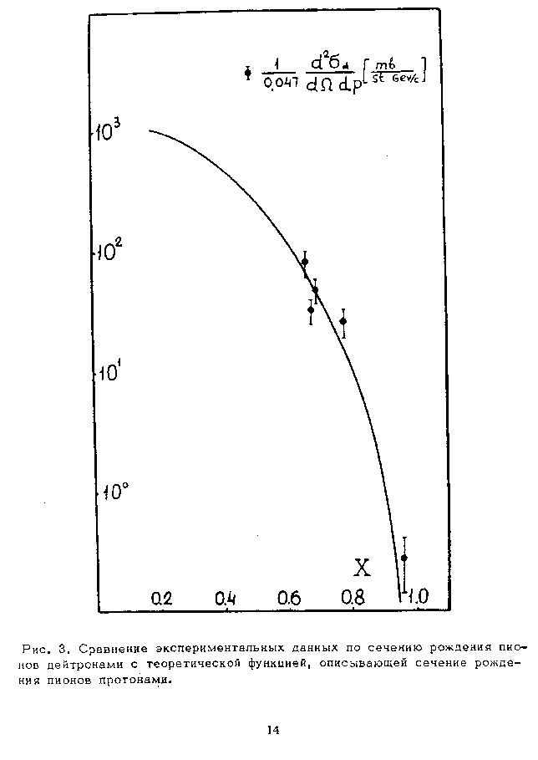
The first experimental data

Slide 7
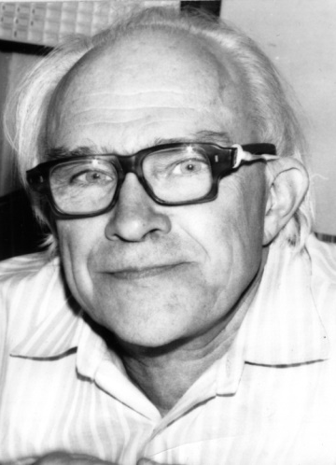
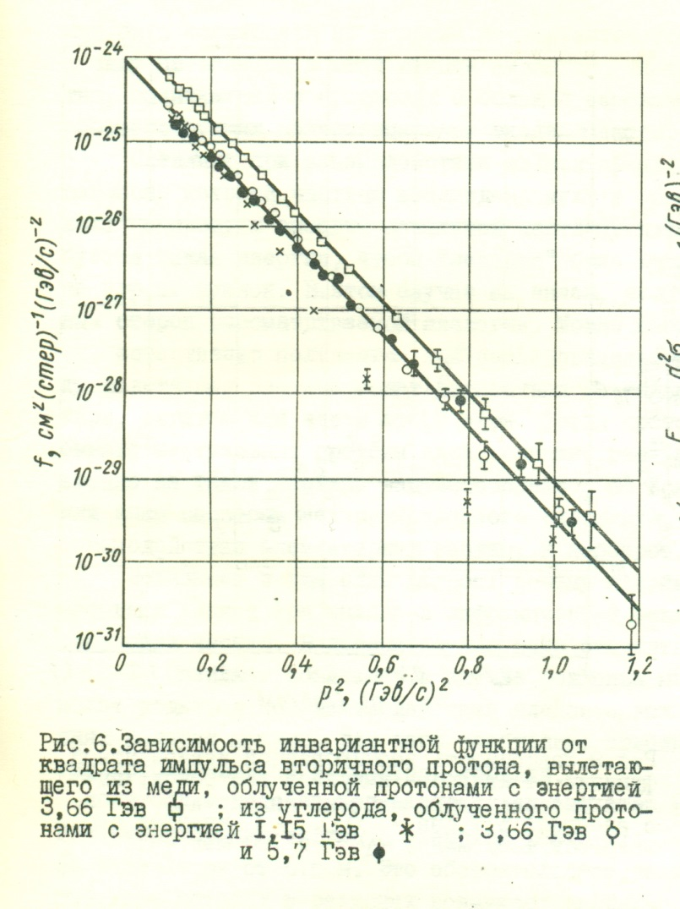
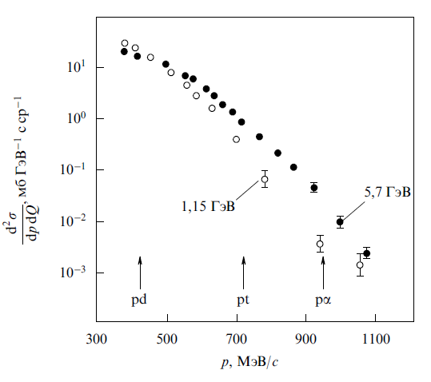
ITEP data for proton spectra
(G.A.Leksin et al.)
На рисунках приведены спектры протонов, измеренные на ускорителе ИТЭФ под углом 137⁰ в реакции р+С→ р+Х [2]. Стрелки показывают положения ожидавшихся квазиупругих максимумов для рассеяния на многонуклонных кластерах типа d,t,He. Присутствие в спектре частиц, за пределами ограничений кинематики рр взаимодействия ясно видно. Это были первые измеренные спектры протонов в кумулятивной области при начальных энергиях несколько ГэВ.
Баюков и др., Изв. АН СССР т.30, 1966, с.521
ЯФ т.18, с.1246, 1973

Slide 8
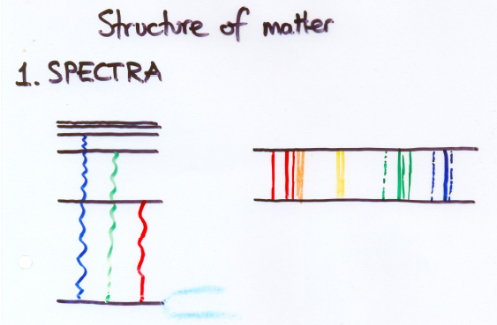
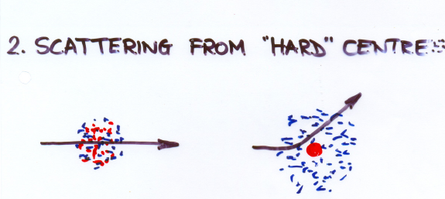
F. Close
Structure of Matter
Two ways that
structure is
revealed:
True from atoms
to particles…..

Slide 9
SPECTRA

Slide 10
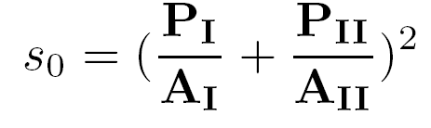
V.S. Stavinsky JINR Rapid Communications N18-86, p.5 (1986)
(X_{I}⋅M_{I}) + (X_{II}⋅M_{II}) → m_{c} + [X_{I}⋅M_{I} + X_{II}⋅M_{II} + m₂ ]
Quark-parton model
(X_{I}⋅P_{I}) + (X_{II}⋅P_{II}) → M(X_{I},X_{II})
P_{I}
{
A_{I}
X_{I}
{
}
S>S₀
{
{
A_{II}
X_{II}
P_{II}
  kinematic limit for free NN-interaction

Slide 11
Cumulative kinematical region
Cumulative processes:
1) X_{I} ≤ 1 and X_{II} > 1 Fragmentation
2) X_{II} ≤ 1 and X_{I} > 1 regions
3) X_{I} > 1 and X_{II} > 1 Central region
}
11

Slide 12
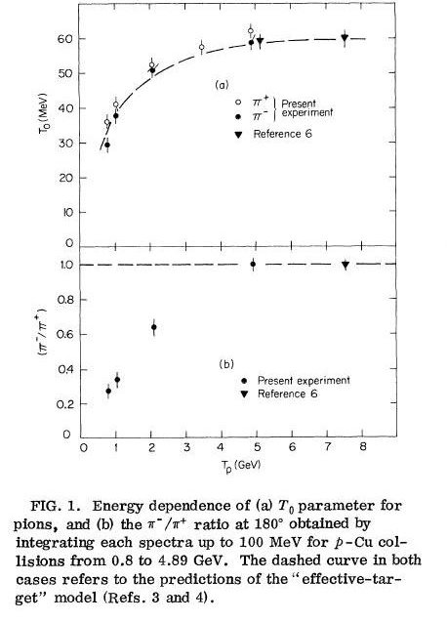
Schroeder L.S. et al. // Phys. Rev. Lett. 1979. V. 43, n. 24. P. 1787
A.M.Baldin et al., Yad.Fiz., 20, 1975, p.1201

Slide 13
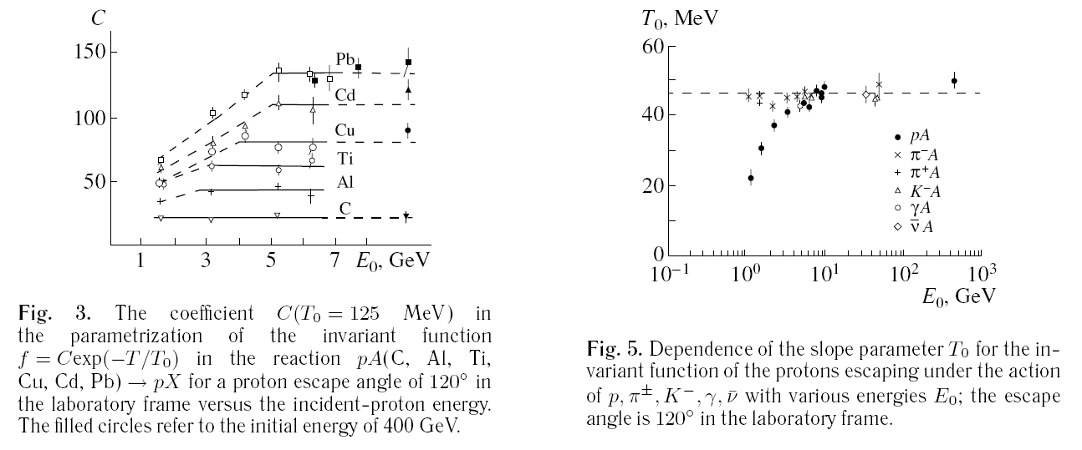
G.A.Leksin, Phys.Atom.Nucl. 65 (2002) 1985-1994; Yad.Fiz. 65 (2002) 2042-2051

Slide 14
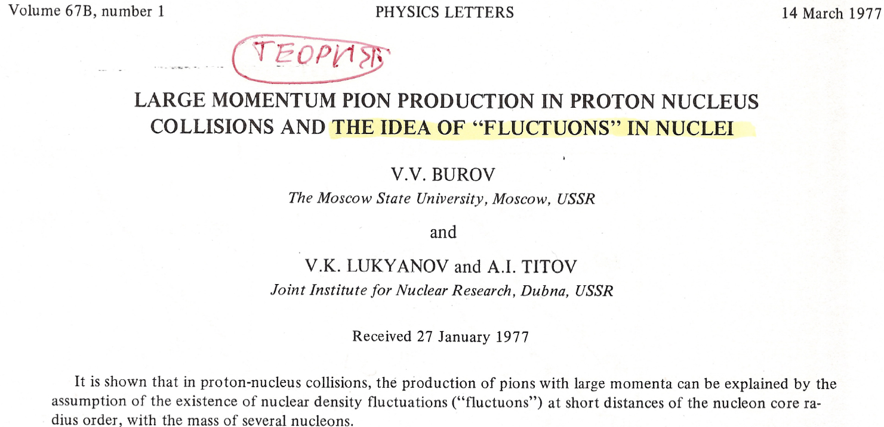
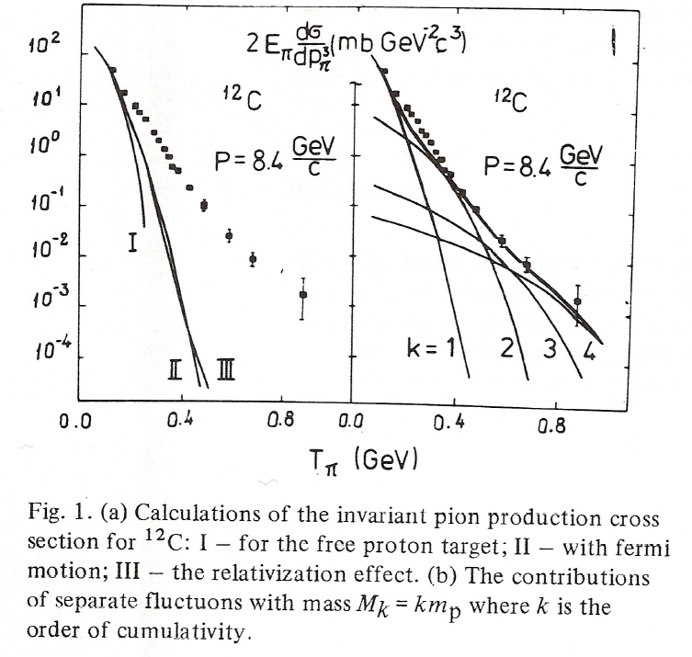
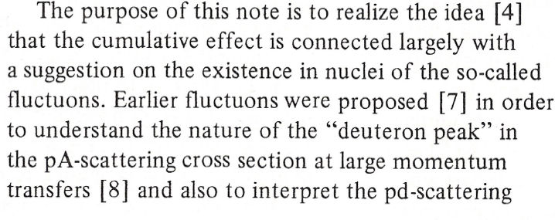
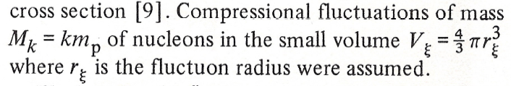

Slide 15
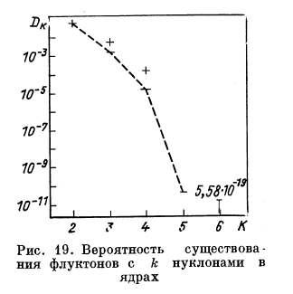
Fluctons Probability inside nuclei

Slide 16
Subthreshold flucton-flucton production

Slide 17
Inverse slope for subthreshold production must be the less then T₀/2
(near the phase space border).
T₀
T₀/2

Slide 18
DIS in the cumulative region.

Slide 19

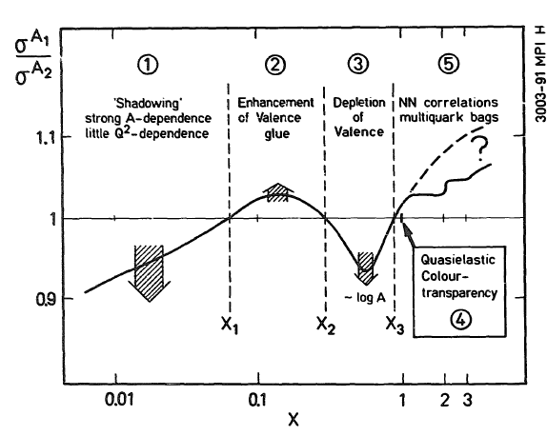
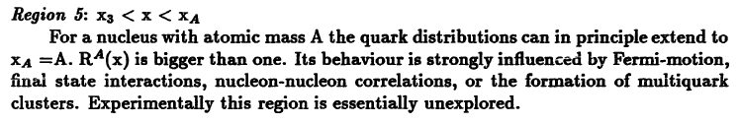
K.Rith
Cumulative kinematical region

Slide 20
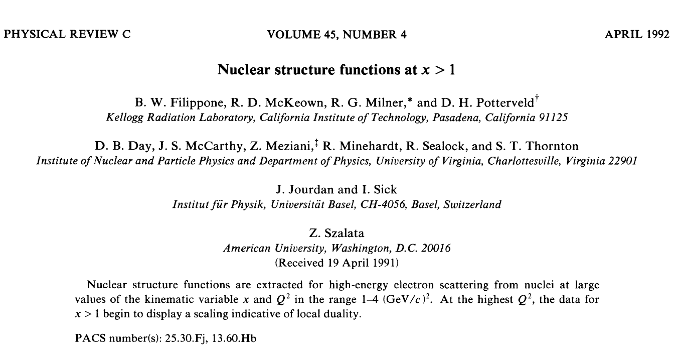
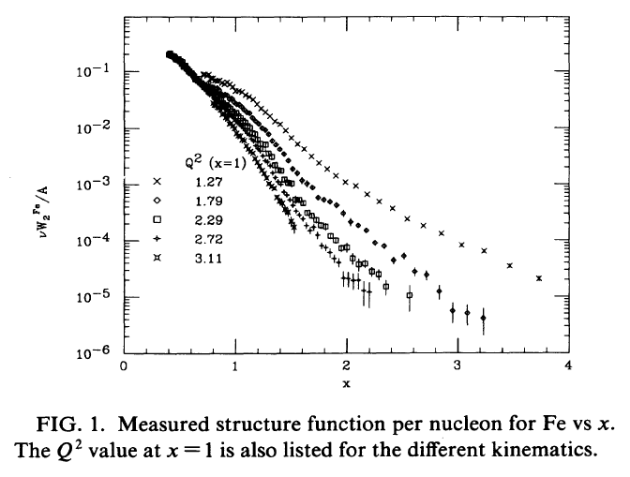
20

Slide 21
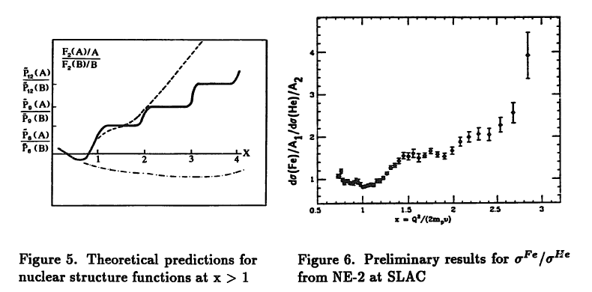
N.P. Zotov, V.A. Saleev, V.A. Tsarev (Lebedev Inst.)
Published in JETP Lett. 40 (1984) 965-968, Pisma Zh.Eksp.Teor.Fiz. 40 (1984) 200-203

Slide 22
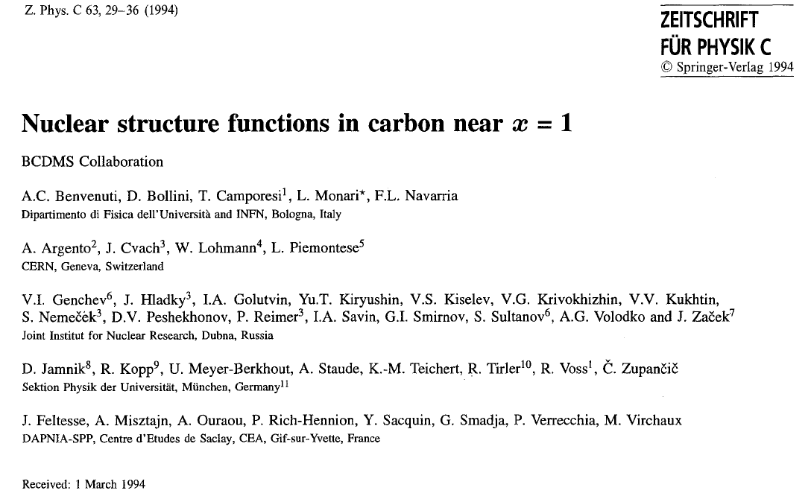
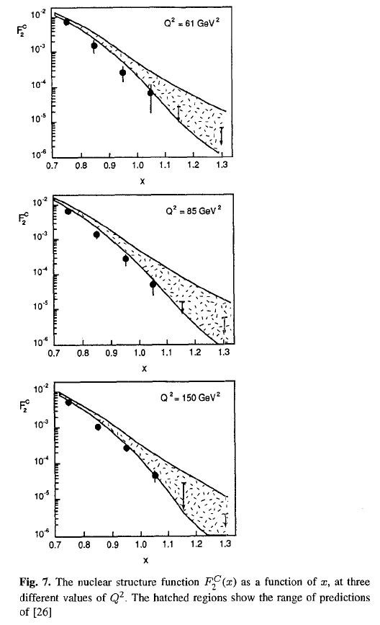

Slide 23
¹²C - structure
RNP – program at JINR
eA – program at JLab
V.V.Burov, V.K.Lukyanov, A.I.Titov, PLB, 67, 46(1977)
R.Subedi et al., Science 320 (2008) 1476-1478
e-Print: arXiv:0908.1514 [nucl-ex]
23

Slide 24
High p_{T}

Slide 25
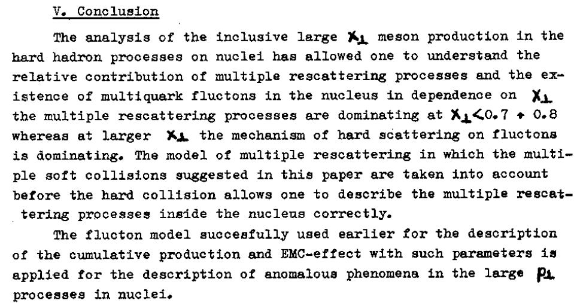
A.V. Efremov, V.T. Kim, G.I. Lykasov (1985)

Slide 26
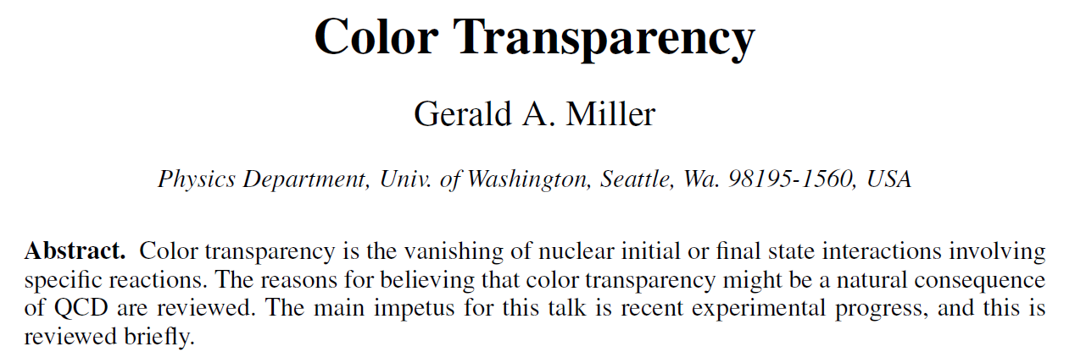
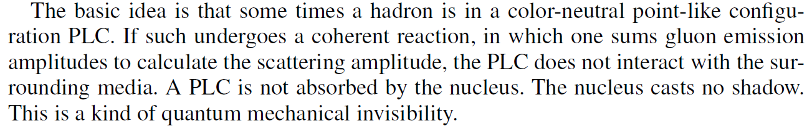
arXiv:1208.3668v1 [nucl-th] 17 Aug 2012

Slide 27
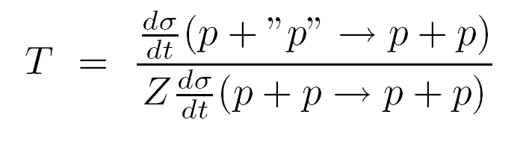
Color(nuclear) transparency in 90⁰ c.m. quasielastic A(p,2p) reactions
The incident momenta varied from 5.9 to 14.4 GeV/c, corresponding to 4.8 <Q² <12.7 (GeV/c)².

Slide 28
E850/EVA (BNL) p +”D”

Slide 29
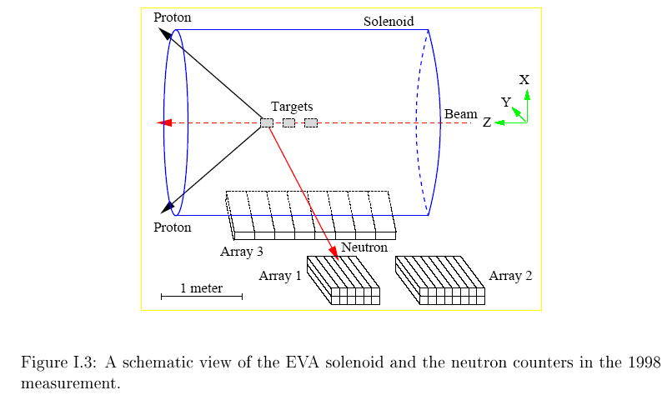
E850/EVA (BNL)

Slide 30
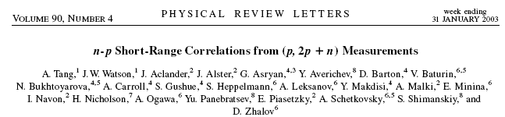
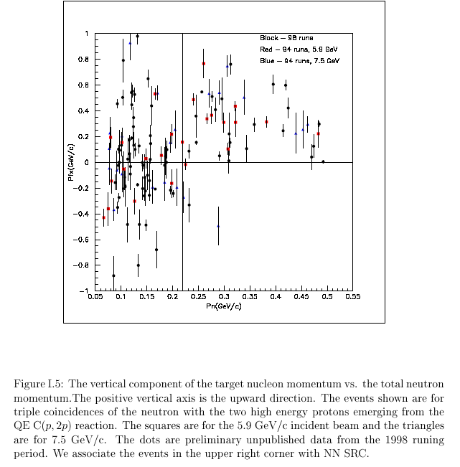

Slide 31
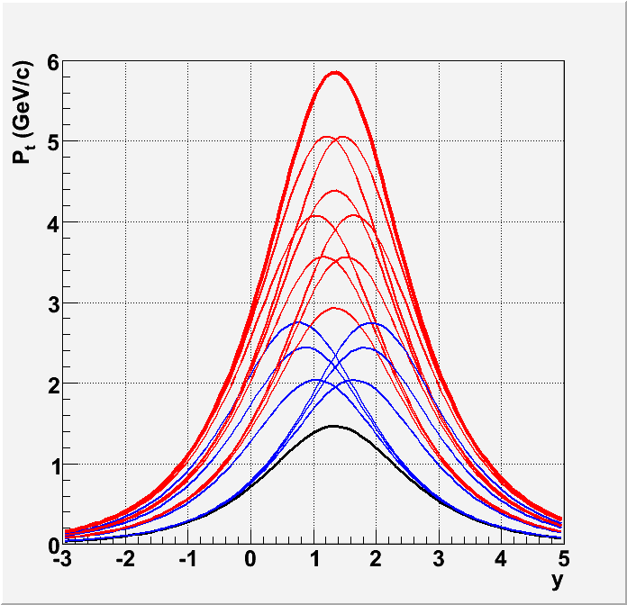
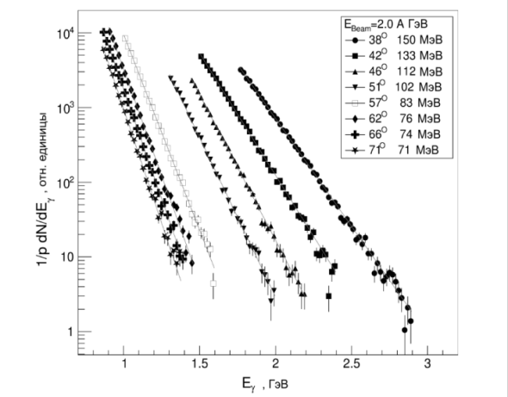
ITEP high p_{T} flucton-flucton data
I.G.Alekseev et.al.(FLINT), ЯФ 71(2008)1;
A.Stavinskiy, EPJ Web Conf. 71 (2014) 00125;
K.R. Mikhailov et al., Phys.Atom.Nucl. 77 (2014) 576;
ЯФ 77 (2014) 610

Slide 32
Knot out cold dense nuclear configurations
SRC configuration
p
Multiquark
configuration

Slide 33
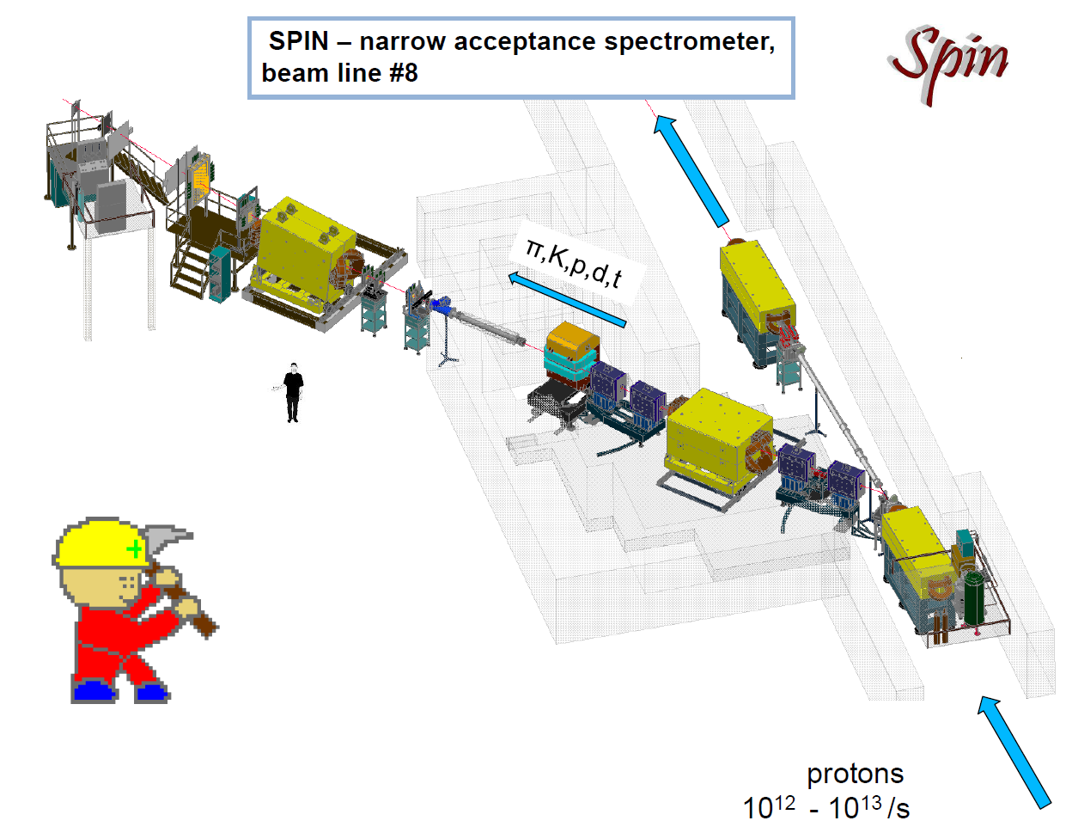
IHEP (Protvino)

Slide 34
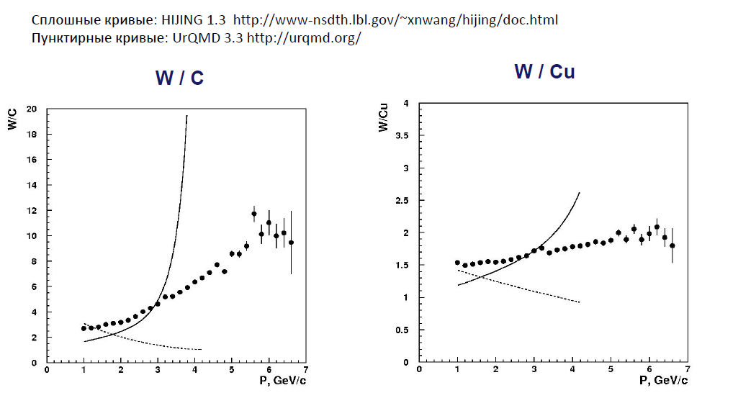
h⁺ - spectrum
Physics of Atomic Nuclei, 2013, Vol. 76, No. 10, pp. 1213–1218

Slide 35
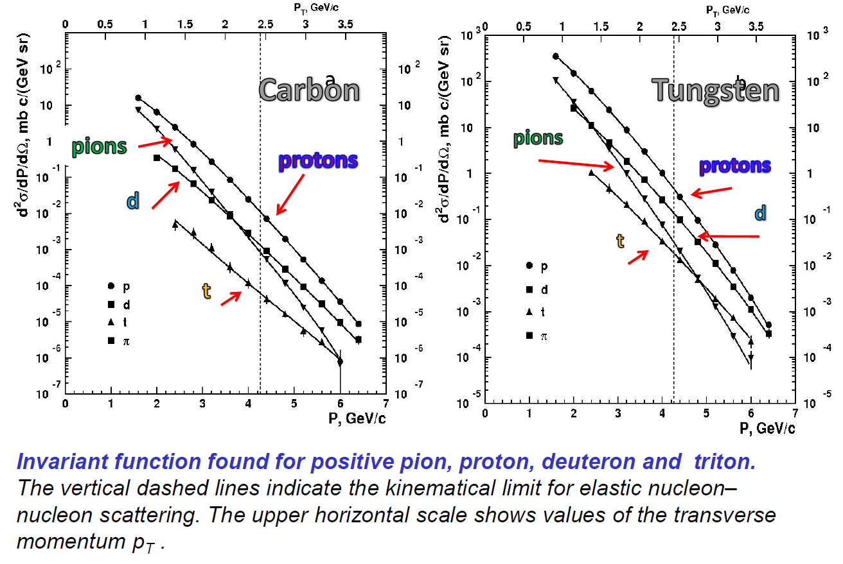
N.N. Antonov et al., JETP Letters, Vol.101, No.10, pp.670-673(2015)

Slide 36
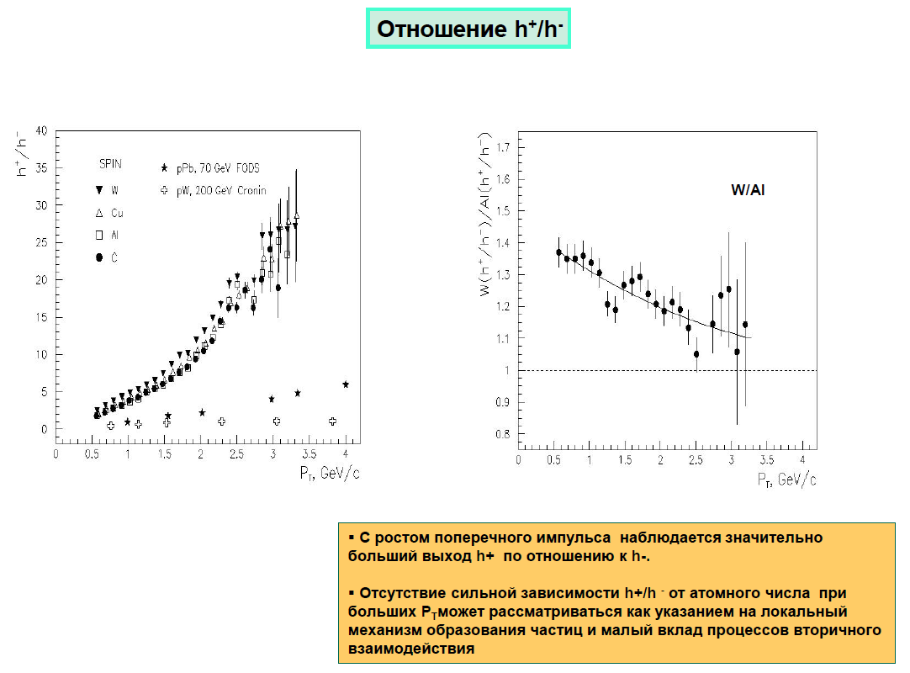
Ratios

Slide 37
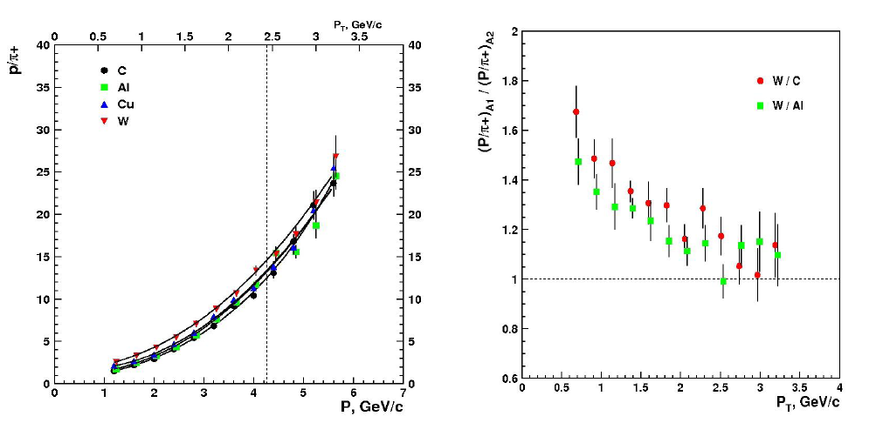
Ratio p/π⁺ (2013)

Slide 38
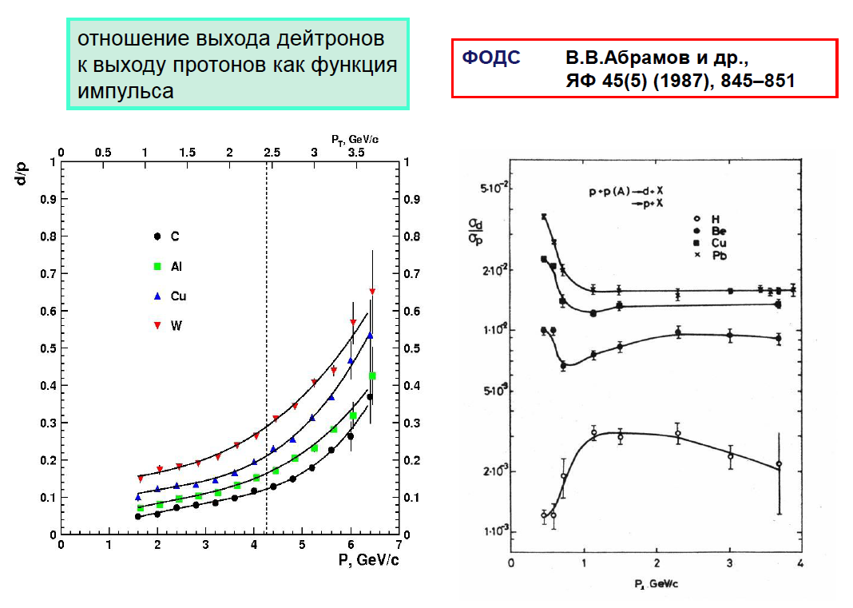
Ratio d/p
SPIN data

Slide 39
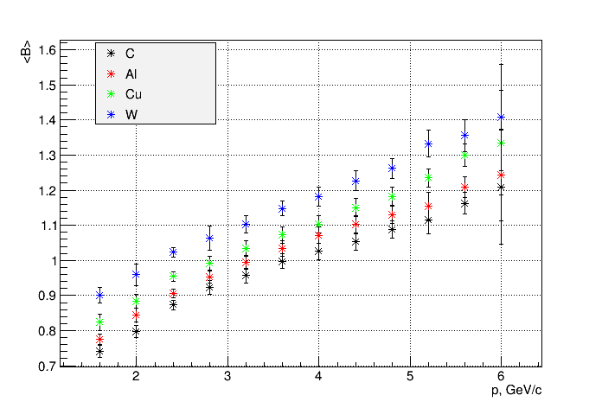
N.N. Antonov et al., JETP Letters, Vol.101, No.10, pp.670-673(2015)
Average baryon number <B>

Slide 40
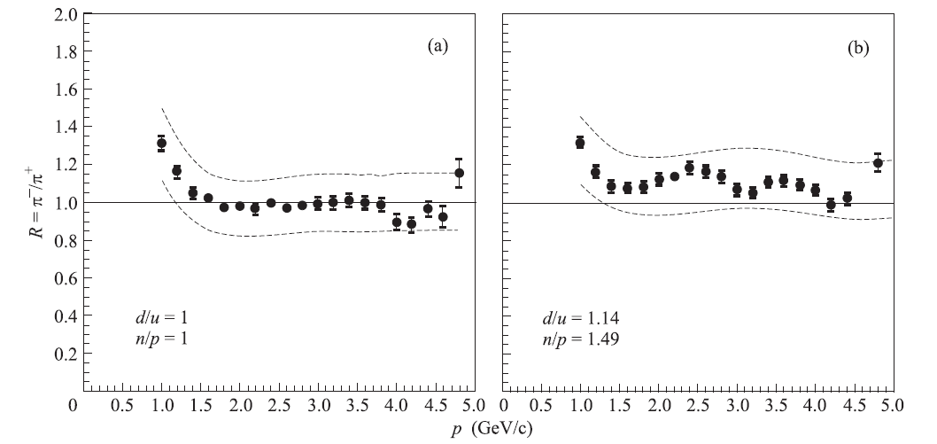
N.N. Antonov et al., JETP Letters, Vol.101, No.10, pp.670-673(2015)
π^{-/}π⁺

Slide 41
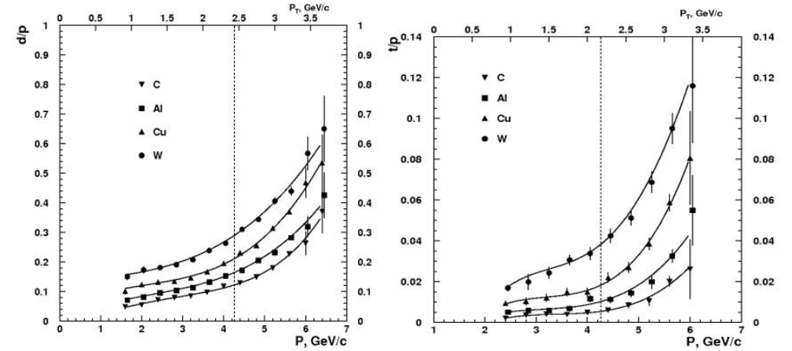
SPIN peliminary

Slide 42
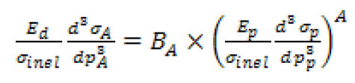


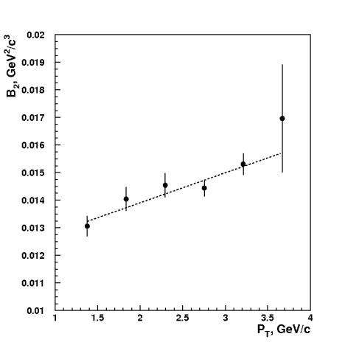
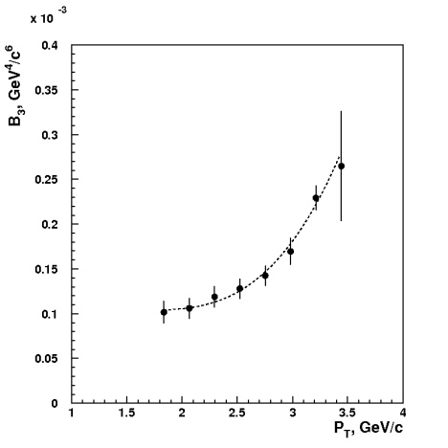
SPIN data JETP Letters, Vol.104, No.10 (2016)

Slide 43
Why CsDBM?

Slide 44
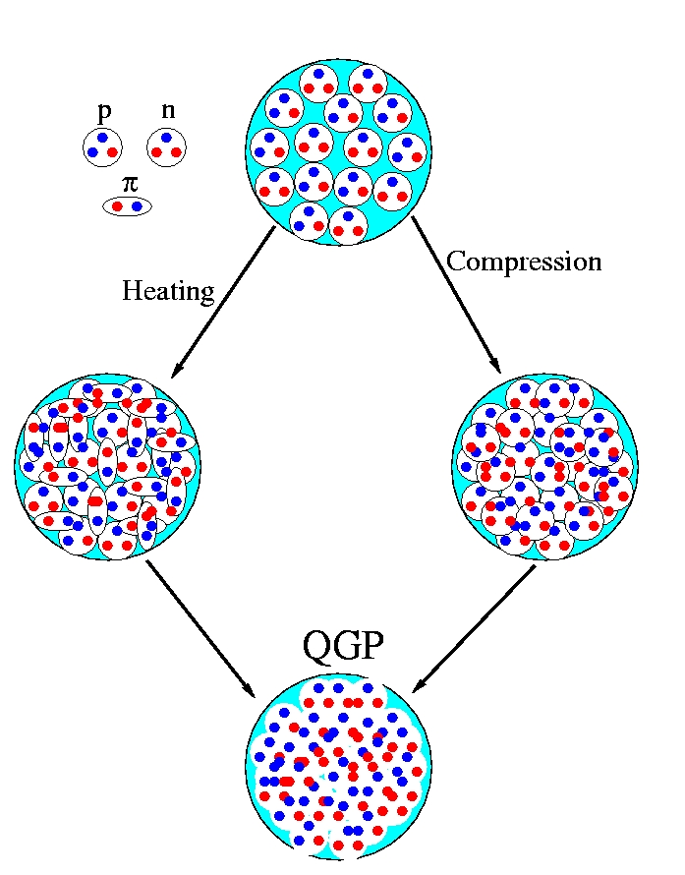
What if we compress/heat the system so much that the individual hadrons start to interpenetrate?
II.Way for Hot
QG phase
I.Way for Cold
QG phase
Heavy AA-collisions
1. QGP, sQGP, CGC,
GLAZMA or …
2. Early time of Universe
evolution
Cumulative and high p_{T} physics
1. Multiquarks states in the cold
nuclear matter or …
2. Properties of the multiquarks
states, high density states
3. Stars evolution, dark matter
?
≡
Stars evolution -
direct direction
Universe evolution –
back in time
Final phases will be equal or not?

Slide 45
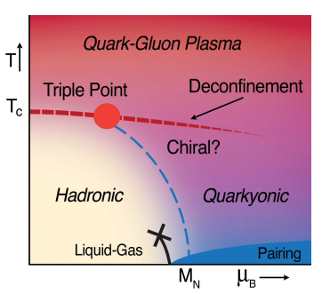
+ CERN Yellow Report
2007-005, p.75
2008-005
Nuclear Physics A 837 (2010) 65–86
RHIC Time(BNL)
Nuclotron-SPS Time (CERN)
45

Slide 47

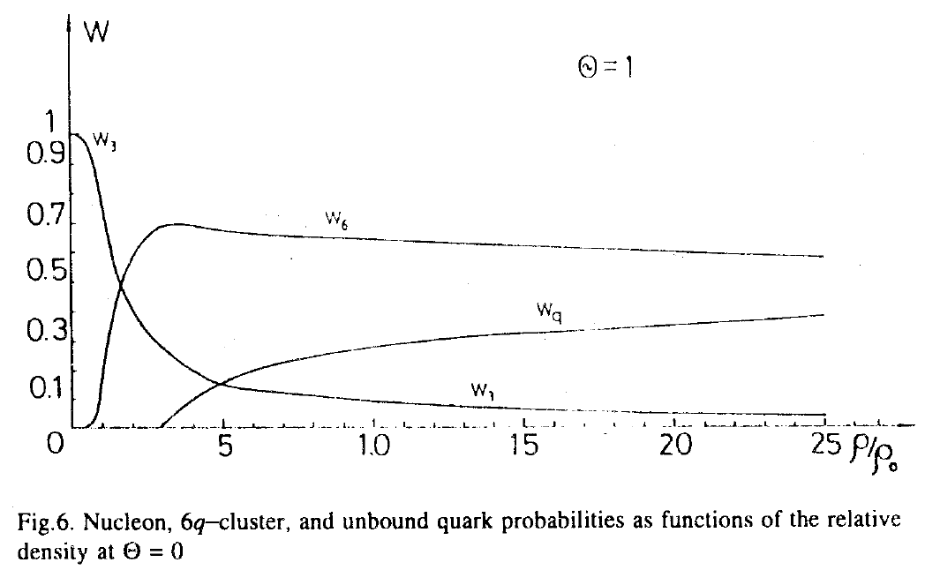

Slide 48
CsDBM
1.Cold - exists inside ordinary nuclear matter as a quantum component of the wave function (with own probability and life time).
2. SuperDense - several nucleons can be in a volume less than the nucleon volume. The mass will be several nucleon masses. The small size means that the multinucleon(multiquark) configuration seeing as point like objects in processes with high transfer energy (CT - ?).

Slide 49
CsDBM - continuation
3. Baryonic Matter – enhancement of baryonic states and suppression of sea and gluon degrees of freedom (mesons and antiparticles production).

Slide 50


Slide 51

V.V. Braguta, this workshop contribution

Slide 52
The multinucleon (multiquark) systems at
SPIN & FODS(IHEP) now and
MARUSYA(JINR), PANDA,
J-PARC HI in the future.

Slide 53





IHEP, Protvino
(proton energy 20-50 GeV and
nuclear beams up to 34 GeV/u)
FODS

Slide 54


Slide 55
FODS

Slide 56

Experiment MARUSYA-FLINT at nuclotron (JINR)
Romanov D. ISHEPP XXII 2014
Scheme of experimental set-up
MARUSYA-FLINT: ST - target station,
M1, M2- scintillation monitors,
DM- multiplicity detectors,
H- scintillation hodoscopes,
ZDC - hadron calorimeter,
PC - proportional chambers,
C – cherenkov counter,
ML17, K100 - quadrupole lens,
SP-57, SP-40 - dipole magnets,
ECal - electromagnetic calorimeter
Magnetic spectrometer:
For P_{t} = 0,3-0,8 GeV/s used magnet SP-57
For P_{t} = 0,6-2 GeV/s used magnet SP-57 and SP-40
Coordinate system on scintillation hodoscopes provide resolution 2-5% in area 0,3-0,8 GeV/s

Slide 57

PANDA

Slide 58


Slide 59
Main PANDA advantages
The unique beam – no worldwide
(FNAL closed antiproton activity) and
Δp/p ~ 10⁻⁵.
The unique detector - ΔΩ ~ 4π -exclusive reactions investigation (correlations, backward range); working at luminosity ~ 10³² cm⁻² s⁻¹ – the very rare event can be investigated; PID – close to full energy range and high momentum resolution.

Slide 60



JINR PAC, 2010

Slide 61




J-PARC HI
HI accelerator scheme
proton (existing)
U³⁵⁺
20 AMeV
HI (under plan)
Figures: Not to scale
stripping
HI Linac
HI booster
p/HI to HD
50 GeV MR
3→30 GeV (p)
50 GeV(p)
p to HD
Parallel operation
HI（ＭＲ）
p（ＭＬＦ）
stripping
U³⁵⁺→U⁶⁶⁺
20 → 67 AMeV
3GeV RCS
(H⁻ → p)
0.4 → 3 GeV
MLF
p to NU
stripping
H⁻ Linac: 0.4 GeV
U⁸⁶⁺
62 → 735 AMeV
U⁹²⁺
0.73 → 11.2 AGeV
  19 AGeV
400MeV p

Slide 62

J-PARC HI

Slide 63


Slide 64
Beam View
Muon Tracker
Neutron counter
JHITS
J-PARC Heavy Ion
Toroidal Spectrometer
EMCAL
RICH
Coils = insensitive
area
12-fold coils
Bφ variations ~+-20%
Toroid coils

Slide 65
Muon Tracker
Top
View
3.2m
EMCAL (e,γ ID)
PbWO_{4,} 15X₀
Neutron counter
EMCAL
Neutron detector
Toroid
coils
JHITS
TOF
0.65m
e-π separation
μ–π separation
Fe absorbers
+trackers
1.90m
RICH
C₅F₁₂ radiator
p<3.4GeV/c
0.5m
ZCAL
R=1m
ZCAL
Beam
SVD
0.25m
4m
1.4m
Multiplicity
counter
GEM trackers
Centrality
MC + ZCAL

Slide 66
END

Slide 67




Slide 68




Slide 69


Slide 70


Slide 71


XII ITEP School 1985

Slide 72


Slide 73


Slide 74



Local processes in NN kinematic
Production of anti-protons in the proton - nucleus interactions at 10.1-Gev/c. A.A. Sibirtsev, G.A. Safronov, G.N. Smitnov, Yu.V. Trebuchovsky (Moscow, ITEP). 1991. Published in Yad.Fiz. 53 (1991) 191-199
Sov.J.Nucl.Phys.37:732,1983

Slide 75
A.V. Efremov (1976) Parton description
A + B → C + X
x_{II} x_{I}

Slide 76


SPIN PHYSICS at
Nuclotron & NIKA

Slide 77





Slide 78



Slide 79
High p_{T} NN Elastic scattering with
polarized deuteron beams :
for calibration
New data!
By the way we will have the
counting rules verification!
With pd, nd and dd – too!

Slide 80
B (p,n,Λ, Δ…), M (π, K , …)
Exclusive high p_{T} NN studies at x_{T} ~ 1
Mechanisms of hyperons polarization
The counting rules and isotopic symmetry
studies, p_{T} ~ 2 GeV/c anomaly
Detail vertexes studies and spin structure of the interaction vertex:

Slide 81
High p_{T} exclusive reactions -> MPI
Without
diquark
diquark
diquark
diquark
Diquark (S=0)

Slide 82
studies at x_{T} ~ 1
The counting rules and isotopic symmetry
studies, p_{T} ~ 2 GeV/c anomaly(?)
Detail vertexes studies:

Slide 83
pp-bar - > pp-bar + X, pp-bar -> D + X reactions with diquarks and antidiquark
d-bar
d
d-bar
Diquark proof
d
q-bar
q
q
d-bar
d
q-bar
Exotic states production
d
d-bar
Kim’s-bar mechanisms

Slide 84

SRC in VBLHEP

Slide 85


Slide 86


Slide 87
CT region

Slide 88
p_{T}~2 GeV/c anomaly at high energy
(RHIC and LHC)

Slide 89



harged hadron suppression in Pb-Pb
Charged hadron suppression in Pb-Pb
Pb
Pb
$$R_{AA}=\frac{{N_{Jet}}^{AA}/N_{coll}}{{N_{Jet}}^{pp}}$$
Pb
Pb
EPJC 72 (2012) 1945
For central collisions:
A pronounced minimum at $P_{T}=6−7 GeV$ where $R_{AA}≈0.2$
At higher $P_{T}$ $R_{AA}$rises and levels off above 40 GeV
Suppression at high $P_{T}$ at the same level as jet suppression

Slide 90


J.W. Cronin et al., Production of hadrons at large transverse momentum at 200, 300, and 400 GeV, Phys.Rev. D, v.11, N 11, 3105-3123 (1975)
p_{T} ~ 2 GeV/c region
V.S. Pantuev Physics of Atomic Nuclei, 2009, Vol. 72, No. 12, pp. 1971–1981

Slide 91


Slide 92

E.A. Crosbie et al., Phys.Rev. D, vol.23, N3,1981
p_{T} ~ 2 GeV/c

Slide 93
The Counting rules

Slide 94
In 1973 were published two artiles :
Matveev V.A., Muradyan R.M., Tavkhelidze A.N. Lett. Nuovo Cimento 7,719 (1973);
Brodsky S., Farrar G. Phys. Rev. Lett. 31,1153 (1973)
Predictions that for momentum p_{beam} ≥ 5 GeV/c in any binary large-angle scattering (θ_{cm} > 40º) reaction at large momentum transfers :
A + B -> C + D
where n_{A},n_{B},n_{C} and n_{D} the amounts of elementary constituents in A,B,C and D.
s=(p_{A}+p_{B})² and t=(p_{A}-p_{C})²,
and

Slide 95



CERN 2004-001

Slide 96



