Slide 1
Laser spectroscopy of atoms and molecules for tests of QED and improved knowledge of fundamental particles and constants
Jeroen Koelemeij
LaserLaB VU University Amsterdam, The Netherlands

Slide 2
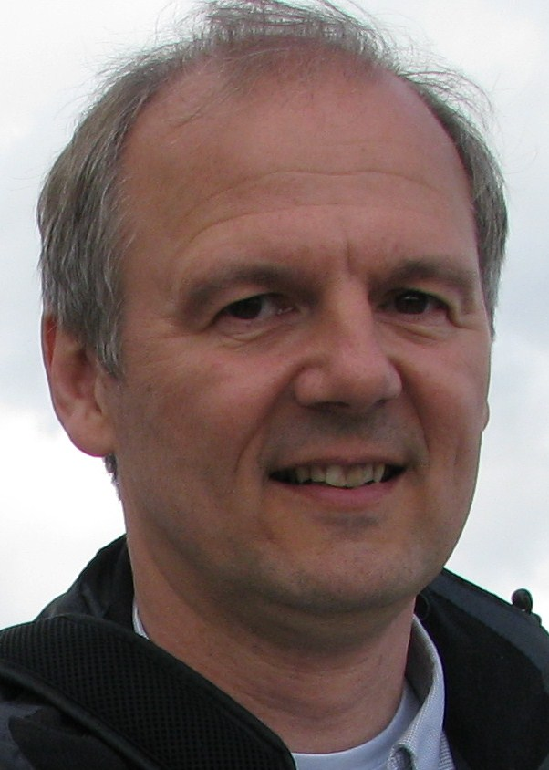
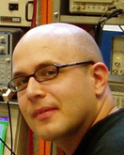
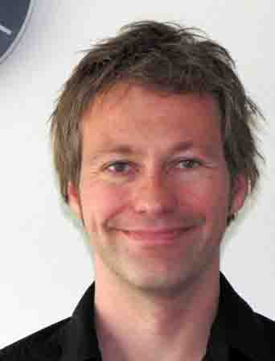
QED/fundamental constants research at LaserLaB
Prof Wim Ubachs
(group leader)
Prof Kjeld Eikema
Dr Wim Vassen
Dr Rick Bethlem
Dr Jeroen Koelemeij
Spectroscopy of H₂
Tests of QED
m_{p}/m_{e} variation
XUV comb
spectroscopy
XUV He spectroscopy
Tests of QED
α variation
Spectroscopy of He*
Tests of QED
He-3 nuclear size
Cold molecules
Spectroscopy of CO, CH₃OH, NH₃
m_{p}/m_{e} variation
Cold molecular ions
QED tests HD⁺
m_{p}/m_{e} value
m_{p}/m_{e} variation
One-electron system: HD⁺
Two-electron systems: He, H₂

Slide 3
Two-electron systems
Metastable helium spectroscopy
Rob van Rooij
Joe Borbely
Juliette Simonet (ENS Paris)
Maarten Hoogerland (Auckland)
Kjeld Eikema
Roel Rozendaal
Wim Vassen

Slide 4
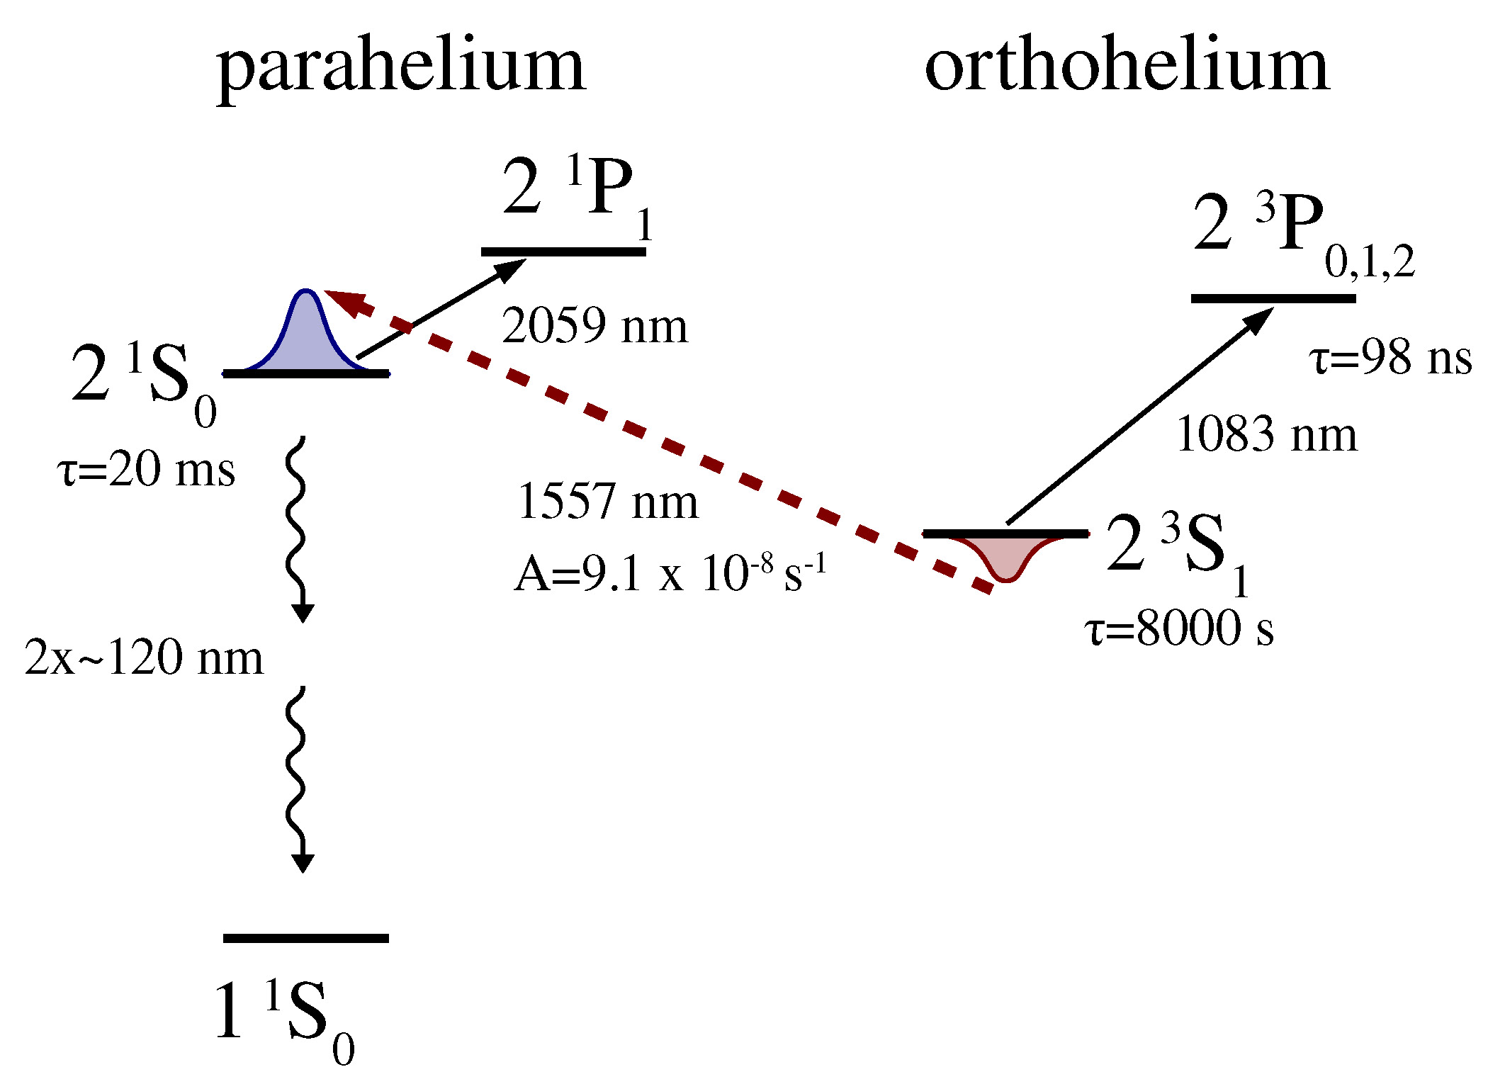
Precision spectroscopy of He*
Use ultracold, quantum degenerate gas of ³He (fermion) or ⁴He (boson) in 1s2s ³S₁ state (He*)
High-res laser spectroscopy of doubly-forbidden 2 ³S₁ – 2 ¹S₀ transition (1557 nm)
Laser cooling
and trapping!

Slide 5
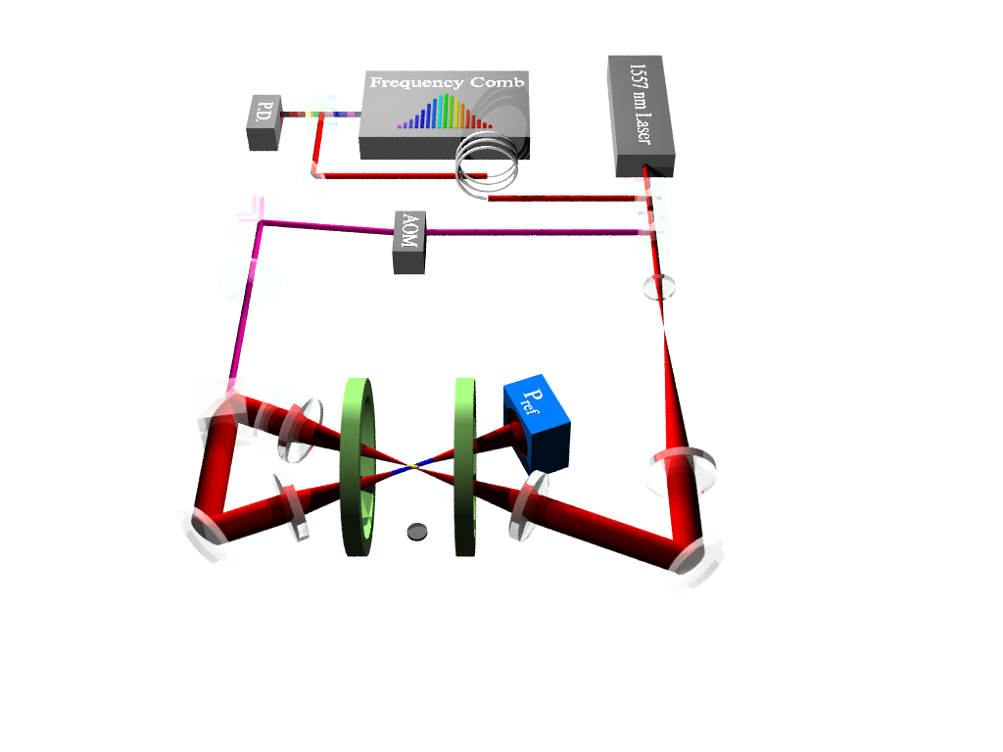
He* spectroscopy setup
Dipole trap laser: 40 MHz detuned from atomic transition
Crossed optical dipole trap at 1557 nm
Bose-Einstein condensate of ⁴He*
Degenerate Fermi gas of ³He*

Slide 6
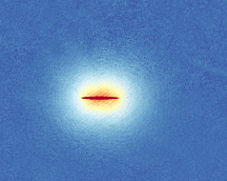
He* spectroscopy setup
Absorption imaging
Dipole trap laser: 40 MHz detuned from atomic transition
Crossed optical dipole trap at 1557 nm
Bose-Einstein condensate of ⁴He*
Degenerate Fermi gas of ³He*

Slide 7
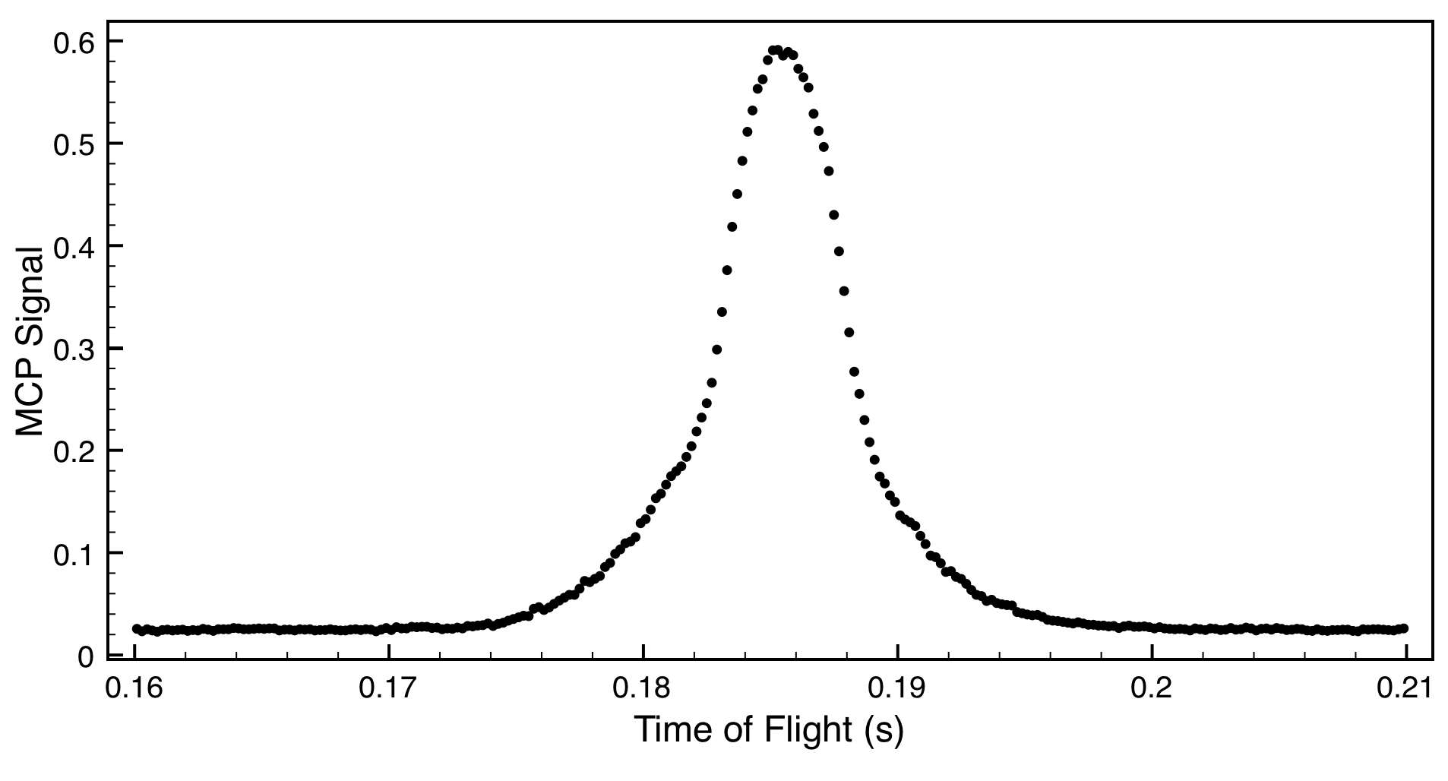
He* spectroscopy setup
Absorption imaging
Dipole trap laser: 40 MHz detuned from atomic transition
TOF on Micro-channel Plate (MCP)
Thermal fraction
at ∼ 1 μK
Crossed optical dipole trap at 1557 nm
Bose-Einstein condensate of ⁴He*
Degenerate Fermi gas of ³He*
MCP Signal (a.u.)
160
170
180
190
200
210
Time of Flight (ms)

Slide 8
He* spectroscopy setup
Mode-locked erbium doped fiber laser (Menlo Systems)
Referenced to a GPS-disciplined rubidium clock
Absorption imaging
Dipole trap laser: 40 MHz detuned from atomic transition
TOF on Micro-channel Plate (MCP)
Thermal fraction
at ∼ 1 μK
Crossed optical dipole trap at 1557 nm
Bose-Einstein condensate of ⁴He*
Degenerate Fermi gas of ³He*
MCP Signal (a.u.)
160
170
180
190
200
210
Time of Flight (ms)

Slide 9
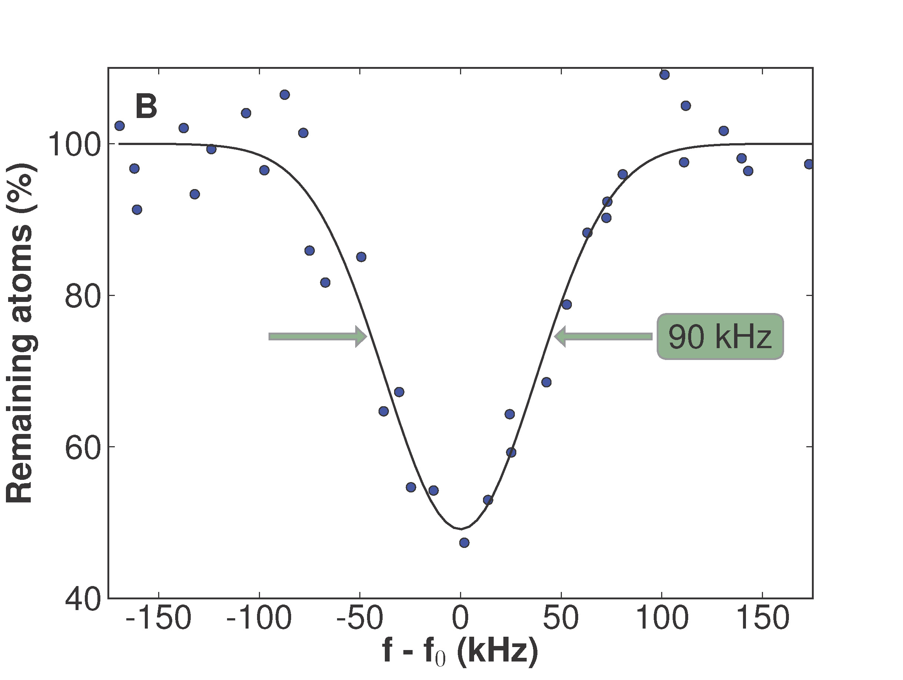
Signal and lineshape
Atoms in 2 ³S₁ state are trapped by dipole trap, but atoms in 2 ¹S₀ excited state are anti-trapped
Detect loss of atoms due to 1557 nm laser
Laser linewidth
75 kHz

Slide 10
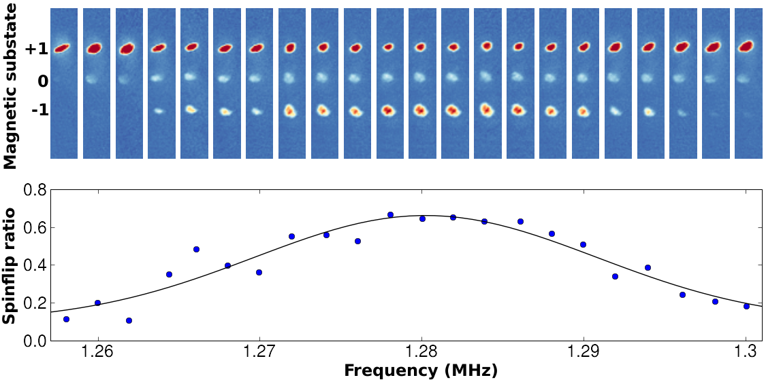
Systematic frequency shifts
He* atoms prepared in M = 1 to suppress Penning ionization
BUT linear Zeeman effect
Spin flips + Stern-Gerlach-type detection (absorption imaging)

Slide 11
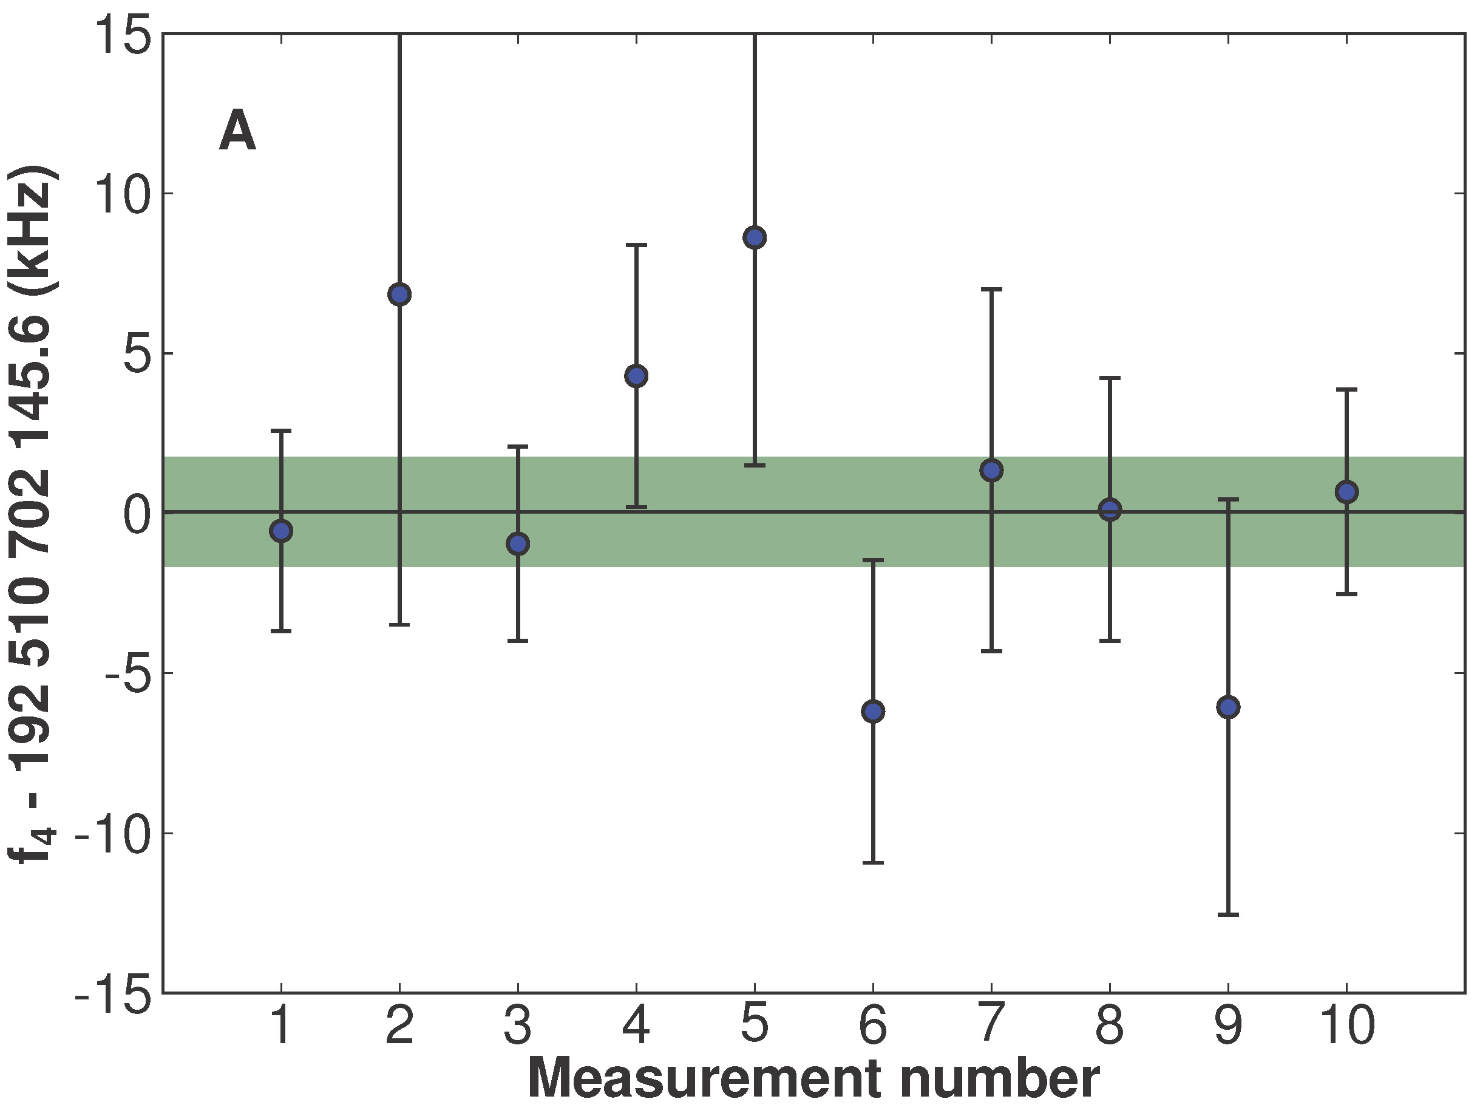
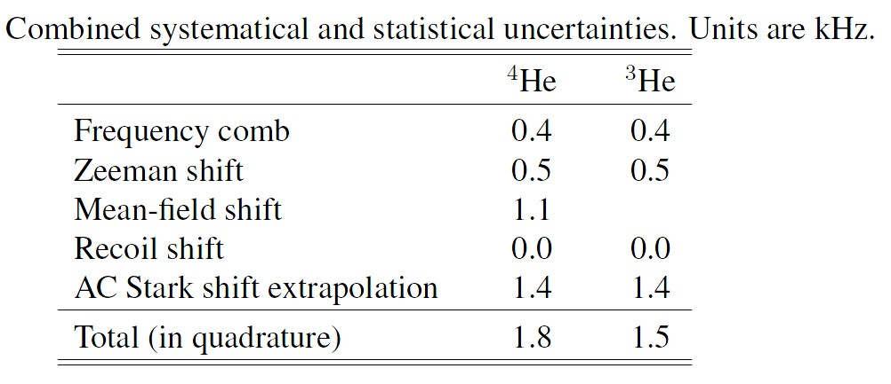
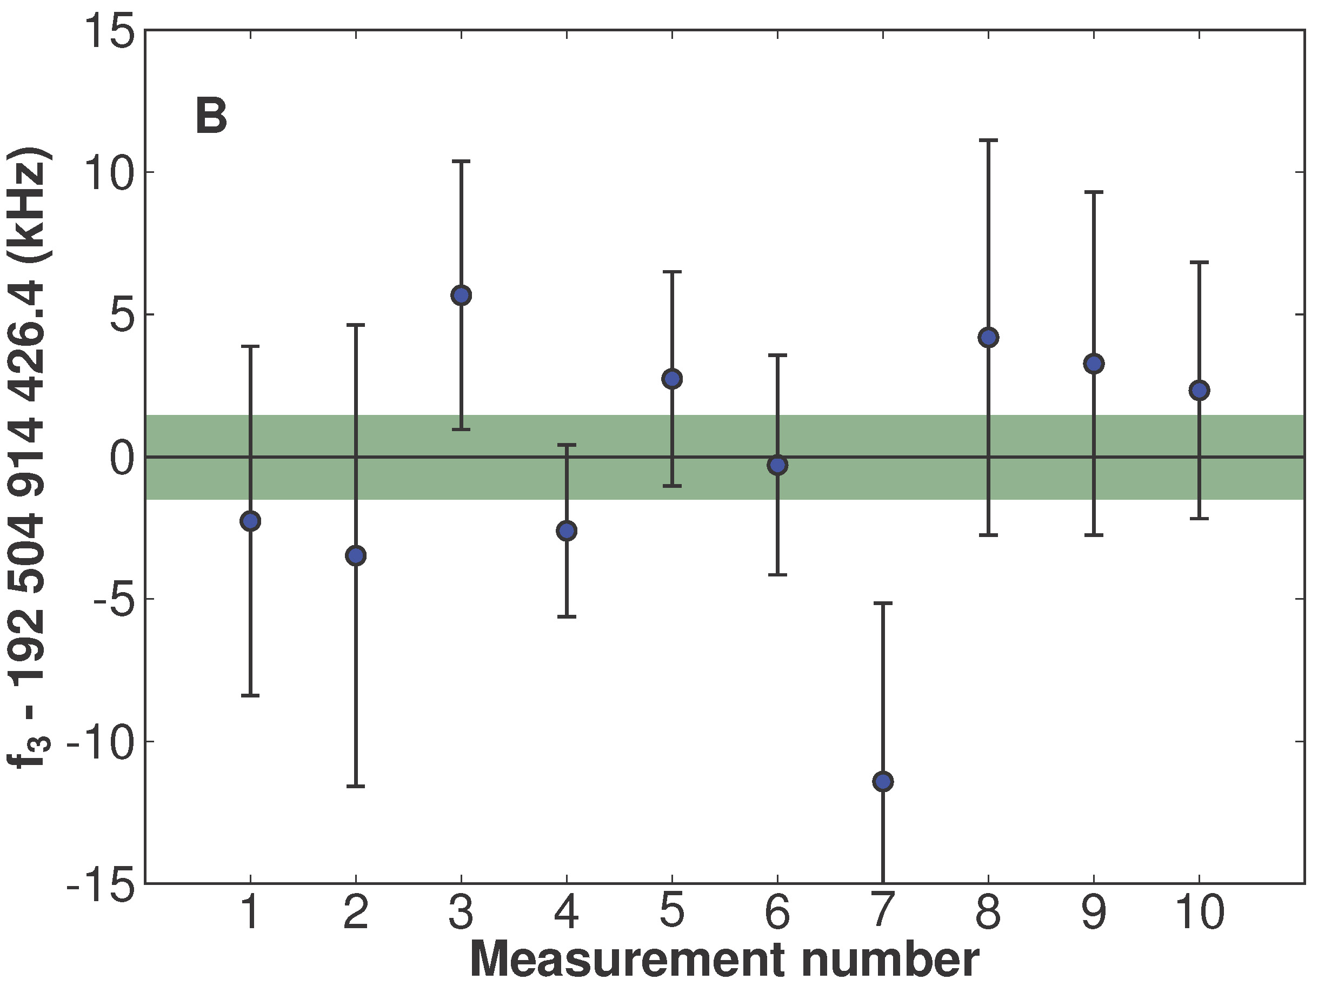
Other systematic shifts
AC Stark shifts by 1557 nm laser (vary power and extrapolate to zero)
⁴He (bosons): mean-field shift 0.07±1.08 kHz
⁴He
[kHz]
³He
9.3 ppt
8.8 ppt

Slide 12
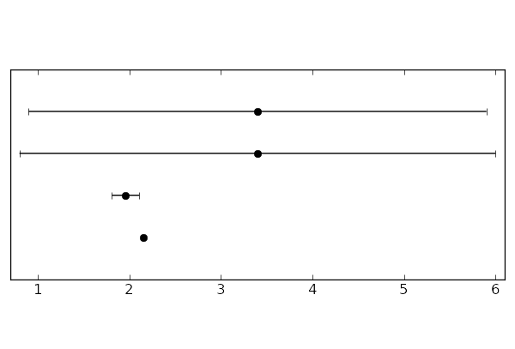
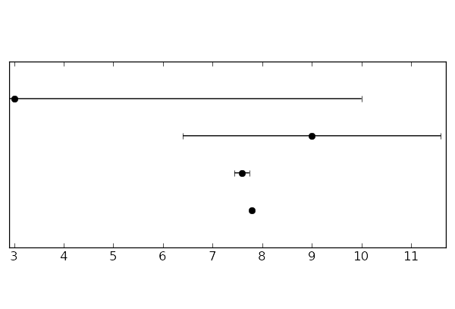
Results – Experiment vs. Theory
Helium 4 transition frequency
Helium 3 transition frequency
Drake
Drake
Pachucki
Pachucki
Indirect expt.
Indirect expt.
This work
This work
f – 192510700 (MHz)
f – 192502660 (MHz)
QED terms contribute at 3 – 4 GHz level
1.5 kHz accuracy: test of He QED at 1-2 ppm level possible
R. van Rooij, J.S. Borbely, J. Simonet, M.D. Hoogerland, K.S.E. Eikema, R.A. Rozendaal, W. Vassen, Science 333 196 (2011).

Slide 13
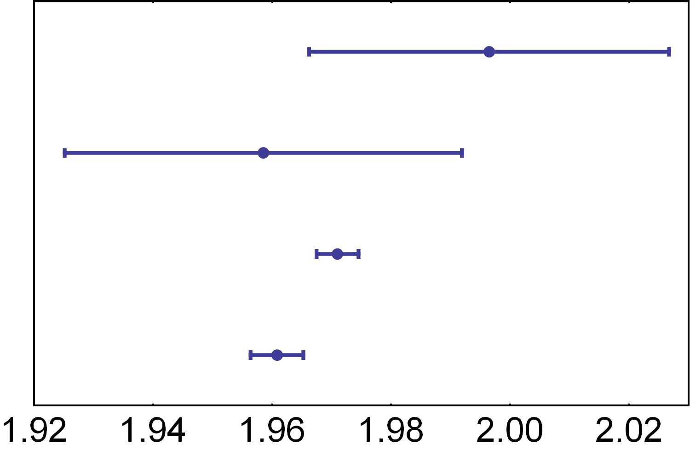
³He nuclear radius
Measure isotope shift (IS) between ⁴He and ³He
⁴He rms nuclear radius accurately known 1.681(4) fm*
QED theory: IS accurate to 8 034 148.6(7) kHz
(Assuming pointlike nuclei)
Experimental IS differs from theory by 218.6(2.4) kHz
Attribute to different rms nuclear radius ³He
³He nuclear radius: 1.961(4) fm (this work)
Comparison with other results:
Nuclear few-body theory
(A. Kievsky et al., J. Phys. G 35, 063101 (2008)
Electron scattering results
(I. Sick, Lect. Notes Phys. 745, 57 (2008)
He 2 ³S₁ – 2 ³P₀
(D. Shiner et al., PRL 74 3553 1995)
this work (R. van Rooij et al. Science 333 196 (2011).
³He rms radius [fm]
* I. Sick, Phys. Rev. C Nucl. Phys. 77, 041302 (2008)

Slide 14
Two-electron systems
XUV frequency comb spectroscopy of helium
Dominik Kandula (now at MBI Berlin)
Tjeerd Pinkert
Christoph Gohle (now at LMU München)
Wim Ubachs
Kjeld Eikema

Slide 15
QED/nuclear size tests
Hydrogen
Helium
Helium+
1s5p
2S
1s2s
2S
243 nm
120 nm
60 nm
51 nm
243 nm
120 nm
60 nm
1S
1s²
1S
Higher-order QED scales with >= Z⁴

Slide 16
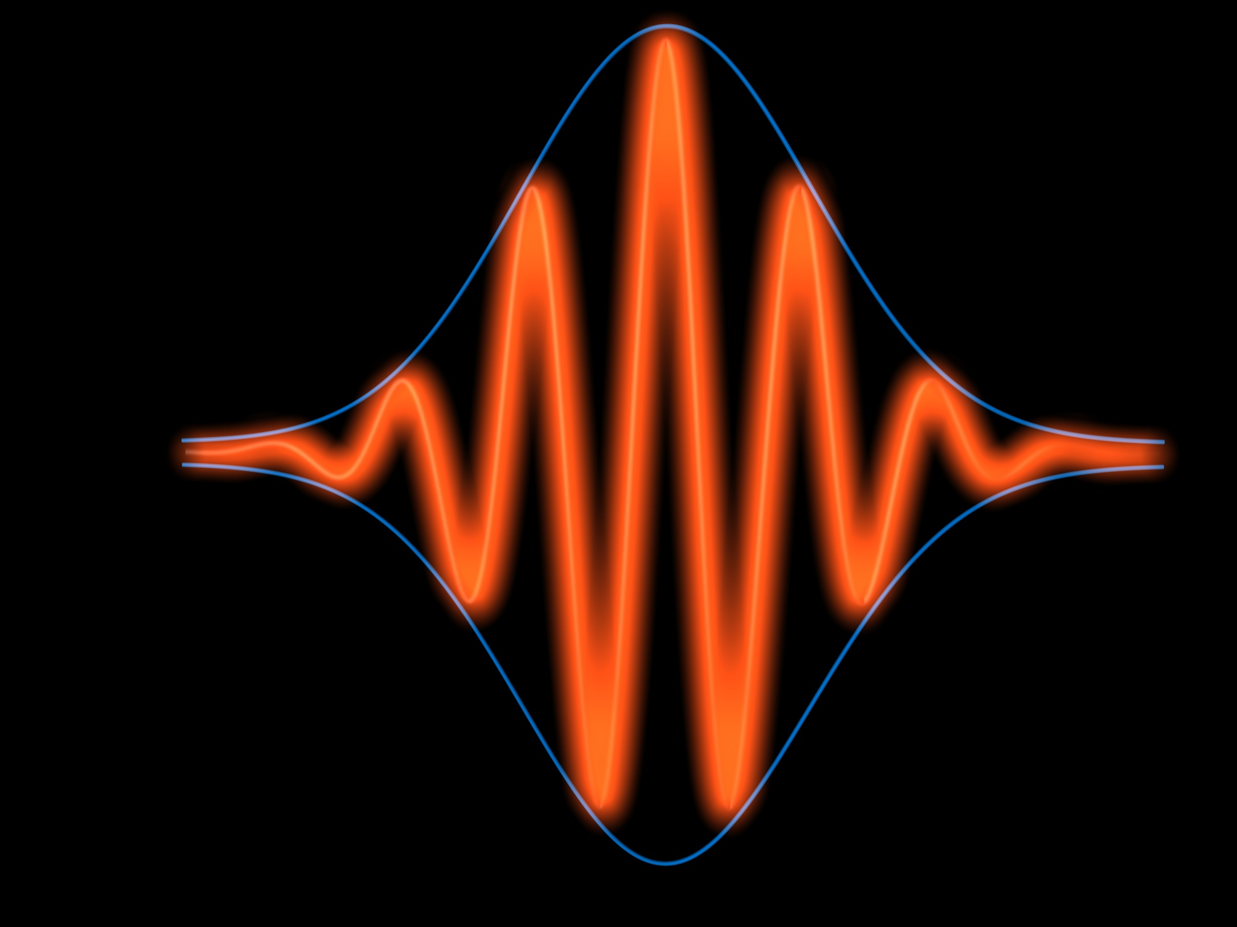
High-harmonic generation to reach XUV
Noble gas jet
IR pulses
XUV (λ<100 nm)
10¹⁴ W/cm²
IR
UV
DUV
VUV
XUV
X-RAY
harmonic
conversion
3rd
5th
7th
9th
333rd
…
frequency

Slide 17
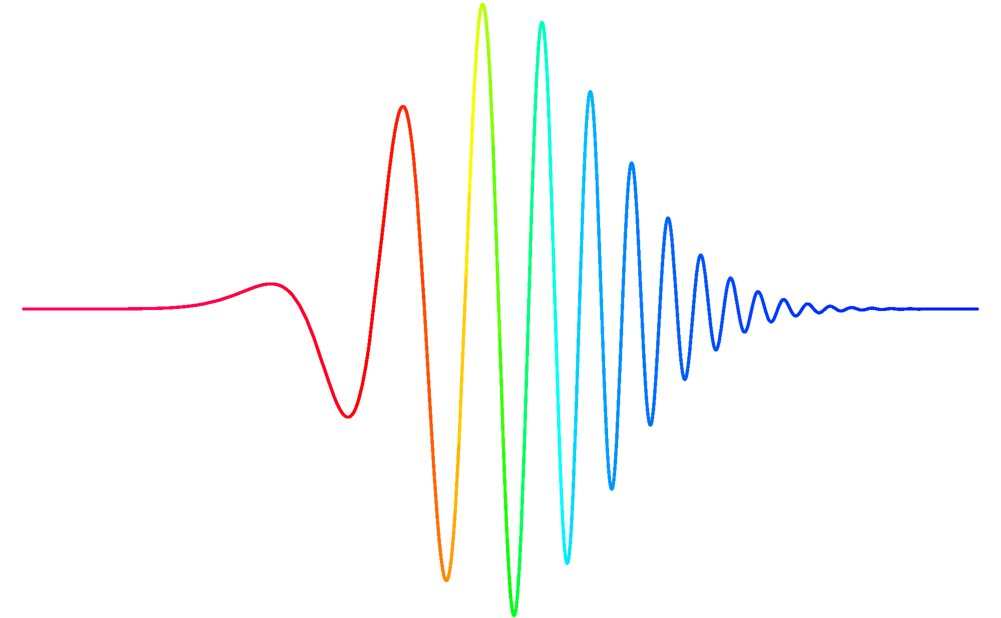
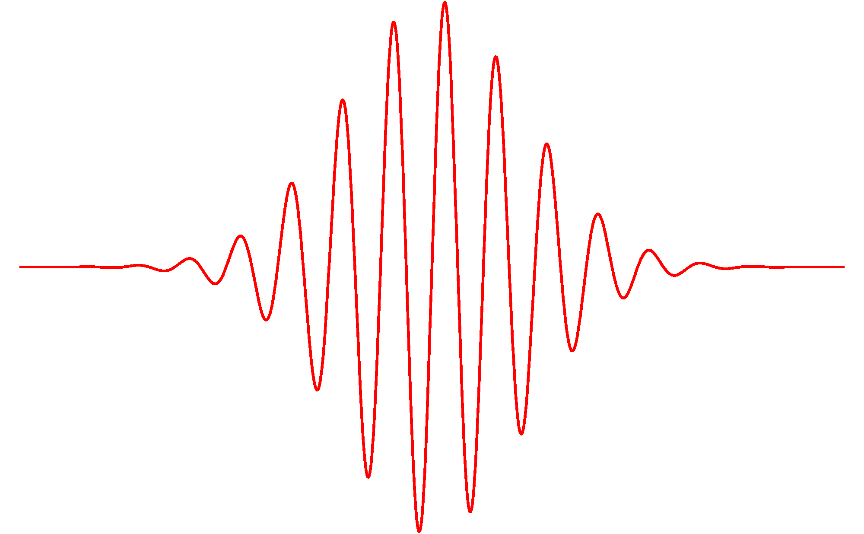
Single pulse excitation: chirp issues
time
frequency
ν
Δτ Δν > 0.44
Δτ
Δν
ν

Slide 18
Comb or Ramsey excitation
time
frequency
ν
T
Δν = 1/T
ν
Phase coherent pulse excitation: Ramsey (1949), Hänsch and coworkers (1976/77), Chebotayev et al. (1976), Snadden et al. (1996), Bellini et al. (1997, 1998), J. Ye and coworkers (2004), ....

Slide 19
Frequency comb lasers
T
φ_{CE}= 0
φ_{CE}= π/2
v_{g} ≠ v_{φ}
time
f_{CEO} = f_{rep} x Δφ_{CE} / 2π
f_{rep} = 1/T
Int.
f_{n} = f_{CEO} + n.f_{rep}
frequency
0

Slide 20
Frequency comb lasers – two pulses
T
φ_{CE}= 0
φ_{CE}= π/2
v_{g} ≠ v_{φ}
time
f_{CEO} = f_{rep} x Δφ_{CE} / 2π
f_{rep} = 1/T
Int.
f_{n} = f_{CEO} + n.f_{rep}
frequency
0
Resemblance with N.F. Ramsey, Phys. Rev. 76, 996 (1949) M.M. Salour and C. Cohen-Tannoudji, PRL 38, 757 (1977)
R. Teets, J. Eckstein, T.W. Haensch, PRL 38, 760 (1977)

Slide 21
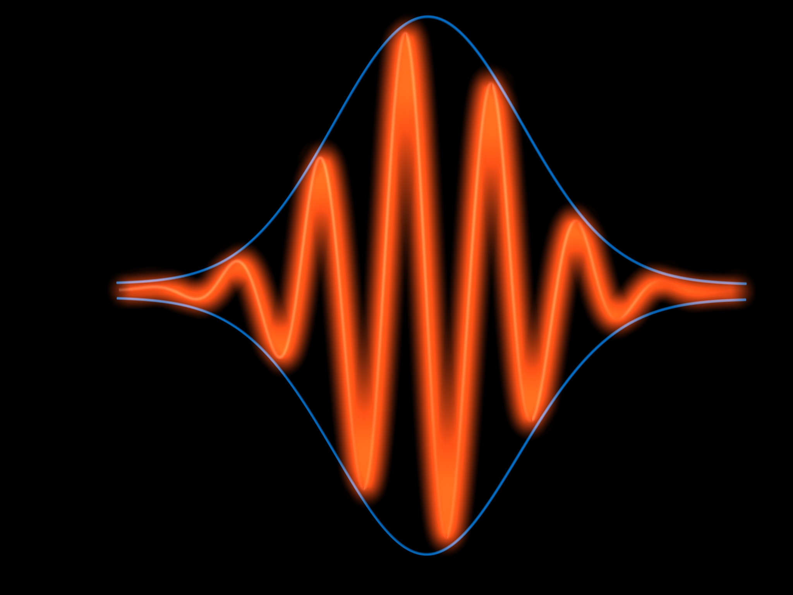
Frequency comb up-conversion
XUV
f_{n} = f_{CEO} + n f_{rep}
p^{th} harmonic
f_{n} = p f_{CEO} + m f_{rep}
IR
UV
harmonic
conversion
DUV
VUV
XUV
X-RAY
frequency

Slide 22
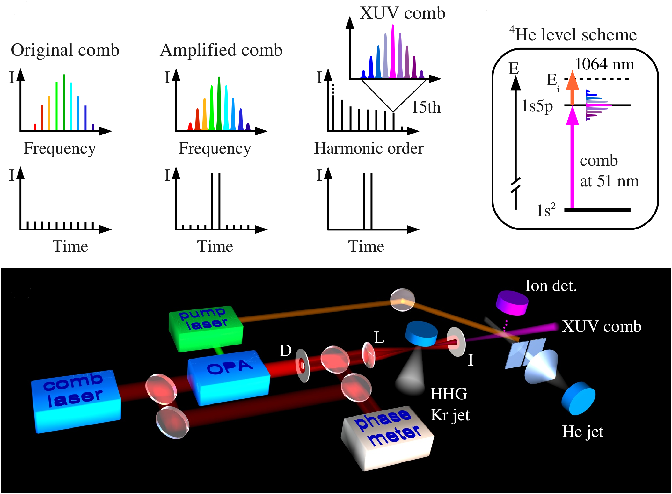
Principle and setup schematic

Slide 23
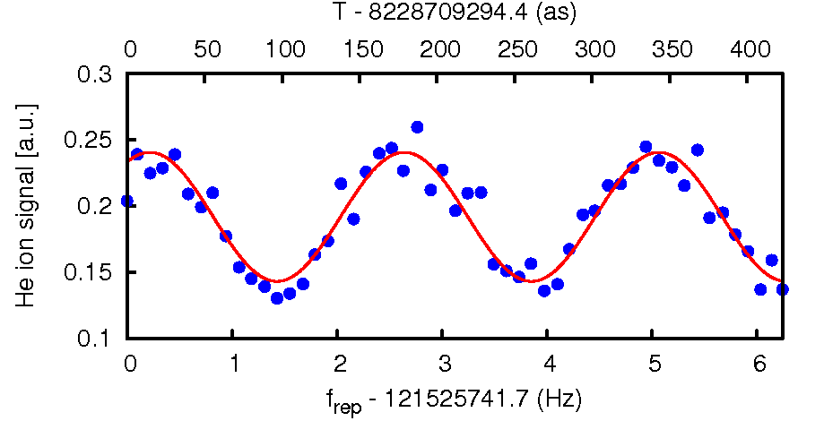
XUV comb excitation of helium at 51 nm
121 MHz
Contrast ~ 27% (up to 60% at higher rep-rate)
Helium seeded in neon @ f_{rep} = 121 MHz

Slide 24
Mode number n?
f_{n} = 15 f₀ + n f_{rep} with n ~ 50 000 000
f_{n}
f_{n+1}
f_{rep}
f_{n+2}

Slide 25
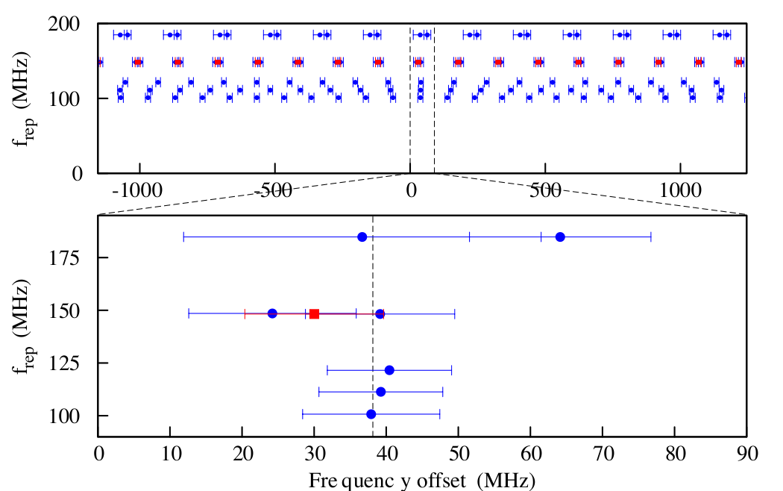
He ground state ionization potential
Theory position (Pachucki, PRA 2010)

Slide 26
He ground state measurement systematics
IR phase shifts in OPA
Pulse phase front tilt
Spectral/temporal phase difference between pulses
Doppler shift: varying speed using He, He/Ne, He/Ar & tune angle
Ionization: varying density, pulse intensity ratio
Adiabatic shift in HHG
shift in HHG due to excitation
AC Stark shifts (IR, XUV, ioniz. l.),
DC Stark (field free)
Self-phase modulation (pulse ratio).
Recoil shift 18.5 MHz for 5p
Many more effects!: Tests of chirp, HHG focus position, f₀, out-of-centre phase, ....etc.

Slide 27
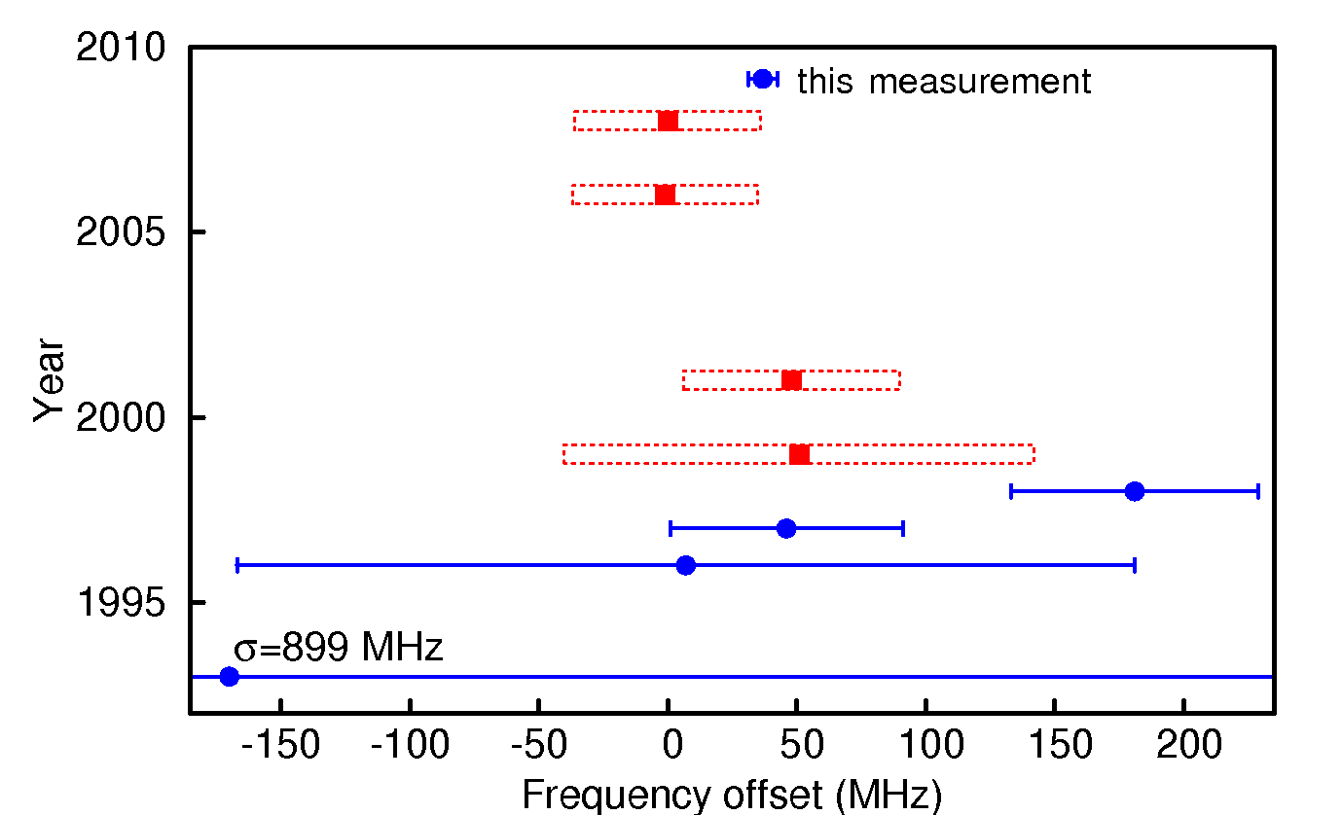
Theory and experiment
(1 ppb)
Drake
Pachucki
blue = experiments
red = theory
Korobov & Yelkhovsky
Drake
S. Bergeson et al.
Eikema et al.
D. Kandula et al. Phys. Rev. Lett. 105, 063001 (2010)
T.J. Pinkert et al., Opt. Lett. 36, 2026 (2011)
D. Kandula et al. Phys. Rev. A (accepted)

Slide 28
Two-electron systems
H₂ laser spectroscopy
Edcel Salumbides
Gareth Dickenson
Mingli Niu
Toncho Ivanov (now at SRON Netherlands)
Wim Ubachs

Slide 29
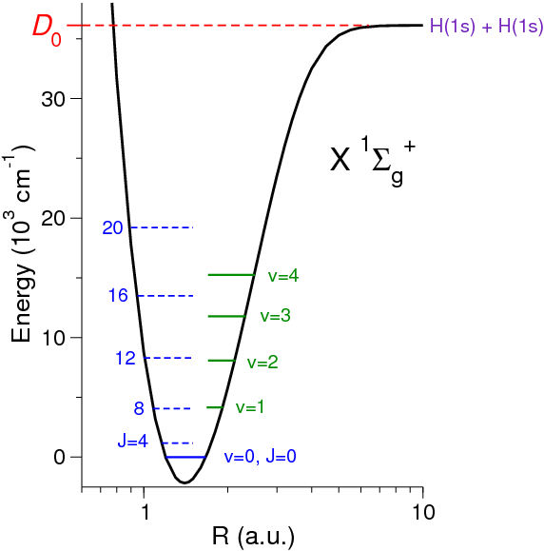
H₂ ground state & rotation levels
Aim:
Determine energies of X(v=0) rotational states with J = 1 – 16
Compare with newly developed QED theory of H₂ (Pachucki et al.)
How?
Direct rotational transitions not allowed
Solution: probe electronic transitions and use method of combination differences

Slide 30
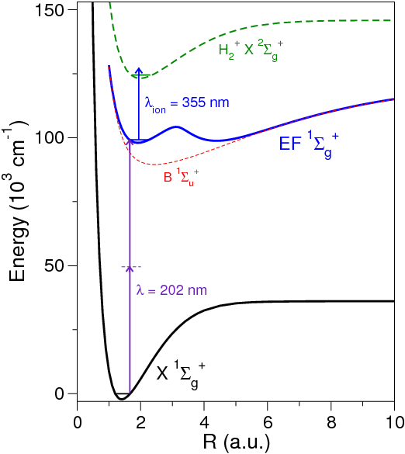
H₂ ground state & rotation levels
Aim:
Determine energies of X(v=0) rotational states with J = 1 – 16
Compare with newly developed QED theory of H₂ (Pachucki et al.)

Slide 31
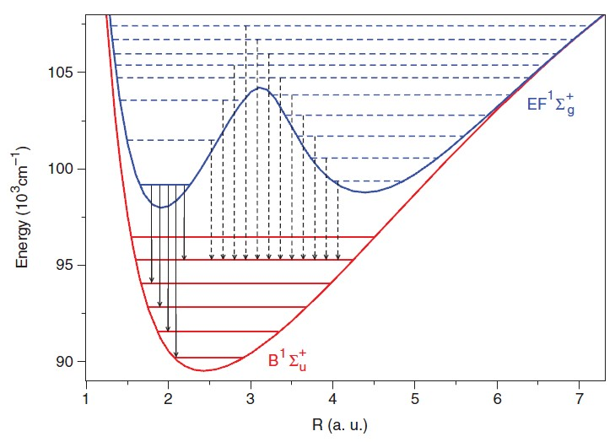
EF state
Rotational levels in EF state well known from emission spectroscopy in discharge*
*D. Bailly, E.J. Salumbides, M. Vervloet, W. Ubachs, Mol. Phys. 108, 827 (2010)

Slide 32
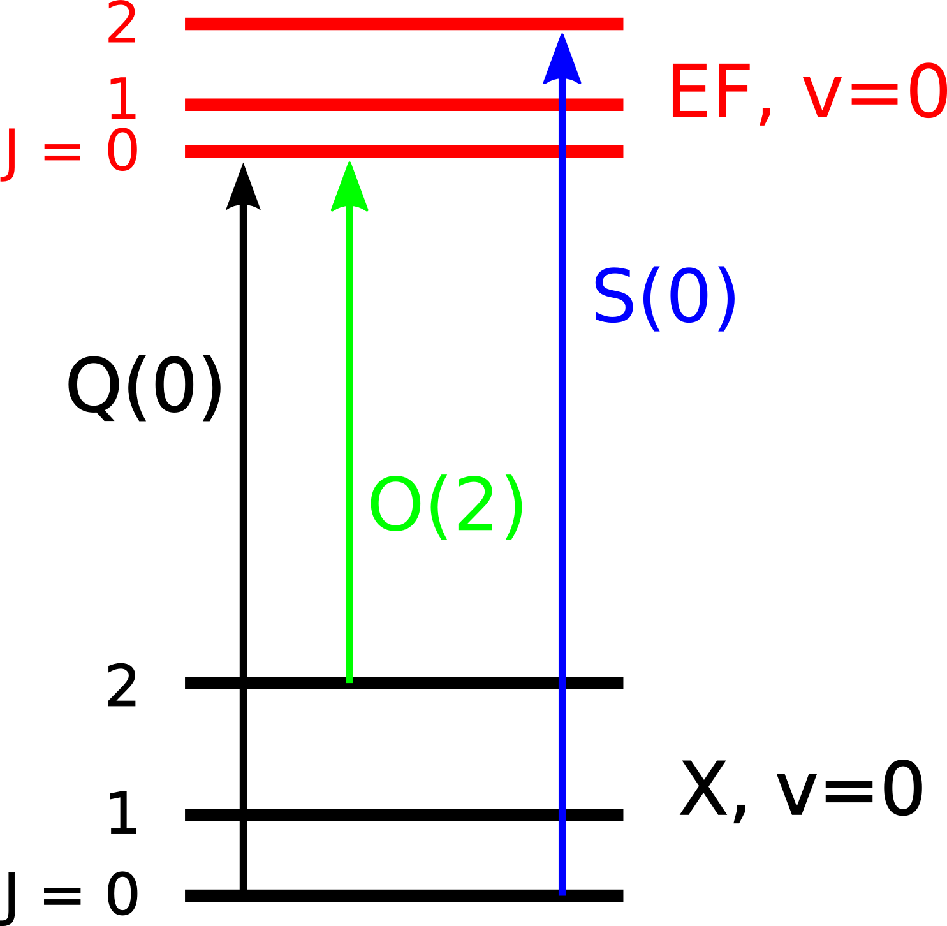
Indirect determination via EF state
EF, v=0, J = 2 – 12:
Accurate level energies from
Bailly et al., Mol. Phys. 108, 827 (2010)
EF – X (0,0) transitions:
Q: ΔJ = 0
O: ΔJ = -2
S: ΔJ = 2
Combination differences produce sequence of rotational level splittings
of H₂ X(v=0)

Slide 33
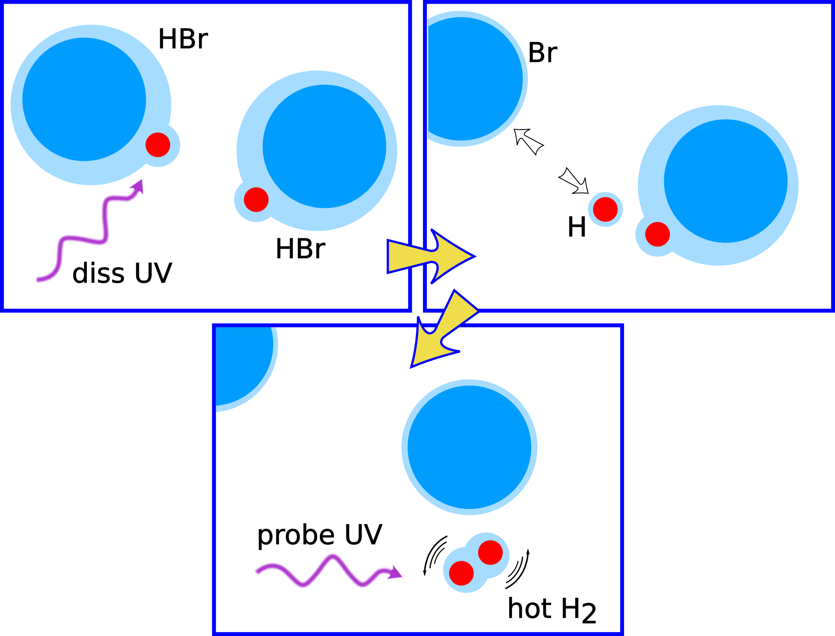
Producing rotationally hot H₂ *
J_{max} (v=0) = 16
T_{equiv} = 24 000 K
* Aker et al., J. Chem Phys. 90, 4795 (1989)

Slide 34
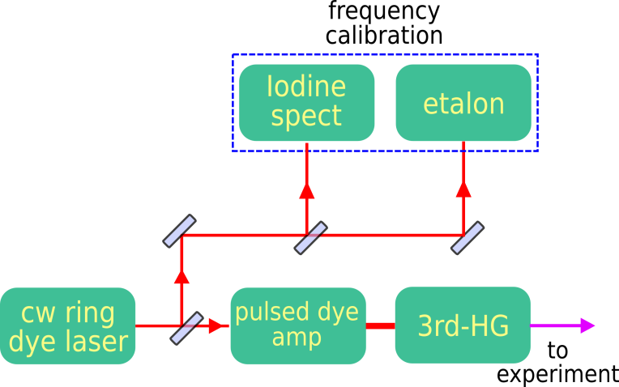
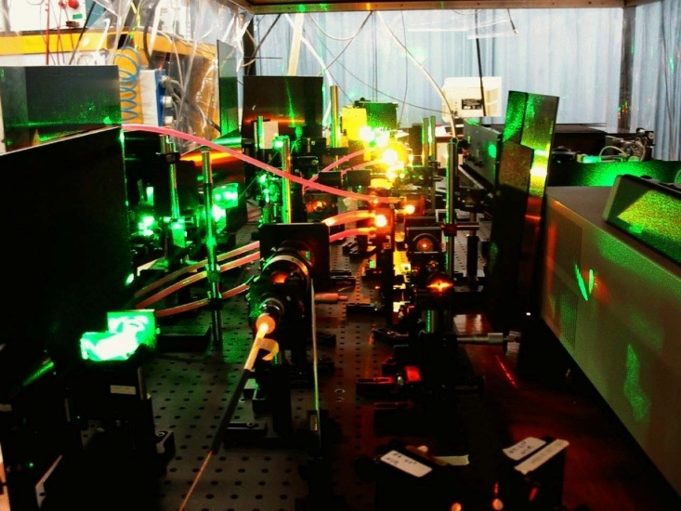
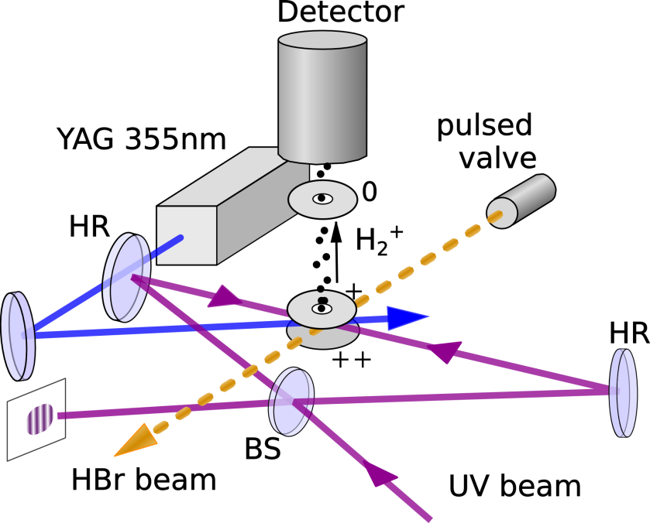
Experiment
Features
5 ns UV pulses
Narrowband UV source
2-photon Doppler-free REMPI
Sagnac alignment
Delayed ionisation
I₂ frequency calibration
ac-Stark extrapolation

Slide 35
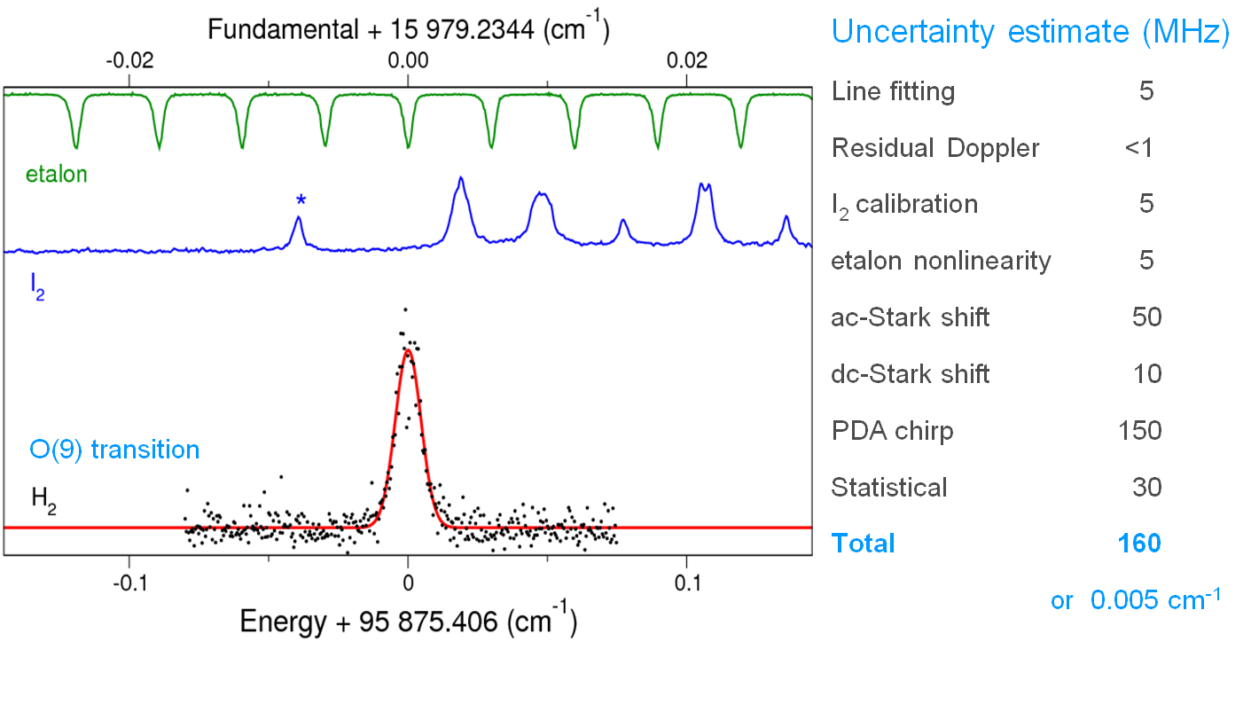
EF – X (0,0) transitions
(50 ppb)

Slide 36
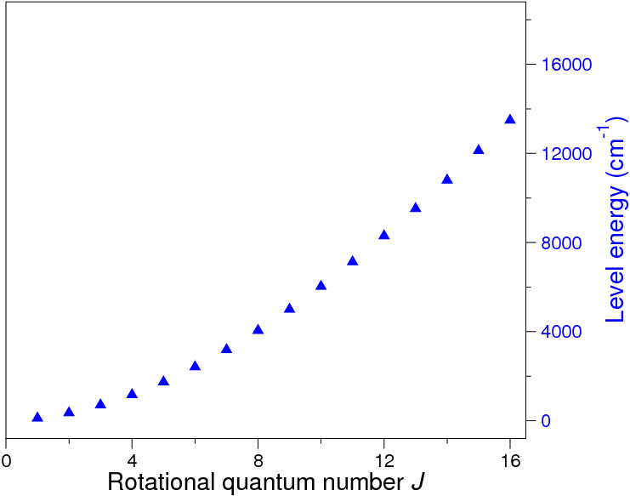
Ground state rotational level energies
Obtained from EF – X (0,0) transitions
Q(0) – Q(16)
O(8) - O(14)
S(10) - S(14)
E.J. Salumbides, G.D. Dickenson, T.I. Ivanov, W. Ubachs, Phys. Rev. Lett. 107, 043005 (2011)

Slide 37
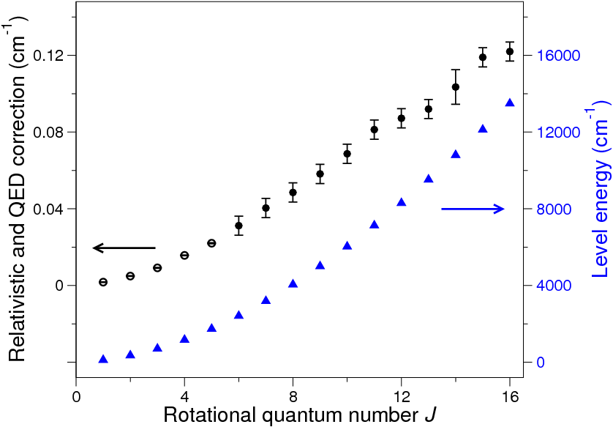
Relativistic and QED corrections
w.r.t. J = 0 QED correction
+0.7283(10) cm⁻¹
(Piszczatowski et al., J. Chem. Theory Comput. 5, 3039 (2009))
Nonrelativistic ab initio level energies: Pachucki, J. Chem. Phys. 130, 164113 (2009)

Slide 38
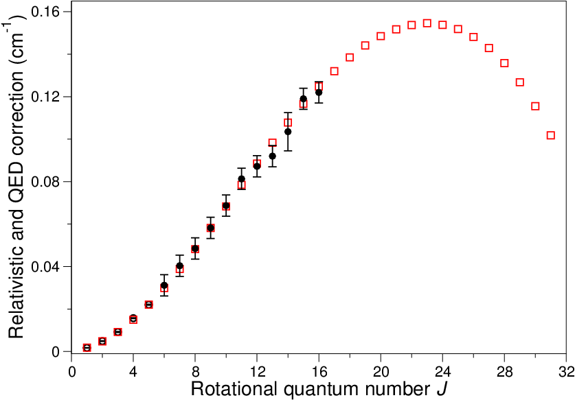
Comparison with theory*
Excellent agreement
at the <0.005 cm⁻¹ level
(150 MHz)
*Komasa et al., J. Chem. Theory Comput. dx.doi.org/10.1021/ct200438t (2011)

Slide 39
One-electron system
Spectroscopy of cold trapped HD⁺
Jurriaan Biesheuvel
Kevin Sheridan (Univ. Sussex)
Frank Cozijn
Martijn Stoffels
Daniel de Jong (now at Erasmus University Rotterdam)
Daniel Noom (now with Kjeld Eikema)
Wim Ubachs
Jeroen Koelemeij

Slide 40
Aims & Approach
High-resolution spectroscopy for tests of QED
Combine experimental and theoretical data: determine new value m_{p}/m_{e}
Future: optical clock based on HD⁺ for tests time-(in)dependence of m_{p}/m_{e}
Approach:
Sympathetic (laser) cooling of HD⁺ by Be⁺

Slide 41
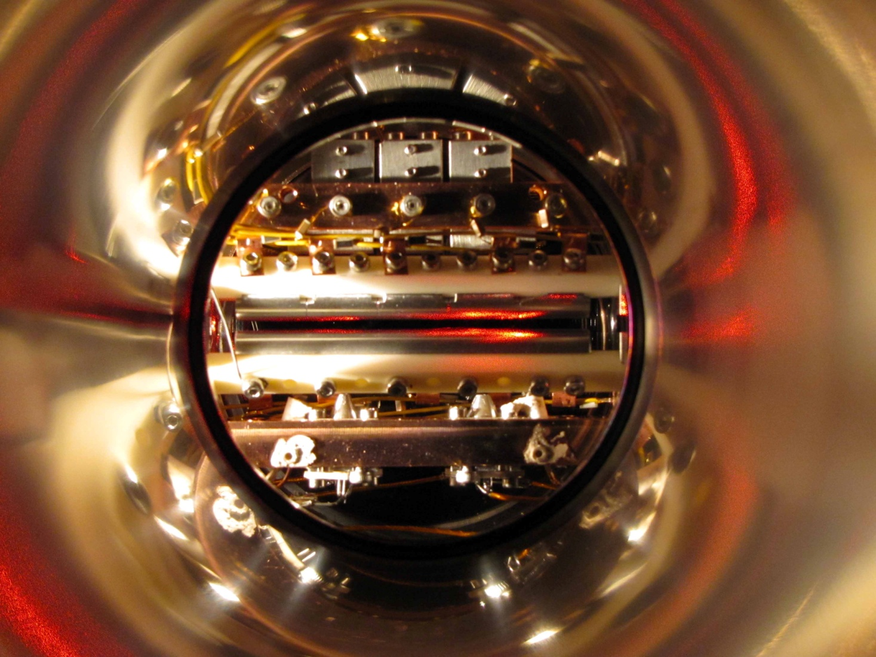
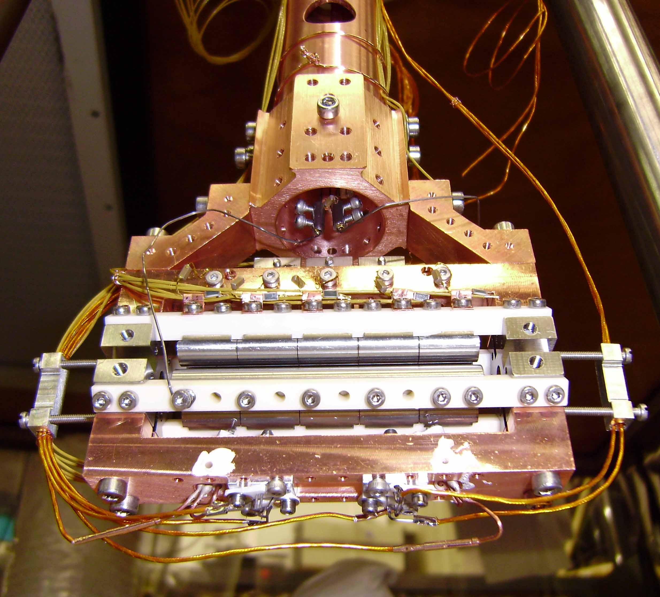
Ion Trap Apparatus
UHV apparatus with linear RF trap
‘Macroscopic’ trap
ω_{r,Be+} ≈ 2π × 300 kHz
ω_{z,Be+} ≈ 2π × 60 kHz
Trap loading by e-bombardment of:
Be (oven)
HD @ 3×10⁻¹⁰ mbar (automated leak valve)
Trap has ‘twin sister’ for Ca⁺ (K. Eikema)
E-gun
E-gun
Be ovens
60 mm
Direct frequency comb spectroscopy of 729 nm Ca⁺ clock transition:
A.L. Wolf, J. Morgenweg, J.C.J.K, S.A. van den Berg, W. Ubachs, K.S.E. Eikema, Opt. Lett. 36, 49 (2011)

Slide 42
Cold Trapped Be⁺ and HD⁺ Ions
Laser cool Be⁺ on ²S_{1/2} - ²P_{3/2} resonance (313 nm)
Observe ions by imaging 313 nm fluorescence
EMCCD camera (Coulomb crystals)
Photomultiplier tube
EMCCD images
∼2 × 10³ Be⁺ ∼2 × 10² HD⁺
4 Be⁺ ions
0.05 mm
5 - 10 mK
∼3 × 10³ Be⁺ ions
MD simulations: 5 - 6 mK
0.2 mm

Slide 43
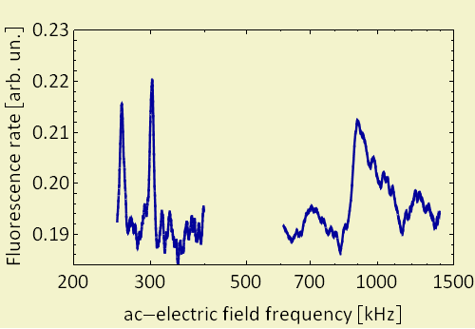
Detecting molecular ions
Be⁺ and HD⁺ have different mass ⇔ They oscillate in the trap at different frequencies
Use resonant ac-electric field to ‘heat’ HD⁺ molecules ⇒ 313 nm fluorescence level of Be⁺ will rise ∼ N_{HD+}
“Fluorescence mass spectrometry”
Be⁺
BeH⁺
H₃⁺/HD⁺
H₂D⁺
H₂⁺
Thus we can measure the number of HD⁺ *
* B. Roth, JK, H. Daerr, S. Schiller, PRA 74, 040501(R) (2006)

Slide 44
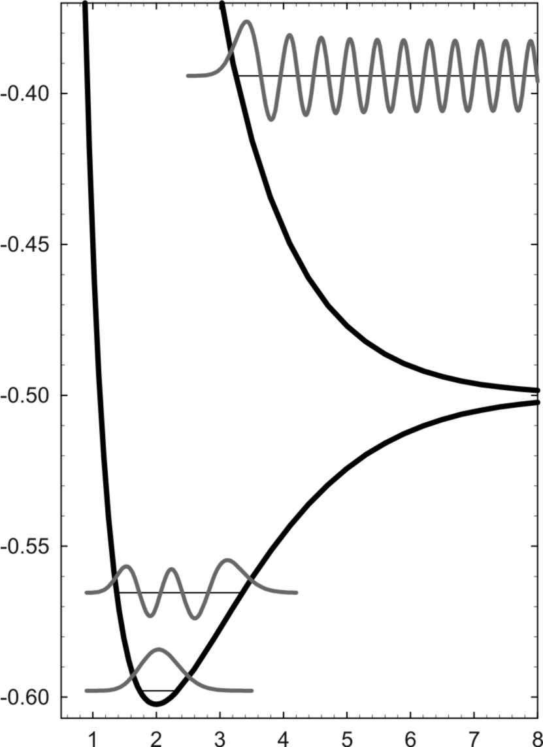
Rovibrational Spectroscopy
Internuclear distance [a0]
Resonance-Enhanced Multiphoton Dissociation (REMPD)
Selective dissociation (UV)
Loss of HD⁺ due to REMPD measured as change in 313 nm Be⁺ fluorescence level!
Fluorescence mass spectrometry
Energy [a.u.]
Be⁺
BeH⁺
H₃⁺/HD⁺
H₂D⁺
H₂⁺
Rovibrational
transition (IR)
Internuclear distance [a₀]
B. Roth, JK et al., PRA 74, 040501 (2006)

Slide 45
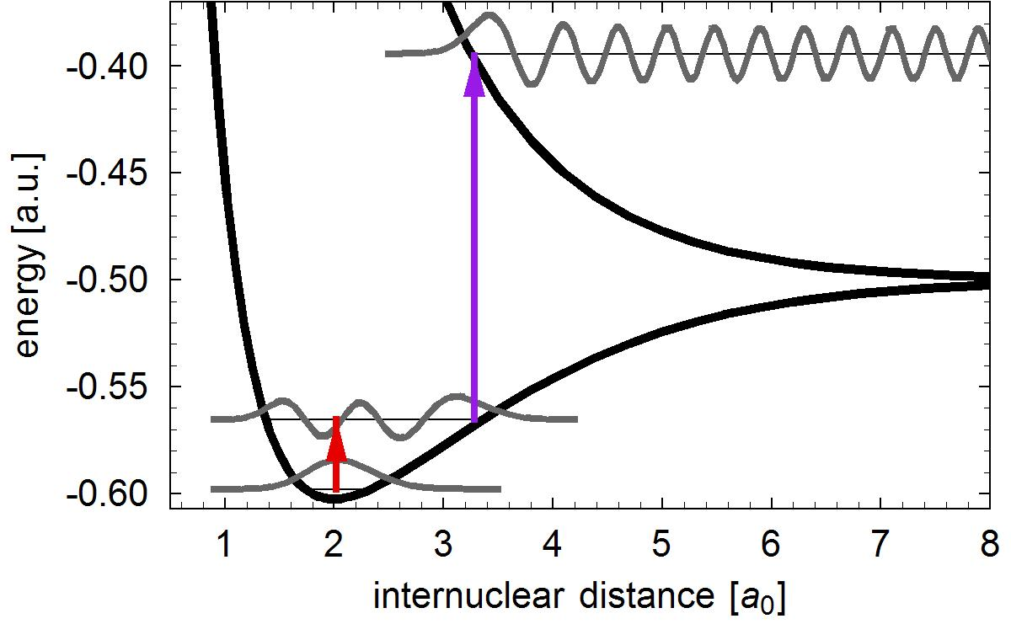
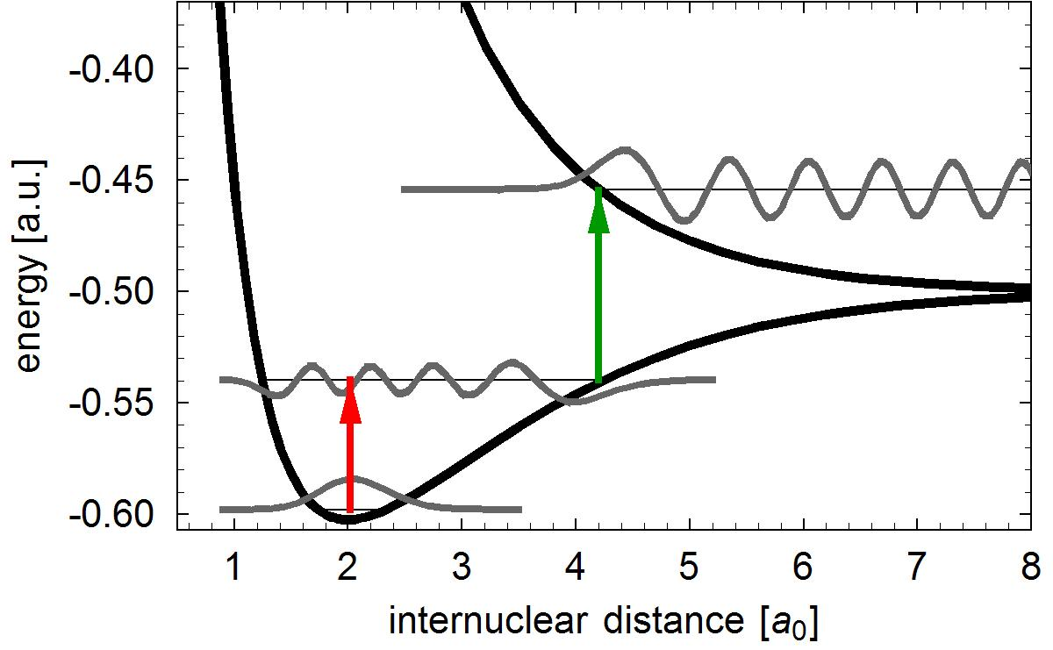
HD⁺ spectroscopy at LaserLaB Amsterdam
First demonstrated at Düsseldorf *:
170 μW at 1.4 μm
several mW at 266 nm
beam waists ∼150 μm
observe REMPD loss of HD⁺
LaserLaB approach:
Overtone v=0 – v’=8 @782 nm
Einstein B-coefficient 1000× smaller
Need ∼200 mW in 150 μm (Ti:S)
REMPD by (780 + 532) nm
OR by (780 + 313) nm
266 nm
313 nm
532 nm
782 nm
1.4 μm
v’ = 8
v’ = 4
v = 0
v = 0
* B. Roth, JK, H. Daerr, S. Schiller Phys. Rev. A 74, 040501(R) (2006)
JK, B. Roth, A. Wicht, I. Ernsting, S. Schiller, Phys. Rev. Lett. 98, 173002 (2007)

Slide 46
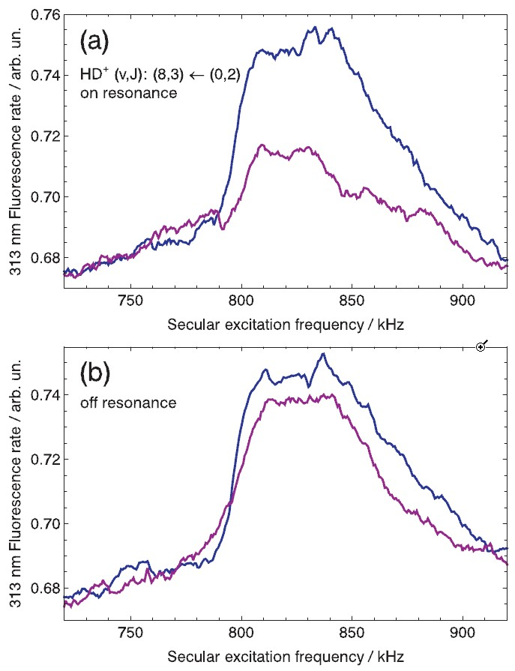
Observation of v=0 – v’=8 overtones
REMPD 782 nm + 313 nm
Required high intensity @313 nm ⇒ T_{HD+} >100 mK …
Recent improvements:
REMPD by 532 nm
Cold (∼10 mK) HD⁺
Ti:S frequency locked to and measured by frequency comb (Rb + GPS)
J.C.J. Koelemeij et al., to appear in Appl. Phys. B.

Slide 47
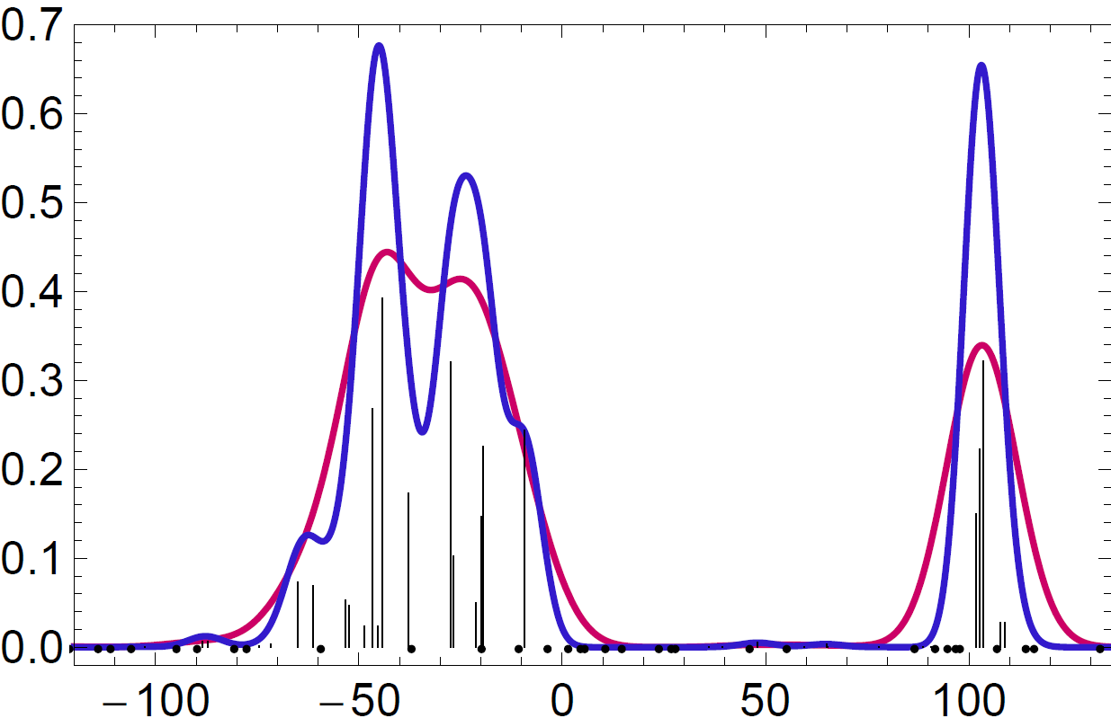
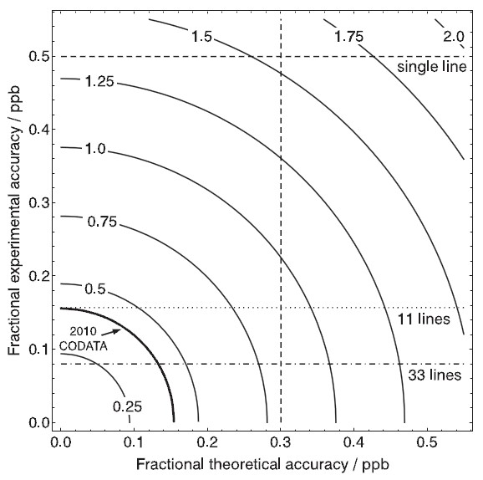
Projected accuracy
Per overtone: 100 kHz / 0.3 ppb @ 782 nm
Measure up to 33 lines (v’ = 7-9)
Simulated HFS structure:
REMPD spectrum @ 5 mK
REMPD spectrum @ 20 mK
Detuning from rovib. freq [MHz]
Projected accuracy m_{p} /m_{e}:
0.8 – 1 ppb (current QED calc.)*
0.3 – 0.5 ppb (QED calc. 3× better)
*V.I. Korobov

Slide 48
HD⁺ infrared dynamic polarizability
HD⁺ : narrow (∼10 Hz) optical lines, suited for Doppler-free spectroscopy in Lamb-Dicke trap (optical clock)
High accuracy HD+ spectroscopy possible (< 10⁻¹⁴) !
ac-Stark shift due to BBR: limiting systematic shift in optical clocks (10⁻¹⁷ to 10⁻¹⁵ level)*
HD⁺ ? (Rovibrational lines ‘embedded’ within 300 K BBR spectrum!)
Approach:
Use simple rovibrational wavefunctions to obtain oscillator strengths etc.
Infrared dynamic polarizability: α(ω) ≈ α_{rovib}(ω) + α_{elect}(0)
* T. Rosenband, W.M. Itano, P.O. Schmidt, D.B. Hume, J.C.J. Koelemeij, J.C. Bergquist, D.J. Wineland,
Proc. EFTF 2006
Moss & Valenzano, Mol. Phys. 100, 1527 (2000)

Slide 49
Polarizability results
Good agreement with more accurate results (but published for discrete wavelengths and J = 0 only) by Hilico et al.
(L. Hilico, N. Billy, B. Grémaud, D. Delande, J. Phys. B 34, 491, 2001)
( v , J ) = (7,0)
(1,0)
(0,0)
J.C.J. Koelemeij, Phys. Chem. Chem. Phys. 13, 18844 (2011)

Slide 50
AC-Stark shift due to BBR (300 K)
Limiting systematic in optical clocks (10⁻¹⁵ – 10⁻¹⁷ level)
Optical transitions in HD⁺ : partial cancellation of electronic and rovibrational contributions to BBR shift
Conclusion: BBR shift to rovibrational lines no limitation for spectroscopy at 10⁻¹⁶ level
Stefan-Boltzmann σT ⁴ scaling of BBR field intensity:
if T known within (300 ± 15) K, then 2 × 10⁻¹⁷ accuracy possible(!)
Shift due to ion trap field may be determined within ∼ 5 × 10⁻¹⁷
Shift due to cooling laser and probe lasers?

Slide 51
Time (in)dependence of m_{p}/m_{e}
Cold neutral molecules
Paul Jansen
Adrian de Nijs
Marina Quintero
Wim Ubachs
Rick Bethlem

Slide 52
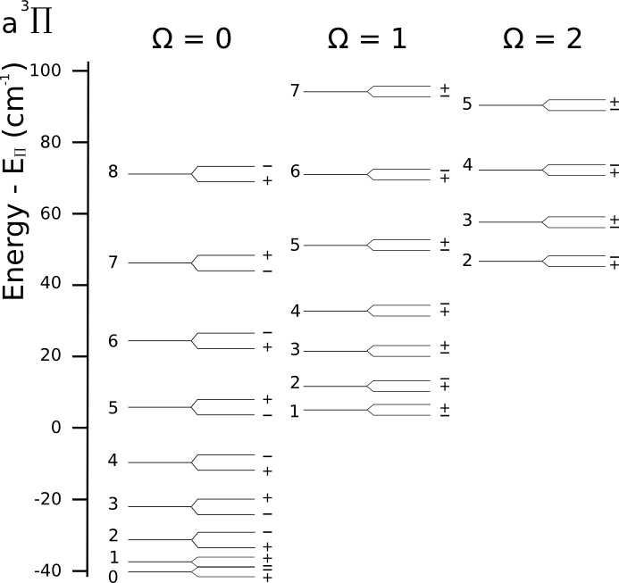
CO a³Π
Three fine structure rotational ladders
Lambda doubling
Ladders shift differently when μ varies

Slide 53
CO a³Π
Three fine structure rotational ladders
Lambda doubling
Ladders shift differently when μ varies
Near degeneracy

Slide 54
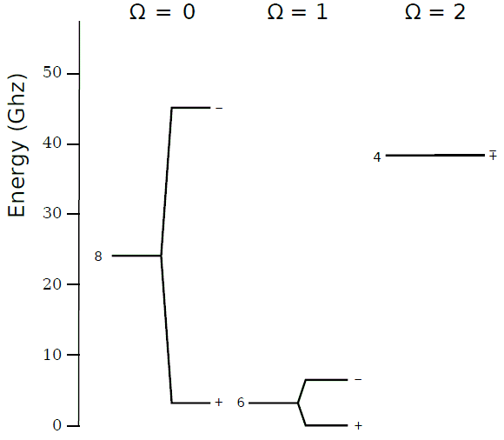
CO a³Π
¹²C¹⁶O: K_{μ}= -334
¹³C¹⁶O: K_{μ}= 126
Measure both: combined sensitivity ~500
Δ J = 2: two-photon transition

Slide 55
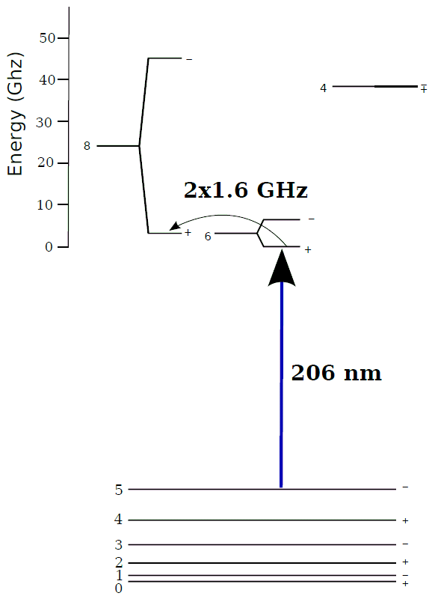
CO a³Π
206 nm to excited metastable state
MW transition
Detection: state-selective deflection using E-field

Slide 56
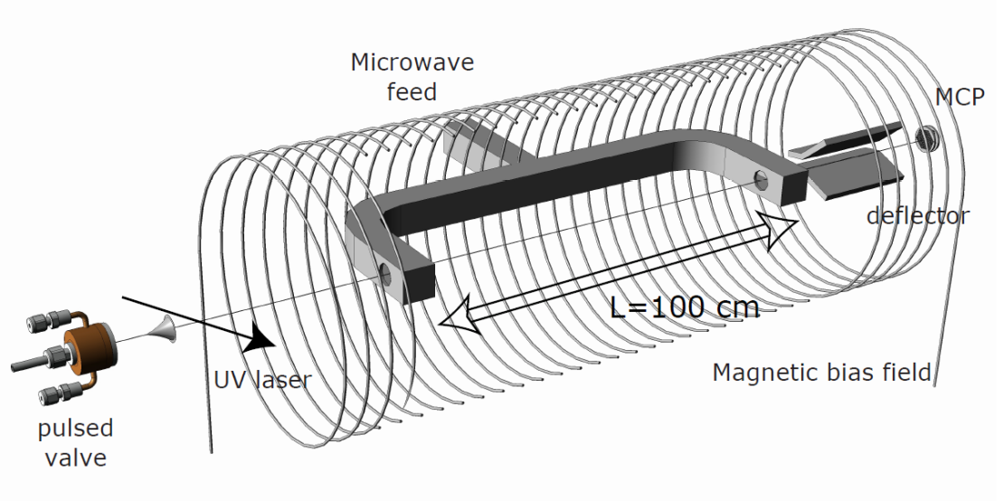
Measurement system
CO molecular beam
206 nm laser
MW cavities for Ramsey spectroscopy
Deflection field
MCP + phosphor screen + camera
A.J. de Nijs, E.J. Salumbides, K.S.E. Eikema, W. Ubachs, H.L. Bethlem, Phys. Rev. A 84, 052509 (2011)

Slide 57
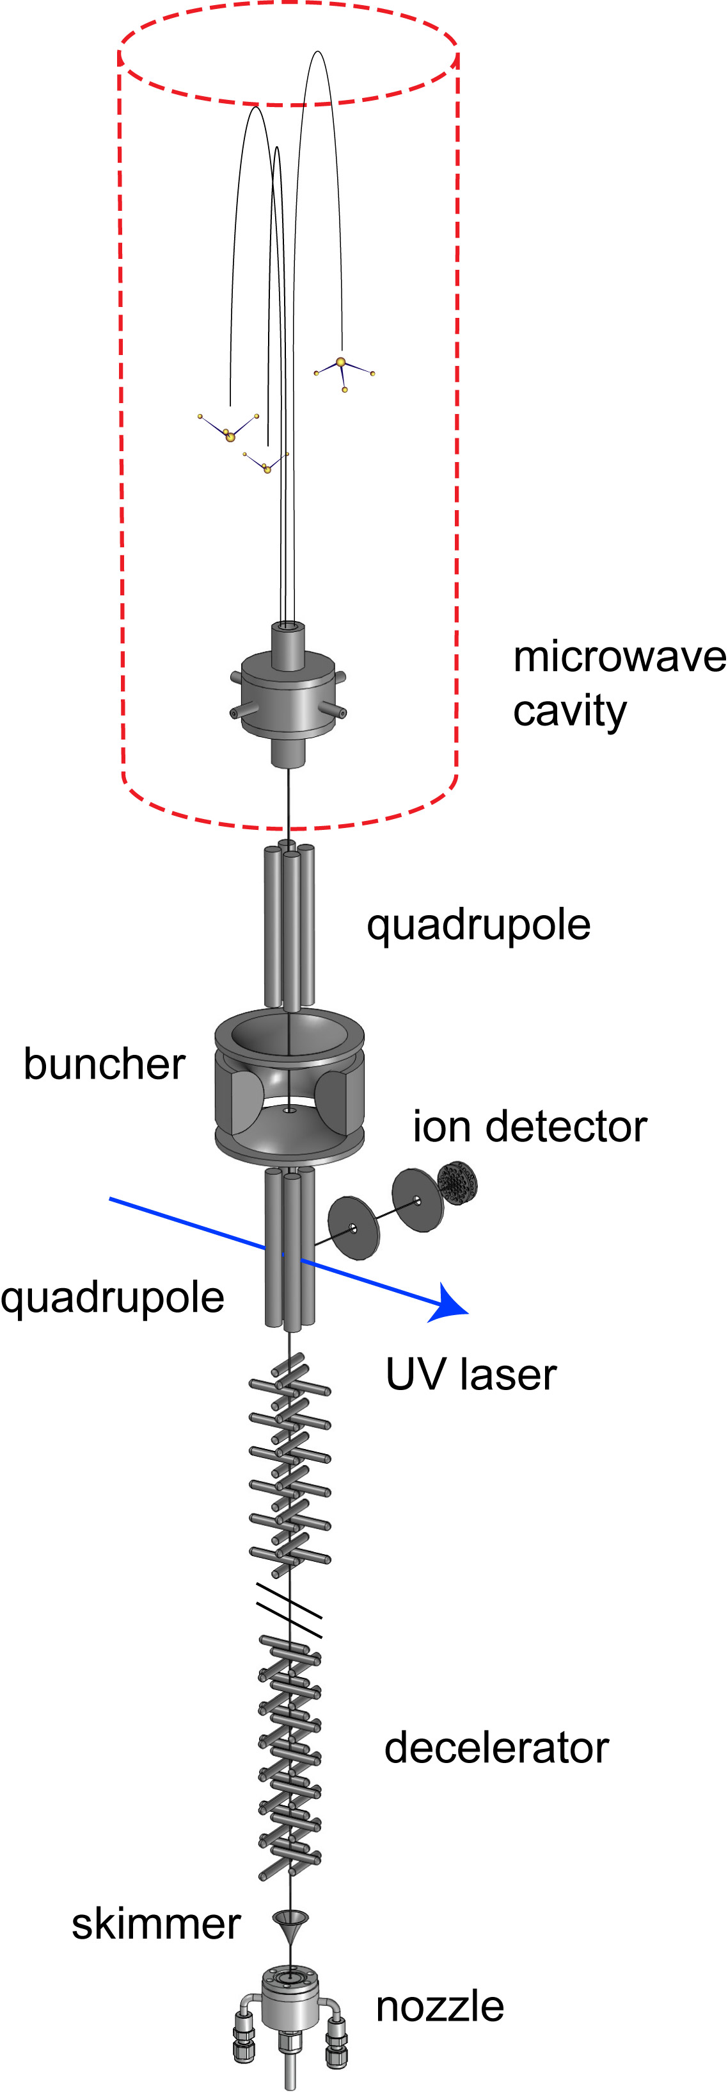
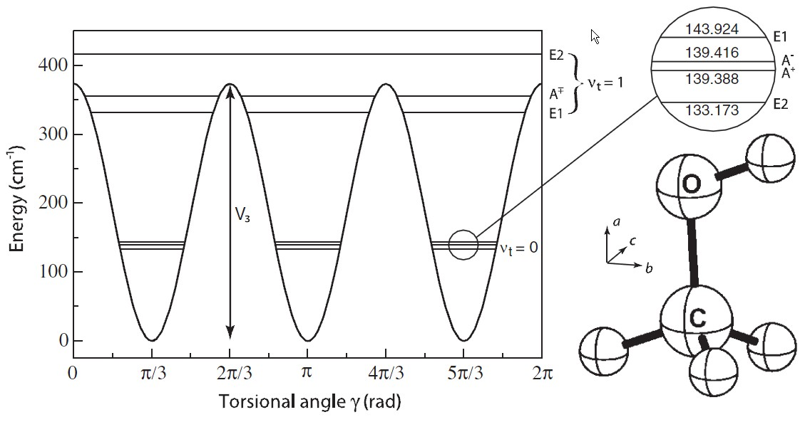
Other searches for μ variation…
Ammonia fountain ‘umbrella’ inversion frequency 22.6 GHz; K_{μ}= –4.2
CH₃CO (methanol)
Near-degeneracies, large K_{μ} coefficients…

Slide 58
in space
in the lab
Jansen et al. PRL 106, 100801 (2011).

Slide 59
Summary
Measured 2 ³S₁ – 2 ¹S₀ at 1557 nm in ³He/ ⁴He with 9 ppt accuracy
New determination ³He nuclear rms radius
Determination ionization potential of (1s)² helium ground state with 1 ppb accuracy through XUV comb spectroscopy
High-accuracy determination of rotational energies J = 1 – 16 of X H₂ ground state
Progress towards precision spectroscopy of cold HD⁺ and CO
Tests of time-(in)dependence of m_{p} /m_{e} using H₂, HD, CH₃OH
R. van Rooij et al., Science 333 196 (2011).
D. Kandula et al., Phys. Rev. Lett. 105, 063001 (2010)
T.J. Pinkert et al., Opt. Lett. 36, 2026 (2011)
D. Kandula et al., to appear in Phys. Rev. A
E.J. Salumbides et al., Phys. Rev. Lett. 107, 043005 (2011)
J.C.J. Koelemeij, Phys. Chem. Chem. Phys. 13, 18844 (2011)
J.C.J. Koelemeij et al., to appear in Appl. Phys. B.
A.J. de Nijs et al., Phys. Rev. A 84, 052509 (2011)
F. van Weerdenburg et al., Phys. Rev. Lett. 106 180802 (2011)
P. Jansen et al., Phys. Rev. Lett. 106, 100801 (2011)
P. Jansen et al., to appear in Phys. Rev. A

Slide 60
Thank you!

