Slide 1
Compact neutron stars
Theory & Observations
Hovik Grigorian
Yerevan State University
Summer School Dubna – 2012
Notes:
1

Slide 2


Compact stars Physics
• physics of compact stars,
• astrophysics of compact stars,
• superdense matter,
• neutrino physics,
• astrochemistry,
• gravitational waves from compact stars and
• supernova explosions.
CompStar meeting in Tahiti 2012: http://compstar-esf.org/tahiti/Conference/home.html

Slide 3
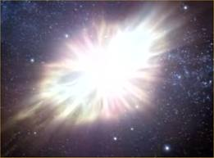
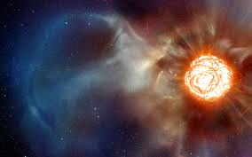
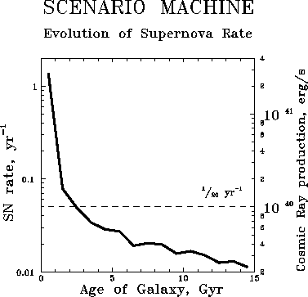

NS is a remnant of Supernova explosion
COMPACT REMNANT MASS FUNCTION: DEPENDENCE ON THE EXPLOSION MECHANISM AND METALLICITY
The Astrophysical Journal V 749 N1
Chris L. Fryer et al. 2012 ApJ 749 91

Slide 4
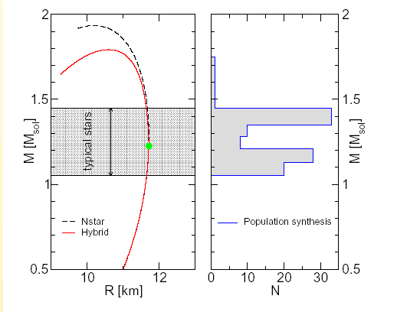
Statistics of Compact stars
Notes:
4

Slide 5
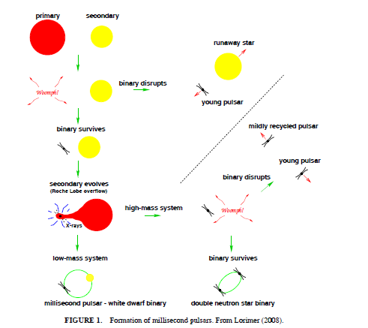
Formation of millisecond pulsars
Paulo C. C. Freire Solar and Stellar Astrophysics (astro-ph.SR) Cite as:
arXiv:0907.3219v1

Slide 6
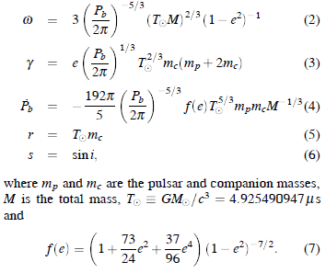
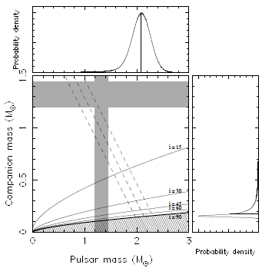
The mass of the millisecond pulsar PSR J1614-2230 to be M = 1.97 ± 0.04 M⊙. This value, together with the mass of pulsar J1903+0327 of M = 1.667 ± 0.021 M⊙ due to the prolonged accretion episode that is thought to be required to form a MSP.
Demorest, P., Pennucci, T., Ransom, S., Roberts, M., & Hessels,
J. 2010, Nature, 467, 1081

Slide 7
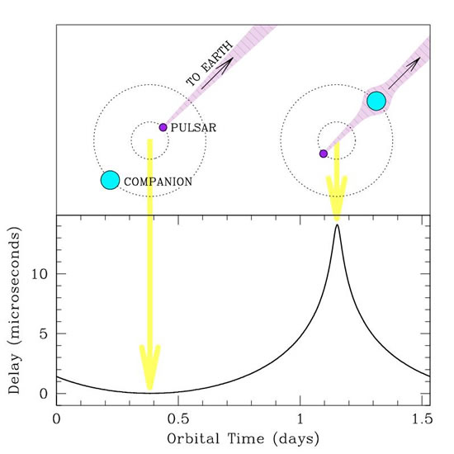
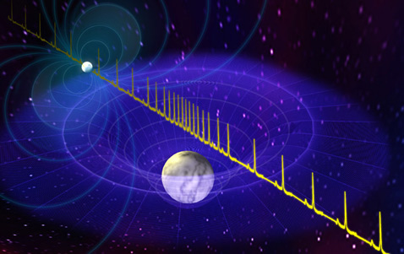
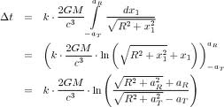
A two-solar-mass neutron star measured using Shapiro delay
The light traveler time difference
In binary systems with "Recycled" Millisecond Pulsar

Slide 8
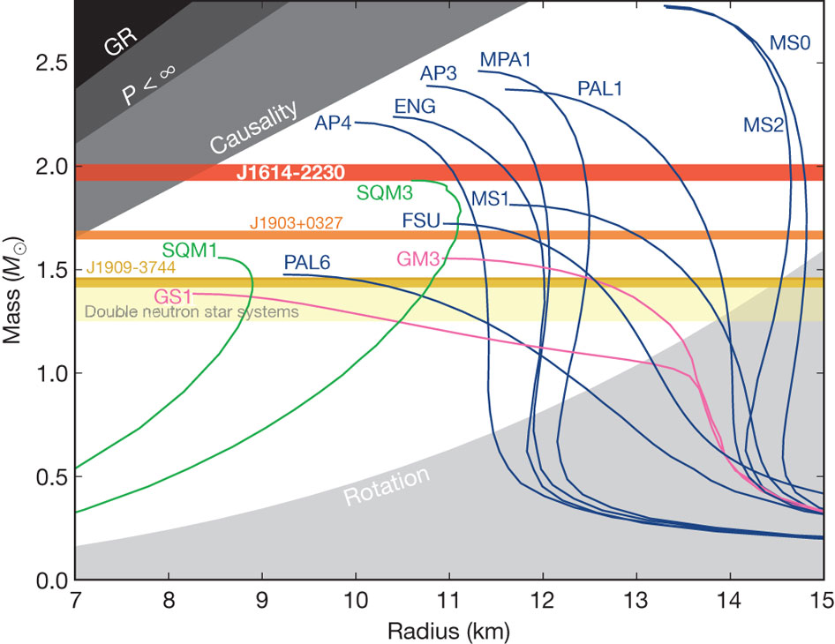

Slide 9
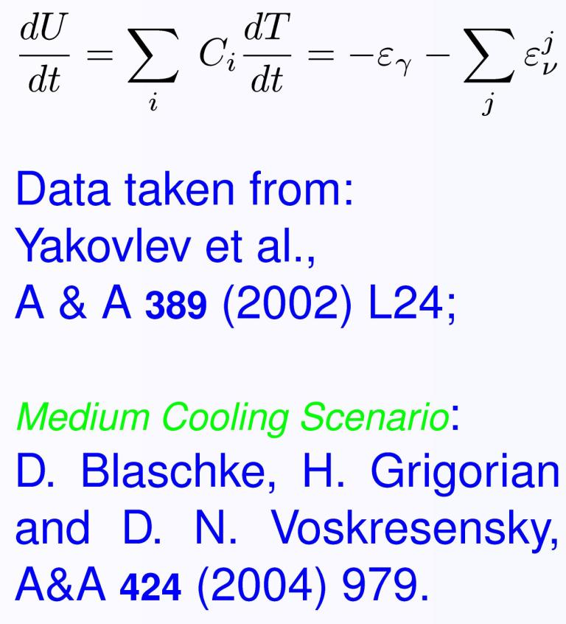
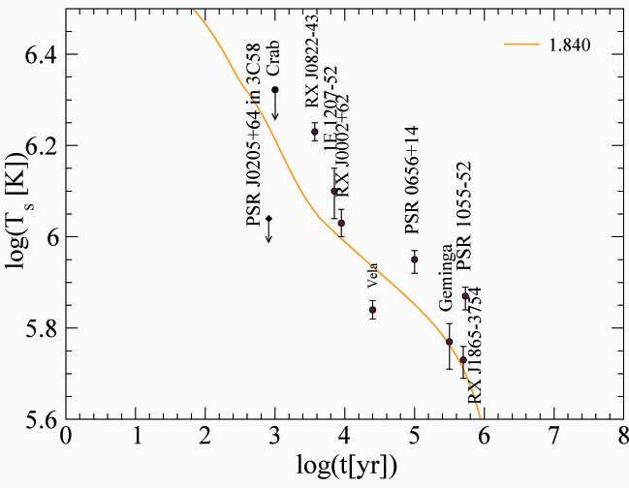
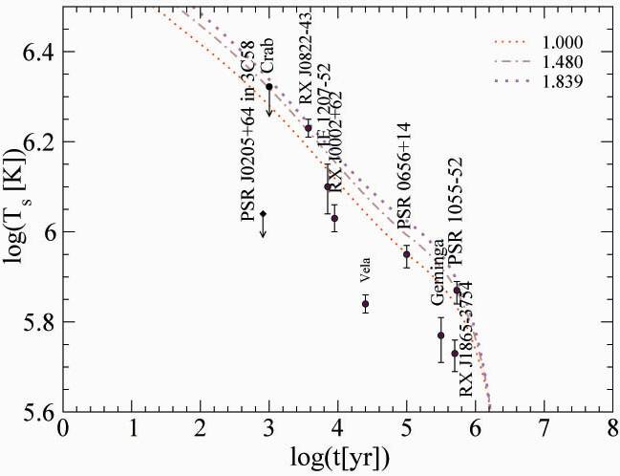
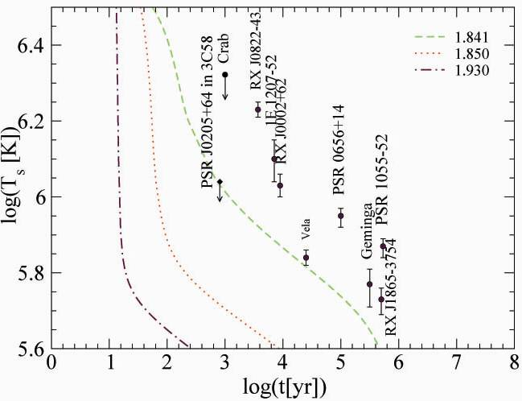
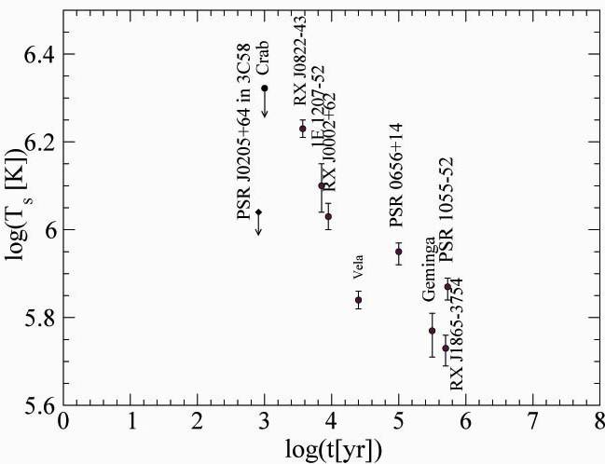
Surface Temperature & Age Data
Slow Coolers
Intermediate Coolers
Fast Coolers
Notes:
9

Slide 10
Cooling of Magnetars
Magnetars
AXPs, SGRs
B = 10^14 -10^15 G
Radio-quiet
NSs
B = 10^13 G
Radio-pulsar
NSs
B = 10^12 G
Radio-pulsar
NSs
B = 10^12 G
H - spectrum

Slide 11
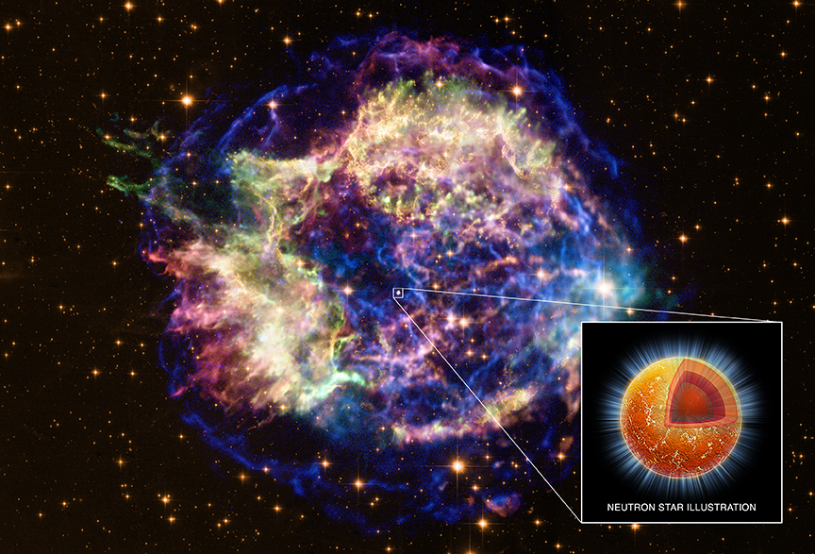
Cooling of Neutron Star
in Cassiopeia A
16.08.1680 John Flamsteed, 6m star 3 Cas
1947 re-discovery in radio
1950 optical counterpart
T ∼ 30 MK
V exp ∼ 4000 − 6000 km/s
distance 11.000 ly = 3.4 kpc
picture: spitzer space telescope
D.Blaschke, H. Grigorian, D. Voskresensky, F. Weber,
Phys. Rev. C 85 (2012) 022802
e-Print: arXiv:1108.4125 [nucl-th]

Slide 12
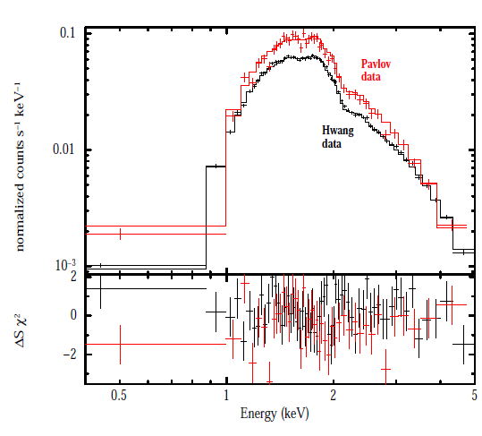
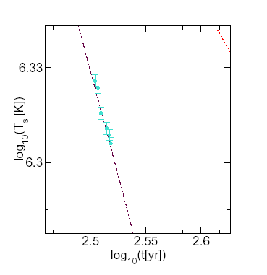
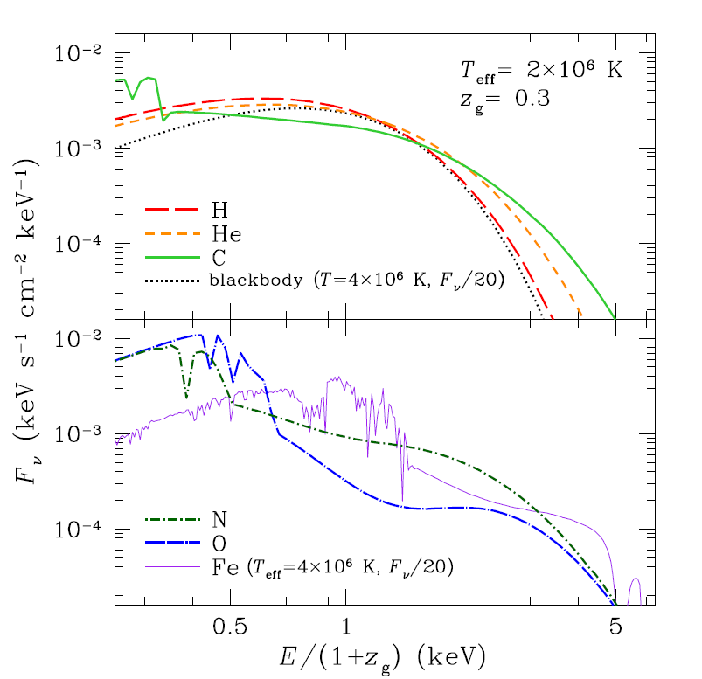
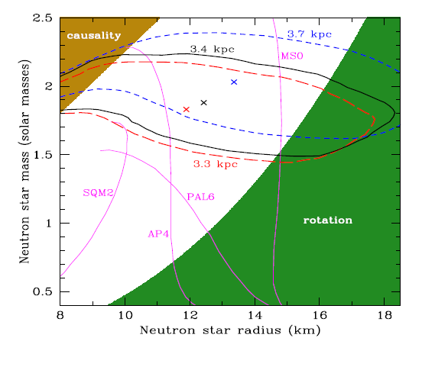
Cass A Cooling Observations
Cass A is a rapid cooling star – Temperature drop - 10% in 10 yr
W.C.G. Ho, C.O. Heinke, Nature 462, 71 (2009)

Slide 13
Phase Diagramm & Cooling Simulations
Description of the stellar matter - local properties
Modeling of the self bound compact star - including the gravitational field
Extrapolations of the energy loss mechanisms to higher densities and temperatures
Consistency of the approaches

Slide 14
How to make a star configuration?
Choice of metric tensor
EoS- P( )
Thermodynamicas of
dence matter
(Energy Momentum Tensor)
Spherically Symetric case
Einstein Equations
TOV
External fields
Schwarzschild Solution
Intrernal solution

Slide 15
Solution for Internal structure
; -
Cerntral conditions :

Slide 16
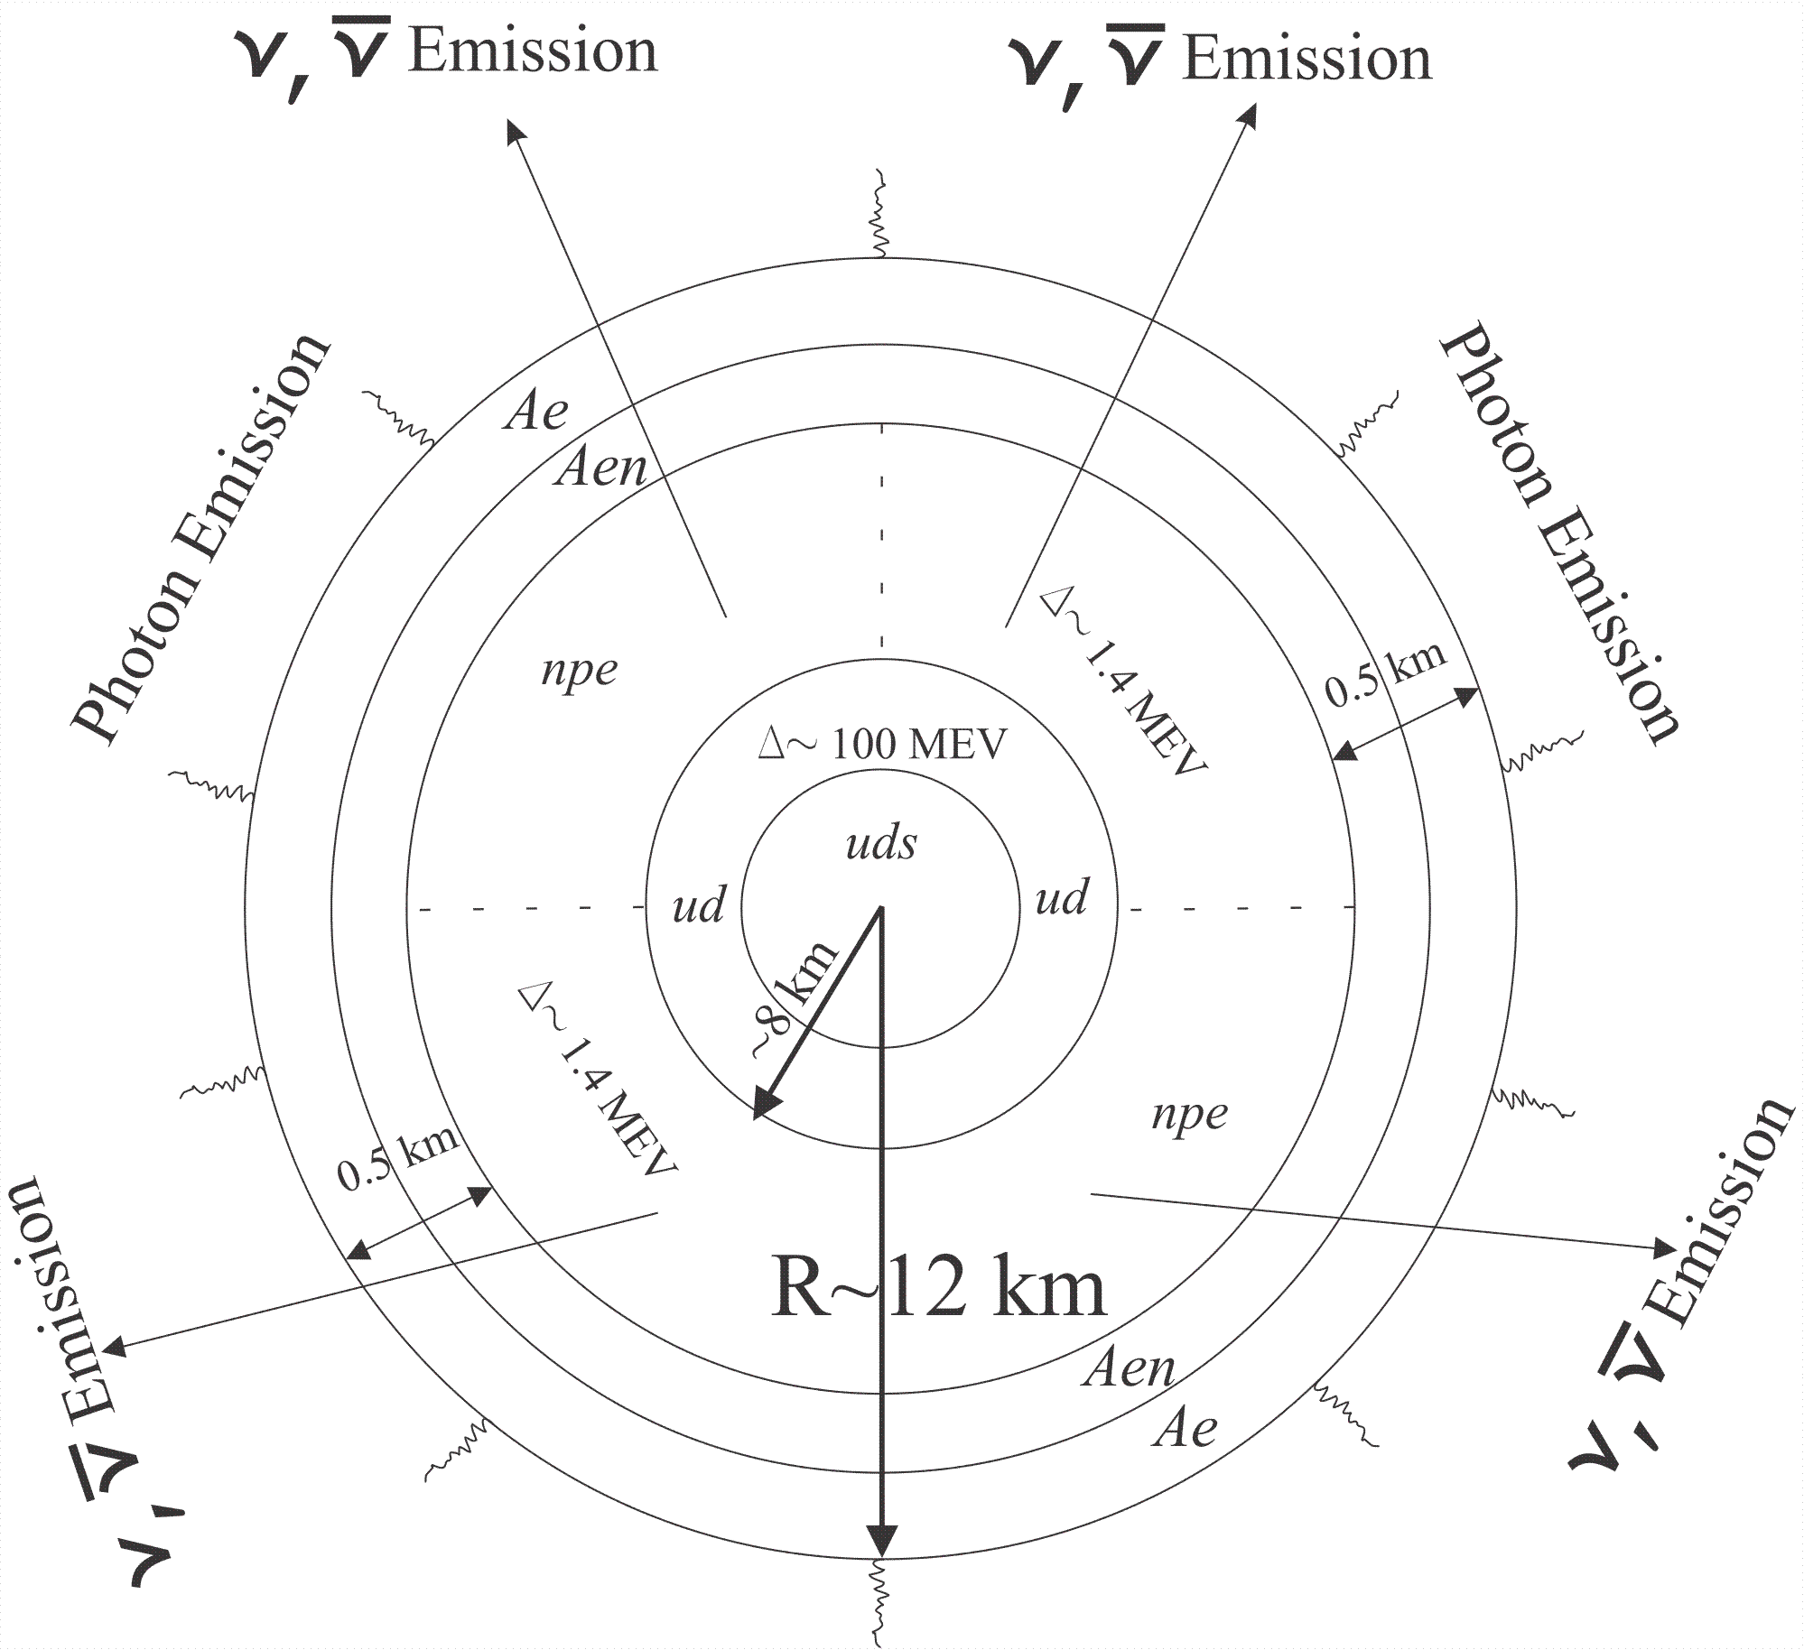
Structure of Hybrid star

Slide 17
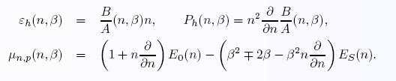
EoS for Nuclear Matter
Notes:
17

Slide 18
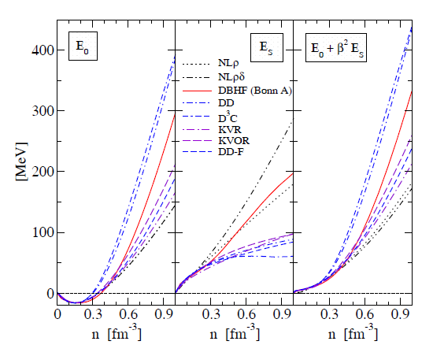

Slide 19
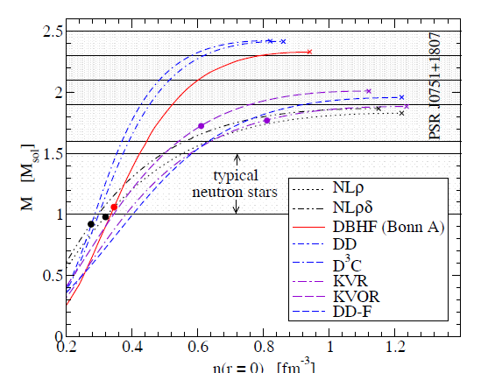
T. Kl¨ahn et al., Phys. Rev. C 74, 035802 (2006).

Slide 20
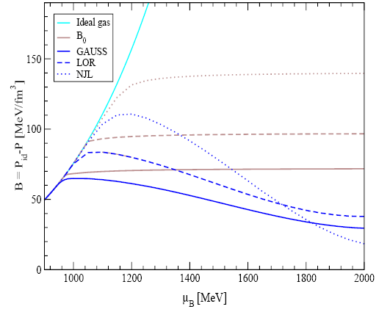
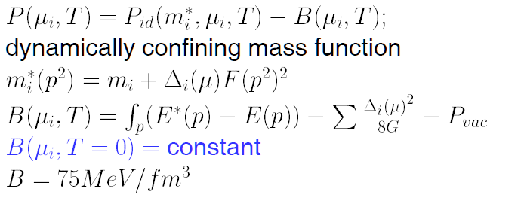
EoS for Quark Matter
Dynamical Chiral Quark Model
Notes:
20

Slide 21
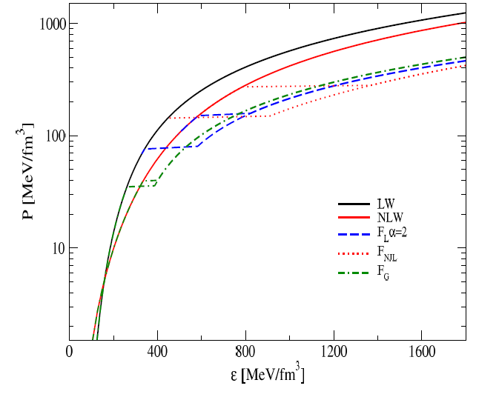
EoS for Hybrid Matter

Slide 22
EoS & Hybrid Configurations
Notes:
22

Slide 23
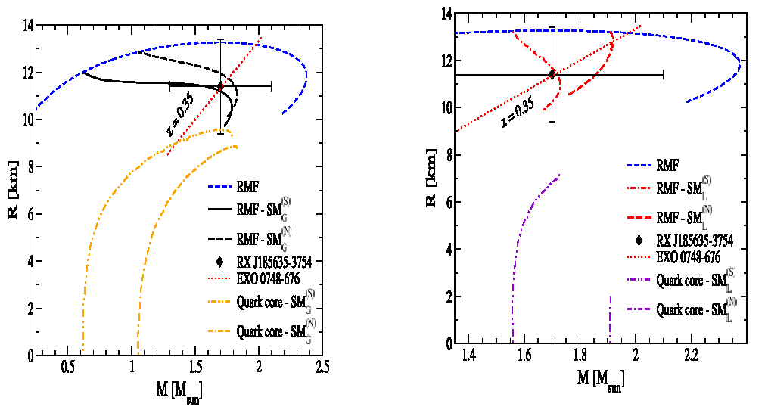
Internal structure of HS

Slide 24
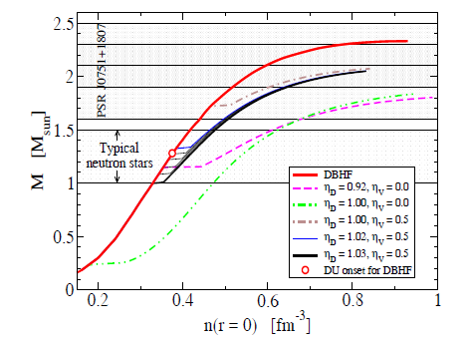
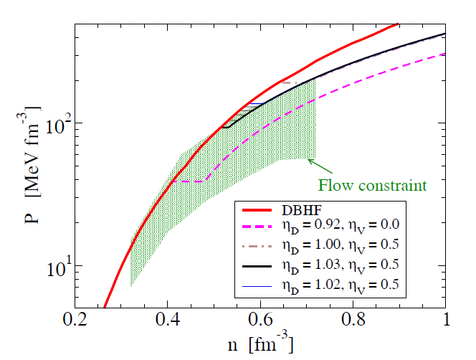
Hibrid Configurations for NJL type QM models
T. Kl¨ahn et al., Phys.Lett.B654:170-176,2007

Slide 25
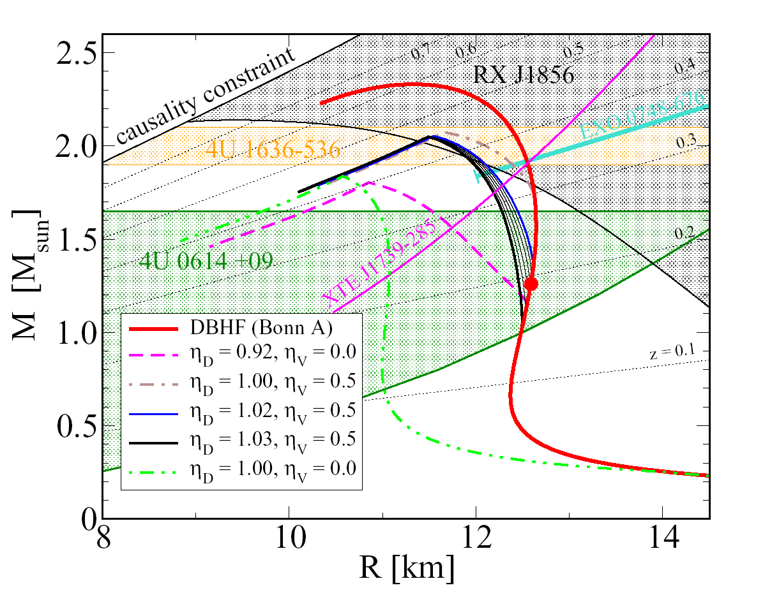
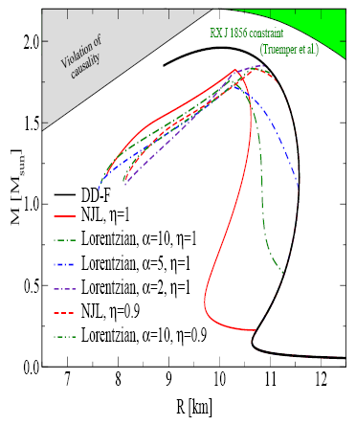
HS Mass-Redius relations

Slide 26
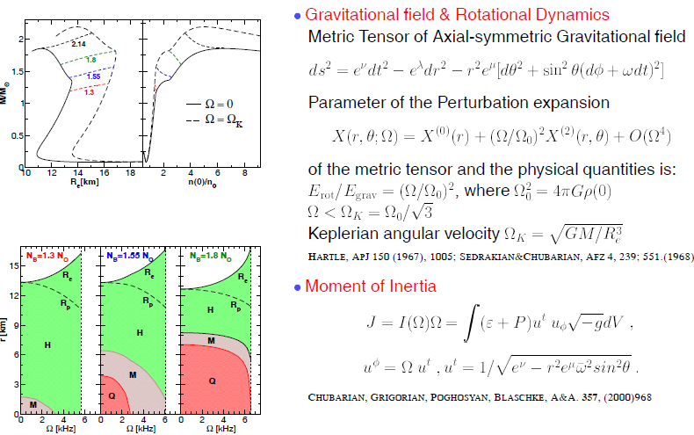

Slide 27
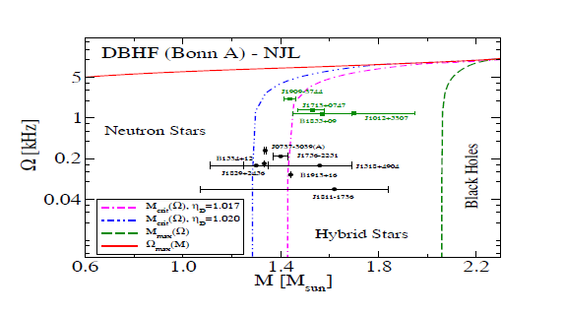
Rotation of Hybrid StarsEvolution of LMXBs

Slide 28
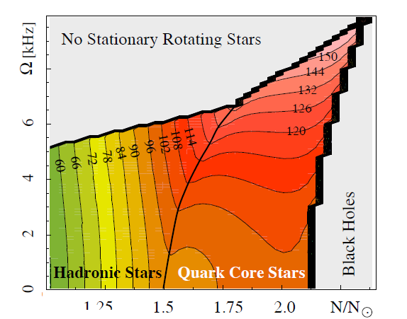

Slide 29
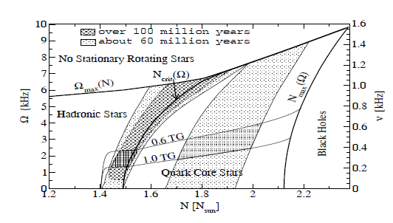
Evolution of LMXBs

Slide 31
Cooling of Compact Stars
Cooling Equations
Time Evolution of Temperature (algorithm)
Thermal Regulators, Crust, SC, Gaps ...
Results and Observations (Cassiopeia A)
Conclusions
Notes:
31

Slide 32
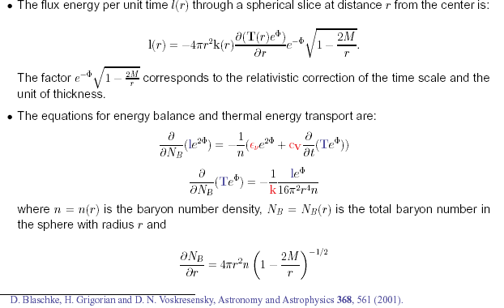
Equations for Cooling Evolution
Notes:
32

Slide 33
Boundary conditions
L_conductivity
Outer Crust of NS
r = R
L_photons
L = 0
Center of NS
r = 0
L

Slide 34
Finite difference scheme
Z_i next step
Time direction
Z_i+1
Z_i initial
Z_i-1

Slide 35
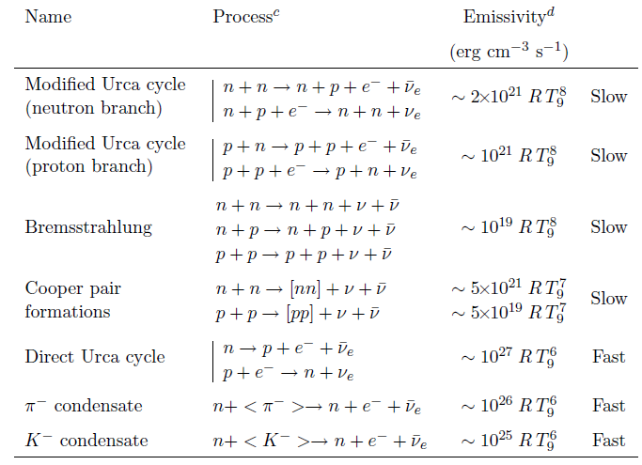
Neutrino - Cooling in HM

Slide 36
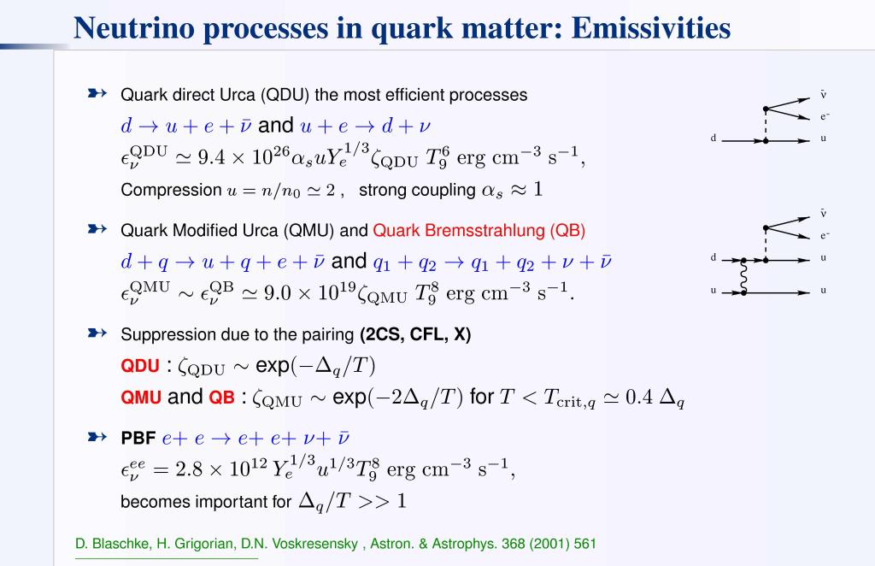
Cooling Mechanism in QM
Notes:
36

Slide 37
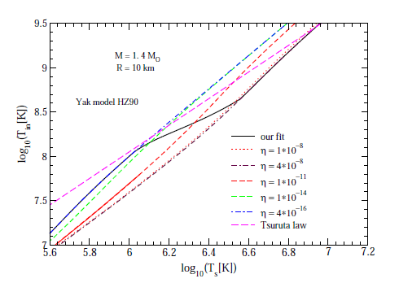

Crust Model
Time dependence of the light element contents in the crust
Blaschke, Grigorian, Voskresensky, A& A 368 (2001)561.
Page,Lattimer,Prakash & Steiner, Astrophys.J. 155,623 (2004)
Yakovlev, Levenfish, Potekhin, Gnedin & Chabrier , Astron. Astrophys , 417, 169 (2004)
Notes:
37

Slide 38
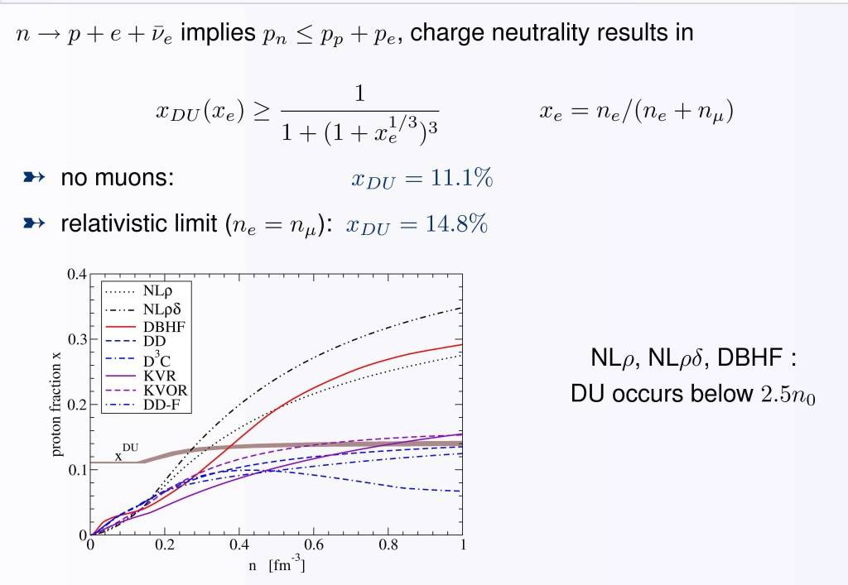
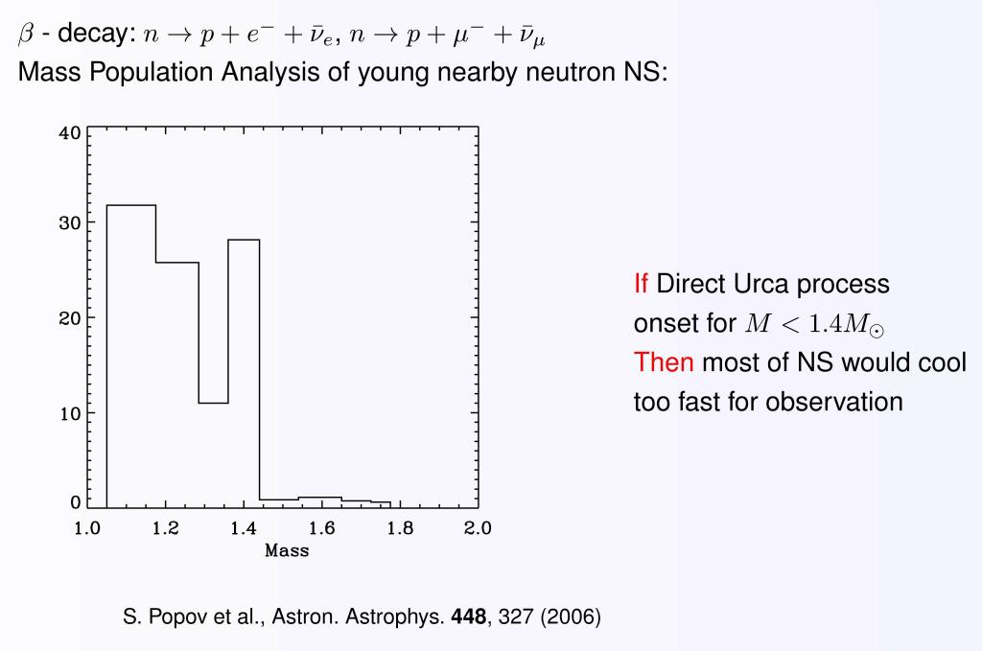
DU constraint
Notes:
38

Slide 39
DU Thresholds
Notes:
39

Slide 40
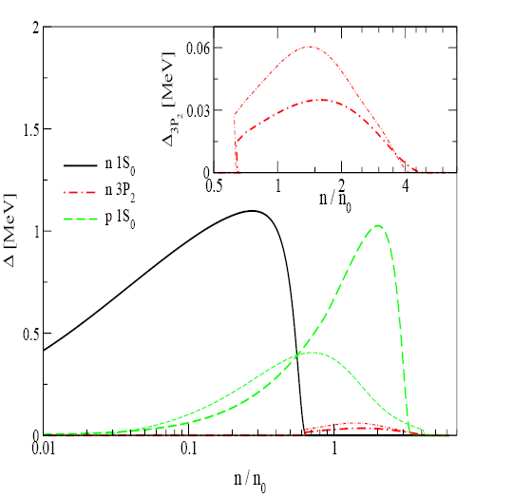
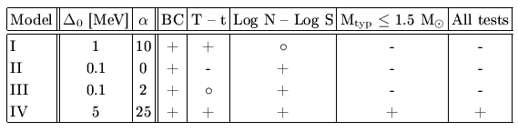
SC pairing gaps
Notes:
40

Slide 41
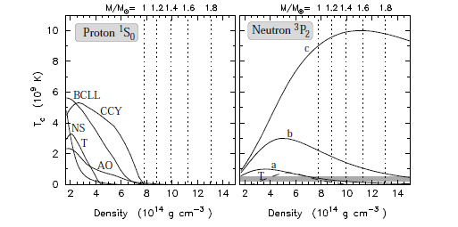
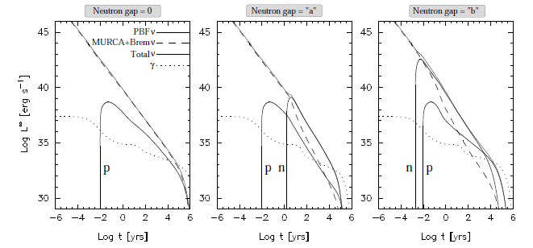
Influence of SC on luminosity
Critical temperature, Tc, for the proton 1S0 and neutron 3P2 gaps, used in PAGE, LATTIMER, PRAKASH, & STEINER Astrophys.J.707:1131 (2009)

Slide 42
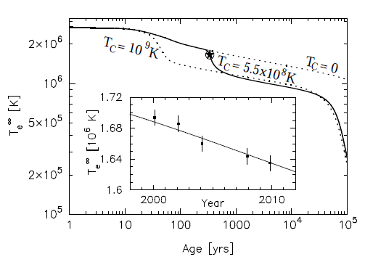
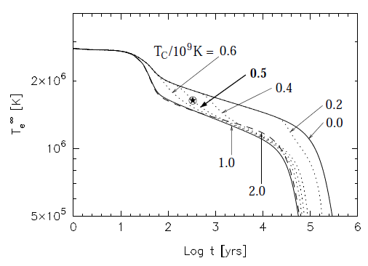
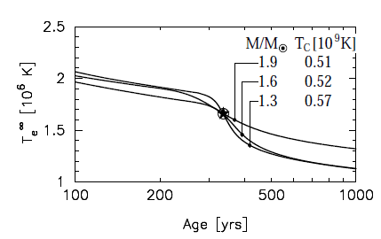
Tc ‘measurement’ from Cas A
1.4 M⊙ star built
from the APR EoS
rapid cooling at ages
∼ 30-100 yrs is due to the thermal relaxation of the crust
Mass dependence
PAGE, LATTIMER, PRAKASH, & STEINER Phys.Rev.Lett.106:081101,2011

Slide 43




Medium effects in cooling of neutron stars
Based on Fermi liquid theory ( Landau (1956), Migdal (1967), Migdal et al. (1990))
MMU – insted of MU
Main regulator in Minimal Cooling

Slide 44

Contributions to luminosity

Slide 45
Some Anomalies
Notes:
45

Slide 46

The influence of a change of the heat conductivity on the scenario
Blaschke, Grigorian, Voskresensky, A& A 424, 979 (2004)

Slide 47


Temperature Profiles for Cas A

Slide 48

Cas A as an Hadronic Star

Slide 49

Cas A as an Hybrid star

Slide 50
Stability of the stars & Mass- Radius relationship

Slide 51
Cooling of Hybrid star with a DD2-NJL
EoS model

Slide 52
Cooling of Hadronic star with a DDF2
EoS model

Slide 53


Slide 54


Slide 55


Slide 56


Cooling profiles

Slide 57
Conclusions
Cas A rapid cooling consistently described by the medium-modified superfluid cooling model
Both alternatives for the inner structure, hadronic and hybrid star, are viable for Cas A; a higher star mass favors the hybrid model
In contrast to the minimal cooling scenario, our approach is sensitive to the star mass and thermal conductivity of superfluid star matter

Slide 58

Thank You!!!!!

Slide 61

Temperature in the Hybrid Star Interior
Notes:
61

Slide 62
Thermal evolutions of NSs with strong manetic fields
Thermal evolution including the Joule heating QJ
Phenomenological model of the field decay
D.N. Aguilera, J.A. Pons, J.A. Miralles, arXiv astro-ph 0803.0486v (2009)

Slide 63
Cooling of Magnetars
Magnetars
AXPs, SGRs
B = 10^14 -10^15 G
Radio-quiet
NSs
B = 10^13 G
Radio-pulsar
NSs
B = 10^12 G
Radio-pulsar
NSs
B = 10^12 G
H - spectrum

