Slide 1
Form factors of the B-S transitions in the covariant quark model
Issadykov Aidos , Ivanov Mikhail A. , Sakhiyev Sayabek K.

Slide 2
outline:
В meson
В→K*₀(800) and В→K*(892)
Scalar mesons: f₀(500), K*₀(800), a₀(980), f₀(980)
Covariant quark model
Form factors of B-S transition
Branching fractions

Slide 3
в meson
Particle | Symbol | Quark content | Charge | Rest mass (Mev/c²) | Mean lifetime (ps)
Strange B meson | B_{s} | sb | 0 | 5,366.3±0.6 | 1.470+0.027 −0.026
Charmed B meson | B_{c} | cb | +1 | 6,276±4 | 0.46±0.07
B meson | B_{u} | ub | +1 | 5,279.15±0.31 | 1.638±0.011
B meson | B_{d} | db | 0 | 5,279.53±0.33 | 1.530±0.009

Slide 4
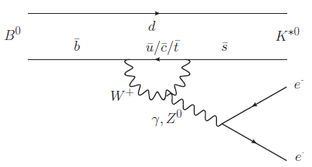
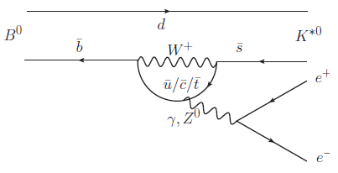
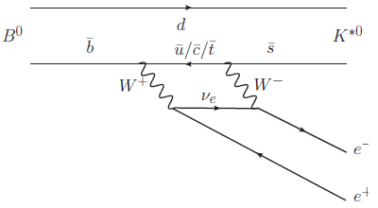
В→K*₀ℓ⁺ℓ⁻ and В→K*ℓ⁺ℓ⁻
*

Slide 5
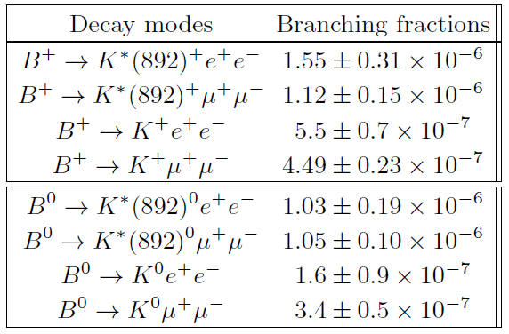
В→ K, K* + ℓ⁺ℓ⁻
*PDG14’

Slide 6
В→K*(→ K𝜋) + ℓ⁺ℓ⁻
$$\frac{d^{4}Γ}{dq^{2} dcosθ_{K} dcosθ_{l} dχ}=\sum_{i}{P_{i}\left(q^{2}\right)}F_{i}(θ_{K},θ_{l},χ)$$
$F_{1}={\frac{3}{8}(1+\cos^{2}θ)∙\frac{3}{4}sin}^{2}θ_{K}$ ,
$F_{2}={\frac{3}{4}\sin^{2}θ∙\frac{3}{2}cos}^{2}θ_{K} ,$
$F_{3}={−\frac{3}{4}\sin^{2}θ∙cos2χ∙\frac{3}{4}sin}^{2}θ_{K} ,….$

Slide 7
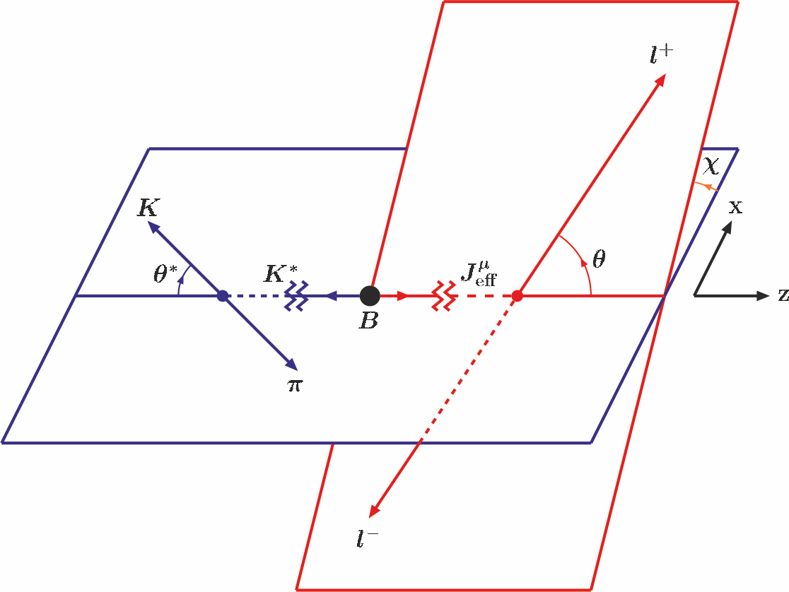
В→K*(→ K𝜋) + ℓ⁺ℓ⁻
*

Slide 8
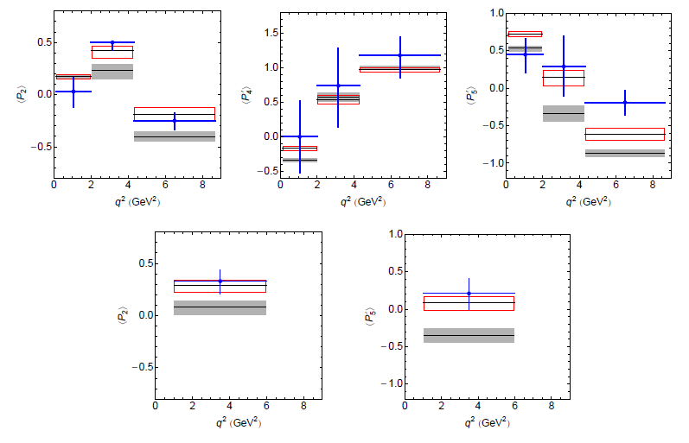
В→K*₀(800) and В→K*(892)
*

Slide 9
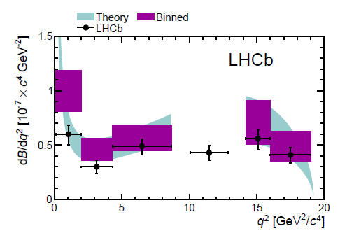
Br(В→K*(K𝜋) 𝜇⁺𝜇⁻ )
В→K*(K𝜋)𝜇⁺𝜇⁻
Exp/SM = 3.7σ
New Physics ??
*

Slide 10
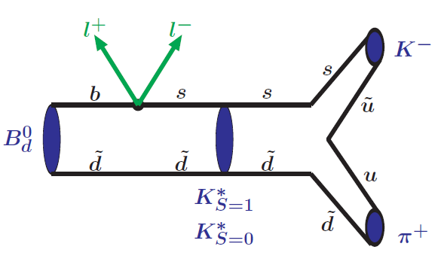
В→K*(→ K𝜋) + ℓ⁺ℓ⁻

Slide 11
Scalar mesons

Slide 12
b → s ℓ⁺ ℓ⁻

Slide 13
Effective Hamiltonian

Slide 14
B-S transition form factors
where H₁=B , H₂=K *(s=1) or K *₀(s=0)

Slide 15
B-S transition form factors in covariant quark model

Slide 16
Compositeness condition in covariant quark model

Slide 17
Compositeness condition in covariant quark model

Slide 18
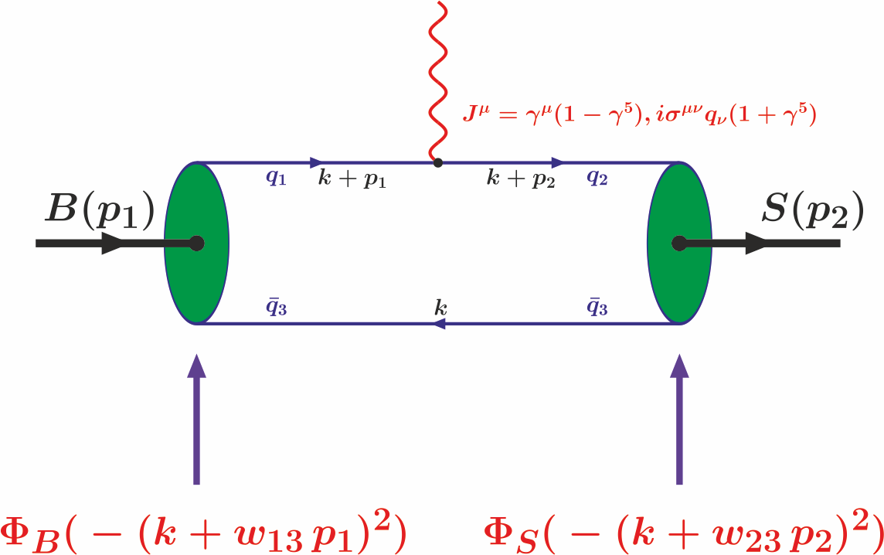
B-S transition diagram

Slide 19
B-S transition matrix elements

Slide 20
Model parameters
The fitted values of the size parameter Λ in GeV

Slide 21
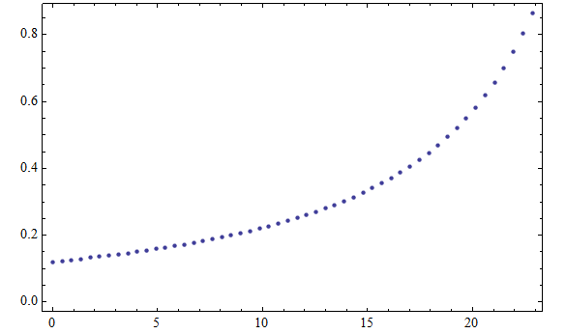
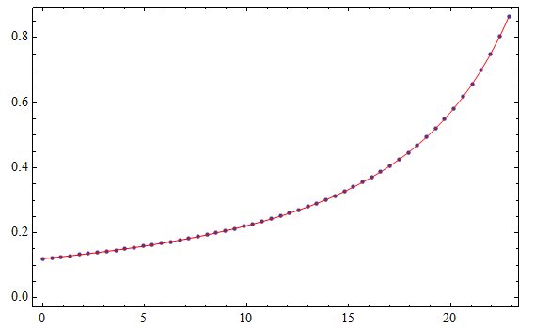
Form factors of B-S transition

Slide 22
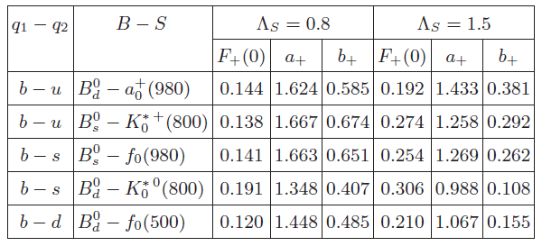
Form factors of B-S transition

Slide 23
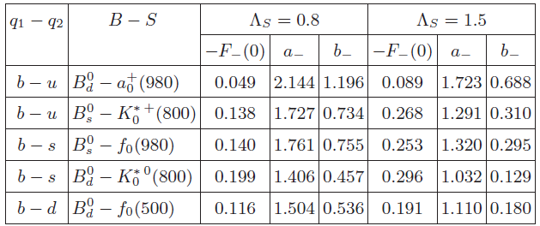
Form factors of B-S transition

Slide 24
Form factors of B-S transition

Slide 25
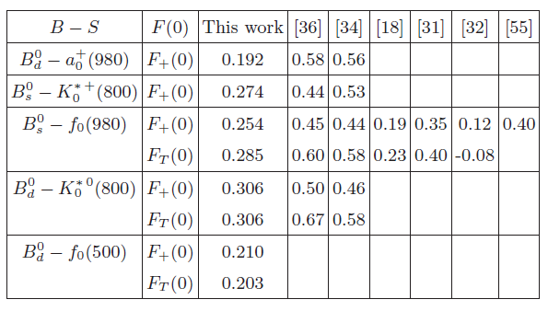
Form factors of B-S transition

Slide 26
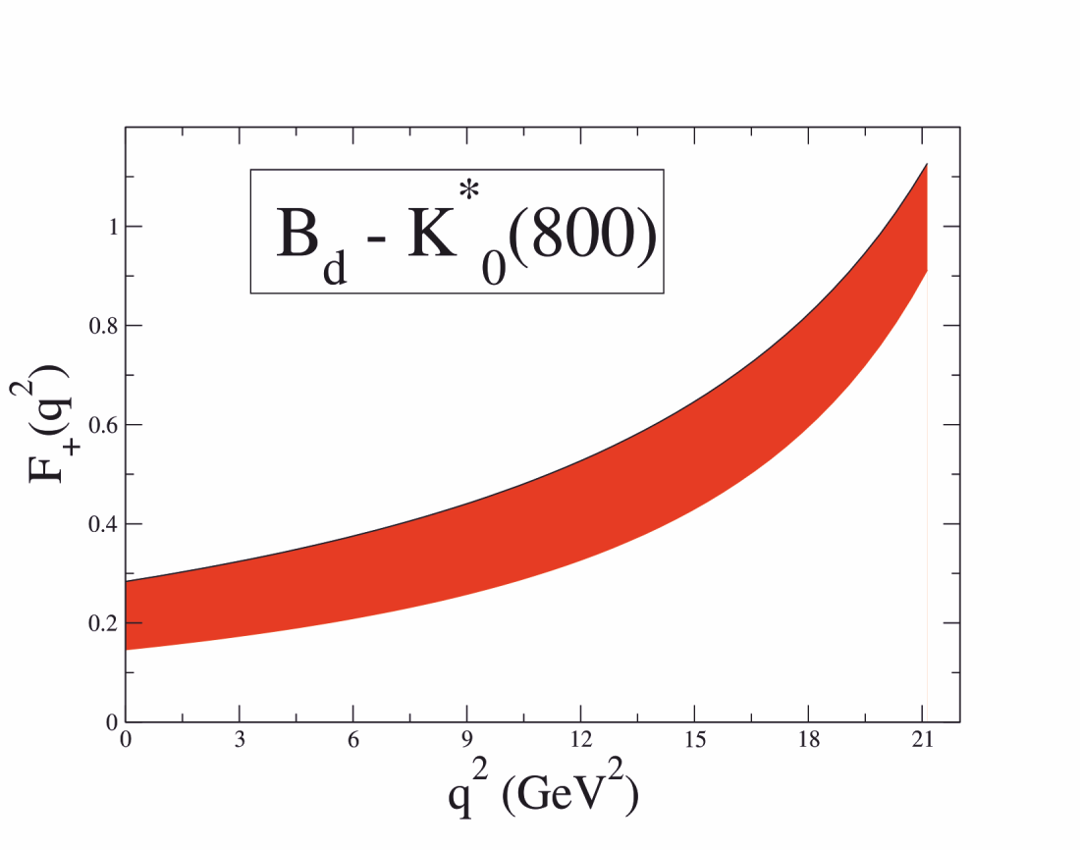
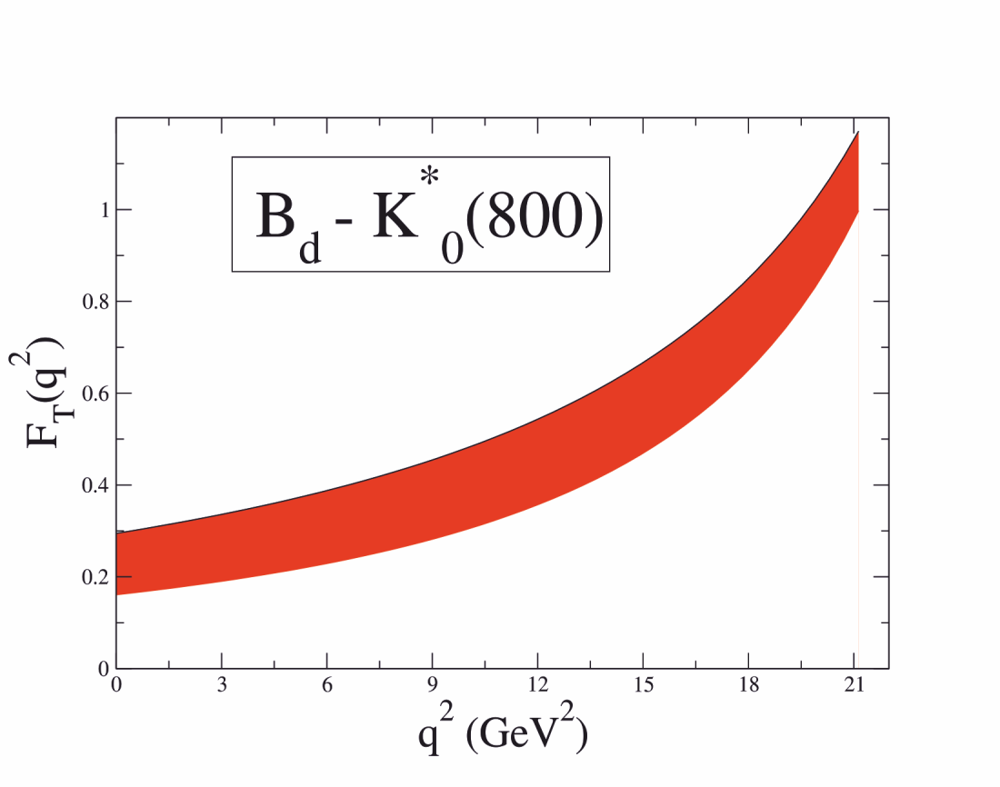
$$B_{d}→K_{0}(800)$$

Slide 27
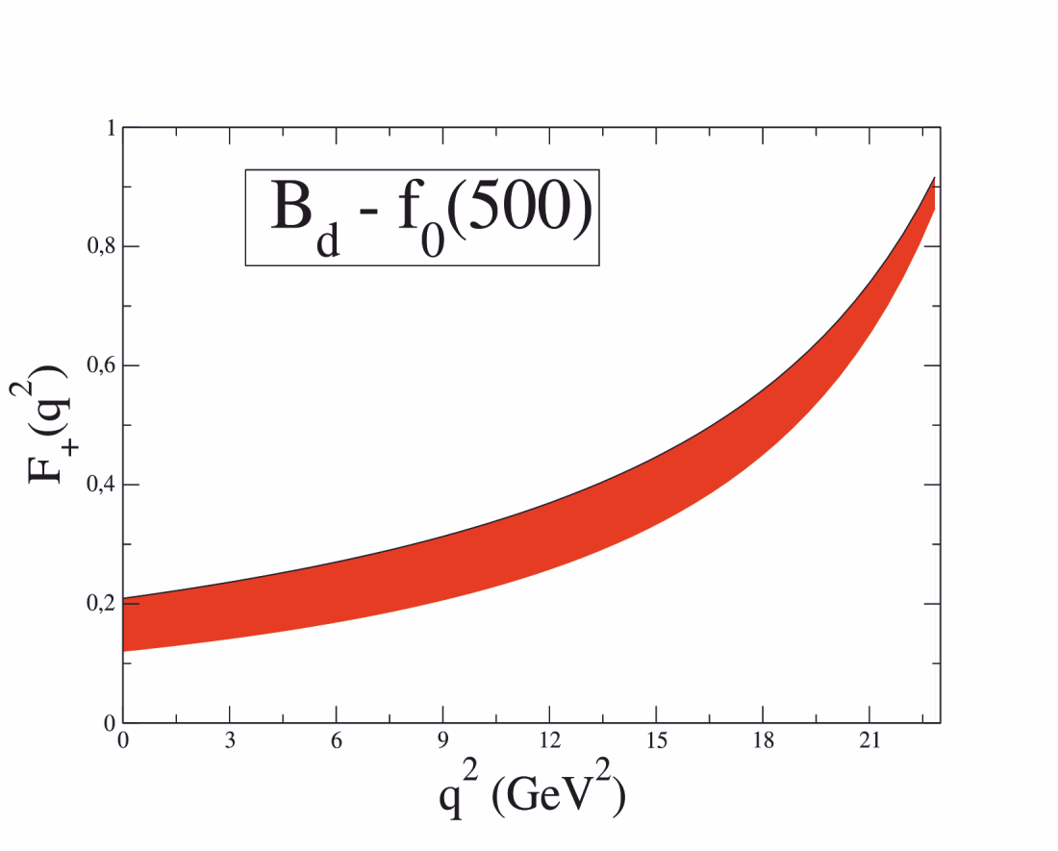
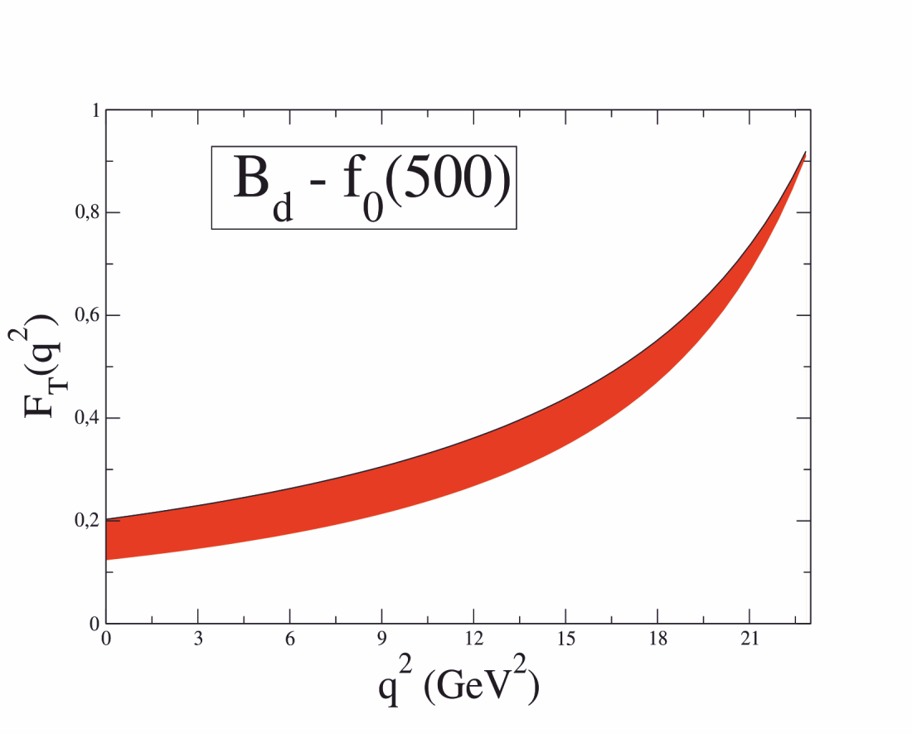
$$B_{d}→f_{0}(500)$$

Slide 28
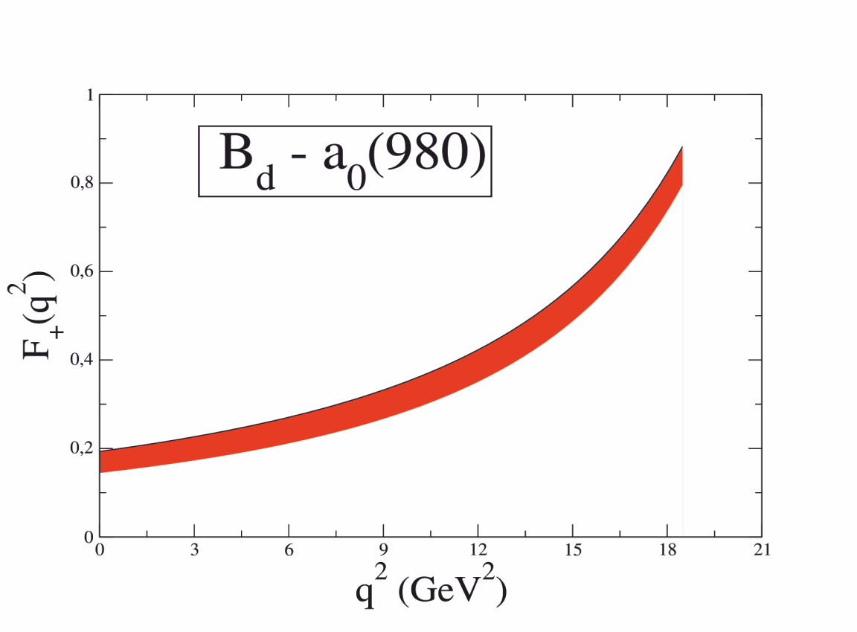
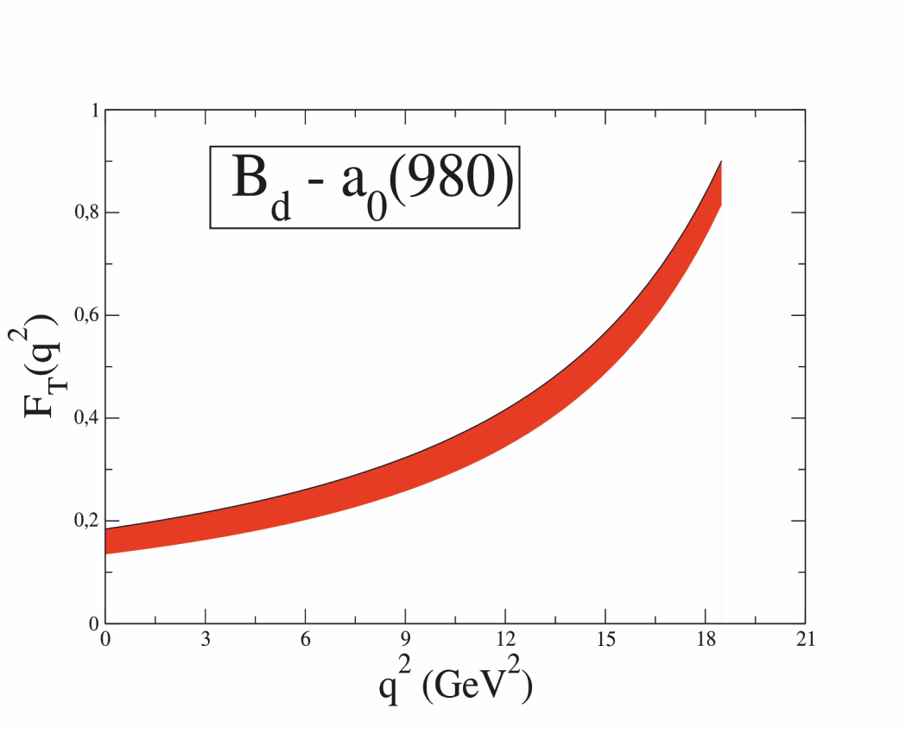
$$B_{d}→a_{0}(980)$$

Slide 29
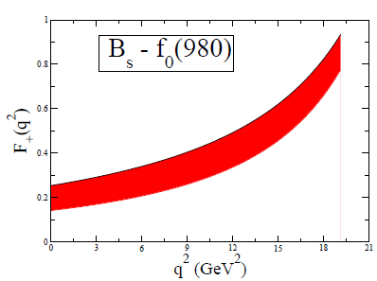
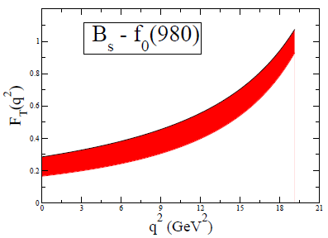
$$B_{s}→f_{0}(980)$$

Slide 30
Branching fractions

Slide 31
S-wave and P-wave contributions in the narrow width-limit
*

Slide 32
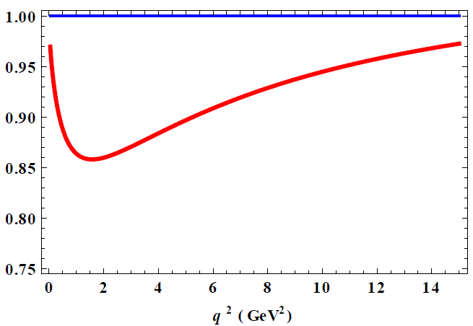
The ratio of the differential decay rate

Slide 33
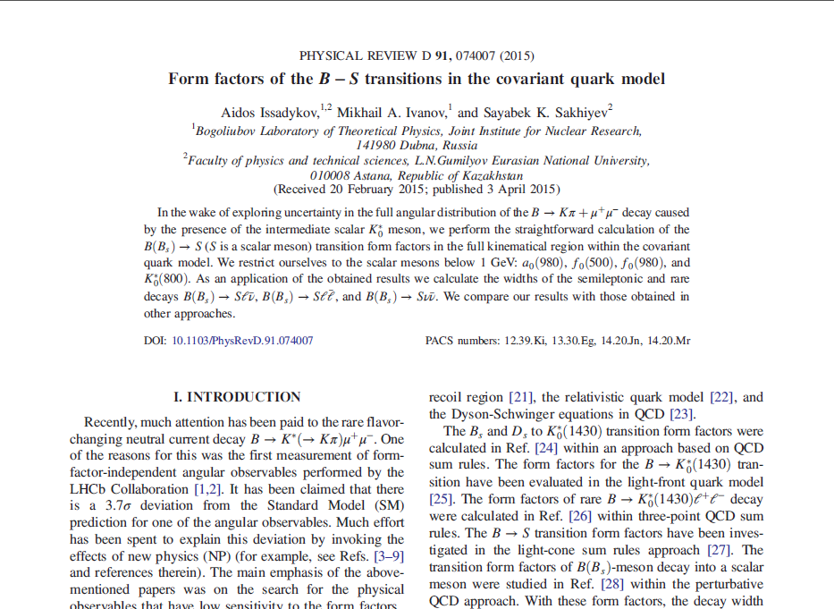
Thank you!

Slide 34
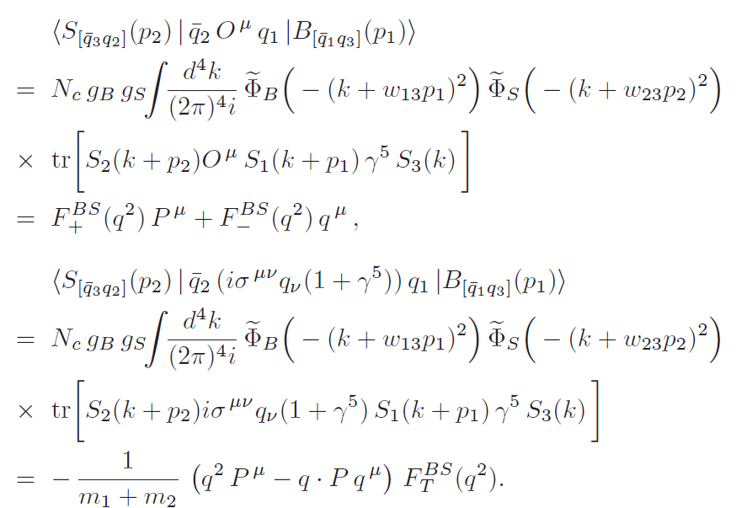

Slide 35
B-S transition form factors

Slide 36
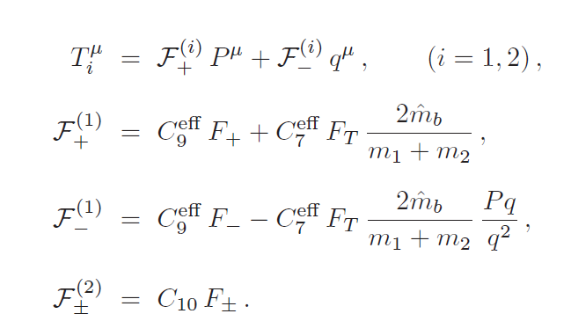
B-S transition form factors

Slide 37
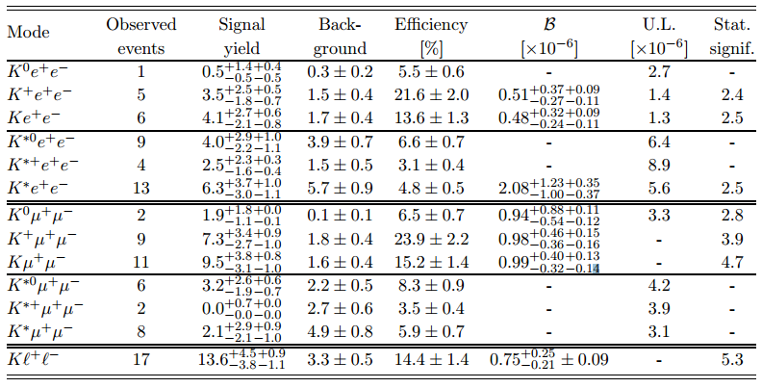
В→ K, K* + ℓ⁺ℓ⁻
*

