Slide 1





Electromagnetic radii of the proton from atomic spectroscopy
Savely Karshenboim
Max-Planck-Institut für Quantenoptik (Garching)
&
Pulkovo Observatory (ГАО РАН) (St. Petersburg)

Slide 2
Outline
Different determinations of the electric and magnetic radii
Proton-finite-size contributions to the energy level
  Leading and next-to-leading contributions
  Spin-independent and spin-dependent terms
  Former evaluations
  Consistency problem
  Fits and fits
Strategy of the self-consistent consideration
  Low momentum area
  High momentum area
The proton charge radius
  Results
  Tests
Hyperfine interval in H and μH and proton magnetic radius

Slide 3
Different methods to determine the proton charge radius
Spectroscopy of hydrogen (and deuterium)
The Lamb shift in muonic hydrogen
Electron-proton scattering

Slide 4
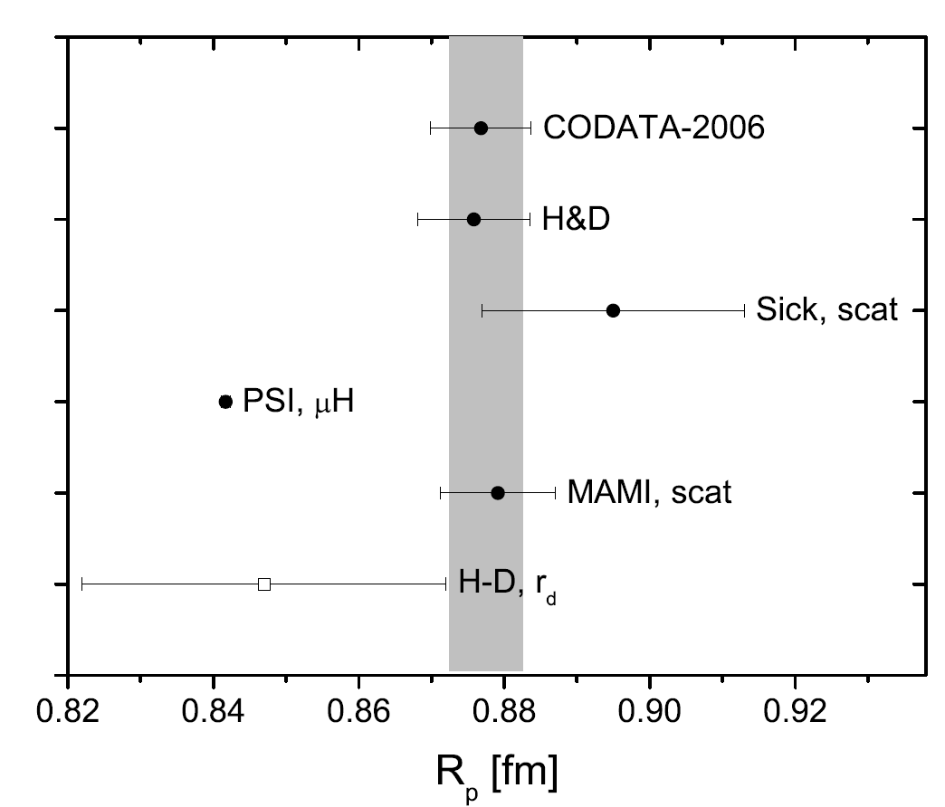
Different methods to determine the proton charge radius
Spectroscopy of hydrogen (and deuterium)
The Lamb shift in muonic hydrogen
Electron-proton scattering

Slide 5
Different methods to determine the proton charge radius
Spectroscopy of hydrogen (and deuterium)
  spectroscopic data are fitted with R∞ and R_{p} (H) or R∞ and R_{d} (D)
The Lamb shift in muonic hydrogen
  higher-order finite-proton-size corrections are involved
Electron-proton scattering
  QED corrections
  two-photon exchange (polarizability)
  limited accuracy of data points
  extrapolation to q²=0 and differentiation
overall model dependence

Slide 6
Different methods to determine the proton charge radius
Spectroscopy of hydrogen (and deuterium)
  spectroscopic data are fitted with R∞ and R_{p} (H) or R∞ and R_{d} (D)
The Lamb shift in muonic hydrogen
  higher-order finite-proton-size corrections are involved
No results on magnetic radius
Electron-proton scattering
  QED corrections
  two-photon exchange (polarizability)
  limited accuracy of data points
  extrapolation to q²=0 and differentiation
overall model dependence
Results on the magnetic radius are controversial

Slide 7
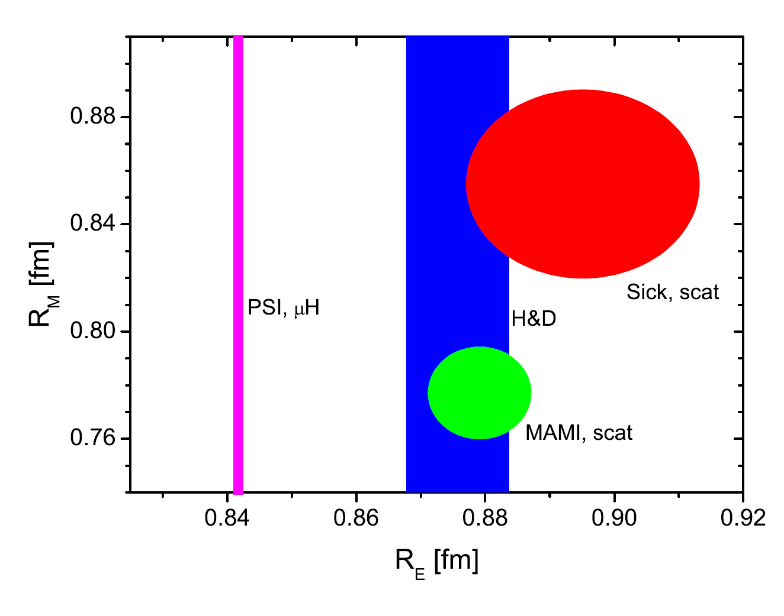
Different methods to determine the proton charge radius
Spectroscopy of hydrogen (and deuterium)
  spectroscopic data are fitted with R∞ and R_{p} (H) or R∞ and R_{d} (D)
The Lamb shift in muonic hydrogen
  finite-proton-size corrections are involved
No results on magnetic radius
Electron-proton scattering
  QED corrections
  two-photon exchange (polarizability)
  limited accuracy of data points
  extrapolation to q²=0 and differentiation
overall model dependence
Results on the magnetic radius are controversial

Slide 8
Contradiction in the determination: two questions
How to resolve it?
I partly address this question producing an independent value of the magnetic radius.
How to live with it?
The contradiction means that the overall picture is not self-consistent and certain calculations may involve inconsistencies.

Slide 9
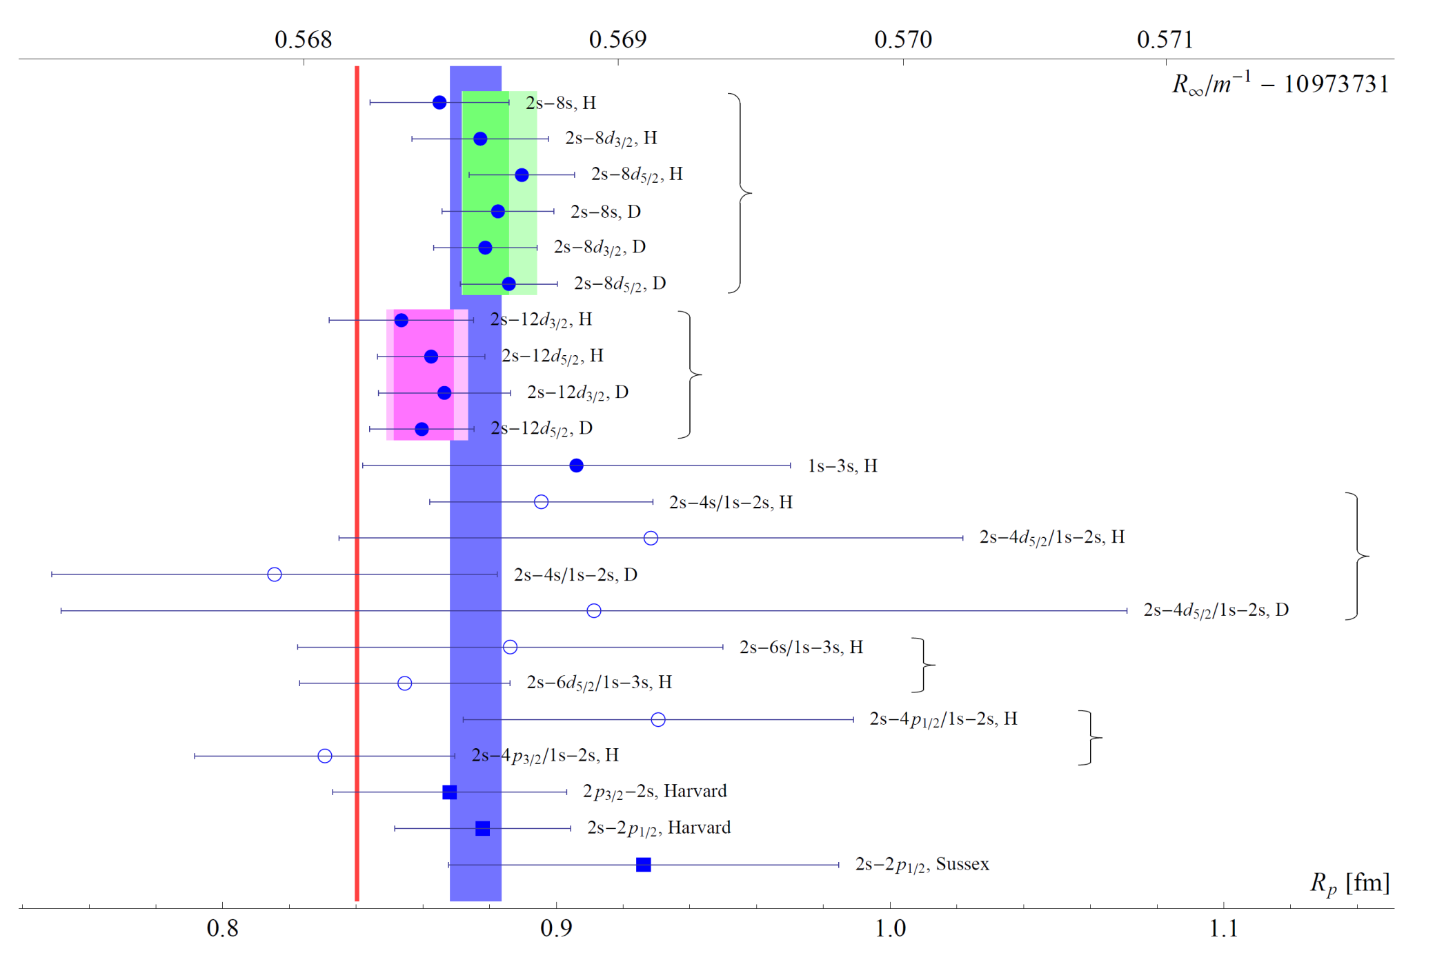
Contradiction in the determination: two questions
How to resolve it?
I partly address this question producing an independent value of the magnetic radius.
How to live with it?
The contradiction means that the overall picture is not self-consistent and certain calculations may involve inconsistencies.

Slide 10
Contradiction in the determination: two questions
How to resolve it?
I partly address this question producing an independent value of the magnetic radius.
How to live with it?
The contradiction means that the overall picture is not self-consistent and certain calculations may involve inconsistencies.

Slide 11
Higher-order proton-finite-size contributions: new approach
The Lamb in muonic hydrogen
  consistency (between form factors from scattering and extracted radius)
  a model-independent self-consistent treatment
HFS in ordinary and muonic hydrogen
  sensitive to the destribution of the magnetic moment
  no model independent result up to date
  a self-consistent treatment and a model-independent constraint for the first time

Slide 12
Proton finite-size contributions
Leading term:
Next-to-leading (spin-independent): Friar term
Next-to-leading (spin-dependent): Zemach term

Slide 13

Standard dipole approximation and empiric fits
R_{p} = 0.81 fm

Slide 14
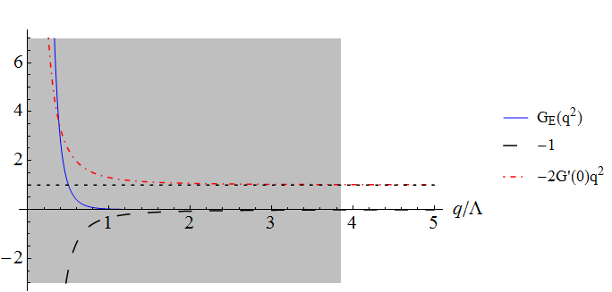
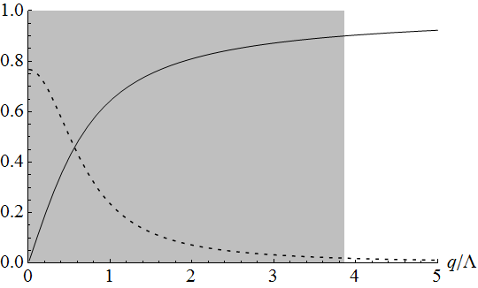
The Lamb shift in muonic hydrogen: Consistency problem !!!
The integrand includes
  Three terms:
integrand:
fractional
contributions
90% of the integral
integral
integrand

Slide 15
The Lamb shift in muonic hydrogen: Consistency problem
The integrand includes
  Three terms:
integrand:
fractional
contributions
90% of the integral
integral
data are inaccurate;
fit for G ?
data are negligible;
fit for G’(0) ?
integrand

Slide 16
The Lamb shift in muonic hydrogen: Consistency problem
The integrand includes
  Three terms:
integrand:
fractional
contributions
90% of the integral
data are inaccurate;
fit for G ?
Not an option!
data are negligible;
fit for G’(0) ?
Not an option!
integrand

Slide 17
The fits & the fits
The fits theoretically motivated
  the shape is determined independently of the fitting
  fitting serves to find the related parameters
  suitable for any operations on the fit
There is no a priori model for the proton form factors
The fits produced empirically
  the shape is arbitrary chosen
  literally it has no sense
  just a good smooth function
  suitable for rough application
Suitable with reservations for extrapolations, differentiations, large subtractions

Slide 18
The fits & the fits
The fits theoretically motivated
  the shape is determined independently of the fitting
  fitting serves to find the related parameters
  suitable for any operations on the fit
There is no a priori model for the proton form factors
The fits produced empirically
  the shape is arbitrary chosen
  literally it has no sense
  just a good smooth function
  suitable for rough application
Suitable with reservations for extrapolations, differentiations, large subtractions
Empiric fits of the proton form factors
Literally incorrect:
  wrong analytic behavior
  questionable asymptotic behavior
Based on certain rough theoretical constraints

Slide 19
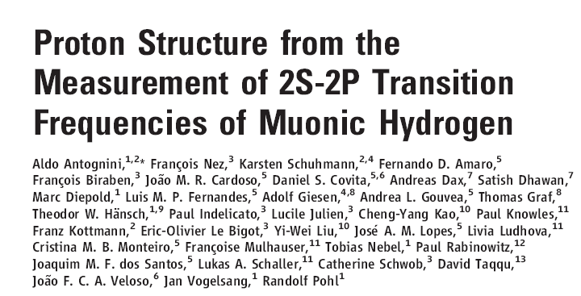
Evaluations of I₃^{EM} within the former extractions
Natural extraction
  following Borie, Eides et al, and others
  dipole shape with an adjustable parameter
A posteriori: the parameter follows the radius from muonic hydrogen
  does not well agree with the expt data!
Scientific extraction
  Crema cited Birse and McGovern
  B&M cited Carlson and Vanderhaeghen
  C&V calculated TPE
TPE includes recoil, but the Friar term dominates
  empiric fits (with a bad radius!)

Slide 20
Evaluations of I₃^{EM} within the former extractions
Natural extraction
  following Borie, Eides et al, and others
  dipole shape with an adjustable parameter
A posteriori: the parameter follows the radius from muonic hydrogen
  does not well agree with the expt data!
Scientific extraction
  Crema cited Birse and McGovern
  B&M cited Carlson and Vanderhaeghen
  C&V calculated TPE
TPE includes recoil, but the Friar term dominates
  empiric fits (with a bad radius!)
Here, I am not going to re-evaluate any result ab initio.
I am only going to check what will happen if instead of
`original’ evaluation of I₃ I will do something else.

Slide 21
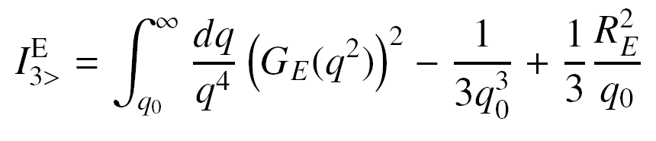
Strategy of the evaluation
Split the integral
Low momentum
High momentum
Minimization of the uncertainty

Slide 22
Low momentum contribution
The integrand involves a substantial cancelation
The low-momentum approximation
The result:

Slide 23
Low momentum contribution
The integrand involves a substantial cancelation
The low-momentum approximation
The result:

Slide 24

High momentum contribution
The integral
The central value is the median of a few empiric fits
The uncertainty

Slide 25
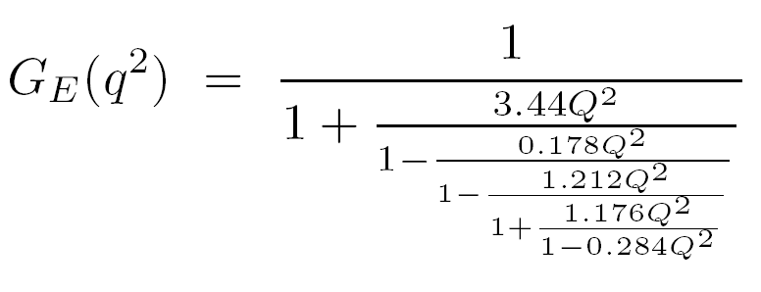

The empiric fits: shape
Chain fraction
Padé approximation

Slide 26
The empiric fits: parameters

Slide 27
Scatter, uncertainty and the Bosted’s fit (1995)

Slide 28
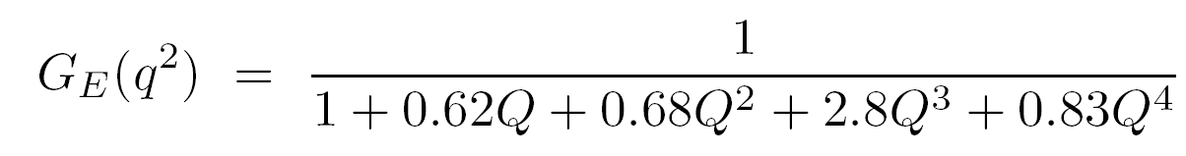
Scatter, uncertainty and the Bosted’s fit (1995)
G’(0) = ∞ (the fit was designed only for medium q)

Slide 29
Strategy: the central value and the uncertainty
The central value
  Low-momentum part
    Dipole value for G”(0)
    G’(0) is adjustable
  High-momentum part
    empiric fits with somewhat different R_{E} and G”(0)
    the median
The uncertainty
  Low-momentum part
    100% uncertainty
  High-momentum part
    1% uncertainty due to integration around q₀
    that is larger than the scatter

Slide 30
Minimization of the uncertainty
The uncertainty is modeled with a smooth simple function and we find its minimum

Slide 31
Determination of the charge radius
Extraction equation
Results

Slide 32
Determination of the charge radius
Extraction equation
Results

Slide 33
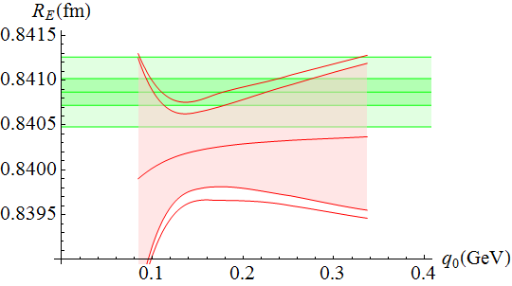
Dependence on q₀
Plot for scientific extraction

Slide 34
Dependence on q₀
Plot for scientific extraction
do not agree well

Slide 35
Continuity of the form factor:
Low momentum (R_{E} is extracted from μH)
High momentum (the median)

Slide 36
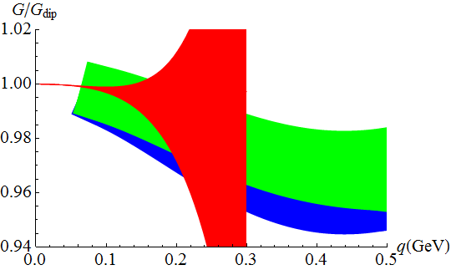
Continuity of the form factor: a posteriori
Low momentum (R_{E} is extracted from μH)
High momentum (the median)
The overall fit

Slide 37
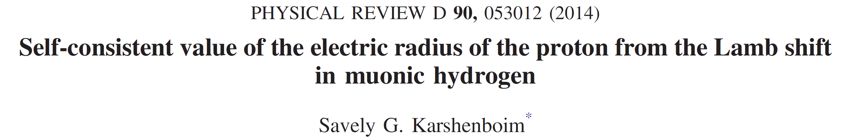
Continuity of the form factor: a posteriori
Low momentum (R_{E} is extracted from μH)
High momentum (the median)
The overall fit

Slide 38
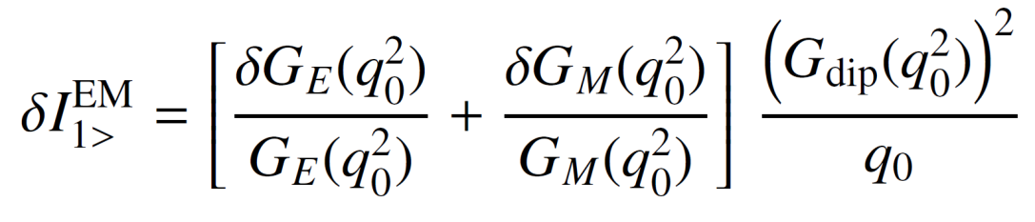
Magnetic radius of the proton: the strategy
Zemach correction
Low-momentum part
High-momentum part

Slide 39
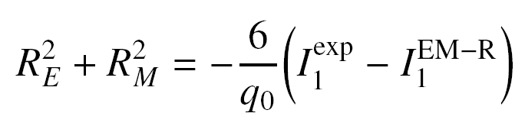
Magnetic radius of the proton: the constraints
Extraction equation
Data

Slide 40
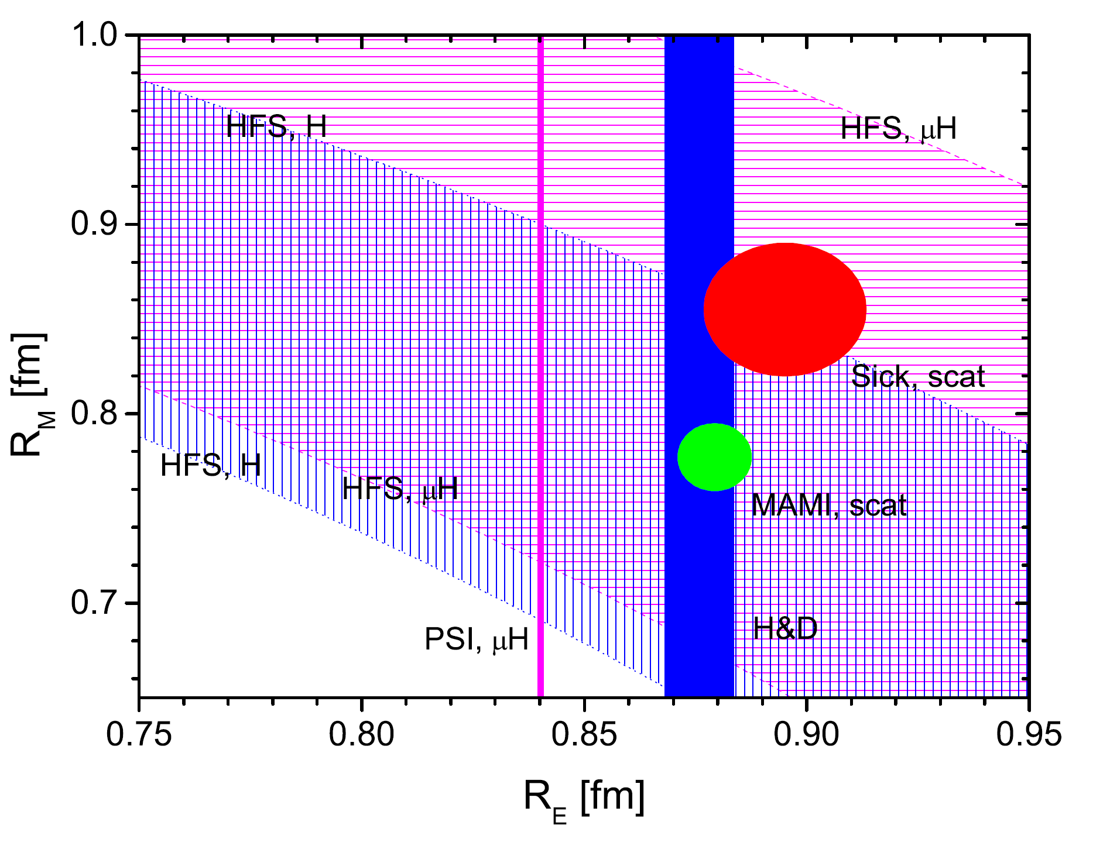
Magnetic radius of the proton: the results

Slide 41
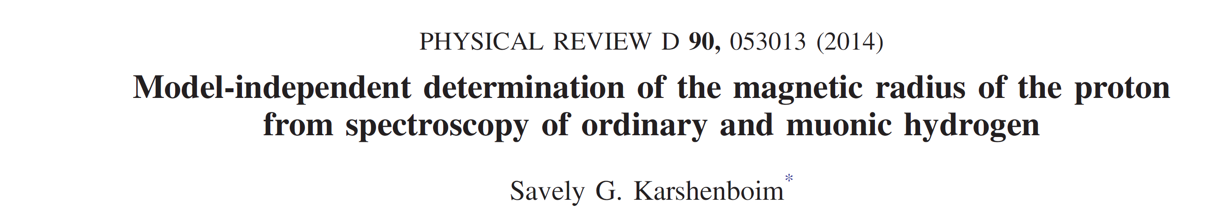
Magnetic radius of the proton: the results

